Slide 1
A Brief Introduction to COA Accreditation
Joe Frisino
Zoë Hutchinson
Philip Gorelick

Slide 2
Learning Objectives
By the end of this training you should be able to:
Describe the key characteristics of COA accreditation
Name and describe the seven steps in COA's accreditation process
Find basic information on COA's website
2

Slide 3
Agenda
1
Who is
COA?
2
The Benefits
Of Accreditation
3
The Accreditation
Process
4
COA
Standards
3

Slide 4
1
Who is COA
4

Slide 5
Who is COA?
National, private, non-profit
Established in 1977
Accredits full range of community-based behavioral health care and social service organizations
1800 + private and public organizations accredited or in process
5

Slide 6
What is Accreditation?
National Consensus-Based Standards
Self-Study Process
Site Visit Conducted by Review Team
Fair, Objective and Open Decision-Making
Checks and Balances and Opportunities to Correct Deficiencies
6

Slide 7
Characteristics of COA Accreditation
Open, Facilitative, Collaborative
Four – Year Accreditation
Reviews All Programs and Services
In-depth Review of Operations & Service Delivery
Process Takes 14-18 Months
Standards / Accreditation Materials Free
Open Book Test
7

Slide 8
Programs and Services We Accredit
Homeless Services
Mental Health Services
Substance Abuse
Child and Family Services
Aging Services
Services for the People with Developmental Disabilities
8

Slide 9
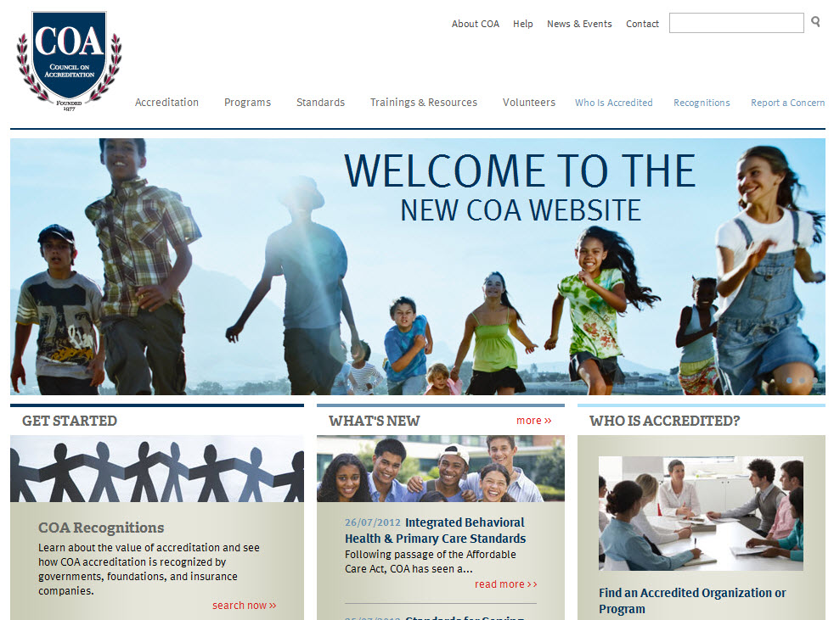
www.COAnet.org

Slide 10
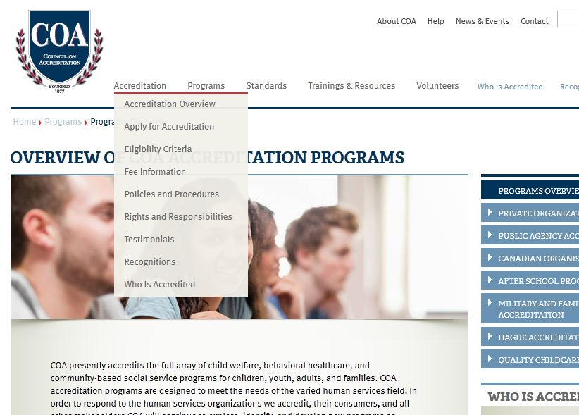
For basic information about COA accreditation open the "Accreditation" Drop-Down Menu

Slide 11
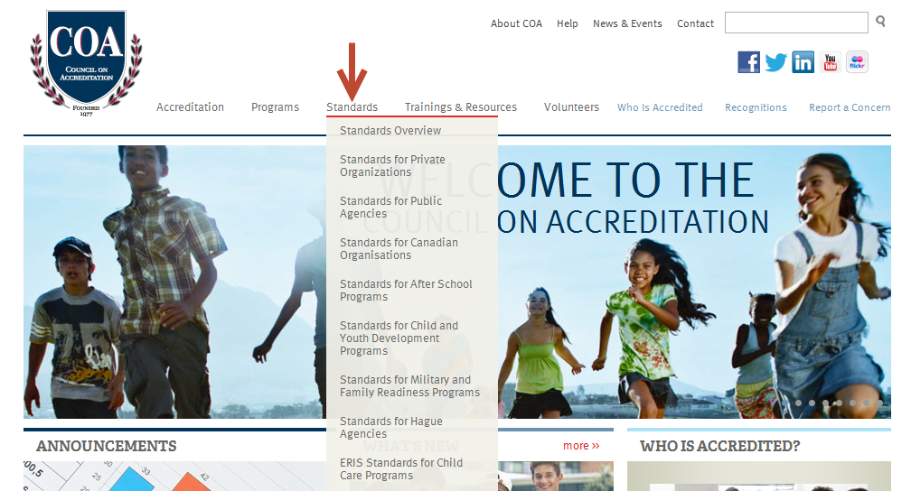
SSVF programs
To Review COA Standards open the "Standards" Drop-Down Menu

Slide 12
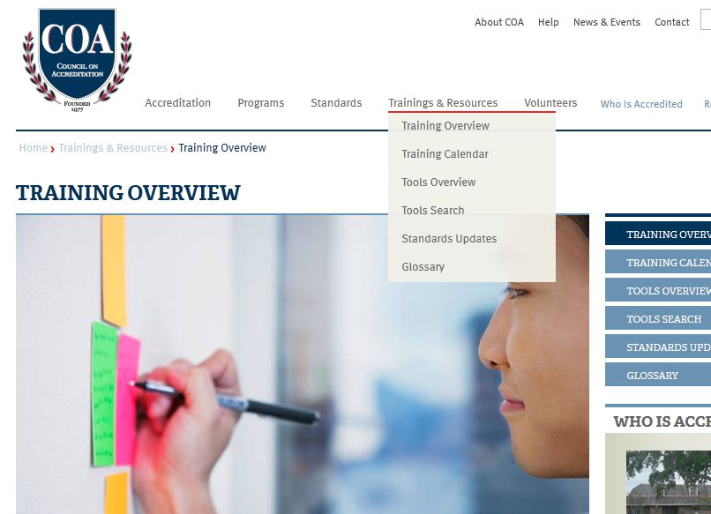
For information about COA Training and other resources open the "Training & Resources" Drop-Down Menu

Slide 13
Suggested Free Trainings
Name of Training | Webinar Dates & Times | Self-Paced Available
Introduction to COA and the Private Organization Accreditation Process | May 1, 3-4 PM ET
COA Accreditation: Getting Started
Get Organized! Creating Your Accreditation Workplan: All Editions | May 8, 3-5 PM ET
Format and Structure COA's Accreditation Standards
Assessing Your Practices Against COA Private Organization Standards | May 9, 3-4 PM ET
email zhutchinson@coanet.org to receive ongoing training updates
13

Slide 14
2
Benefits of Accreditation
14

Slide 15
Benefits of Accreditation
In-Depth Self Evaluation
Builds / Strengthens Organizational Infrastructure
Standards address all aspects of management and operational functioning
Thorough vetting of procedures and policies
Implementation of a framework for ongoing review of performance
Adoption of Known Best Practices
Research-based standards
External Validation of Your Practices
Recognition from government agencies, foundations, and insurance companies

Slide 16
Q. How has COA Accreditation Benefited Your Organization?
a
% Agree or Strongly Agree
n=1425 Responses

Slide 17
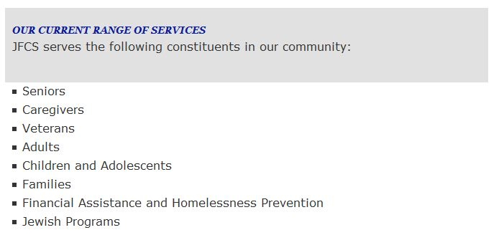
Perspective of an Accredited Organization
17

Slide 18
3
The Accreditation Process
18

Slide 19
Your COA Accreditation Coordinator
Single point of contact w/ COA
Answer questions
Provide feedback and guidance
Connect you with resources
Help you meet timetable and milestones
Help you prepare Self-Study
19

Slide 20
Steps in the Process
Step 1: Accreditation Agreement
Step 2: Intake
Step 3: Self-Study
Step 4 – Site Visit
Step 5: Ratings Report
Step 6: Accreditation Decision
Step 7: Maintaining Accreditation
20

Slide 21
Steps in the Process
Step 1: Accreditation Agreement
Step 2: Intake
Step 3: Self-Study
Step 4 – Site Visit
Step 5: Ratings Report
Step 6: Accreditation Decision
Step 7: Maintaining Accreditation
On-line Application
Verification of eligibility
Accreditation agreement and fee
Description of rights and responsibilities
21

Slide 22
Steps in the Process
Step 1: Accreditation Agreement
Step 2: Intake
Step 3: Self-Study
Step 4 – Site Visit
Step 5: Ratings Report
Step 6: Accreditation Decision
Step 7: Maintaining Accreditation
Match programs to COA's service standards
Establish important dates and milestones
22

Slide 23
Steps in the Process
Step 1: Accreditation Agreement
Step 2: Intake
Step 3: Self-Study
Step 4 – Site Visit
Step 5: Ratings Report
Step 6: Accreditation Decision
Step 7: Maintaining Accreditation
Evaluate practices against standards
Six to Twelve Months
On-line Submission of Evidence Eight Weeks Before Site Visit
23

Slide 24
Steps in the Process
Minimum of 2-3 peer reviewers for 2-3 days
Activities
Interview Staff, Board, Stakeholders
Review Documents and Records
Visit Programs, Observe Staff/Client Interactions
Step 1: Accreditation Agreement
Step 2: Intake
Step 3: Self-Study
Step 4 – Site Visit
Step 5: Ratings Report
Step 6: Accreditation Decision
Step 7: Maintaining Accreditation
24

Slide 25
Steps in the Process
Step 1: Accreditation Agreement
Step 2: Intake
Step 3: Self-Study
Step 4 – Site Visit
Step 5: Ratings Report
Step 6: Accreditation Decision
Step 7: Maintaining Accreditation
Summarizes important Site Visit findings
Provides specific recommendations for additional work as necessary
25

Slide 26
Steps in the Process
Step 1: Accreditation Agreement
Step 2: Intake
Step 3: Self-Study
Step 4 – Site Visit
Step 5: Ratings Report
Step 6: Accreditation Decision
Step 7: Maintaining Accreditation
Reviews site visit report and orgs response
Makes accreditation decision
26

Slide 27
Steps in the Process
Step 1: Accreditation Agreement
Step 2: Intake
Step 3: Self-Study
Step 4 – Site Visit
Step 5: Ratings Report
Step 6: Accreditation Decision
Step 7: Maintaining Accreditation
Maintain and sustain implementation
Annual Maintenance of Accreditation Report
27

Slide 28
4
COA Standards
28

Slide 29
COA Standards
Rigorous, Relevant, Realistic
Developed by the Field
Goal Statements -- Don't Have to be Perfect
Describe What not How
This is the Essence of "Contextual Accreditation"
29

Slide 31
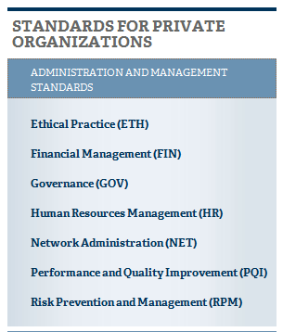
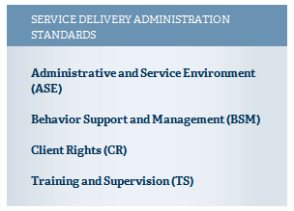
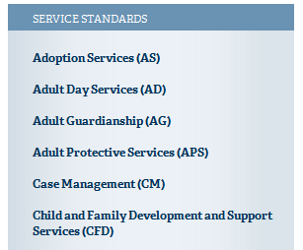
Categories of COA Standards
N/A for SSVF
31

Slide 33
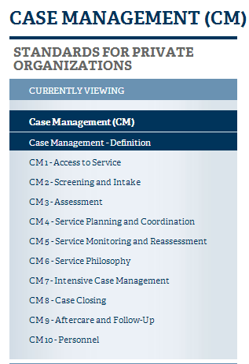
Case Management
SSVF programs will at a minimum, be assigned Case Management (CM) Service Section
33

Slide 34
Standards Example: CM 7
34

Slide 35
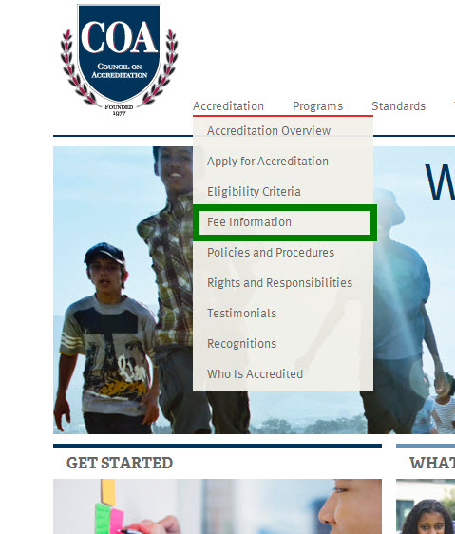
Cost of Accreditation
Fee Information on the Website
Application Fee
Accreditation Fee
Site Visit Fee
Maintenance of Accreditation Fee
35

Slide 36
Suggested Next Steps
Speak with Client Relations (Zoë)
Request a Cost Estimate
Request an Initial Assessment of Service Standards
Visit www.COAnet.org
Review the Standards
Review the Accreditation Guidelines (“Where to get started”)
Attend a COA Training or Webinar
Assessing Your Practices Against COA's Standards
Get Organized: Creating an Accreditation Work Plan
Intensive Accreditation Training
Getting Started Self Paced Training
36

Slide 37
Thank You
Joe Frisino: jfrisino@coanet.org
Zoë Hutchinson: zhutchinson@coanet.org
Phillip Gorelick: pgorelick@jfcs-cares.org
Council on Accreditation 45 Broadway, 29th Floor, New York, NY 10006 toll free 866.262.8088 www.COAnet.org

