Slide 1
Supportive Services for Veteran Families (SSVF) Program
Notice of Funding Availability (NOFA) Workshop
October 2012

Slide 2
Agenda
Developing a Program Design
Basing Design on Current Knowledge
Understanding VA Programs
SSVF Program Overview
Notice of Fund Availability (NOFA) Overview
Application Review
2

Slide 3
I. Developing A Program Design
3

Slide 4
Basic Concepts
Most important focus is housing stability. SSVF is a housing first model.
Goal is to provide sufficient resources to stabilize housing or end homelessness.
SSVF serves the entire household.
Intervention is short-term.
SSVF services are offered on a “but for” basis. Must be able to define for screening.
Intensity and scope of services must match identified needs.
Services integrated with community resources.

Slide 5
Housing Stability
Elements necessary to stabilize housing
Strong relationships with landlords
Linkages to mainstream resources for benefits such as TANF, Medicaid, and SNAPS
Services that aid stabilization
Legal assistance
Landlord mediation
Financial assistance
Transportation assistance
Child Care
Case management
Long-term income resources
Employment & training
Disability benefits (SSI/SSD, VBA)

Slide 6
Case Management
Supports housing stability as a priority. Housing not contingent on treatment.
Define intensity required to meet housing stability, not treatment, goals.
Strength-based approach both to engage successfully and reflect program priorities.
Must include planning for housing stability after short-term SSVF intervention is complete.
When collaborating with other programs, cannot duplicate efforts.

Slide 7
Outreach
Who will you serve and how will you engage?
Outreach to target population – serve those identified as at-risk.
Establish referral relationships with agencies appropriate to target population: shelters, food pantries, VA, TANF offices, housing courts, criminal justice, hospitals, substance use treatment facilities, schools, etc.
Outreach, screening & assessment must be done quickly – offering rapid re-housing or prevention in a response to a crisis.

Slide 8
Legal Needs
100 million Americans face civil justice problems that can impact housing, jobs, income, and children.
Many poor Americans do nothing in response or try to avoid, likely due to lack of access to legal assistance or lack of knowledge about their rights
In light of continued funding cuts for legal aid, the practical reality for local programs is that without a sub-award their vets won’t get the help they need with just a referral.

Slide 9
Veteran Centered Services
We begin with a recognition that every person/family who is homeless or at-risk has different concerns and needs to be addressed. These concerns may not match agency/provider interests.
To offer Veteran appropriate options, must know what they are. Essential to coordinate with VA in service area. All VA funded providers have a responsibility to help Veterans get the right service at the right time.
To get to Zero requires the development of a broad coordinated continuum of care that can address the needs identified by Veterans. Services need to be delivered both effectively and efficiently for this goal to be met.
9

Slide 10
II. Basing Design on Current Knowledge
10

Slide 11
Challenge of Prevention
Targeting, who is at-risk of becoming homeless?
Once at-risk are identified, how do we determine who at-risk would become homeless “but for” intervention. Even rapid re-housing can be unnecessary; one-third of Veterans stay in shelters less than 1 week & generally leave without special intervention.
Determining the appropriate (and efficient) response to support housing stability
Mainstream services
Intensive case management
Financial supports
Sustainability

Slide 12
Location of Homeless Veterans*
Almost half of homeless Veterans on a given night were located in four states: California, Florida, Texas, and New York. Only 28 percent of all Veterans were located in those same four states.
The share of homeless Veterans located in the densest urban areas (or principal cities) is more than twice that of all Veterans (72 percent compared to 31 percent).
During the course of the year, 33 percent of Veterans experiencing homelessness stayed in emergency shelter for less than one week, 61 percent stayed less than one month, and more than 84 percent Veterans stayed in emergency shelter for less than 3 months.
U.S. Department of HUD and U.S. Department of VA. Veteran Homelessness: A Supplemental Report to The Annual Homeless Assessment Report to Congress. October 2011.

Slide 13
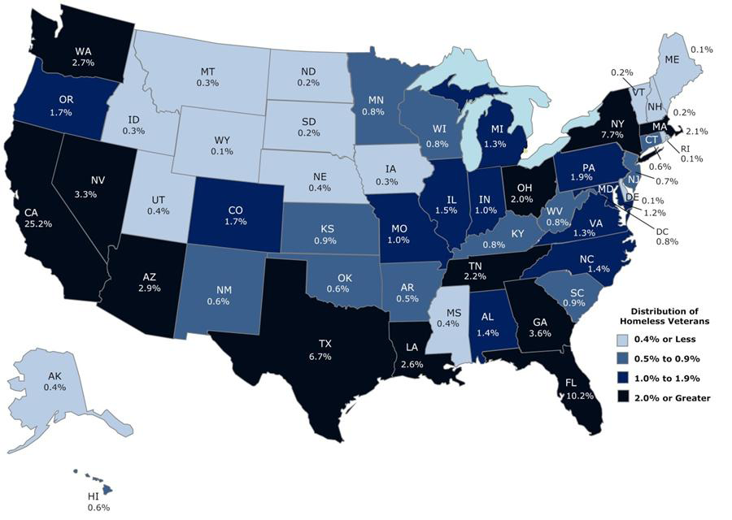
Distribution of Homeless Veterans

Slide 14
Homeless Veterans are Older Than General Homeless Population
41 percent of homeless Veterans are 51–61 years compared with 16 percent of homeless non-Veterans.
9 percent of homeless Veterans are 62 years and older compared with 3 percent of homeless non-Veterans.
Veterans are older and are more disabled. About 51 percent of individual homeless Veterans have disabilities, compared with 41 percent of sheltered homeless non-Veteran individuals.

Slide 15
Populations at Higher Risk
2008 ACS shows median income of Veterans was $36,800 compared to $25,700 for non-Veterans.
However,13 percent of individual Veterans in poverty became homeless at some point during the year, compared to 6 percent of adults in poverty.
Rates of homelessness among Veterans living in poverty are particularly high for Veterans identifying as Hispanic/Latino (2.8x) or African American (2.2x).
Impoverished women Veterans are 3.4x as likely to be in the homeless population as they are to be in the U.S. adult female population.
Younger Veterans, age 18-30, in poverty are 3.7 times more likely to be homeless that other adults of that age.

Slide 16
Distribution of the 1,356,610 Veterans in Poverty

Slide 17
The Existential Question
SSVF projects to serving 67,000 people in FY 2013 and there are over 1.3 million impoverished Veteran households.
How do we ensure that SSVF is an effective program to end and prevent homelessness, and not suffer “mission creep” and become an anti-poverty program?

Slide 18
Why target – What We Know Katherine Gale: 2009
Table: San Mateo/Redwood City Prevention Assistance and Shelter Entry Comparison
 | Applied for Prevention assistance | Number who subsequently entered shelter (within 3 year period) | Percent of group
Households that were turned down for prevention assistance * | 1019 | 40 | 3.9%
Households that received prevention assistance | 243 | 12 | 4.9%
Total | 1262 | 52 | 4.1%
*Most common reason for being refused assistance was not having adequate ongoing income (i.e. too poor).
Slide courtesy NAEH

Slide 19
Why Target – What We Know
IMPLICATIONS
Most important: “Prevention makes the most difference for those at highest risk. There is no level of risk that is too high.”
Use of data to refine targeting
Development of an instrument: use of risk factors to screen in those w/most acute risk, screen out those w/fewer risk factors
Serving smaller pool of families more intensively
Lightened, almost minimal touches for other families
NYC commissioned a study, Understanding Family Homelessness, (release date for 2012). Slide Courtesy NAEH.

Slide 20
Assessing Need
Assessing need not simply a matter of counting homeless and at-risk populations.
How do existing resources match need?
Use data, not anecdotal information based on HIC, HMIS, shelter capacity reports, etc.
Areas with relatively low numbers of homeless and at-risk populations may have high need due to few available resources.

Slide 21
III. Understanding VA Programs
21

Slide 22
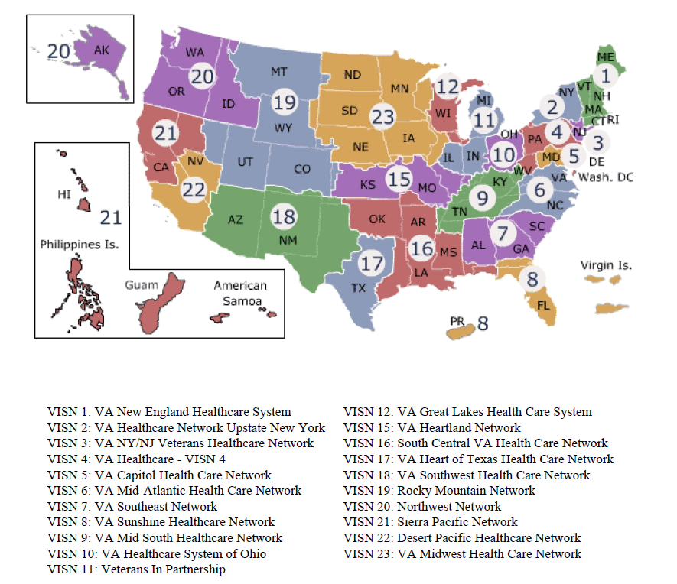
Section B1: Need for Program
Notes:
22

Slide 23
A Continuum of Care
VA’s Alphabet Soup
Veteran Integrated Service Network (VISN)
Community Based Outpatient Clinic (CBOC)
Homeless Outreach (HCHV)
National Call Center (NCCHV)
Prevention (HCRV, VJO, SSVF, HUD-VA Pilot)
Transitional Housing (GPD, CWT/TR, HCHV Contract Housing)
Residential Rehab (RRTP)
Voc Rehab (CWT)
Permanent Supportive Housing (HUD-VASH)
Services described at www.va.gov/homeless
8

Slide 24
A Continuum of Care (cont.)
Prevention | Outreach and Referral | Residential Treatment | Transitional Housing | Permanent Housing
SSVF Prevention* Veteran Justice Outreach (VJO) Health Care for Re-Entry (HCRV) | Health Care for the Homeless (HCHV) National Call Center (NCCHV) ----------- Vet Centers Veterans Benefits (VBA) VA Medical Centers (VHA) | HCHV contracts Residential Rehabilitation Treatment Programs (RRTPs) | Grant & Per Diem (GPD) Compensated Work Therapy Transitional Residences (CWT/TR) | SSVF Rapid Re-housing HUD-VASH

Slide 25
VBA Benefits
VBA provides services for homeless Veterans at all 56 regional offices. Claims expedited for homeless Veterans.
VBA can provide disability benefits, educational assistance, home loans, insurance, and benefits for dependents.
Disability Benefits/General Information: 1-800-827-1000
Insurance: 1-800-669-8477
Education: 1-888-442-4551
Health Care Eligibility: 1-877-222-8382
25

Slide 26
Vet Centers
Community-based counseling centers located in all 50 states, DC, Puerto Rico, and Guam
Provide readjustment counseling & outreach services to all Veterans who served in any combat zone;
Staffed by small multi-disciplinary teams of dedicated providers, many of which are combat Veterans themselves.
http://www.vetcenter.va.gov/index.asp
26
Notes:
26

Slide 27
IV. SSVF Program Overview
27

Slide 28
Introduction to SSVF Program
Goal of SSVF Program
Provide housing stability to homeless and at-risk Veterans and their families
Process
VA will award grants to eligible entities (private non-profit organizations and consumer cooperatives)
Grantees will provide supportive services to very low-income Veterans and their families who are homeless or at-risk of homelessness
28

Slide 29
SSVF Program Overview Background
Authority: 38 U.S.C. 2044 / Section 604 of Veterans’ Mental Health and Other Care Improvements Act of 2008 / P.L. 110-387
Purpose: To provide grants to eligible entities to facilitate the provision of supportive services to very low-income Veteran families who are “occupying permanent housing”
Status:
Final Rule and Notice of Fund Availability published in Federal Register and available on the SSVF website: http://www.va.gov/HOMELESS/SSVF.asp
Application, webcast recordings, and FAQs available on SSVF website: http://www.va.gov/HOMELESS/SSVF.asp
Application due 4:00 p.m. Eastern on Friday, February 1, 2013
29

Slide 30
SSVF Program Overview Operations
VA
Award Supportive Services Grants
Eligible Entities (private nonprofit organizations or consumer cooperatives)
Provide Supportive Services
Participants (very low-income Veteran families “occupying permanent housing”)
30

Slide 31
SSVF Program Overview “Eligible Entity”
To be eligible for a SSVF grant, the applicant must be either:
Types of Eligible Entity | Documentation Required
Private nonprofit organization means any of the following four entities: An incorporated private institution or foundation that: Has no part of the net earnings that inure to the benefit of any member, founder, contributor, or individual; Has a governing board that is responsible for the operation of the supportive services provided under this part; and Is approved by VA as to financial responsibility. | 1. IRS ruling certifying tax-exempt status under the IRS Code of 1986
A for-profit limited partnership, the sole general partner of which is an organization meeting the requirements of paragraphs (1)(a), (b), and (c) above. | 2. Partnership Agreement
A corporation wholly owned and controlled by an organization meeting the requirements of paragraphs (1)(a), (b), and (c) above. | 3. Articles of Incorporation or By-Laws
A tribally designated housing entity (as defined in section 4 of the Native American Housing Assistance and Self-Determination Act of 1996 (25 U.S.C. 4103)). | 4. Indian Housing Plan Tribal Certification
Consumer Cooperative has the meaning given such term in section 202 of the Housing Act of 1959 (12 U.S.C. 1701q). | State certification of consumer cooperative status
31

Slide 32
SSVF Program Overview Participant Eligibility
Veteran Family:
Veteran* who is a single person, or
Family in which the head of household, or the spouse of the head of household, is a Veteran
Very Low-Income: <50% area median income (www.huduser.org)
“Occupying Permanent Housing”:
Category (1): Currently residing in permanent housing
Category (2): Currently homeless, scheduled to become resident of permanent housing within 90 days pending the location or development of suitable permanent housing
Category (3): Currently homeless, exited permanent housing within the previous 90 days in order to seek housing more responsive to needs and preferences
*”Veteran” means a person who served in the active military, naval, or air service, and who was discharged or released under conditions other than dishonorable.
32

Slide 33
Program Overview Supportive Services
Required Supportive Services:
Outreach services (Section 62.30)
Use best efforts to ensure that hard-to-reach eligible participants are found, engaged, and provided supportive services
Active liaison with local VA facilities, State, local, tribal, and private agencies and organizations providing services
Case management services (Section 62.31)
Careful assessment of participant functions
Developing and monitoring case plans
Establishing linkages to help participants
Providing referrals and performing related activities as necessary
Deciding how resources are allocated to participants
Educating participants on issues
33

Slide 34
SSVF Program Overview Supportive Services (cont’d)
Required Supportive Services (Cont’d):
Assist participants to obtain VA benefits (Section 62.32)
Assist participants to obtain and coordinate the provision of other public benefits provided by Federal, State, or local agencies, or any eligible entity in the area served by the grantee (provided directly or through referral to partner agencies) (Section 62.33)
Vocational and rehabilitation counseling Educational assistance | Employment and training services Health care services
Health care services Daily living services Personal financial planning services Transportation services Income support services | Fiduciary and representative payee services Legal services Child care Housing counseling services
34
34

Slide 35
SSVF Program Overview Supportive Services (cont’d)
Optional Supportive Services:
Other services which may be suggested by an applicant, a grantee, or VA in the future that are consistent with the SSVF Program
Temporary financial assistance payments
Payments must help participants remain in or obtain permanent housing
Payments are subject to the restrictions in the Final Rule and the Notice of Fund Availability (NOFA), including time/amount limitations, development of housing stability plan, payments only to third parties
35

Slide 36
SSVF Financial Assistance
Definitions: This NOFA introduces two program areas.
Type of Temporary Financial Assistance | Time/Amount Limitation
Emergency Housing Assistance* | Max. of 30 days of temporary housing when no space is available at community shelter, and where permanent housing has been identified and secured for participant but is not immediately available. Limited to families with children under the age of 18.
General Housing Stability Assistance* | Includes items necessary for participants life or safety (includes Emergency Supplies with max. $500 during a 3-year period); expenses associated to employment gain or maintenance; expenses associated with moving into permanent housing; and expenses necessary for securing appropriate permanent housing.
*See NOFA Section I.B. on page 65449 for additional requirements and restrictions.
36
36

Slide 37
SSVF Financial Assistance
Type of Temporary Financial Assistance | Time/Amount Limitation
Rental Assistance | Max. of 8 months in a 3-year period; no more than 5 months in any 12-month period
Utility-Fee Payment Assistance | Max. of 4 months in a 3-year period; no more than 2 months in any 12-month period
Security Deposits or Utility Deposits | Max. of 1 time in a 3-year period for security deposit; Max. of 1 time in a 3-year period for utility deposit
Moving Costs | Max. of 1 time in a 3-year period
General Housing Stability Assistance | Max. $1500 during a 3-year period
Child Care | Max. of 4 months in a 12-month period
Emergency Housing | Max of 30 days – families with children under 18 only
Transportation | Tokens, vouchers, etc. – no time limit Car repairs/maintenance – $1,000 max in 3-year period
37
37

Slide 38
SSVF Program Overview Grant Agreements
Supportive Services Grant Agreements
Selected applicants will execute an agreement with VA which provides that the grantee agrees (and will ensure that each of its subcontractors agree) to:
Operate the program in accordance with Final Rule and your application
Comply with other terms and conditions, including recordkeeping and reports for program monitoring and evaluation purposes, as VA may establish for purposes of carrying out the SSVF Program in an effective and efficient manner
Provide such additional information as deemed appropriate by VA
38
38

Slide 39
SSVF Program Overview Program Changes
Changes After Grant Award
Significant Changes – submit to VA written request BEFORE implementing a significant change; if VA agrees, will issue an amendment. Examples:
Change in grantee or any identified subcontractors
Change in area or community served
Additions or deletions of supportive services being provided
Change in category of participants served
Change in budget line items more than 10% of grant award
Key Personnel Changes/Address Changes – inform VA within 30 days
Corrective Action Plan (CAP) – VA may require CAP if:
On a quarterly basis, actual grant expenditures vary from amount disbursed
Actual grant activities vary from description in grant agreement
39
39

Slide 40
Overview of
SSVF Program
How SSVF Differs from Other VA Programs
Focus is on housing stability, not treatment.
Grantees will be community-based organizations
Grantees will serve Veterans and their families
Homelessness prevention and rapid re-housing focus
Temporary financial assistance payments may be provided to third parties on behalf of participants
40

Slide 41
Overview of
SSVF Program
How SSVF Complements Other Programs
A synergistic complement to DOL’s Homeless Veterans’ Reintegration Program (HVRP). Veterans receive the employment and training services they need in order to re-enter the labor force.
Find a HVRP grantee at http://bbi.syr.edu/nvtac/index.htm
A services “bridge”/enhancement to permanent supportive housing (e.g. in conjunction with the HUD-VASH Program)
A stand-alone, short-term, intensive case management model (e.g. in conjunction with a program using a critical time intervention model)
Can complement a homelessness, eviction, or housing crisis prevention program such as HUD’s Emergency Solutions Grants (ESG) program or local Temporary Assistance to Needy Families (TANF) programs.
41

Slide 42
Overview of SSVF Program
How SSVF Complements Other Programs
In addition to VA supports, SSVF grantees access universal prevention services, entitlements, and other available community resources.
National Foundation for Credit Counseling, www.nfcc.org, a
counselor can be reached at (800)388-2227
Legal Assistance: www.lawhelp.org, http://statesidelegal.org
SOAR (SSI/SSD):
www.prainc.com/SOAR/soar101/states.asp
National Resource Directory:
www.nationalresourcedirectory.gov
Available income, health, educational and other supportive
services benefits: www.govbenefits.gov
Notes:
HUD VASH
Replicate, partner with and learn from successful local scattered site supportive housing programs
Shelter + Care
Community Mental Health
Replicate what has worked with experienced PSH for homeless Veterans across the country
Use VASH vouchers to set aside units in new & existing supportive housing projects
Projects in development may need operating subsidies for units to serve homeless Veterans
Local funding partnerships integrate capital, operating and services resources to produce supportive housing
Partner with affordable housing providers who offer resident services to build healthy communities
Integrated housing opportunities for families and people with disabilities
Deliver effective supportive housing opportunities for homeless Veterans – invest in quality!
CTI
- This is a time limited case management model to ensure housing stability through transitional services tiered to be reduced over time as individuals exit from institutional systems of care.
- The premise is to strengthen an individual’s long-term ties to services, family, friends and other support networks to assist in reducing the possibility of an individual or family cycling out in to homelessness.
-CTI ideally lasts no more than 9 months and is broken down in to 3 phases that each last approximately 3 months.
- Consists of 3 phases
Transition to Community
Try-Out
Transfer of Care

Slide 43
V. Notice of Fund Availability (NOFA) Overview
43

Slide 44
NOFA Application
Application Availability
Application package is posted on the SSVF website (http://www.va.gov/homeless/SSVF.asp) – includes PDF file and Excel file (Attachment B)
Application Deadline
Two copies and two CDs of application (prepared in accordance with NOFA requirements) are due by 4:00 p.m. Eastern on Friday, February 1, 2013
44

Slide 45
NOFA Available Funding
Allocation
Up to $300 million available for SSVF grants this year (with at approximately $160 million available for new grantees)
Maximum allowable grant size is $2 million per year per grantee with a national limit of 5 grants per organization (there are no additional state caps)
Limits do not apply to sub-contractors.
Propose and justify the appropriate grant amount for your project
Supportive Services Grant Award Period
New SSVF grants awarded this year will be for a one-year period
If funding allows, future NOFAs may continue to be issued to enable grantees to renew their grant through a simplified application process
45

Slide 46
Use of Grant Funds
TFA budget can be 50% of overall budget.
TFA optional, but all successful grantees have included it in their proposals
Appropriate to ask for co-pays. Payments to third party only.
Limits on time described in Final Rule
46

Slide 47
NOFA Payments of SSVF Grants
Payments of Supportive Services Grant Funds
Payments will be made to grantees electronically via the Department of Health and Human Services’ (HHS) Payment Management System
Grantees may request payments as frequently as they choose, subject to the following limitations:
Time Period | Limitation on Cumulative Requests for Grant Funds
During 1st Qtr of Grant Award Period | May not exceed 35% of the total grant award without written approval by VA
End of 2nd Qtr of Grant Award Period | May not exceed 60% of the total grant award without written approval by VA
End of 3rd Qtr of Grant Award Period | May not exceed 80% of the total grant award without written approval by VA
End of 4th Qtr of Grant Award Period | May not exceed 100% of the total grant award
47

Slide 48
NOFA Approach
Approach – Insight into VA’s Expectations
SSVF funding to be used under “but for” criteria
Leverage grant funds to enhance housing stability of very low-income Veteran families occupying permanent housing
Veterans should contribute co-pays whenever possible
Encouraged to establish relationships with Continuum of Care
SSVF Program not intended to provide long-term support for participants, nor will it be able to address all the financial and supportive services needs of participants that affect housing stability; partnerships and referrals are critical (e.g. HUD-VASH, HUD’s Housing Choice Voucher programs, McKinney-Vento funded supportive housing programs, TANF)
48

Slide 49
NOFA VA’s Goals & Objectives
Goals and Objectives for Awards under NOFA
Enhance the housing stability and independent living skills of very low-income Veteran families occupying permanent housing across geographic regions
Rapidly re-house or prevent homelessness among the following target populations who also meet all requirements for being part of a very low-income Veteran family occupying permanent housing:
Veteran families earning less than 30% of area median income (AMI) as most recently published by HUD (http://www.huduser.org)
Veterans with at least one dependent family member
Veterans returning from Operation Enduring Freedom, Operation Iraqi Freedom, or Operation New Dawn.
Veteran families located in a community, as defined by HUD CoCs, not currently served by a SSVF grantee.
Veterans located in a rural area.
Veteran families located on Indian Tribal Property.
49
49

Slide 50
NOFA Guidance
Guidance
When serving participants in category 1, ask: “Would this individual or family be homeless but for this assistance?”
Review risk factors in NOFA
May want to focus on: housing stabilization; linking to community resources and mainstream benefits; development of a plan to prevent housing instability; temporary financial assistance
When serving participants in categories 2 and 3, may want to focus on:
Housing counseling
Assisting participants to understand leases
Securing utilities
Making moving arrangements
Representative payee services concerning rent and utilities
Mediation and outreach to property owners related to locating or retaining housing
Rental assistance, deposits, moving costs, emergency supplies
50
50

Slide 51
NOFA Monitoring and Reporting
Monitoring and Reporting
Grantees will have VA liaison (SSVF Regional Coordinator) who will provide oversight and monitor supportive services provided to participants.
Grantees must submit quarterly and annual financial and performance reports.
Grantees must transmit HMIS data monthly.
Grantees must provide each participant with satisfaction surveys (to be provided by VA), which will be submitted directly to VA, 45-60 days after entry and within 30 days of exit from the grantee’s program.
51
51

Slide 52
NOFA Program Cost and Budget
Cost Plan and Budget
Grantees must specify (in both the narrative and budget form) what program costs will be used for the direct provision and coordination of supportive services [to be included in Section I of the budget] and which costs are associated with the management of the program [to be included in Section II of the budget].
Grantees should research and include estimated costs related to utilization of HMIS (system access and training, if necessary).
Line items in each budget should be clearly specified in Section D narrative, including estimated cost and time commitments of SSVF personnel.
Consider costs for training of SSVF personnel (beyond VA-sponsored events).
52
52

Slide 53
Homeless Management Information System (HMIS)
Entering Data into HMIS
Homeless Management Information System (HMIS) is a computerized data collection tool specifically designed to capture individual-level, system-wide information over time on the characteristics and service needs of men, women, and children experiencing homelessness.
HMIS is typically web-based software applications that communities implement to enter and share individual-level data across agencies about homeless persons served in shelters or other homeless service agencies.
Makes standard data collection procedures easier.
Able to compare broader range of programs, helping to identify best practices.
Better understand the needs of all homeless persons and unique characteristics of Veterans.
Opportunity to better coordinate services across VA and community run programs.
53
53

Slide 54
HMIS
Entering Data into HMIS
Grantees must enter data into a Homeless Management Information System (HMIS) web-based software application. Client-level data must be exported to VA on a regular basis.
SSVF programs must participate in their local Continuum of Care Homeless Management Information System (HMIS)
SSVF program grantees should work with HMIS administrators to set up the SSVF program in HMIS as soon as their grants are executed
HMIS allows the aggregation of client-level data across homeless service agencies to generate unduplicated counts and service patterns of clients served.
54
54

Slide 55
HMIS Data Collection Requirements
SSVF Data collection same as HUD’s Homeless Prevention and Rapid Re-housing (HPRP) Program
SSVF will be required to collect data from all 3 of the data element categories
Program Descriptors
Universal Data Elements
Program-Specific Data Elements
All data will be collected in HMIS, but data analysis and reporting will be facilitated by VA

Slide 56
Highlighted Changes from Last NOFA
TFA up to 50% of budget
Grant caps increased, state restrictions eliminated
Multi-year funding for existing grantees by meeting performance goals and CARF or COA (proposed) accreditation.
List of services that SSVF will not fund
Use of VA approved screening tool
Definition of “but for”
Availability of family emergency housing (up to 30 days) when community resource is not available
“General Housing Stability Assistance” category supports expenses for move-in costs, employment, housing fees
Waiver can increase prevention (Category 1) funding to 60%

Slide 57
VI. Application Review
57
57

Slide 58
Application Review
Process
NOFA Issued
Applications Submitted
VA Performs Threshold Review & Scores Applications That Pass Threshold Review
VA Groups Applicants within Funding Priorities (if applicable) & Ranks Applicants within Funding Priority Groups (if any)
Review of Additional Considerations*
Applicants Selected
Grant Award Letters Issued
Grant Agreements Executed
* Equitable geographic distribution of grant funds, as practicable
58

Slide 59
Application Review
Threshold Requirements
Threshold requirements:
Application is submitted on time and is complete
Applicant is a non-profit organization or consumer cooperative
Proposed activities are eligible for funding
Proposed participants are eligible to receive supportive services
Applicant agrees to comply with the requirements in the Final Rule
Applicant does not have an outstanding obligation to the Federal government that is in arrears and does not have an overdue or unsatisfactory response to an audit
Applicant is not in default by failing to meet the requirements for any previous Federal assistance
Note: Applicants must receive at least 60 cumulative points and at least one point per category to receive a supportive services grant.

Slide 60
Application Review
Scoring Criteria
Scoring Criteria:
Category | Points | Elements
Background, Experience, Qualifications and Past Performance | 35 | Background and organizational history Staff qualifications Organizational qualifications and past performance Experience working with Veterans
Program Concept and Supportive Services Plan | 25 | Need for program Outreach and screening plan Program concept Program implementation timeline Collaboration and communication with VA Ability to meet VA’s requirements, goals, and objectives for the SSVF Program Capacity to undertake program
60

Slide 61
Application Review
Scoring Criteria (cont’d)
Scoring Criteria (cont’d)
Category | Points | Elements
Quality Assurance and Evaluation Plan | 15 | Program evaluation Monitoring Remediation Management and reporting
Financial Capability and Plan | 15 | Organizational finances Financial feasibility of program
Area and Community Linkages and Relations | 10 | Area or community linkages Past working relationships Local presence and knowledge Integration of linkages and program concept
61

Slide 62
Application Advice - General
Statutory requirement for equitable distribution.
Important focus will be to expand accessibility to homeless and at-risk Veteran families.
Look at current list of grantees to see what CoCs are unserved or underserved for potential target areas.

Slide 63
Application Advice - General
Follow exact formatting and submission requirements. Be sure to answer the questions in the SSVF application.
Be as specific as possible, providing data (with citations) to support statements on need and services.
There is limited response space in the application, so be focused. Use program design and data to demonstrate philosophy.

Slide 64
Application Advice on Organizational Capacity
Clearly describe the experience of both your organization and sub-contractors. Include info on types of organizational experiences (ex. HPRP). Describe both breadth of experience, such as years of operation, number served, and success. Remember to demonstrate quality.
Mention awards, accreditations, area leadership, other funding awards.
Show that you and your partners have the capacity to meet the need.

Slide 65
Application Advice on Needs and Program Design
Articulate needs based on data, not sentiment.
Define both homeless and at-risk populations referencing data from Veterans Supplemental Report to the Annual Homeless Assessment Report (AHAR) as well as sources available from a range of sources: VA, HUD, census, and American Community Survey (ACS).
VA goal is to end homelessness. Will your efforts help address this in your community?

Slide 66
Application Advice on Needs and Program Design
Clearly link described need to program design. What models are you using to provide services (ex., Housing First, Critical Time Intervention, etc.) and why.
What is your experience using these models- be specific.
Demonstrate organizational experience directly and through the use of partners.

Slide 67
Application Advice on Outcomes
What do you plan to measure? Hint: It must be measurable!
Why have you selected the particular measure and target?
What happens when/if you miss your target? Describe your quality improvement and remediation plan.

Slide 68
Application Advice on Outreach and Linkages
Consider methods and environments where you can reach target those at-risk: housing courts, food pantries, shelters, TANF offices, etc.
Outreach plan needs to reach entire service area described in application.
Need a range of community linkages to have effective outreach and provide mandated services.
Describe your working relationships with other community providers, providing details on extent. Get support letters with specific content.

Slide 69
Resources
Website: http://www.va.gov/HOMELESS/SSVF.asp
Resources:
Final Rule
SSVF Data Collection Guide
SSVF Program Fact Sheet
SSVF FAQs
Webinars
Conference Materials

Slide 70
Contact Information
Email: SSVF@VA.gov
Phone: (877)737-0111
Website:
www.va.gov/HOMELESS/SSVF.asp

