Slide 1
Supportive Services for Veteran Families (SSVF) Program
Promising Practices and Common Issues Identified During Monitoring Visits
June 21, 2012 National Call

Slide 2
The webinar will last approximately 90 minutes.
Participant phones will be muted due to the high number of participants.
If you have questions, please contact ssvf@va.gov or your Regional Coordinator.

Slide 3
Hot Topics
Linda Southcott, SSVF Supervisor Regional Coordinator
HHS Draw Downs and SSVF Grant Expenditures
Temporary Financial Assistance & Emergency Supplies
Corrective Action Plans
Notes:
Linda to present on hot topics.

Slide 4
Overview
  Outreach & Targeting
  Documentation & Supportive Services
  Policies & Procedures

Slide 5
Outreach and Targeting
Tamara Wright, Southwest Regional Coordinator

Slide 6
Promising Practices
Conducting outreach consistently (weekly) at local shelters for both individuals and families.
Working with local VAMC to obtain referrals for Veterans who did not receive a HUD-VASH voucher.
Conducting outreach consistently at food banks in the community.
Placing marketing materials in places where the target population is likely to see them, which may not be the locations with highest volumes of traffic. For example, placing billboards along desert roads (where homeless camps exist) rather than major highways (where commuters travel).
Notifying referral source why household is not eligible
Track the number of referrals that come from each outreach engagement to gauge most effective and refine efforts

Slide 7
Promising Practices
Using food, toiletries, or other basic items as an engagement tool for street outreach and including basic information about the program in these “care packages”
Having Veterans that used to live in encampments accompany outreach workers on their visits to help develop trust
Partner with 100,000 Homes Campaign initiatives to provide rapid move-in assistance
Develop relationships with veteran liaisons at community colleges and homeless liaisons at public school systems

Slide 8
Common Issues
Waiting for Veterans to contact agency via phone or referral
Not conducting consistent outreach at shelters, drop in centers and places where homeless can be found
Focused too narrowly on prevention or rapid re-housing
Heavily focused on providing security deposits for HUD-VASH households
Not connected with veteran service organizations
Don’t understand or explain to referral sources that SSVF is a short-term housing stabilization program that can compliment existing services the household receives
Not responding to all referrals received

Slide 9
Common Issues
Expectation that the clients should find the SSVF provider
Not connecting with other homeless service providers in the community
Focus too heavily on referrals from other agencies rather than seeking out Veteran families

Slide 10

Grantee Example
Effective Outreach
Irene Hall, Program Director, Family Endeavors

Slide 11

^{Finish Strong}

Slide 12
Effective Outreach
Veterans

Slide 13

Develop Relationships
        Events
        Visits
        Phone
        Emails
        Gratitude

Slide 14
VA – Beyond VASH
VASH
Incarcerated
Veterans
Program
Emergency
Room
Social Workers
Health Care
Enrollment
Coordinators
VA
Employment
Coordinators
Women’s
Veteran
Coordinators
Comp.
Work
Therapy
Veteran
Advocates

Slide 15
Spectrum of Community Agencies
Veteran
Focus
Local
Legislators
Landlords
Job Training
Substance
Abuse
Groups
Veterans
Disability
Groups
Mental
Health
Groups
Public
Schools
Single
Parent
Groups
Probation

Slide 16
Veterans referring Veterans
Veteran
Veteran

Slide 17

Effective Outreach
Develop Relationships
VA – Beyond VASH
Spectrum of Community Agencies
Veteran Referrals
Finish Strong
Irene Hall, Program Director
210-431-6466 ihall@familyendeavors.org

Slide 18
Documentation &
Supportive services
Sarah Mahin, West Regional Coordinator

Slide 19
Common Issues
Inconsistent filing and organizational systems
Missing occupying permanent housing status in case files
  Lack of written executed leases
  Eviction notices not a legal document, simply written on paper
TFA
  Don’t explain connection to housing stability
  Don’t document months of assistance provided
  Lack appropriate backup documentation
Housing Stability Plans
  No written plan
  Include overly broad objectives and/or too many goals over too many life domains
  Agency-driven instead of participant-driven

Slide 20
Common Issues, Continued
Lack documentation on referrals given to both participants and persons screened but not enrolled
Lack documentation indicating Veteran benefits were reviewed and appropriate referrals made
Lack recertification documentation
Not distributing surveys as required
Not notifying participants in writing if they are terminated from the program
Staff lack understanding that SSVF is intended to provide short- to medium-term interventions focused on housing stability
Not exiting households or not exiting households when appropriate “just in case”

Slide 21
Promising Practices
Consistent filing system for all case managers
Use checklists in case files
Consistent and complete use of forms
Clear documentation of the following:
  Intake with comprehensive HMIS data collection information
  “But for” assessment
  Occupying permanent housing status
  Income
  Participant agreements
  Grievance procedure notification
  Connection to benefits and resources through case notes
  Recertification
  Exit

Slide 22
Promising Practices, Continued
Check requisition forms for TFA document housing category, expense type, how the assistance will improve housing stability, and months of assistance provided.
Assign general ledger subaccounts to track TFA by housing category and expense type.
Conduct periodic reviews of case files for accuracy and completeness, and then review errors with case managers.
Use of electronic filing, if possible.
Use of spreadsheets/databases to track TFA expenses and progress in meeting subpopulation targets.
Budget modifications related to “lag funds” and Corrective Action Plans: hiring employees (regular or term) such as outreach, employment, housing, intake, or benefits specialists; subcontracting legal services; support for HMIS data entry and reporting; sending staff to SOAR or other relevant trainings.

Slide 23
Promising Practices, Continued
Use a collaborative, participant-lead process to develop housing stability plans. When households have difficulty identifying/accepting appropriate objectives, present them with options and give them a day or two to think it over.
Give participants a copy of their housing stability plans so they have documentation about goals, objectives, and the responsibilities assigned to themselves and their case manager.
Review and refine housing stability plans at every participant meeting.
Decide to exit a household by reviewing the housing stability plan and confirming that the barriers identified at intake are addressed. Can go through this process with participants who are uneasy about exiting the program.
Complete a household budget with every family.

Slide 24
Promising Practices, Continued
Accompany Veterans to look for rental units.
If unable to accompany participants to view units, use google earth to show participants the exteriors of housing options and neighborhoods, as well as map public transportation options.
Hand carry checks to new landlords.
Hold a job fair for SSVF participants that is intentionally executed to ensure employers come with jobs available and that participants who attend have appropriate skills, experience, and preparation for interviews.
Arrange for an attorney or benefits counselor to come on-site to assist participants with legal or complex benefits issues.
Stagger staff hours so that participants who work 9-5 can meet with SSVF staff outside of normal business hours.

Slide 25
Grantee Example
Tracking/Budgeting Temporary Financial Assistance
Ken Saefkow, Director, Adult Case Management Services, Centerstone

Slide 26
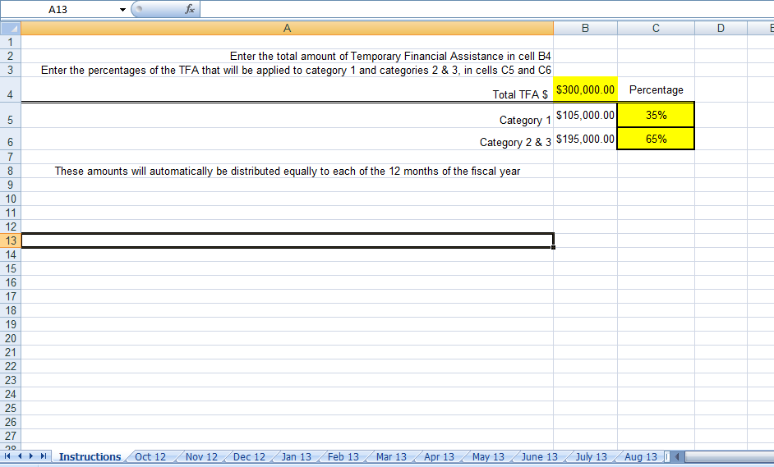

Slide 27
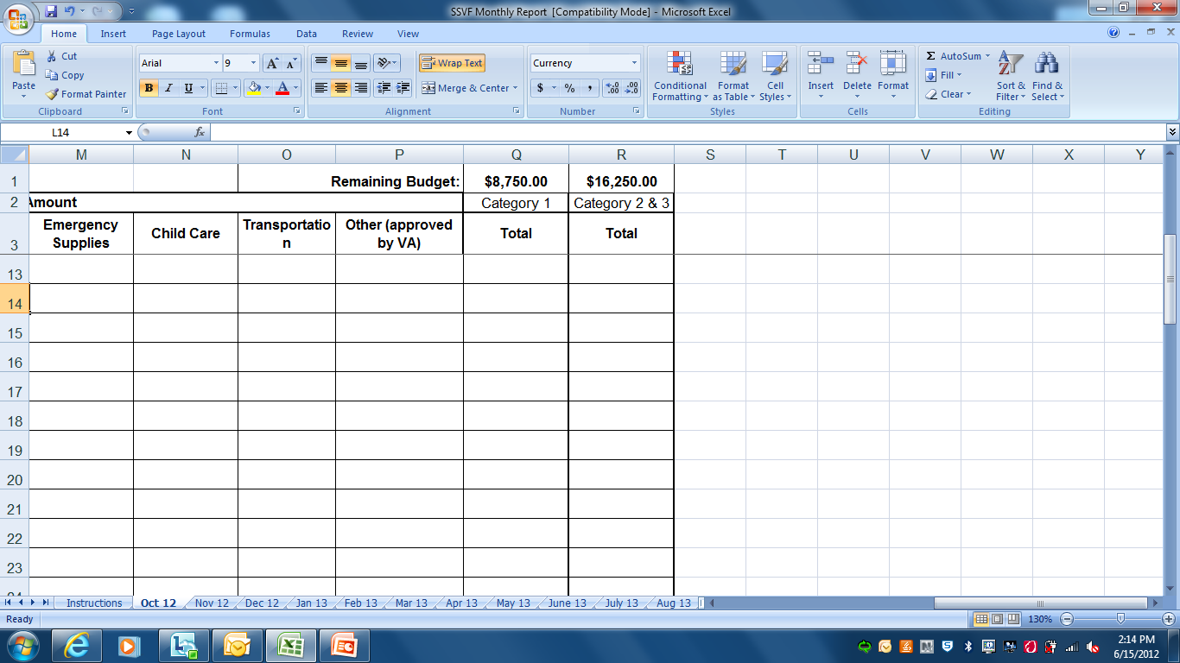
TFA is equally divided to each monthly worksheet based on category of funding

Slide 28
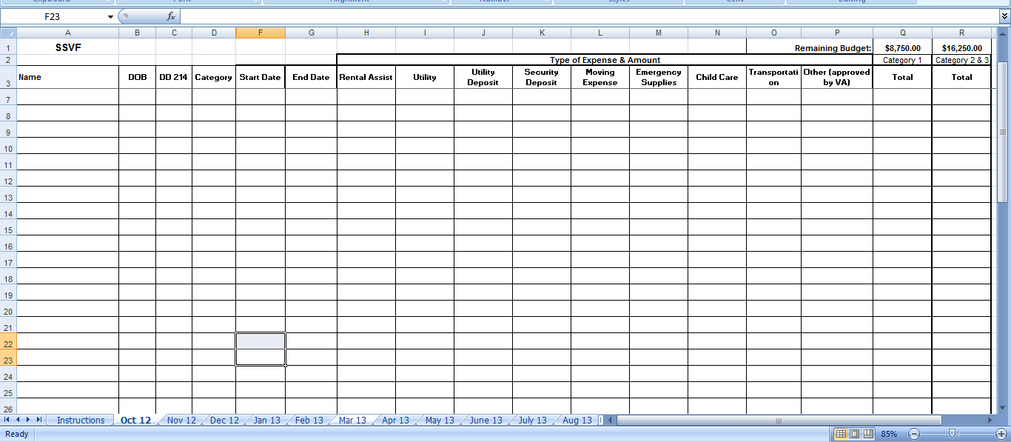
View of entire monthly worksheet

Slide 29
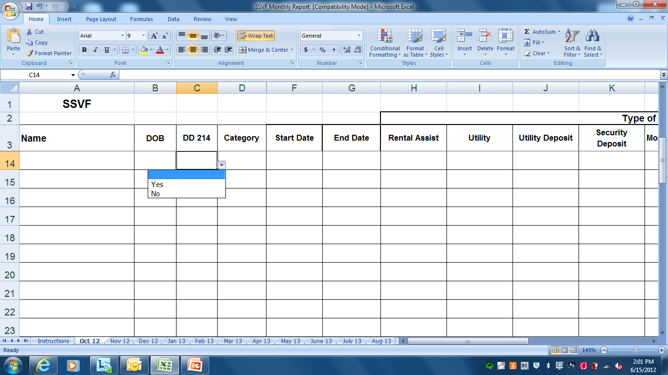
Worksheet records name of veteran, DOB, DD214 present (select yes/no from dropdown)

Slide 30
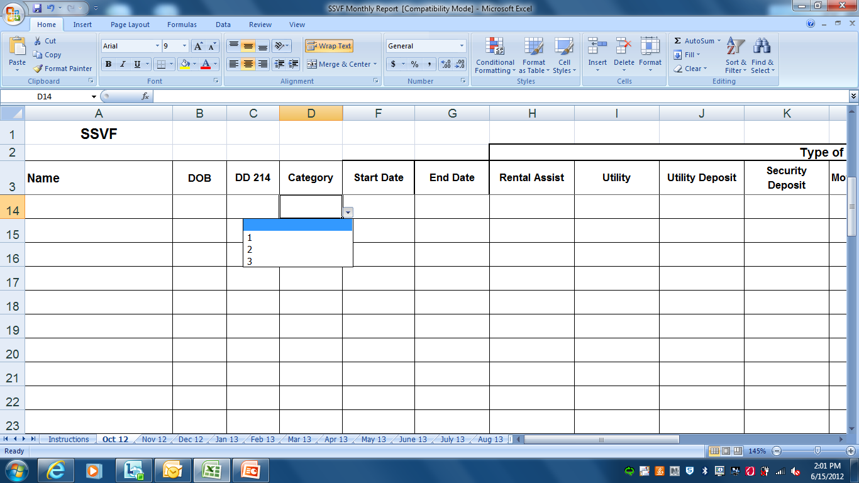
Select funding category (1, 2 , or 3) from dropdown, program start date and end date.

Slide 31
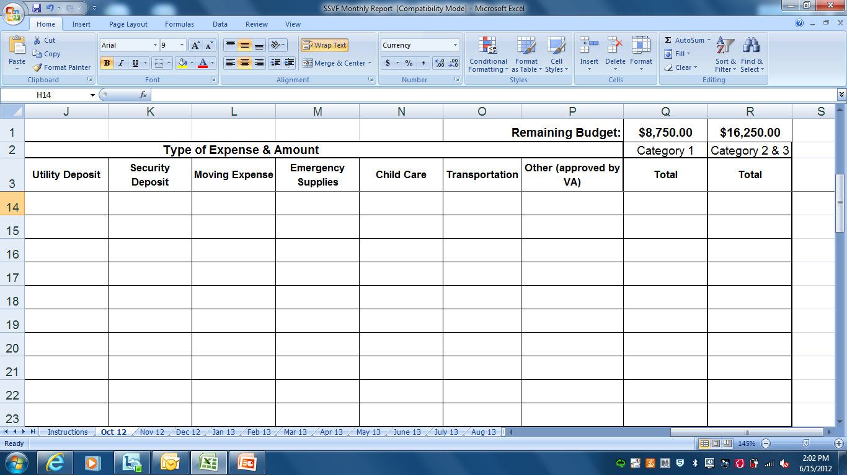
Allowable funding areas

Slide 32
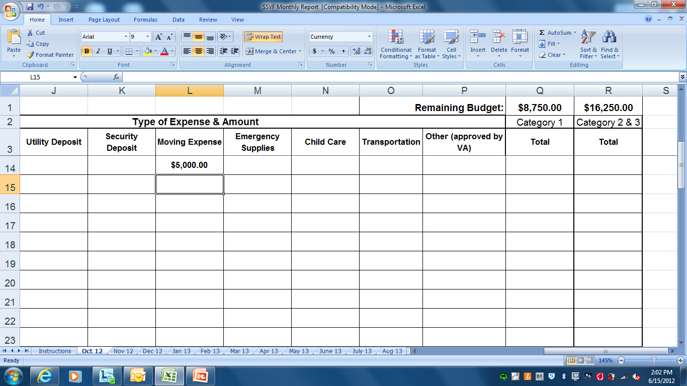
Enter $ amount spent in each allowable area for each member served.

Slide 33
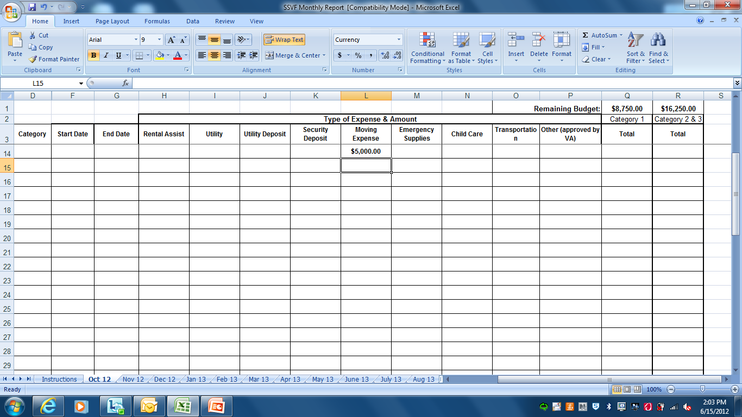

Slide 34
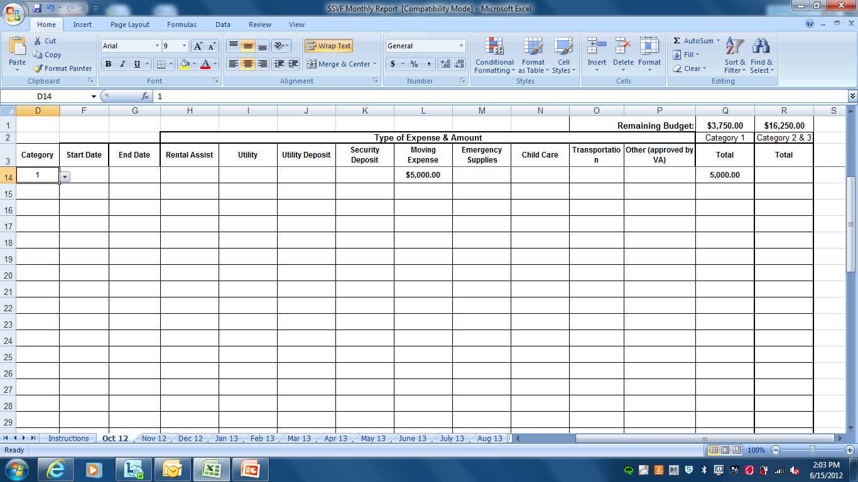
Total Column will not calculate until funding category is selected from dropdown

Slide 35
These $ will automatically be deducted from the total monthly budget for each category

Slide 36
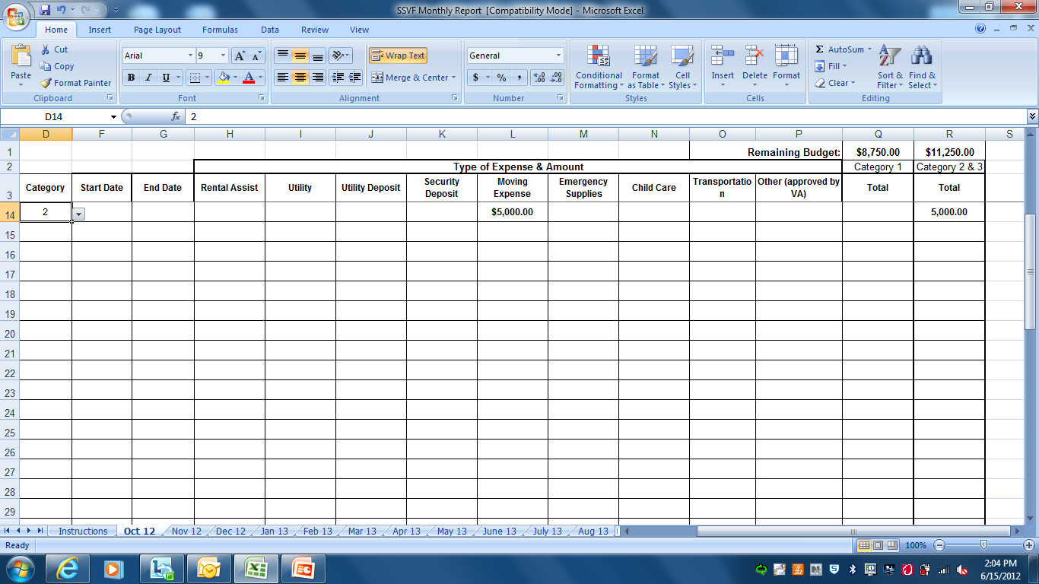

Slide 37
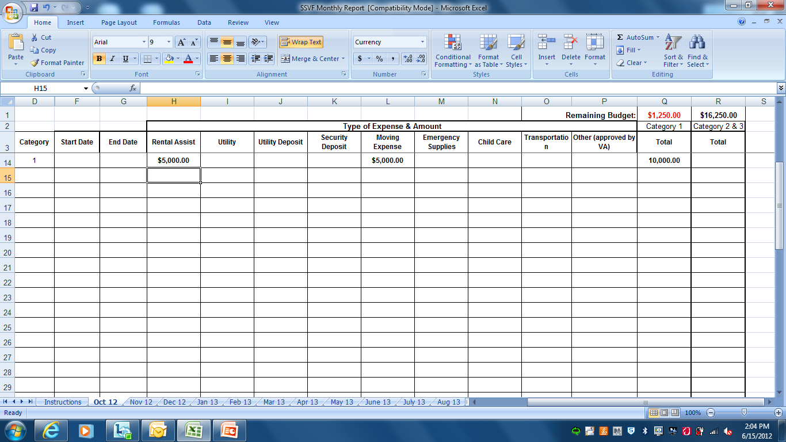
If the monthly spending exceeds what was budgeted, the negative number will be displayed in red. It will then be deducted from next month’s budgeted amount.

Slide 38
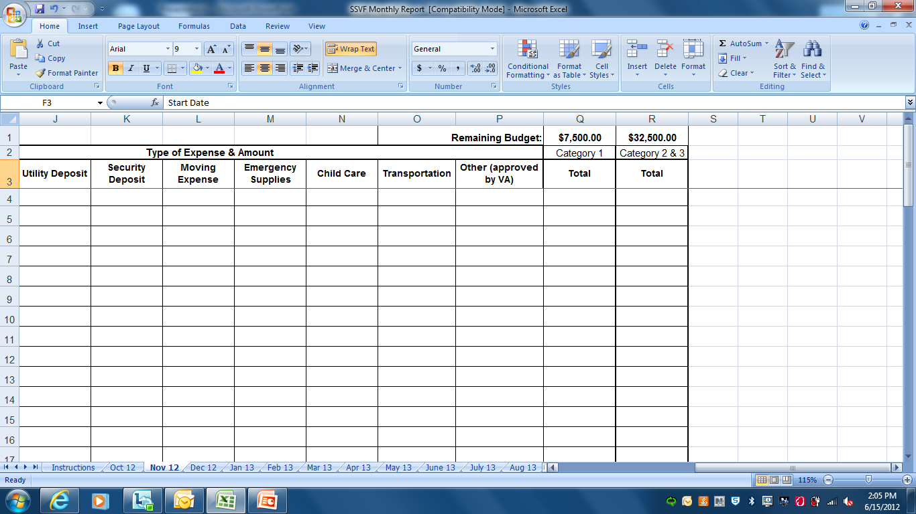

Slide 39
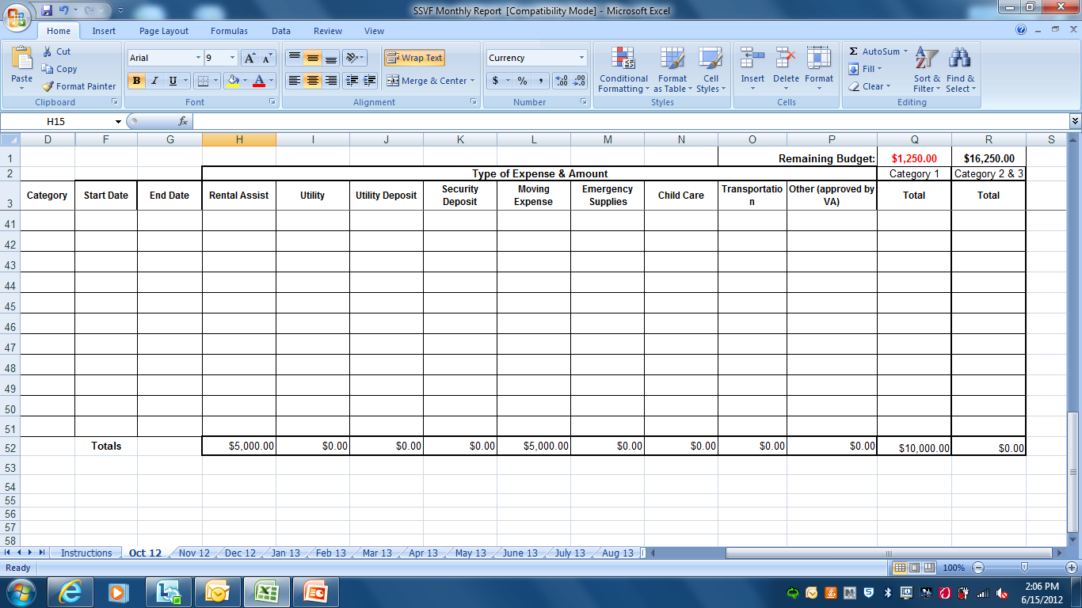
Each column is also automatically totaled as data is entered

Slide 40
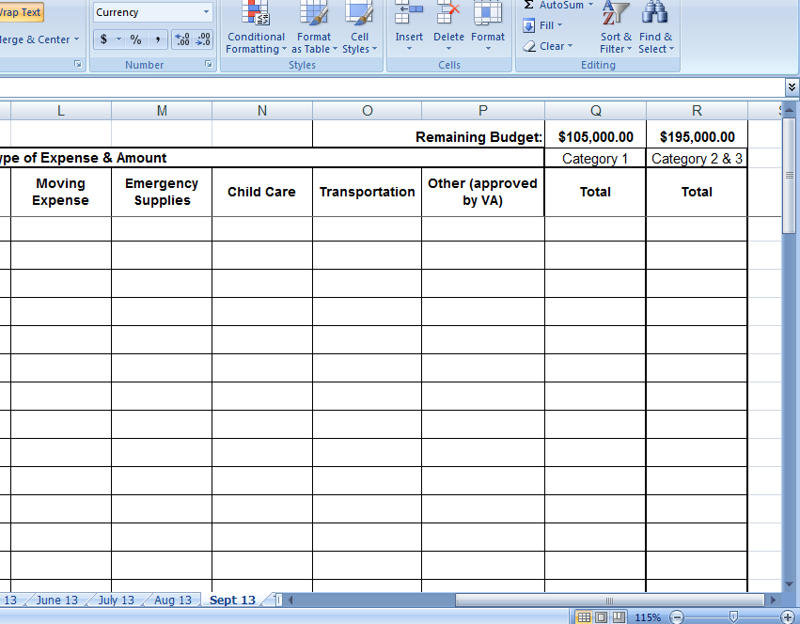
Unspent $ that is budgeted for the month gets added to the next month.

Slide 41
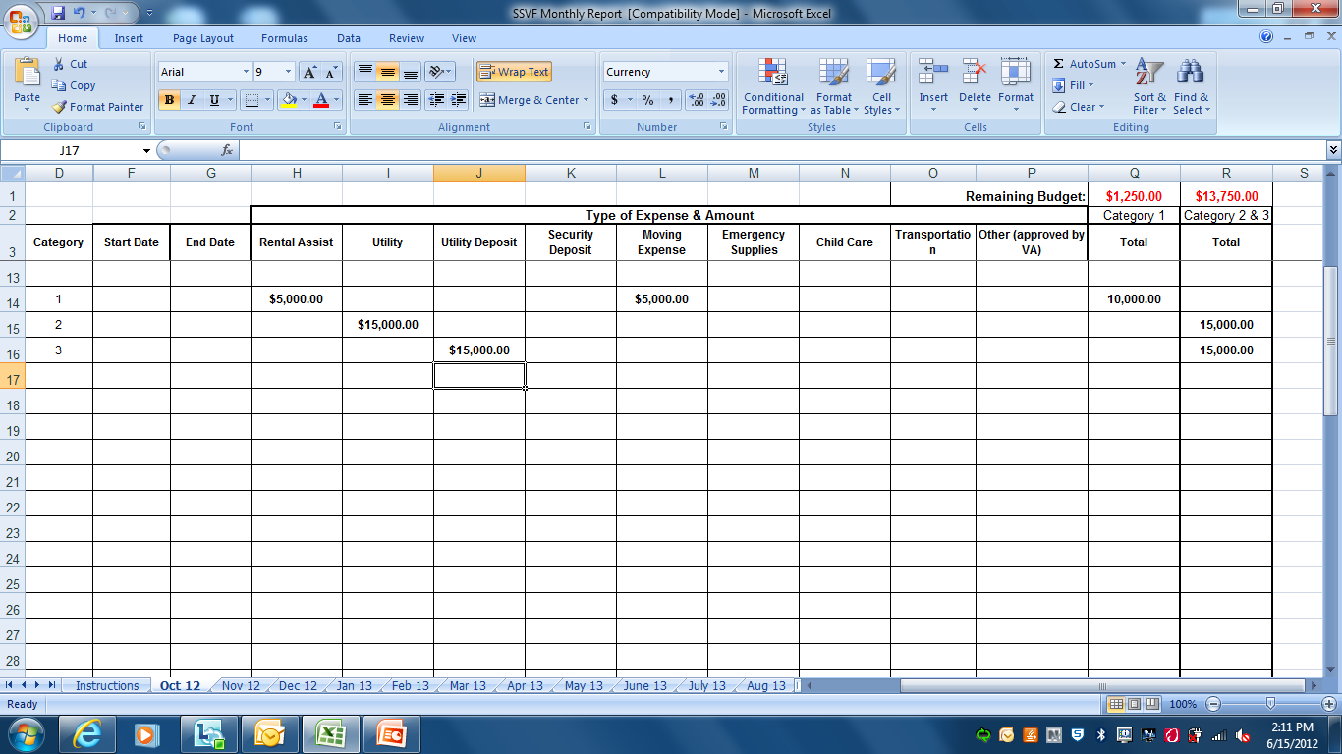

Slide 42

The last sheet (titled “Totals) tracks year to date spending by category/by month. Displays unspent balance and % of funding spent by category to date.

Slide 43
Policies & Procedures
Jackie Smith, Northwest Regional Coordinator
Notes:
Thank you so much for the introduction. Before I move on, I want to take a moment to thank Ken for his presentation. If we were together at a conference your presentation would earn a roaring applause. What a great tracking tool! The next topic we will be discussing with you today in our Promising Practices and Common Issues Presentation is Policies and Procedures. SSVF grantees have been provided an outline of a policy and procedure manual which has been posted on the SSVF website. However, throughout the site visits the SSVF regional coordinators have identified that many grantees would benefit from further conversations about the SSVF Policy and Procedure Manual as it is a major cornerstone in your SSVF Program.

Slide 44
Common Issues
SSVF Program Guide is not a Policy and Procedure Manual
Lack local context
  Little to no guidance on how the program is implemented locally
  Lack of detail describing the process for prioritization of clients, program admission, and supportive services
Lack SSVF’s focus on housing stabilization, not treatment
Notes:
However, before we begin a discussion about promising practices, I wanted to briefly discuss some common issues that have been noted in some monitoring visits. First, I want to communicate to you that the SSVF Program Guide is not a policy and procedure manual. I am going to say it again so it is clear to everyone….The SSVF Program Guide is not a policy and procedure manual. A common issue that is being encountered in the field is that the SSVF Program Guide is being used as policy and procedure manual. However, the intention of the guide is to provide an overview of the SSVF Program. It has force for oversight, auditing, and program review purposes, and is to be used by the Applicants to the SSVF Program, grantees, Department of Veteran Affairs staff members, and other interested parties. It provides a wealth of information about the SSVF Program. Essentially, it is a broad National view of the SSVF program.
Lack of local context-
The SSVF Program Office is keenly aware that the service delivery in Nebraska will differ greatly from the provision of services in New York. Therefore, each program is expected to have and maintain a policy and procedure manual that explains how their SSVF program is going to function within the guidelines noted in the SSVF Program Guide.
Lack of focus on housing stability-
The SSVF Program is a housing stability program. The focus on the SSVF Policy and Procedure manual should be focused on housing stability.

Slide 45
Promising Practices
Definition
Policy is a definite course or method of action selected from among alternatives and in light of given conditions to guide and determine present and future decisions
Procedure is a series of steps followed in a regular definite order
Notes:
So before I begin to discuss specific promising practices, I think its important to think about the definition of policy and procedure as it will help you in the development, refinement and creation of your SSVF Program’s Policy and Procedure Manual.
Use the homework example
Subject: Homework
Policy: That all homework must be completed before you play outside.
Forms: Signed Homework Planner
Upon arrival from home after school the student is asked to review all homework assignments.
Prioritize based on the date the assignment is due
Begin working on homework with the closest due date
If multiple assignments are due on the same date, the homework anticpated to take the longest goes first… etc

Slide 46
Promising Practices
Clear and concise policy
Clear and concise steps explaining how to ensure the policy is supported
Manual that fully describes all aspects of the SSVF Program
Allows a reader to fully understand how the SSVF Program functions at the agency level
Notes:
Clear and concise policy
You may even go as far as stating …It is the policy of Agency SSVF Program to
Clear and concise steps explaining how to ensure the policy is supported
Manual that fully describes all aspects of the SSVF Program
Allows a reader to fully understand how the SSVF Function at the agency level

Slide 47
Promising Practices
Policy Formatting
Subject: Outreach
Policy: It is the policy to provide outreach…
Forms: Form A will be used to discuss the program
Procedure: This is how the SSVF Program will conduct outreach

Slide 48
Promising Practices
Comprehensive manual that clearly describes how the agency’s SSVF Program Functions
  Intake Process
  Prioritization Process
  Provision of Case management services
  Process of writing Individual Housing Stabilization Plan
  Clearly describes the use of TFA
  Clearly describes how to know TFA is necessary and how to get approval for TFA
  Clear grievance policy
  Frequency of review of Individual Housing Stabilization Plan
For each TFA category, include a list of questions for case managers to use in determining “but for” criteria that takes into account other local resources.

Slide 49
Grantee Example
SSVF Field Manual Development
Community Psychiatric Clinic
Stan Brownlow, Program Supervisor
Supportive Services for Veterans Families (SSVF)
Notes:
Stan began working with Community Psychiatric Clinic in 1999 as a residential counselor. Before being asked to implement SSVF at CPC, he supervised transitional housing programs for mentally ill chronically homeless adults, and young homeless adults. He has served on the Board of Directors for a Seattle area mental health services agency, and was appointed and served for five-years on the Seattle Human Rights Commission under two city administrations. SSVF is the first veterans' specific program he has supervised.

Slide 50
Development and Formatting
The CPC SSVF Field Manual is modeled after the CPC Policies and Procedures Manual. This ensures consistency between policy design for the SSVF program and policies and procedures within agency operations. The Manual is intended to assist staff in navigating the complexities of the program and obtaining guidance from one central resource. Policies were derived from:
-Grant Guidelines
-The Program Guide
-The CPC Policies and Procedures Manual
-CPC Housing and Case Management Programs
-Staff input on policy development and formatting

Slide 51
Supportive Services For Veteran Families
Field Manual
Section I - GENERAL ADMINISTRATION PROCEDURES
-Program Description
-Program Resources
-Evaluation & Monitoring
-Critical Time Intervention (CTI) Case Management Model
-Participant Fees
-Eligible Expenses
-Ineligible Activities
-Program Terms
-Targeted Benchmarks
-Prioritization, Acuity & Self Sufficiency Matrix
-Staff Supervision
-Staff Meetings
-Participant Complaints, Grievances, and Appeals
-Participant Rights and Responsibilities
-SSVF Case Manager Five-Day Training Plan
-SSVF Job Descriptions
-SSVF Staff Performance Appraisals

Slide 52
Supportive Services For Veteran Families
Field Manual
Section II - DOCUMENTATION PROCEDURES
-Supportive Services
-Participant Eligibility Determination & Documentation
-Program Exits
-Participant Agreements
-Habitability Standards
-Notification to Participants
-Confidentiality
-Releasing Participants from Program
-Reporting Requirements
-HMIS Data Collection Requirements

Slide 53
Supportive Services For Veteran Families
Field Manual
Section III -SAFETY/EMERGENCY PROCEDURES
-Participant Safety
-Staff Safety
-Accident or Injury to Staff or Clients
-Emergency Lock-Down
-Emergency Phone Procedures
-Emergency Phone List
-Fire, Disaster & Evacuation Plan
-Managing Assaultive and/or Out-of Control Behavior
-Notification of Legal Guardian or Next of Kin
-Reporting of Abuse and Violation of Adult Rights
-Staff Show of Support
-Suicidal Ideation, Gestures & Attempts
-Critical Incident Reporting

Slide 54
Supportive Services For Veteran Families
Field Manual
Section IV - MEDICAL PROCEDURES
-Body Fluids and Hazardous Waste
-Diabetic Clients in SSVF
-First Aid Kits
-Guidelines for Determining an Infection
-Infection Control
-Medication Education
-Treatment of Lice, Scabies and Bed Bugs

Slide 55
Policy Template
POLICY: Supportive Services for Veteran Families (SSVF) Field Manual-
PURPOSE:
REFERENCE:
Supportive Services for Veterans Families – Program Plan
VA SSVF grant, VA SSVF Program Guide.
ATTACHMENTS:
PROCEDURES:
A.

Slide 56
Policy Sample: Monthly Reports
POLICY: Supportive Services for Veteran Families (SSVF) Field Manual- Monthly Report.
PURPOSE: To inform the SSVF Program Office and the SSVF Regional Grant Coordinator of monthly
progress and performance of the SSVF program.
REFERENCE:
Supportive Services for Veterans Families – Program Plan
VA SSVF grant, VA SSVF Program Guide.
ATTACHMENTS: SSVF Monthly Reporting Coversheet Template
PROCEDURES:
A. All intake, exit, and HMIS data is to be tracked by the Program Supervisor.
B. After the information is compiled for the month by the SSVF Program Supervisor, it is to be documented along with a summary of the program performance on the SSVF Monthly Reporting Coversheet.
C. Once the information on the Coversheet is deemed to be accurate, it is to be reconciled with the Safe Harbors Monthly APR Report and any discrepancies corrected in either the program tracking system, or the Safe Harbors HMIS data collection system.
D. Once the report is reconciled, the dollars spent from each category are reported in the financial section of the SSVF Monthly Reporting Coversheet. These expenditures will be placed on the (R) drive SSVF/ SSVF Financial Assistance/Reporting by Category by the Chief Financial Officer.
E. Any missing or de-identified data in the Safe Harbors HMIS data collection system must be tracked and an explanation submitted in writing to the Regional Grant Coordinator to accompany the Monthly Report.
D. The Safe Harbors Monthly APR Report, The SSVF Monthly Reporting Coversheet, and the written explanation for any missing or de-identified data must all be compiled and submitted to the Regional Grant Coordinator no later than the 4th business day of each month.

Slide 57
Policy Attachment
SSVF Monthly Reporting Coversheet
Reporting period start date
Reporting period end date
Summary
 | Homelessness Prevention |  | Rapid Re-housing |  | Unduplicated Total
 | Report period | GTD | Report period | GTD | Report period | GTD
Persons screened but not enrolled
Persons served
New enrollees
Persons exiting
Veterans served
Female Veterans served
Afghanistan/Iraq Veterans served
Households served

Slide 58
Feedback
Case Managers and Administrative staff report that a comprehensive Field Manual with clear policies is helpful for answering questions about program practices that may include diverse subjects such as:
-Program entries and prioritization
-Eligible and ineligible expenses
-Participants’ Rights and Responsibilities
-HMIS data collection requirements
-Accident or injury to staff or clients
-Reporting of abuse or violation of adult rights
-Critical incident reports
-Support in combination with the Five-Day Training Plan

Slide 59
Field Manual Updates
The Field Manual is updated with each new policy or policy change within the agency, the SSVF program office, the VA, or other contributing organizations. Forms are updated with each change and copies placed with the accompanying policy or procedure.

Slide 60
Please send any questions or feedback to SSVF@va.gov
Promising Practices and Common Issues Identified During Monitoring Visits
Notes:
Before we conclude I want to thank all of the presenters on the call today. Especially, Irene Hall from Family Endeavors, Ken Saefkow from Centerstone and Stan Brownlow from Community Psychiatric Clinic for highlighting some promising practices with everyone on the call today. We covered a great deal of information today and I found the presentation to be extremely helpful. I am confident that everyone else on the call is very appreciate of the information.
This concludes the SSVF National Call for June 21, 2012. should you have any questions for feedback please email the SSVF program office at SSVF@va.gov.
Thank you

