Slide 1
MDAC Introduction and Participant Satisfaction Survey Overview for SSVF Grantees
March 17, 2016
Notes:
Name
Welcome
Thank you
Overview of process of capturing Veteran feedback
Similar to last year – no surprises

Slide 2
About MDAC
A full service market research company that provides insights which are analytical, strategic, tactical, operationally relevant, and impactful
Established in 1985 with an experienced and diverse staff comprised of former private sector executives, government administrators, and academics
National and regional demonstration projects, campaign and program evaluations and tracking studies
www.mdavisco.com
Presented By M. Davis and Company, Inc.
Notes:
Overview of MDAC
Who we are, what we do

Slide 3
Importance of work
Information provided from Veterans helps sustain a continuous improvement process to better serve our veterans and their families.
Participation is essential to assess veteran perceptions of services received, to help determine potential actions to increase veteran satisfaction and to reduce operational burden.
Requirement under SSVF final rule

Slide 4
Assessment Process Overview
Process similar to last year
Services provided
Veteran registered through weblink once within 30 days of final services (change from last year)
Including cell phone number
Email invitation sent to Veteran
Veteran provides feedback (Spanish version available)
Receive monthly reports with feedback from the Veterans you serve
Presented By M. Davis and Company, Inc.
Notes:
Work begins when Veterans and their families come to your agency to receive services
You will register the Veteran two times (45-60 days after initial services and within 30 days of final services), using the weblink that has been provided
An email invitation will be sent to Veteran shortly. Tell them about the importance of the survey and how their responses are so useful
Veteran provides feedback through the URL link in their email, responses come to our server
We will provide reports with feedback from the Veterans you serve

Slide 5
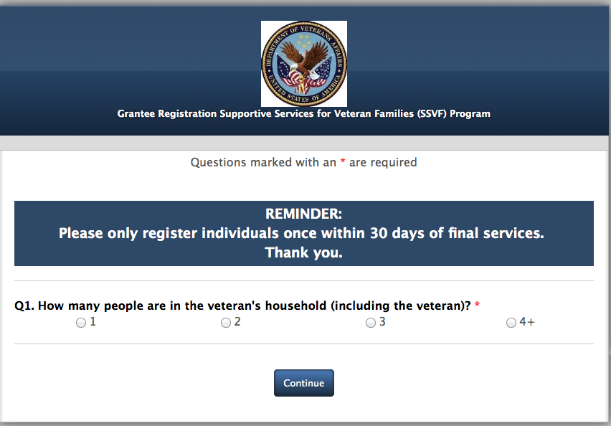
Registration Screen Shot
Presented By M. Davis and Company, Inc.
Notes:
First time or second time responder
Unique URL goes to your agency, that is why we don’t need to know your agency name
Very easy process
You can always go back if you enter something by mistake

Slide 6
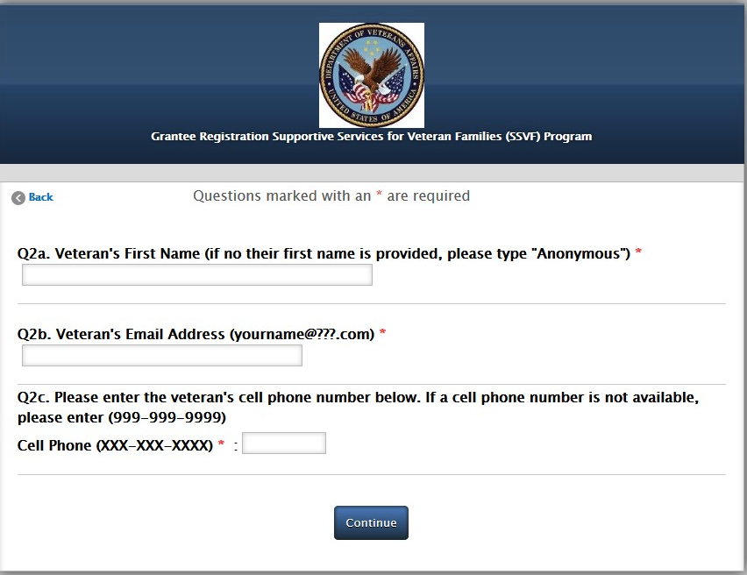
Registration screen shot
Presented By M. Davis and Company, Inc.
Notes:
First name (we don’t need their last name, we would just like to personalize the email that we send to them) – but if Veteran feels uncomfortable, you can just put anonymous
We really need either the email or the cell number so that we can send them the survey link
Click finish and our system will send out the survey link to the Veteran

Slide 7
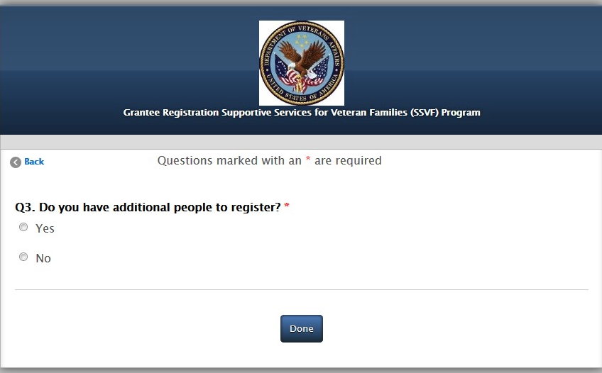
Registration Screen Shot
Presented By M. Davis and Company, Inc.
Notes:
This is what the Veteran will get – they will click on the survey link
Review the survey so that if the Veteran has any questions of what they will be completing, you can help answer

Slide 8
Veteran introduction Screen Shot
Presented By M. Davis and Company, Inc.
Notes:
This is what the Veteran will get – they will click on the survey link
Review the survey so that if the Veteran has any questions of what they will be completing, you can help answer

Slide 9
Next Steps
Train staff and subcontractors on how to use the weblink
Share webinar slides
Save weblink to computer desktop (as many computers as needed)
Ask questions
MDAC will send email with weblink on 3/18/2016 to all points of contact provided
Be ready to go live on 03/18/2016
Including all Veterans that have finished with services since March 1, 2016
Presented By M. Davis and Company, Inc.
Notes:
Please give weblink to all staff and subcontractors that will be registering Veterans
The email that you received has instructions on how to make the shortcut
You can put on as many computers as you want
Really encourage you to practice
Demo assessment?
Go live on ?

Slide 10
Questions?
MDAC
Please call or email immediately if you do not receive the email containing the weblink or if you have any questions
vassvf@mdavisco.com (staff will respond within 24 hours)
215-790-8900 ext 132 If you need to leave a message, someone will return your call by the next business day)
Resources available on SSVF website
Webinar slides, copy of survey
http://www.va.gov/homeless/ssvf/index.asp
Presented By M. Davis and Company, Inc.

