Slide 1
Department of Veterans Affairs
Hepatitis C Treatment :
Request for
choice Program flexibility
To Address
$500 Million Shortfall in FY 2015

Slide 2
Veteran Hepatitis-C Treatment: Summary
VA is changing the lives of Veterans with Hepatitis-C (HCV)
The FDA approved two sets of HCV drug treatments in the last 12 months – 4 new drugs. Both sets became available after VA submitted its 2015 Budget requests to Congress
Of the total 180,000 enrolled Veterans diagnosed with HCV, VA has treated 27,244 (or 15 percent) --
19,600 Veterans treated during FY 2015
7,644 Veterans treated during FY 2014
VA reallocated nearly $700 million of base resources to fund HCV treatment in FY 2015
As of June 2015, VA has exhausted all available FY 2015 resources and is relying on the Choice Program for HCV treatment
VA is requesting an amendment to the Choice Act, Section 802 to provide $500 million for critically needed HCV pharmaceutical treatment drugs in FY 2015.

Slide 3
HCV Clinical Considerations and the Veteran Population
VA estimates that about 180,000 current enrollees diagnosed with HCV
VA cares for a population with one of the highest prevalence rates of HCV infection in the country
VA estimates there may be an additional 40,000 enrollees with HCV infection not yet diagnosed
Progression of HCV infection includes serious complications, such as cirrhosis and hepatocellular carcinoma, which typically take decades to occur
Most Veterans in VHA care were infected 30-40 years ago
Cure of infection significantly decreases mortality and complication rates for some patients
HCV is a chronic disease and with the newer medications, HCV can be cured in a large proportion of patients treated. Newer medications:
Have significantly higher cure rates than older medications
Are easier to prescribe (all oral regimens are now available)
Have many fewer and milder side effects

Slide 4
Referral of HCV Veterans to Choice Program
Although VA has exhausted its budgeted funds for HCV pharmaceuticals, we are continuing to treat to Veterans and are referring HCV positive Veterans to the private sector through the Choice Program.
Care Coordination Challenges
Duplication of Services
Continuity of Care – Choice only authorized for 60 day and then need re-authorization but HCV treatment is 12-24 weeks long.
Risk for interruption of treatment can lead to failure.
Lack of availability of qualified community providers, particularly given our complex patients with multiple comorbidities.
High Veteran case load (many patients ready and waiting for treatment -over 130,000 veterans) and limited Choice capacity to handle influx of Veterans ready to use Choice
Privacy issues: will require extra vigilance over release of Info required by Veteran which delays care – (many HCV pts have HIV tests and substance use issues)
Many Veteran have had workup in VA (imaging, procedures, lab tests) which Choice provider may not have access to and will repeat – driving up Care in Community costs
No mechanism to measure quality of care being provided (monitoring labs, response, drug interactions) in community as it depends on medical documentation being sent back to VA
Problem of patient having multiple providers (VA and non-VA)

Slide 5
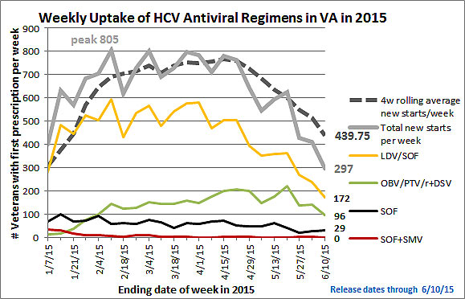
Current uptake rates for HCV treatment
Note: LDV/SOF=Ledipasvir/sofosbuvir; OBV/PTV/r+DSV=Ombitasvir/paritaprevir/ ritonavir/dasabuvir; SOF=Sofosbuvir+ Ribavirin; SOF+SIM=Sofosbuvir+simeprevir

Slide 6
Background

Slide 7
Criteria for patient selection for HCV treatment
Inclusion criteria
Confirmed diagnosis
Disease stage (not absolute)
Ability to adhere to regimen
Exclusion criteria
Medical comorbidities (e.g., end-stage kidney disease)
Inability to adhere because of alcohol/substance use, serious mental illness (not absolute)

Slide 8
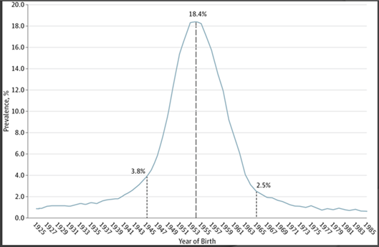
Prevalence of HCV among Veterans by Birth Cohort
Prevalence of Hepatitis C by Birth Year
Source: Backus L et al JAMA 2013; 173(16):1-3

Slide 9
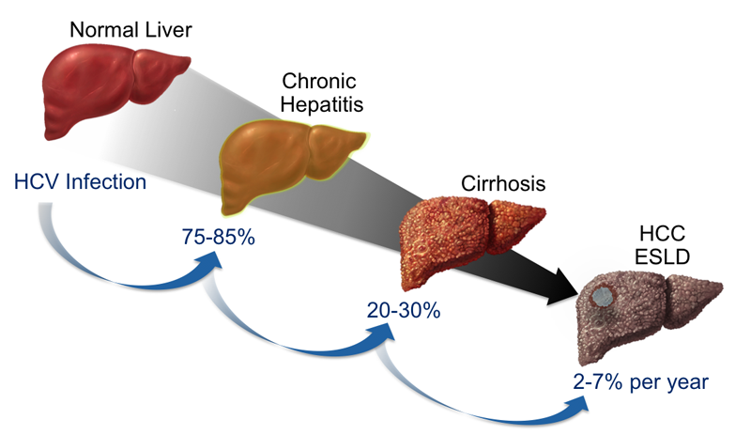
HCV: natural history
NOTE: HCC=Hepatocellular Carcinoma; ESLD=End Stage Liver Disease
Source: Presentation by Thornton, K., 2013, retrieved on 4/24/15 from: http://www. hepatitisc.uw.edu/go/evaluation-staging-monitoring/natural-history/core-concept/all
Notes:
Natural History Following Initial Infection with HCV Following initial infection with HCV, approximately 75 to 85% of persons develop chronic infection. Among those with chronic infection, approximately 20 to 30% will eventually develop cirrhosis. Patients who have HCV-related cirrhosis have a 2 to 7% per year risk of developing either end-stage liver disease or hepatocellular carcinoma. Abbreviations: ESLD = end stage liver disease HCC = hepatocellular carcinoma

Slide 10
Prevalence of liver cancer cases in VA HCV patients is increasing rapidly
*median survival for all patients is <24 months
NOTE: Calendar year (CY) 2014 data not yet available; last bar represents CY 2013 data. In CY 2013, VHA had 174,302 Veterans with HCV in care
Source: HCV Clinical Case Registry (CCR)

Slide 11
HCV anti-viral therapy prevents death and complications
NOTE: Sustained Virologic Response (SVR) = cure
Source: Backus L et al Clin Gastroenterol Hepatol 2011 Jun; 9(6):509-516
Notes:
Anti-viral therapy of HCV, when successful, dramatically decreases the risk of costly, life-threatening complications. Dr. Lisa Backus at the Palo Alto VA, has analyzed Veterans with HCV receiving anti-viral treatment; as shown in the left-hand panel, treated Veterans who are cured have much lower mortality rates than those who were not cured, even after adjusting for potential confounders. Standard therapy decreases mortality for all of the major strains (i.e., genotypes) of HCV.
However, over three-quarters of HCV-infected Veterans in VHA care have never been treated, and of those who have been treated, most have not been cured. Standard therapy has consisted of weekly injections of interferon in combination with an oral drug, ribavirin for up to a year. This combination is not very effective; of Veterans infected with genotype 1, the most common strain, only about 25% are cured by standard therapy. Standard therapy is highly toxic, leading many patients to refuse therapy or discontinue it prematurely. Finally, many patients are not good candidates because of co-existing problems such as alcohol or substance use disorders.

Slide 12
Milestones for achieving HCV target outcomes by year
NOTE: Sustained Virologic Response (SVR) = cure

