Slide 1
Top 5 FSS Clauses Part I
FSS Webinar – July 28, 2022
Presented by Lydia McKay

Slide 2
Purpose – IIb
Purpose
This training will discuss in depth some of the most important FSS contract clauses and what they mean to you for compliance and proper management of an FSS contract as well as how some of these clauses can impact an offeror. This session, Part I, will take you through three clauses, with the remaining two being covered in another session as Part II.
Note: The presentation today is based on specific dated versions of the regulations and is subject to change if the regulations are updated.

Slide 3
Agenda
I-FSS-639 Contract Sales Criteria
Offeror and contractor impact
52.225-5 Trade Agreements
Requirement for U.S.-made or designated country end products
Order level set-asides & the nonmanufacturer rule
Non-Availability Determinations
552.238-82 Modifications (Federal Supply Schedule)
Modification criteria and forms
Notes:
Part II of this webinar in late August will cover the Price Reductions Clause and the Economic Price Adjustments clause.

Slide 4
I-FSS-639
I-FSS-639 Contract Sales Criteria
(Mar 2002)

Slide 5
Minimum Contract Sales
I-FSS-639(a): “A contract will not be awarded unless anticipated sales are expected to exceed $25,000 within the first 24 months following contract award, and are expected to exceed $25,000 in sales each 12-month period thereafter.”

Slide 6
Cancellation Authority
I-FSS-639(b): “The Government may cancel the contract in accordance with clause 552.238-79, Cancellation, unless reported sales are at the levels specified in paragraph (a) above.”

Slide 7
I-FSS-639: Recap
What does this mean for me?
Offeror: The assigned Contract Specialist will consider your ability to meet the sales minimum when determining whether to consider your proposal for contract award.
Contractor: If you are not meeting the sales minimum, FSS has the authority to cancel the contract or to not exercise a 5-year option allowing the contract to naturally expire.
Notes:
Note that FSS doesn’t exercise options under Schedule 65 I B. On that schedule, contractors would submit a follow-on proposal instead .

Slide 8
52.225-5
52.225-5 Trade Agreements
(Oct 2019)

Slide 9
52.225-5 Overview
52.225-5(a): Sets forth definitions for
Designated country, including four types and a listing of countries for each type
End product, including definitions for end products from each of the designated country categories as well as U.S.-made end products
52.225(b): Sets forth the requirement for products to be only U.S.-made or designated country end products

Slide 10
52.225-5(b) - Requirement
52.225-5(b): “Delivery of end products. The Contracting Officer has determined that the WTO GPA and FTAs apply to this acquisition. Unless otherwise specified, these trade agreements apply to all items in the Schedule. The Contractor shall deliver under this contract only U.S.-made or designated country end products except to the extent that, in its offer, it specified delivery of other end products in the provision entitled "Trade Agreements Certificate."

Slide 11
Designated Country
Designated countries fall under four categories:
World Trade Organization Government Procurement Agreement (WTO GPA) countries
Free Trade Agreement (FTO) countries
Least Developed countries
Caribbean Basin countries

Slide 12
WTO GPA Countries*
Armenia, Aruba, Austria, Belgium, Bulgaria, Canada, Croatia, Cyprus, Czech Republic, Denmark, Estonia, Finland, France, Germany, Greece, Hong Kong, Hungary, Iceland, Ireland, Israel, Italy, Japan, Korea (Republic of), Latvia, Liechtenstein, Lithuania, Luxembourg, Malta, Montenegro, Netherlands, New Zealand, Norway, Poland, Portugal, Romania, Singapore, Slovak Republic, Slovenia, Spain, Sweden, Switzerland, Taiwan (known in the World Trade Organization as “the Separate Customs Territory of Taiwan, Penghu, Kinmen and Matsu (Chinese Taipei)”), or United Kingdom
*Listing is current as of 7/28/22

Slide 13
Least Developed Countries*
Afghanistan, Angola, Bangladesh, Benin, Bhutan, Burkina Faso, Burundi, Cambodia, Central African Republic, Chad, Comoros, Democratic Republic of Congo, Djibouti, Equatorial Guinea, Eritrea, Ethiopia, Gambia, Guinea, Guinea-Bissau, Haiti, Kiribati, Laos, Lesotho, Liberia, Madagascar, Malawi, Mali, Mauritania, Mozambique, Nepal, Niger, Rwanda, Samoa, Sao Tome and Principe, Senegal, Sierra Leone, Solomon Islands, Somalia, South Sudan, Tanzania, Timor-Leste, Togo, Tuvalu, Uganda, Vanuatu, Yemen, or Zambia)
*Listing is current as of 7/28/22

Slide 14
Caribbean Basin & FTA Countries*
Caribbean Basin Countries:
Antigua and Barbuda, Aruba, Bahamas, Barbados, Belize, Bonaire, British Virgin Islands, Curacao, Dominica, Grenada, Guyana, Haiti, Jamaica, Montserrat, Saba, St. Kitts and Nevis, St. Lucia, St. Vincent and the Grenadines, Sint Eustatius, Sint Maarten, or Trinidad and Tobago
Free Trade Agreement (FTA) Countries:
Australia, Bahrain, Canada, Chile, Colombia, Costa Rica, Dominican Republic, El Salvador, Guatemala, Honduras, Korea (Republic of), Mexico, Morocco, Nicaragua, Oman, Panama, Peru, or Singapore
*Listing is current as of 7/28/22

Slide 15
End Product
End product (and variations)
End product: Defined as “those articles, materials, and supplies to be acquired under the contract for public use”.
Designated country category end product: Speaks to an article being “substantially transformed … into a new and different article of commerce with a name, character, or use distinct from that of the article or articles from which it was transformed.”
U.S.-made end product: Defined as “an article that is mined, produced, or manufactured in the United States or that is substantially transformed in the United States into a new and different article of commerce with a name, character, or use distinct from that of the article or articles from which it was transformed.”

Slide 16
Substantial Transformation
Substantially Transformed Article: An article that is substantially transformed “into a new and different article of commerce with a name, character, or use distinct from that of the article or articles from which it was transformed.”
Country of Origin - CAUTION! Only the country of substantial transformation determines the country of origin. Neither the country of export nor the country of manufacture determines the country of origin.

Slide 17
Substantial Transformation – cont’d
Item Components from Multiple Countries: When an item consists of components from more than one country and those components are assembled or otherwise manufactured into a final product, the test to determine country of origin is “substantial transformation”.
CBP Historic Rulings: You can search historical rulings by U.S. Customs and Border Protection (CBP) at https://rulings.cbp.gov/home which can assist you in understanding how country of origin is determined.
CBP Ruling Requests: You can request a determination on substantial transformation from CBP’s Office of Regulations and Rulings at https://www.cbp.gov/trade/rulings.

Slide 18
Set-Asides: The Nonmanufacturer Rule
Applicability/Exceptions to the Non-Manufacturer Rule
19.505(a): Applies to small business set-asides above the simplified acquisition threshold (SAT)
19.505(b): Outlines applicability, regardless of dollar value, to
Contracts with the SBA (19.8)
Awards under 19.13, 19.14, and 19.15 (the HUBZone, SDVO, and WOSB programs) for
(i) Contracts that are set aside.
(ii) Contracts that are awarded on a sole-source basis.
(iii) Orders that are set-aside as described in 8.405-5 and 16.505(b)(2)(i)(F).
(iv) Orders that are issued directly in accordance with 19.504(c)(1)(ii).
(v) Contracts that use the HUBZone price evaluation preference to award to a HUBZone small business concern unless the concern waived the evaluation preference.

Slide 19
Set-Asides: Nonmanufacturer Rule
19.505(c)(1) - Nonmanufacturers: Sets forth that nonmanufacturers must “provide an end item that a small business has manufactured, processed, or produced in the United States or its outlying areas”.
19.505(c)(2) – Kit assemblers: Requires that at least 50% of the total cost of the components of the kit be “manufactured, processed, or produced in the Unites States or its outlying areas by business concerns that are small under the size standards for the NAICS codes of the components of the kit”.

Slide 20
Services Requirement
Country of Origin for Services
25.402(a)(2): “The contracting officer shall determine the origin of services by the country in which the firm providing the services is established. See subpart 25.5 for evaluation procedures for supply contracts covered by trade agreements.”

Slide 21
Non-Availability Determinations
Products do not have to be U.S.-made or designated country end products but can come from any source except those listed in FAR subpart 25.7 - Prohibited Sources.
Covered Drugs (Ongoing)
Individual determinations for SIN 42-2a only
Due to Public Law 102-585 requirements to make covered drugs available on FSS
Disposable Medical Nitrile Gloves (Temporary)
Determination made 3/1/2021
Currently authorized through 11/30/2022, unless extended
COVID-19 Rapid Diagnostic & Serology/Antibody Tests (Temporary)
Determination made 6/24/2021
Currently authorized through 12/31/2022, unless extended

Slide 22
52.225-5: Recap
What does this mean for me?
Responsibility - Initial: The offeror/contractor must verify that all proposed products are U.S.-made or designated country end products (unless there is a non-availability determination).
Responsibility - Ongoing: The contractor must monitor the source of their products and notify FSS if the country of origin has become non-compliant (as well as to submit a Request for Modification to remove the items from contract).
Set-Aside Orders for Nonmanufacturers: Be aware of the restrictive language of the nonmanufacturer rule at FAR 19.505, including the US source language.

Slide 23
552.238-82
552.238-82 Modifications (Federal Supply Schedule)
(Mar 2020, Alt I – Apr 2014, Tailored)

Slide 24
Types of Modifications
552.238-82(b) identifies three types of modifications and their submission requirements.
Additional items/SINs
Deletions
Price Reductions

Slide 25
Additions Documentation: i-ii
552.238-82(b)(1) lists 7 requirements for addition requests.
Information requested in paragraphs (1) and (2) of the Commercial Sales Practice Format to add SINs. Note: FSS also requires this for new products.
Discount information for the new item(s) or new SIN(s). Specifically, submit the information requested in paragraphs 3 through 5 of the Commercial Sales Practice Format. If this information is the same as the initial award, a statement to that effect may be submitted instead.
Note: FSS requires this information for all addition requests.

Slide 26
Additions Documentation: iii
Information about the new item(s) or the item(s) under the new SIN(s) must be submitted in accordance with the request for proposal.
This refers to submission of the information required by 552.212-70
(I-FSS-972) Preparation of Offer (Multiple Award Schedule):
Commercial price list (dated/identified)
SIN category for each offered item
Description of all offered discounts
Description of any offered concessions
Identification of any dealers/distributors

Slide 27
Additions Documentation: iv-v
Delivery time(s) for the new item(s) or the item(s) under the new SIN(s) must be submitted in accordance with the request for proposal
This refers to submission of the information required by 552.238-86 Delivery Schedule, to include standard and expedited delivery times.
Production point(s) for the new item(s) or the item(s) under the new SIN(s) must be submitted if required by FAR 52.215-6, Place of Performance
For Schedule 65 I B, information is also required under AS8005 Manufacturing Facilities/Place of Performance.

Slide 28
Additions Documentation: vi-vii
Hazardous Material information (if applicable) must be submitted as required by FAR 52.223-3 (Alternate I), Hazardous Material Identification and Material Safety Data.
Any information requested by FAR 52.212-3(f), Offeror Representations and Certifications-Commercial Products and Commercial Services, that may be necessary to assure compliance with FAR 52.225-5, Trade Agreements.

Slide 29
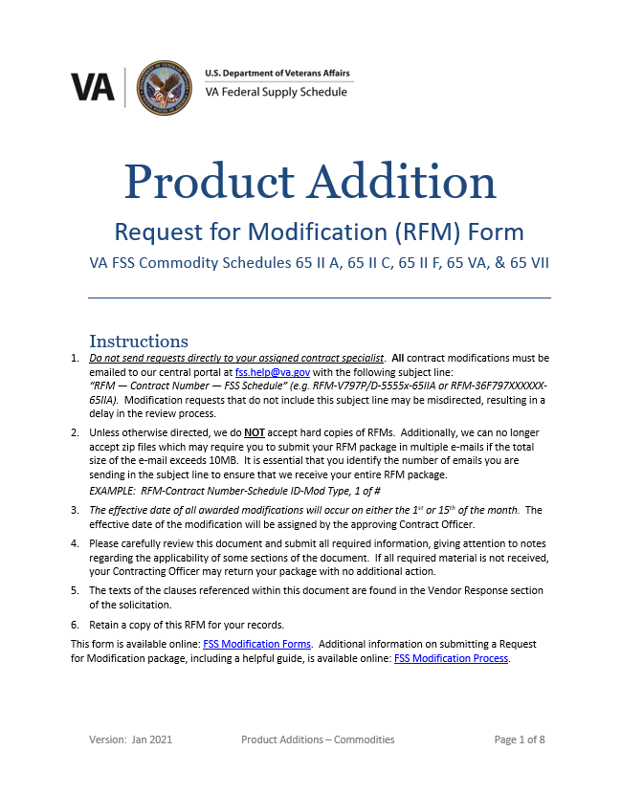
Additions RFM

Slide 30
Deletions Documentation
552.238-82(b)(2): Deletions. The Contractors shall provide an explanation for the deletion. The Government reserves the right to reject any subsequent offer of the same item or a substantially equal item at a higher price during the same contract period if the contracting officer finds the higher price to be unreasonable when compared with the deleted item.

Slide 31
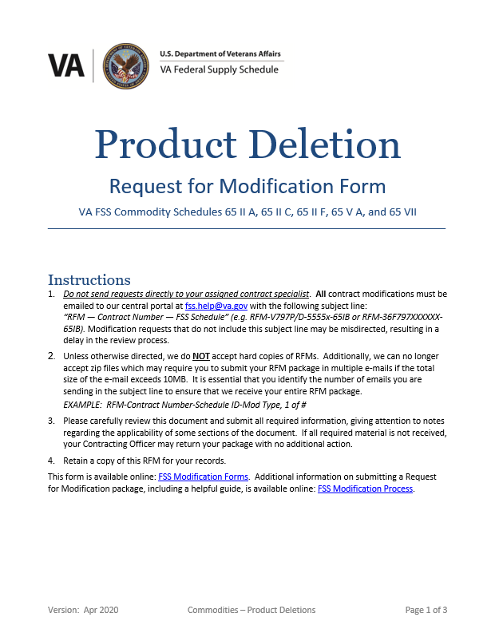
Deletions RFM

Slide 32
Price Reductions Documentation
552.238-82(b)(3): Price reduction. The Contractor shall indicate whether the price reduction falls under the item (i), (ii), or (iii) of paragraph (c)(1) of the Price Reductions clause at 552.238‑81 .
If the Price reduction falls under item (i), the Contractor shall transmit a copy of the dated commercial price list.
If the price reduction falls under item (ii) or (iii), the Contractor shall transmit a copy of the applicable price list(s), bulletins or letters or customer agreements which outline the effective date, duration, terms and conditions of the price reduction.
Note: This also applies to temporary price reductions.

Slide 33
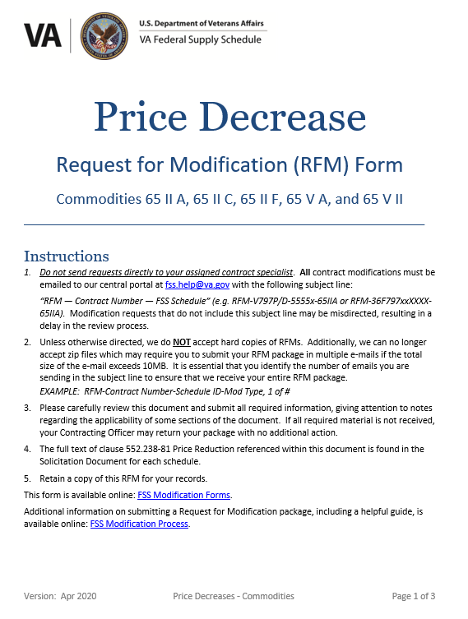
Price Reductions RFM

Slide 34
Effective Dates
552.238-82(c): Effective dates. The effective date of any modification is the date specified in the modification, except as otherwise provided in the Price Reductions clause at 552.238‑81.
The effective dates* for approved modifications is determined as follows:
If the CO approves the request between the 11th and the 25th of the month, the effective date will be the 1st of the following month.
If the CO approves the request between the 26th of the current month and the 10th of the following month, the effective date will be the 15th of the following month.
*The above dates do not apply to some types of modification under Schedule 65 I B.

Slide 35
Electronic File Updates
552.238-82(d): Electronic file updates. The Contractor shall update electronic file submissions to reflect all modifications.
For additional items or SINs, the Contractor shall obtain the Contracting Officer's approval before transmitting changes.
Contract modifications will not be made effective until the Government receives the electronic file updates. Note that VA FSS requires GSA Advantage files to be updated no later than 30 days after the modification effective date.
The Contractor may transmit price reductions, item deletions, and corrections without prior approval. However, the Contractor shall notify the Contracting Officer as set forth in the Price Reductions clause at 552.238-81.

Slide 36
Submission Method
552.238-82(e): Electronic submission of modification requests is mandatory.
Helpful Web Links:
Learn about the process to modify your VA FSS Contract on our RFM Process web page.
Download the most recent RFM forms, including mass modification forms, on our Modification Request Forms web page.

Slide 37
552.238-82: Recap
What does this mean for me?
RFM Forms: Utilize the RFM forms on our web site to ensure compliance with clause criteria and supplementary information required to process your request.
RFM Submission: Submit modifications electronically to fss.help@va.gov using the proper subject line as outlined in the RFM instructions and our web page.
Effective Dates: Be aware of mod effective dates so that you can plan ahead and properly manage your contract.
Electronic Files Updates: Be timely in updating electronic files to ensure clause compliance and proper publication of your contract information.

Slide 38
Resources
FSS Home Page: http://www.fss.va.gov/
VA Schedule Programs: https://www.va.gov/opal/nac/fss/schedules.asp
Request for Modification Process: https://www.va.gov/opal/nac/fss/rfmProcess.asp
Request for Modification Forms: https://www.va.gov/opal/nac/fss/modForms.asp
Trade Agreements: https://www.va.gov/opal/nac/fss/taa.asp
FSS Training Page: https://www.va.gov/opal/nac/fss/training.asp
NAC Contract Catalog Search Tool (CCST): https://www.vendorportal.ecms.va.gov/nac
FSS Helpdesk: fss.help@va.gov

Slide 39
?
QUESTIONS?

