Slide 1
Center For Women Veterans Partners Presentation
ORMDI Road to the Future
Human Resources and Administration/Operations, Security and Preparedness (HRA/OSP), Office of Resolution Management, Diversity and Inclusion (ORMDI)
Presented by Harvey Johnson, Deputy Assistant Secretary
May 5, 2021
#epu

Slide 2


Conscious Inclusion Diversity Equity and Access
#epu

Slide 3

EQUALITY VS. EQUITY
CONSCIOUS EQUITY
“Fair” is not everyone getting the same thing…
Fair is everyone getting what they need to be successful.
#epu

Slide 4

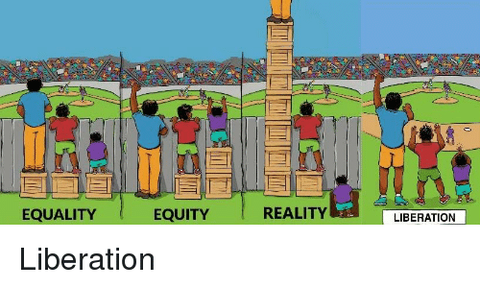
EQUALITY VS. EQUITY 2
CONSCIOUS EQUITY
#epu

Slide 5


“EQUAL OPPORTUNITY IS THE BEDROCK OF AMERICAN DEMOCRACY, AND OUR DIVERSITY IS ONE OF OUR COUNTRY’S GREATEST STRENGTHS…BY ADVANCING EQUITY ACROSS THE FEDERAL GOVERNMENT, WE CAN CREATE OPPORTUNITIES FOR THE IMPROVEMENT OF COMMUNITIES THAT HAVE BEEN HISTORICALLY UNDERSERVED, WHICH BENEFITS EVERYONE.”
- President Joseph R. BidenEqu

Slide 6

HOW WE’LL ADDRESS THESE CHALLENGES
CONSCIOUS EQUITY
Address EO 13988 (Preventing & Combating Discrimination on the Basis of Gender Identity or Sexual Orientation)
  Review all existing orders, regulations, guidance documents, policies, programs and other agency actions by April 2021
  Plan to carry out actions that the agency has identified that prohibit sex discrimination by May 5, 2021
Address EO 13985 (Advancing Racial Equity and Support for Underserved Communities)
  Identify best methods to assist agencies in assessing Equity within six months
  Conduct Equity Assessment Report within 200 days
  Allocate Federal Resources to Advance Fairness and Opportunity Resources and Budget within six months
  Promote Equitable Delivery of Government Benefits and Equitable Opportunities within one year
Address Memorandum Condemning and Combating Racism, Xenophobia, and Intolerance Against Asian Americans and Pacific Islander in the United States
  Issue best practice guidance for advancing cultural competency, language access, and sensitivity towards Asian Americans and Pacific Islanders in the context of the Federal
#epu

Slide 7


#epu

Slide 8
DIGITAL LISTENING DASHBOARDS
ORMDI DIGITAL LISTENING
We harness the power of Social Studio, a digital and social media tool with listening, reporting, and engagement capabilities, to identify trends and conversations relevant to the U.S. Department of Veterans Affairs and ORMDI specifically.
Overall ORMDI
ORMDI Trainings (D&I, EEO), Dispute Resolution,
Reasonable Accommodations, Reprisal, EEO
Diversity, Equity and Inclusion
Race
Gender Identity
Sexual Orientation
Pregnancy & Women’s Rights
Harassment
Disability
Ethics
#epu
8

Slide 9


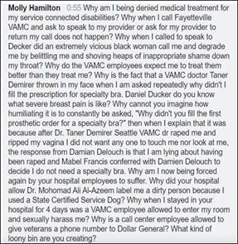

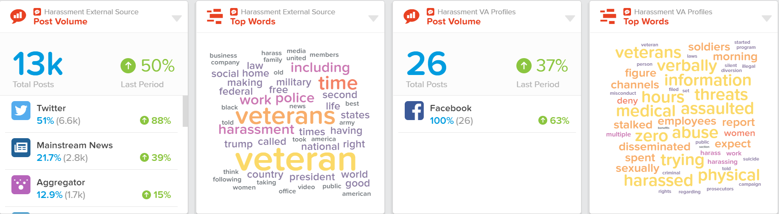
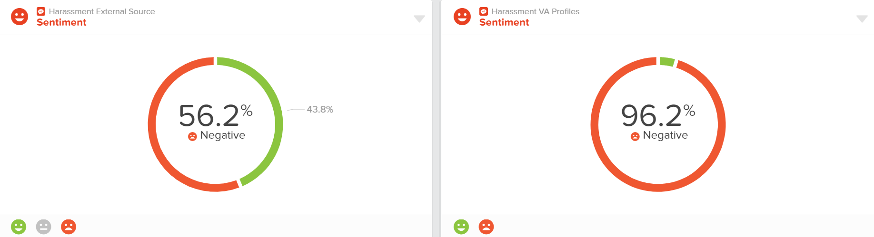
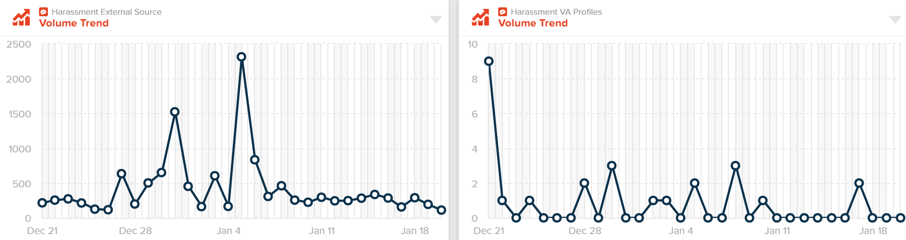
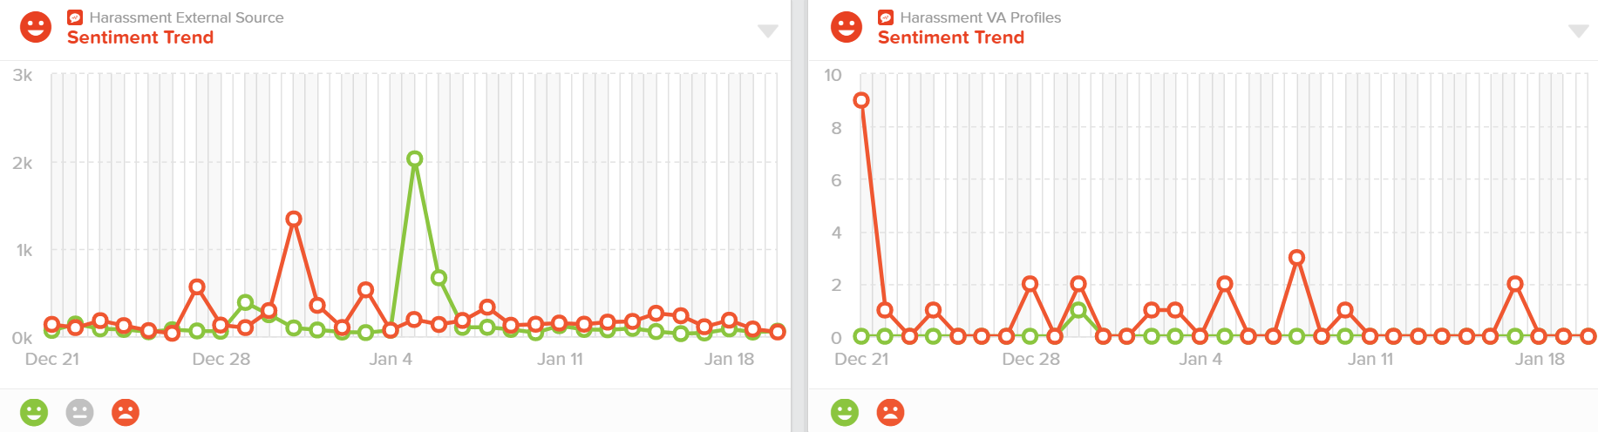
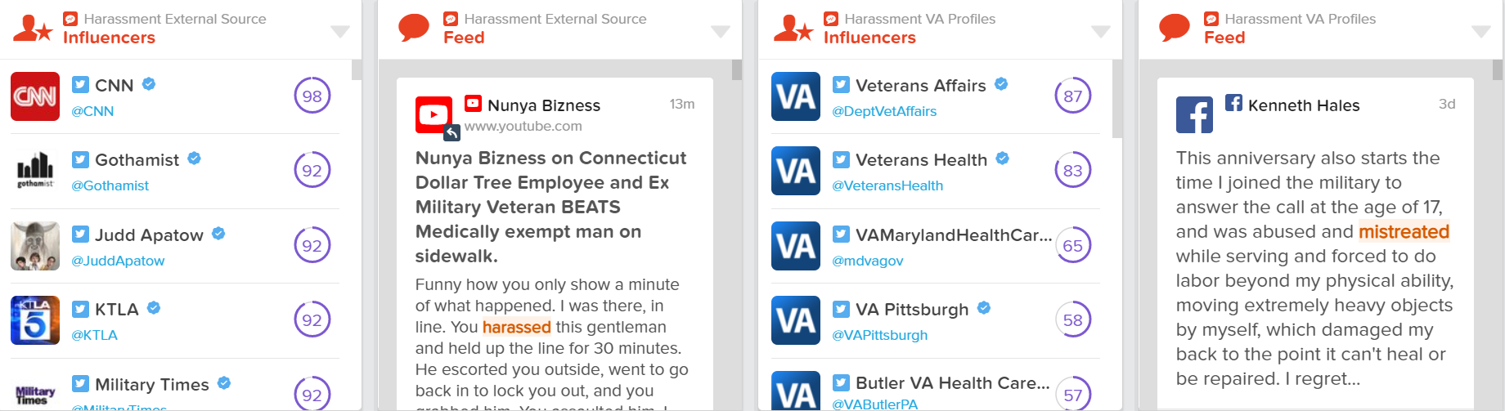
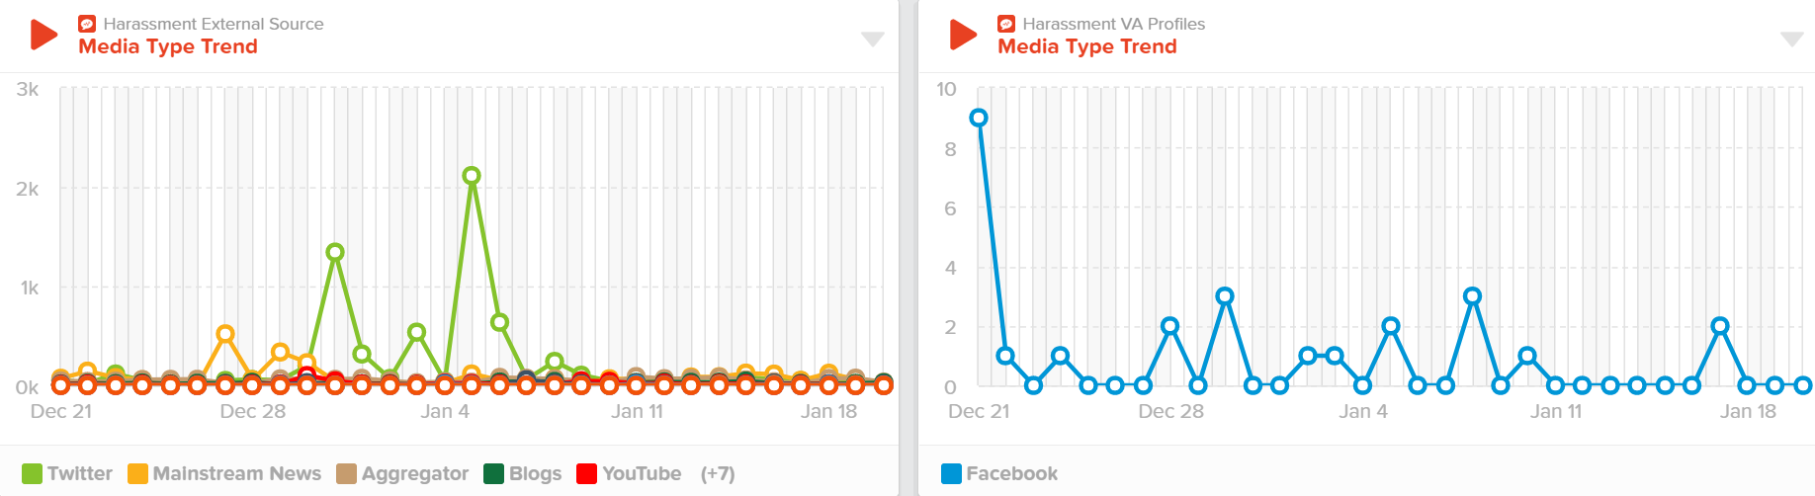
DIGITAL LISTENING IN ACTION
CONSCIOUS EQUITY
Assault Allegation FB Post
Dashboard Monitoring
Incident escalated within 48 hours of original post to:
1. Office of the Chief of Police
2. Office of Public & Intergovernmental Affairs (OPA)
3. Office of Congressional & Legislative Affairs (OCA)
4. VAMC Seattle Leadership
Harassment Dashboard
#epu

Slide 10
THE VA OF THE FUTURE I SEE
CONSCIOUS EQUITY
The VA of the future I see
is the VA I want it to be
I see a VA where 100% of our people
are physically and psychologically safe
I see a VA that’s diverse and fairly represents
those we serve in our communities
I see a VA where not only doctors, but all of us,
find our purpose in helping to heal our Veterans
I see a VA where we’re asking: what about cultural health?
(as much as we’re taking physical temperatures)
I see a VA where millennials and Gen Zers choose us
because we include them; we understand them
I see a VA where employees choose us
because there’s no other rational choice
I see a VA where employees are free
to innovate; not trapped by dogma
I see a VA with less structure, hierarchy, rules;
more openness, inclusion, principles, acceptance
I see a scientific VA; an intelligent VA;
a microcosm of our nation, holding hands
I see a VA that’s evolving, transforming, progressing
into alignment, civility, consciousness
I see us awakening, re-imagining, re-emerging from a slumber
into our role in a new civil rights era
Always, walking in kindness--
we’ve got this.
Inspired by the words & story of
Deputy Assistant Secretary
Harvey W. Johnson
#epu

