Slide 1
Office of Transition and Economic Development (OTED)
Center For Women Veterans Breakfast
Dr. Lawrencia Pierce, Acting Executive Director
March 3, 2021

Slide 2
Agenda
Overview of OTED
How OTED Aligns with VBA Priorities
The Transition Journey with OTED
Easing the Journey
Women’s Health Transition Training (WHTT)
Economic Development Initiatives (EDI)
Questions

Slide 3
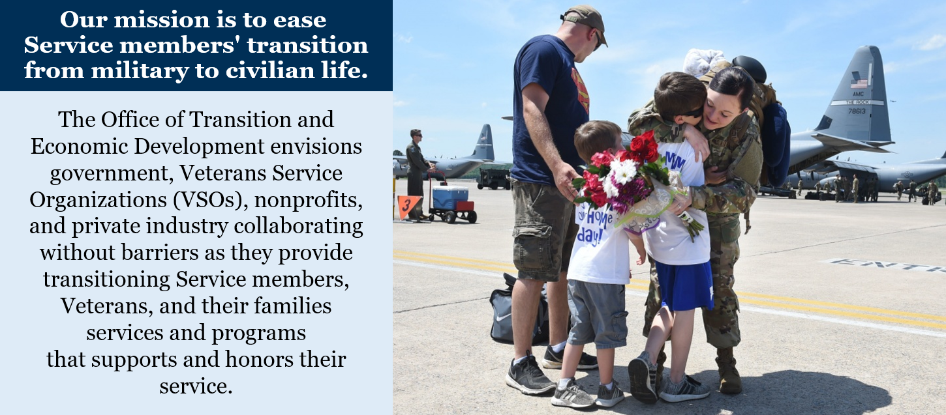
Office of Transition and Economic Development (OTED)

Slide 4
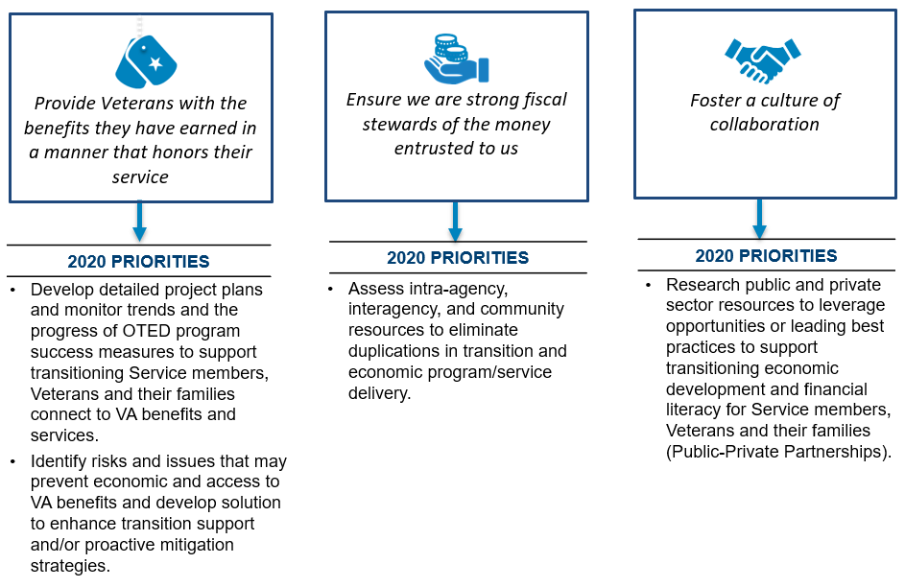
How We Align With VBA Priorities

Slide 5
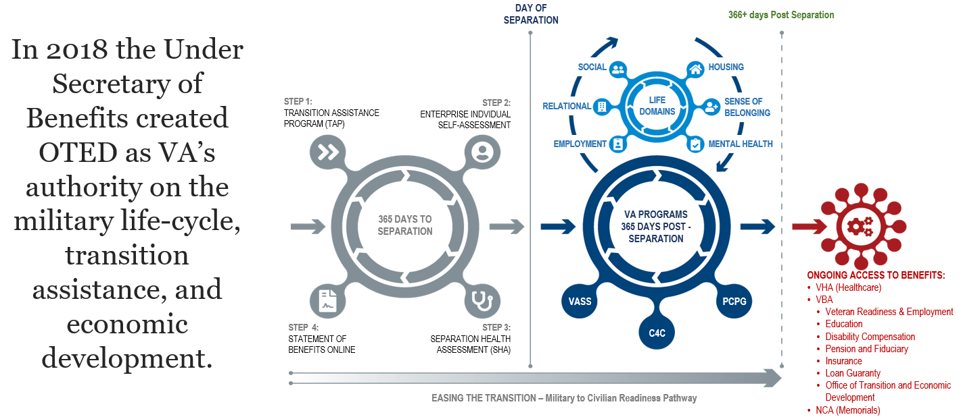
The Transition Journey with OTED

Slide 6
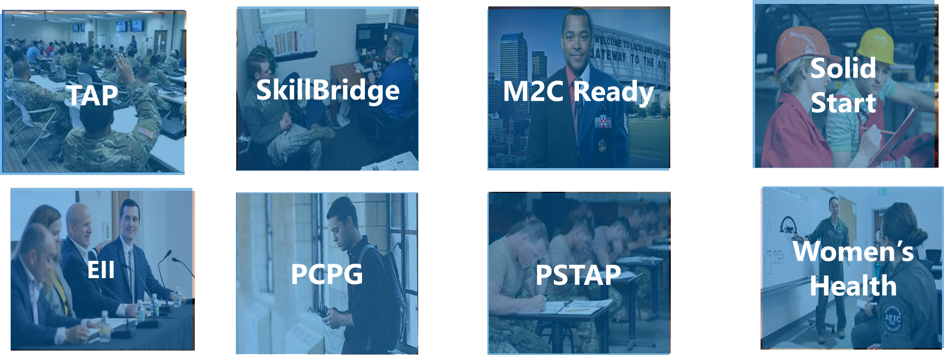
Easing the Journey

Slide 7
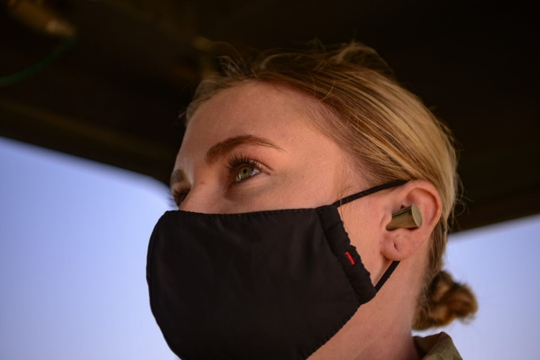
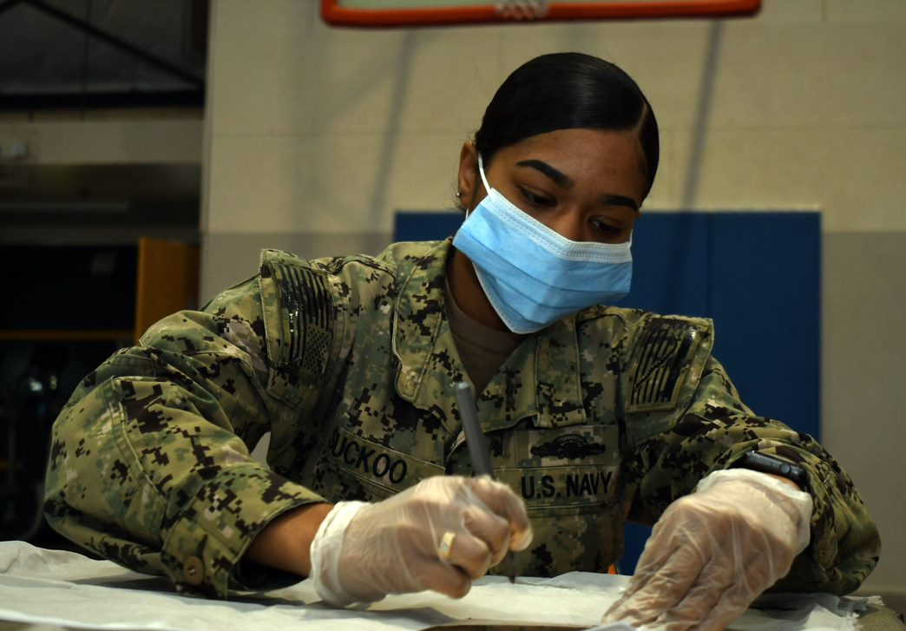
Women’s Health Transition Training (WHTT)
Women’s Health Transition Training (WHTT) focuses solely on addressing women Veterans, gender-specific health care needs.
Per an implementation plan approved by the Joint Executive Committee, OTED has assumed oversight and implementation of WHTT.
As of FEB 22, an online, self-paced course is now available at TAPevents.org, the learning management system that hosts all of VBA’s transition-related courses.
This four-hour course, developed in collaboration with VHA and the Defense Department, helps participants understand VA’s health care services, enroll in VA health care as quickly as possible after separation and prepare to manage post-military health care.
Notes:
In early 2021, OTED assumed responsibility for program management of the Women’s Health Transition Training course. Through feedback from participants of VHA’s pilot, we know that transitioning Servicewomen and women Veterans find the course valuable for planning for their post-military health care. The training is meant to complement the VA Benefits and Services course, is now available as a self-paced, eLearning course.
The training is meant to complement the VA Benefits and Services course and we are thrilled to share with you that as of FEB 22, WHTT is now available as a self-paced, eLearning course.
The transition to OTED expands the course so that any transitioning Servicewoman or recently separated woman Veteran can learn more about what is offered through VA Health…Anytime. . . Anywhere!
The course is available to all Servicewomen and recently separated women Veterans but is encouraged for Servicewomen who will be transitioning to civilian life or the reserve components within the next calendar year.

Slide 8
Women’s Health Transition Training Content Overview
PHASE 1
PHASE 2
PHASE 3
PHASE 4
PHASE 5
Shift from Active Duty
Transition to civilian life
Military Health System (MHS)/VA crosswalk
Understanding the VA
VA organizational structure
Designated women’s health care roles and clinic models
Layout and services at VA women’s health clinic
Finding a VA facility
Available Women’s Health Services
VA whole-health approach, including role of the Patient Aligned Care team (PACT)
VA health care services and benefits
Health-related challenges faced by women Veterans
Enrolling in VA
Eligibility for VA health care services
Enrollment timeline
Application process
Tools and resources for managing health care
Transition Assistance
Local and national organizations for support during and after transition
Estimated total runtime: 2.5 hours
Notes:
The online course runs about two and a half hours, but participants can complete the course in multiple sittings, pausing and resuming as needed.
The course consists of five phases that walk women through the transition to civilian life, particularly in the context of health care.
Women learn about the breadth of the VA health system and the women-focused services it offers. They learn about eligibility and enrollment in VA health care and are encouraged to engage with other transition-related resources.
This content is particularly relevant for Servicewomen transitioning from active duty within the next year, but any Servicewoman or woman Veteran curious about VA can learn something from this course.
OTED appreciates the assistance from CWV in our efforts to market the launch of the eLearning version.

Slide 9
Former Women’s Health Transition Training participant e
Definitely took out the mystery of everything … it’s good to know what options are out there and what I can expect.
­—
Notes:
As this former participant in VHA’s pilot notes, a major benefit of this training is the fact that it lays out women’s options and removes some of the guesswork as they plan for their future health care.

Slide 10
Economic Development Initiatives (EDI) Vision & Goals
Vision – “Assemble VA resources as catalyst to stimulate economic opportunity in distressed communities w/veteran populations”
Goals
Provide Veterans access to benefits and services to promote financial security and contribute to the community
Foster a culture of collaboration with the VA, communities and Veterans to sustain long-term outcomes
Identify and connect Veterans with local employment opportunities
Invigorate economies of local communities
Tailored with Veteran experience to the community and matched EII to the Veteran/community needs
Events provide Veterans with the benefits they are entitled by ensuring Veterans are connected to VBA, VHA and NCA benefits/services, community resources and interagency programs and services to enhance overall well-being.
Events can include – Hiring Fairs, Benefits Fairs, Townhall Meetings, Community Events, Roundtables, Claims Clinics, and tailored workshops.
EIIs are 3-year commitments with three follow ups to act as a community multiplier by leveraging off the success of Veterans to enhance economic stability in the community.

Slide 11
Prudential Memorandum of Understanding Highlights
Benefits to transitioning Service members, Veterans, and their family members
Provide Financial Wellness education, tools and solutions by:
Platform to provide individuals with what they need to create financial wellness by giving beneficiaries tools to help them efficiently manage their money, achieve their goals and manage against financial risk.
Sample site: Military Women’s Memorial: www.prudential.com/womensmemorial
Opportunities to participate in virtual and in-person workshops at Economic
Investment Initiatives
VBA Partners
Veterans Readiness & Employment (VR&E) – Mr. Timothy Johnston
Loan Guarantee (LGY) - Mr. Raleigh Contreras

Slide 12
Questions

Slide 13
hankThank You s

