Slide 1
VA Women’s Health Communications Updates Catherine Rice
February 2, 2022

Slide 2
Women’s Health Communications Update
February Heart Health Campaign
March Osteoporosis Campaign
March Women’s History Month Campaign
Women Veterans Call Center Updates
Campaign calendar

Slide 3
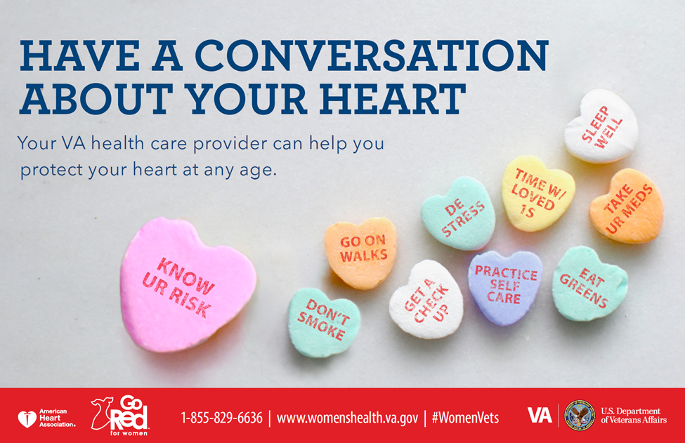
February Heart Health Campaign

Slide 4
February Heart Health Campaign
Risk factors:
Smoking (women have an even greater risk for heart disease if they smoke, compared to men)
Being overweight
A sedentary lifestyle (not moving enough throughout the day)
High blood pressure
Too much stress in your life
History of preeclampsia or diabetes while pregnant
Having PTSD, depression, or experiences of trauma
Having sleep apnea and/or not getting good sleep
Increased stress due to some mental health concerns like PTSD and depression, and experiences of trauma can increase heart disease risk for women of all ages, including younger women.

Slide 5
February Heart Health Campaign 2
Protective factors:
Not smoking
Getting regular exercise (i.e., going on walks)
Eating a healthy diet rich in nutrients (such as green leafy vegetables)
Getting good sleep
Spending time with loved ones
Reducing stress in your life and practicing self-care
Trying some Whole Health approaches like yoga, tai chi, mindfulness, or meditation
Visiting your VA health care provider to get your blood pressure, cholesterol, and blood sugar checked.
Taking your prescribed medications

Slide 6
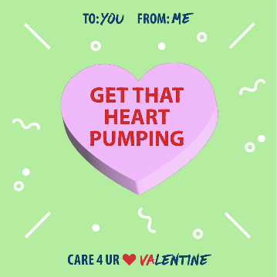
February Heart Health Campaign 3

Slide 7
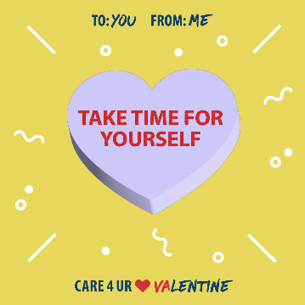
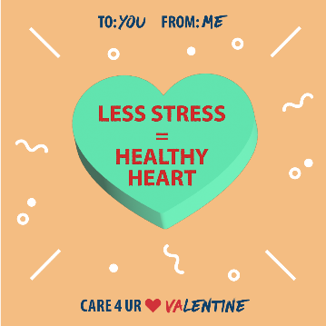
February Heart Health Campaign 4

Slide 8
February Heart Health Campaign 5
VA resources for heart health:
VHA Women’s Health Heart Health Resources: Information and resources to help women Veterans learn about the risk factors for and symptoms of heart disease and steps they can take to lower their risks.
VA Tobacco Cessation Resources: VA offers a variety of resources to help Veterans quit tobacco use. Tobacco cessation is one way to help women Veterans improve their heart health.
VA Mindfulness Coach App: Mindfulness has been shown to reduce stress, a major risk factor for heart disease. The Mindfulness Coach helps Veterans and service members practice mindfulness techniques to manage their stress levels.
MOVE! Weight Management Program: Physical activity and maintaining a healthy weight can help women Veterans reduce their risk of heart disease. The MOVE! Weight Management Program encourages and offers resources for healthy eating behaviors, physical activity and exercise, and weight loss.

Slide 9
March Osteoporosis Campaign 6
Notes:
Encourage women to make their bones as strong as their spirit – talk to their provider about their risks (including medications that can weaken your bones) and when to get a DEXA scan which is recommended at age 65.

Slide 10
Women’s History Month Campaign

Slide 11
Women Veterans Call Center
Notes:
How to reconnect with VA health care if they applied a long time ago but never used their benefits
How to get connected with their local women’s health contact including their local Maternity Care Coordinator or Women Veterans Program Manager who will assist in coordinating all the services they need.
How to find out what they are eligible for (including general questions about disability ratings) and other VA benefits like employment, education, and home loans
How to refill a prescription or make an appointment

Slide 12
Campaign Calendar
Month in 2022 | Health Campaign | Culture Campaign
April | Pre-conception Health: “Begin your journey to a healthy pregnancy with VA”
May | Pelvic Health - Tie into maternal health | Gender-based Harassment (TP: Men Veterans)
June | LGBTQ+ Health
July | Menopause | Gender-based Harassment (TP: Staff and Providers)
August | Preventive Health Checklist - Include Immunizations and annual exams
September | Substance Use and Recovery - Include recovery is possible themes | Eligibility and Enrollment - Integrate Best Care Anywhere
October | Breast Cancer Awareness
November | Chronic Pain - Incorporate MSK, headaches, chronic pain syndromes | Veterans Day / Month - "Recognize all women who have served - elevating women into larger VA Veterans Day theme"
December | Stress Support

Slide 13
Contact Us
VA Women’s Health Creative Services Team
VACOVHAWHCS@va.gov

