Slide 1
Addressing Women Veteran Homelessness: VHA Homeless Resources & Eviction Moratorium
Dina Hooshyar, MD MPH
Director, National Center on Homelessness among Veterans
VHA Homeless Programs Office
Dina.Hooshyar@va.gov
VA Center for Women Veterans’ National Partners Meeting September 1, 2021

Slide 2
Topics Overview
VHA Homeless Programs
Understanding Evictions
Eviction Moratorium

Slide 3
VHA Homeless Programs
Notes:
Shawn

Slide 4
The Homeless Service System
Doubled
Up
Rapid Resolution Intervention
Own
Place
*Entry into Homelessness
Permanent Housing
Traditional
Prevention
Diversion
Rapid Exit
Rapid Re-Housing,
Permanent Supportive Housing, with Family
and/or Friends, Self-Resolve, Other
*Could be a shelter, outreach engagements at drop-in center, VA, and wherever people are most likely to present asking for help.
Notes:
Shawn

Slide 5
VHA Homeless Programs
Outreach, Engagement, Assessment, and Referral
Health Care for Homeless Veterans (HCHV) Outreach
Community Resource and Referral Center (CRRC)
National Call Center for Homeless Veterans (NCCHV)
Residential Services
HCHV Contract Residential Services (CRS)
HCHV Low Demand Safe Haven (LDSH)
Grant and Per Diem (GPD) Transitional Housing
Permanent Housing
Housing and Urban Development-VA Supportive Housing (HUD-VASH)
Supportive Services for Veteran Families (SSVF)
Services
Justice Involved Veterans
Veterans Justice Outreach (VJO)
Health Care for Reentry Veterans (HCRV)
Homeless Veteran Community Employment Services (HVCES)
Homeless Patient Aligned Care Teams (HPACT)

Slide 6
Women Veteran Homelessness Annual Homeless Assessment Report, Point-in-Time, 2013 – 2020
Year | Total Women Homeless Sheltered Women Unsheltered Women Veterans Homeless Veterans Homeless Veterans |  | Sheltered Women Homeless Veterans |  | Unsheltered Women Homeless Veterans
2013 | 4,339 | 7.8% | 2,932 | 8.4% | 1,407 | 6.8%
2014 | 4,647 | 9.4% | 2,921 | 9.1% | 1,726 | 9.8%
2015 | 4,338 | 9.1% | 2,708 | 8.6% | 1,630 | 10.0%
2016 | 3,328 | 8.4% | 2,208 | 8.4% | 1,120 | 8.6%
2017 | 3,571 | 8.9% | 2,071 | 8.4% | 1,500 | 9.8%
2018 | 3,219 | 8.5% | 1,811 | 7.8% | 1,408 | 9.7%
2019 | 3,292 | 8.9% | 1,798 | 7.9% | 1,494 | 10.4%
2020 | 3,126 | 8.4% | 1,662 | 7.5% | 1,464 | 9.6%
U.S. Department of Housing and Urban Development Annual Homeless Assessment Report to Congress
Percentages reflect total homeless Veteran population in each category.

Slide 7
Women Veterans Served by VA Homeless Programs
VA Homeless Program | Fiscal Year 19 |  | Fiscal Year 20 |  | Fiscal Year to Date 21
 | # | % | # | % | # | %
GPD | 1,889 | 6% | 1,560 | 6% | 1,110 | 6%
HCHV-CRS/SH | 758 | 5% | 574 | 5% | 387 | 5%
HCHV-CM | 983 | 9% | 982 | 9% | 938 | 10%
HCHV-Outreach | 16,174 | 12% | 14,156 | 12% | 10,820 | 12%
HCRV | 246 | 3% | 180 | 2% | 144 | 3%
HPACT | 944 | 5% | 929 | 5% | 976 | 6%
HUD-VASH | 16,990 | 12% | 16,495 | 12% | 14,503 | 12%
SSVF | 9,473 | 13% | 10,197 | 13% | 8,869 | 13%
VJO | 3,429 | 7% | 3,140 | 7% | 2,558 | 8%
Total | 35,701 | 11% | 32,736 | 11% | 29,162 | 12%

Slide 8
Understanding Evictions

Slide 9
Tracking Evictions
No national survey tracks what proportion of evicted people become homeless.
No national survey tracks what proportion of unsheltered/sheltered homeless population were recently evicted.
Courts do not track what happens to renters after they receive eviction notices.
Number of evictions vary per locality depending on housing supports and household characteristics.
Study findings of the percentage of people who become homeless after being evicted range from 25% to 62%.
Princeton University’s Eviction Lab: The Eviction Lab;
Portland State University: Homelessness Research & Action Collaborative

Slide 10
One Example of Eviction Rates
Legal records of court-ordered evictions in Milwaukee County (600,000 population) from January 1, 2003 to December 31, 2007
Landlords evicted 15,983 adults and children from 5,995 units in an average year
46% from black neighborhoods
30% from mixed neighborhoods
20% from white neighborhoods
4% Hispanic neighborhoods
Women: 60% of evicted tenants
Desmond, M. (2012). Eviction and the reproduction of urban poverty. The American Journal of Sociology, 118, 88–133.

Slide 11
Milwaukee County Example continued
Evicted Tenants
Desmond, M. (2012). Eviction and the reproduction of urban poverty. The American Journal of Sociology, 118, 88–133.

Slide 12
Milwaukee County Example: Potential Reasons for Findings
Black women more likely to be the named renter on a lease
In Milwaukee, half of working-age black men are out of work
Unemployment and criminal records among these black men are barriers to renting
At same time, black women have less secure income
In 1999: 81% of employed black men in Milwaukee worked full-time vs. 75% of employed black women
In 1999: median annual income for full-time workers in Milwaukee was $30,174 for black men vs. $24,437 for black women.
Difference = year’s rent for a one-bedroom apartment at Milwaukee’s 1999 fair market rent
Single-mother households:
Compose 58% of all African-American households in Milwaukee
Inconsistent child support
Need larger (i.e., more expensive housing) to accommodate their children
Desmond, M. (2012). Eviction and the reproduction of urban poverty. The American Journal of Sociology, 118, 88–133.

Slide 13
A Contemporary Example of Housing Insecurity
February 9, 2021: Census Household Pulse survey of social and economic impact of COVID-19 pandemic
89,000 Oregon households owe back rent
200,000 have little to no confidence in their ability to pay next month’s rent
More than half included households with children
Oregon Renters Survey
Community Alliance of Tenants has a hotline which receives calls from around the state of Oregon
460 callers completed the survey from mid-March 2020 through July 2020
Woman headed household: 37%
Extremely low income: 52% (below 30% Area Median Income)
35% of all respondents owe back rent
56% of black, indigenous, and people of color respondents owe back rent
53% of respondents have cut back on food and medications to pay rent
84% of respondents are experiencing mental or physical stress due to housing insecurity
Portland State University: Homelessness Research & Action Collaborative Cost of Oregon Evictions Report (3).pdf (pdx.edu)

Slide 14
Risk Factors for Evictions
Strength of Association with Eviction
Physical & Mental Health Conditions
Substance Use
Sociodemographic & Household Characteristics
Financial Hardship
Financial Hardship: Unstable income, job loss, and inability to pay rent, bills, and other debt payments
Sociodemographic & Household Characteristics: Larger household size & greater number of children
Tsai, J., & Huang, M. (2019). Systematic review of psychosocial factors associated with evictions. Health & Social Care in the Community, 27(3), e1-e9.

Slide 15
Financial Health: Veterans
2017 American Community Survey Public Use Microdata Sample
Civilian population 17 years and older living in the United States and Puerto Rico
Census Bureau’s definition of poverty
Money income before taxes and does not include capital gains or noncash benefits (such as public housing, Medicaid, and food stamps).
Dollar value thresholds varies by family size.
2017: 1 person household = $12,060 (except in Alaska = $15, 060; Hawaii = $13,860)
How the Census Bureau Measures Poverty

Slide 16
Poverty Level Distribution: 2017
Percent
Percent
9.4%
6.4%
VA National Center for Veterans Analysis and Statistics. Profile of Veterans: 2017

Slide 17
Profile of Veterans in Poverty: Women in 2017
Percent
12.5%
11.8%
11.5%
11.4%
9.7%
8.2%
3.3%
American Indian/Alaska Native
Native Hawaiian/Other Pacific Islander
VA National Center for Veterans Analysis and Statistics. Profile of Veterans in Poverty: 2017

Slide 18
Profile of Veterans in Poverty: Men in 2017
Percent
12.7%
10.9%
8.5%
7.8%
8.5%
5.5%
6.2%
American Indian/Alaska Native
Native Hawaiian/Other Pacific Islander
VA National Center for Veterans Analysis and Statistics. Profile of Veterans in Poverty: 2017

Slide 19
Median Earnings of Year-Round Full-Time Workers
$40,939
“Earnings” refer to salary, wages, and self-employment income. “Year-Round Full-Time” (YRFT) refers to employment of 50 or more weeks per year and 35 or more hours per week. Median earnings are calculated for YRFT employed population with earnings greater than zero and less than 65 years of age.
VA National Center for Veterans Analysis and Statistics. Profile of Veterans: 2017

Slide 20
Median Personal Income
$31,810
“Income” refers to the total of earnings and other sources of income such as pension, Supplement Security Income, public assistance, etc. Median income is calculated for the total population with personal income greater than zero.
VA National Center for Veterans Analysis and Statistics. Profile of Veterans: 2017

Slide 21
Eviction Moratorium

Slide 22
Eviction Moratorium Key Points
Helping Veterans exit homeless and remain in stable housing remains one of VA’s top priorities.
VA is committed to helping Veterans access resources to prevent them from losing their housing due to the expiration of national and local eviction moratoria and other COVID-19-related renter protections.
The federal government is conducting an all-out push to ensure tenants and landlords take advantage of the historic funding for emergency rental assistance to help cover rent, utilities, and other housing costs to keep people in their homes.
Thanks to the American Rescue Plan, federal rental assistance is reaching renters behind on housing costs, as well as landlords who have struggled during the pandemic. These programs are run locally, and emergency rental assistance is available across the country.

Slide 23
Key Resources to Help At-Risk Veterans
The Consumer Financial Protection Bureau has developed an online tool to find information about rental assistance resources. The Rental Assistance Finder help renters and landlords find their local program and apply for assistance.
The National Call Center for Homeless Veterans is standing by to assess each Veteran’s unique situation and identify the best options to help them secure stable housing, pay their rent, avoid foreclosure or eviction, and access food insecurity assistance.
With its unique blend of rapid rehousing and homeless prevention solutions, VA’s Supportive Services for Veteran Families (SSVF) Program will continue to be a vital resource to help Veterans during housing crises.
For Veterans facing foreclosure due to the COVID-19 pandemic, VA’s Partial Claim Payment program (VAPCP) temporarily defers repayment of mortgage principal to help eligible Veterans remain in their homes.
Veterans who have fallen behind or are at risk of falling behind on their mortgage payments should contact VA’s Home Loan Center at (877) 827-3702 for help.

Slide 24
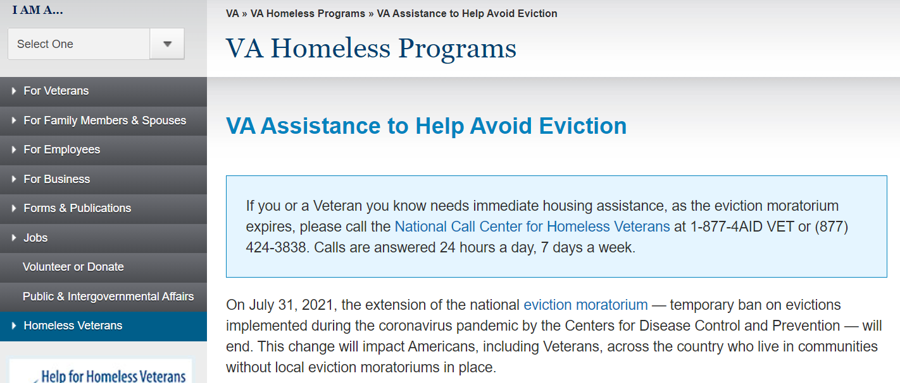
One Stop for Resources
www.va.gov/homeless/HousingResources/

Slide 25
Question and Answer
Notes:
Done!

