Slide 1
Paralyzed Veterans of America
Paralyzed Veterans of America
Serving Veterans with SCI/D
Presented by: Julie Howell; Associate Legislative Director

Slide 2
Who We Are
33 Chapters in the US & Puerto Rico
70 National Service Offices
More than 16,000 members
Founded in 1947
Congressionally chartered
Membership for spinal cord injury or dysfunction (SCI/D)
Traditional spinal cord injuries, ALS, MS

Slide 3
What We Do
Provide Caregiver Support
Legal Services
Medical Services
SCI Centers
National Service Officers
Research and Education
Veteran Career Program
Government Affairs and Legislation
Advocacy Services
Transportation, employment, ADA
Adaptive Sports Program
Wheelchair games w/ VA

Slide 4
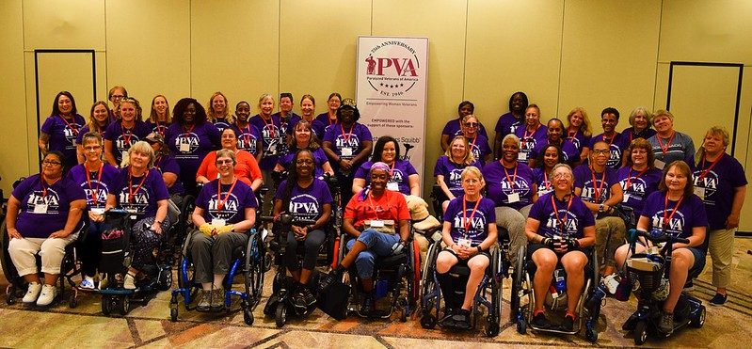
Empowering Women Veterans
2021 WVER Event, Tempe, AZ
Notes:
PVA has approximately 1,300 women members
Anita Bloom Committee
Women Veteran Empowerment Retreat (WVER)

Slide 5
Legislative Priorities for Women Veterans
Increased access at VA for women veterans living w SCI/D
MAMMO Act (Signed into law in June)
Improve access for Assisted Reproductive Technology (ART)
HR 1957 – Veterans Infertility Treatment Act
Improved support for MST survivors
HR 5666/ S 3025 – Servicemember & Veteran Empowerment & Support Act

Slide 6
PVA fights to increase and ensure access for catastrophically disabled Veterans
PVA fights to increase and ensure access for catastrophically disabled veterans while empowering veterans to live a life with dignity and purpose. We are a small but mighty organization that is dedicated to the basic human rights of all people living with a disability.

