Slide 1
The Veterans Health Administration Response to Military Sexual Trauma Jessica Keith, PhD Clinical Programs & Practices Lead Military Sexual Trauma (MST) Support Team Office of Mental Health and Suicide Prevention Department of Veterans Affairs Presentation for The Center for Women Veterans April National Partners Meeting April 6, 2022

Slide 2
Topics for Today’s Talk
Key elements of the Veterans Health Administration (VHA) response to military sexual trauma (MST)
MST-related health care services available through VA
VHA’s MST-Related outreach campaign for Sexual Assault Awareness Month (SAAM) this April
VHA’s MST-related resources and points of contact who can assist with accessing MST-related care

Slide 3
Military Sexual Trauma
Military sexual trauma (MST) is the term used by VA to refer to experiences of sexual assault or sexual harassment that occur during a period of military service
Can occur on or off base
Can occur while on or off duty
The identity of the perpetrator(s) does not matter – may be a fellow Service member or a civilian
The reason for the sexual assault or harassment also does not matter (for example, “hazing”)

Slide 4
Military Sexual Trauma 2
Any sexual activity in which someone is involved against their will
Someone may be:
Physically forced into participation
Unable to consent to sexual activities (e.g., intoxicated, asleep)
Pressured into sexual activities (e.g., with threats of consequences or promises of rewards)
Can involve:
Threatening, offensive remarks about a person’s body or sexual activities
Threatening and unwelcome sexual advances
Unwanted touching or grabbing
Unwanted sexual messages or texts or sharing of intimate images and videos without permission
Oral sex, anal sex, sexual penetration with an object and/or sexual intercourse
Compliance does not mean consent

Slide 5
MST is an Experience, Not a Diagnosis
Although some MST survivors may have a diagnosed mental or physical health condition related to their experience of MST, MST itself is not a diagnosis or a mental health condition

Slide 6
Who Experiences MST?
When screened by a VA health care provider, about 1 in 3 women and 1 in 50 men report experiencing MST
Although women are more likely to experience MST than men, because of the larger number of men in the military, there are significant numbers of men and women who experienced MST
People of all backgrounds have experienced MST, including:
All genders
All ages
All ranks, branches, and eras of service
All racial and ethnic backgrounds
All sexual orientations
All physical sizes and abilities

Slide 7
MST and Gender
People of all genders struggle with many of same issues related to MST, but there are also some important gender differences:
Women
More likely to experience MST and to experience it concurrent with sexism
Often face pressure to prove their strength and power in a traditionally male-dominated military environment
May feel increased stress after MST related to gender role expectations in the military, blame self or downplay impact of the MST as a result, or choose to leave military service early
Men
May view experiencing MST as a violation of traditional gender norms that men should be strong and aggressive
May question masculinity or sexual orientation and view the experience as evidence that they are weak
May be less likely to report MST and to be perceived as less deserving of assistance when they do

Slide 8
MST and Individual Differences
Personal and cultural variables play important roles in how individuals make sense of their experiences, view suffering and recovery and access help after MST
Gay, lesbian, bisexual, transgender and gender non-conforming individuals
May experience fewer sources of support following MST, especially as they may have needed to hide their identity within a military context
For some, MST may have been committed by the perpetrator(s) to victimize them due to their perceived sexual orientation or gender identity, and this can impact self-identify, feelings of safety and fear about seeking support
Racial, ethnic, sexual and/or gender minorities
Experiences of MST occur within a larger context of other difficult and discriminatory experiences, which can impact their experience of trauma and recovery

Slide 9
The Impact of MST
There is no one way that people respond to MST
Many survivors experience difficulties afterwards
PTSD, depression, anxiety disorders and substance use disorders are common mental health difficulties experienced
MST is also linked to increased risk of suicidal ideation, suicide attempts, and death by suicide
Related physical health concerns include gastrointestinal difficulties, chronic pain, obesity and weight loss, liver disease, chronic pulmonary disease, and sexual functioning difficulties
MST can be associated with difficulties in core areas of functioning, such relationships, employment and housing
But also… survivors are remarkably resilient after experiencing trauma, and many who experienced MST have no diagnosis or long-term difficulties

Slide 10
Key Elements of VHA’s Response to MST
Free MST-related health care, with expansive eligibility
Full continuum of MST-related health care services
MST Coordinator at every VA health care system, to serve as a point person for MST-related issues
Universal screening program
National MST Support Team, to promote best practices related to MST
Education and training for staff
Outreach and other access to care initiatives

Slide 11
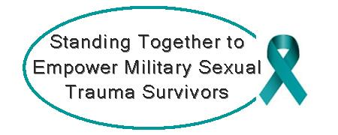
Premises Underpinning VHA’s Response to MST
Recovery and healing are possible
Different survivors have different needs
There are many paths to recovery
Choice matters
Treatment and recovery after MST is similar in many ways to recovery from other forms of trauma, but there can be unique aspects
Experiences of MST and with previous help-seeking affect how survivors view and experience systems and sources of help
Inclusivity related to gender and other identity variables is critical

Slide 12
Putting Premises Into Practice
Address barriers to speaking up and accessing help
Make MST visible, with MST-informed and MST-sensitive efforts
Ensure gender and other inclusivity in materials
Ask proactively about MST
Make information widely available
No wrong door for getting help
Ensure a broad range of staff — both clinical and……………………………… non-clinical — are informed about MST
Offer choice of a variety of services and ………………………. models to meet a variety of needs and preferences
Meet survivors where they’re at, knowing their needs and preferences may change over time

Slide 13
Eligibility for VHA’s MST-Related Services
Eligibility for MST-related health care is expansive
Veterans and most former Service members with an Other Than Honorable (OTH) or uncharacterized discharge are eligible
There are no length of service or income requirements, and individuals may be able to receive MST-related care even if they are not eligible for other VHA care
Filing a claim for service connection (VA disability compensation) is not required
Individuals do not need to have reported their experiences of MST at the time or have other documentation that the MST occurred
Individuals do not need to initiate MST-related care within a certain time period after their experiences of MST or separation from service
Current Service members can receive services related to MST, although for some services, a Department of Defense referral may be required

Slide 14
Free MST-related Services
VHA provides all MST-related care free of charge
Treatment is provided for both mental health and physical health conditions related to the experience MST
Outpatient, inpatient, and residential care, including medications
An individual’s treatment needs determine length of treatment; there are no a priori time limits

Slide 15
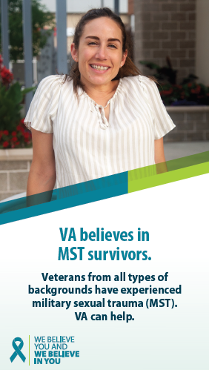
Full Continuum of MST-Related Health Care
MST-related care is available at all VA health care systems
Treatment for physical health conditions is provided through VHA’s general and specialty medical clinics at VA medical facilities
Treatment for mental health conditions is provided at VA medical facilities via a range of service delivery models
Outpatient MST-related counseling is also available at Vet Centers

Slide 16
Outpatient Mental Health Services
MST-related outpatient mental health services are available at every VA medical center (VAMC) and many community-based outpatient clinics (CBOCs)
Services are organized differently at different facilities and available regardless of whether the facility has a specific MST clinic or program
Services include psychological assessment and evaluation, psychiatry, and individual and group psychotherapy, including cognitive-behavioral and other evidence-based psychotherapies
General mental health and specialty services are available for difficulties such as PTSD, substance use disorders, depression and homelessness
Whole Health services (e.g., health coaching, art and recreational therapies, yoga), Chaplaincy and peer support services are available

Slide 17
Vet Center Services
Outpatient MST-related counseling is also available at Vet Centers
Vet Centers are community-based facilities that provide counseling, support, and advocacy services for Veterans and current Service members; they do not provide medical care
Individual and group counseling, marital and family counseling, referral for benefits assistance, liaison with community agencies and substance use information and referral is available

Slide 18
Residential and Inpatient Mental Health Services
For individuals who need more intensive treatment, many VA medical centers have Mental Health Residential Rehabilitation and Treatment Programs
Provide treatment for mental health issues such as PTSD and substance abuse, as well as homelessness and vocational rehabilitation services
Target rehabilitation, recovery, health maintenance, improved quality of life and community reintegration
A number focus specifically on MST/sexual trauma or have specialized MST/sexual trauma tracks
VA medical centers also have mental health inpatient programs available for acute care needs
Focus is on addressing psychiatric emergencies, promoting stabilization or facilitating medication adjustment

Slide 19
Gender-Sensitive Care
VA facilities must accommodate individuals’ requests for a provider of a particular gender when clinically indicated
All outpatient, inpatient, and residential programs must have environments that can accommodate both women and men with safety, privacy, dignity and respect
VHA has both single-gender and mixed-gender programming available
Specific offerings vary from facility to facility, based on local demand and resources
Women’s only residential programs available serve as national resources, not just programs for the local facility

Slide 20
How to Access MST-Related Care
No wrong door
To access care at VA medical facilities, individuals can:
Contact their local VA medical facility and ask to speak to the MST Coordinator
Talk to their existing VA health care provider about a referral
To access care at Vet Centers, individuals can contact their local Vet Center directly
Find a list of VA medical facilities and Vet Centers at va.gov

Slide 21
VHA MST Coordinators
Every VA medical facility has an MST Coordinator
Serves as a point person for MST-related services at the facility
Responsible for ensuring appropriate services are available, addressing systems issues that might serve as barriers to care, engaging in outreach and ensuring MST-related staff education occurs
Usually a mental health clinician who provides some clinical care, but the MST Coordinator is not the only clinician providing MST-related mental health care at the facility
The MST Coordinator is the best point of contact for assistance in accessing MST-related care or for answering questions about services at the facility
MST Coordinators work closely with local Vet Centers and can facilitate referrals as needed

Slide 22
Universal MST Screening
Recognizing that many survivors of sexual trauma do not disclose their experiences unless asked directly, it is VA policy that all former Service members seen for health care are screened for experiences of MST
Those who report having experienced MST are offered a referral for further assessment and/or treatment
Universal screening is a key way to:
Ensure individuals are aware of and as needed connected to services available to assist in their recovery from MST
Ensure providers are aware of an important aspect of their patient’s history
Convey VA’s awareness of and sensitivity to the issue of MST

Slide 23
VHA’s National MST Support Team
VHA’s national MST Support Team in the VHA Office of Mental Health and Suicide Prevention is another core component of VHA’s response to MST
Established in 2006
Coordinates and expands national MST-related education, training and outreach
Conducts national MST-specific monitoring
Provides consultation and technical assistance to facilities to promote policy implementation and best practices in care
Provides assistance to VA Central Office on MST-related policy issues, Congressional requests and stakeholder inquiries

Slide 24
Staff Education and Training
MST is associated with a broad range of health problems, so it is essential for a broad range of providers to be well-informed about MST
VHA offers national MST-related training opportunities for staff including bimonthly webinars, an annual conference, online courses, topical resources and a community of practice intranet website
All mental health and primary care providers in VHA must complete mandatory MST training
MST Coordinators offer local trainings on MST screening best practices and clinical care
VA’s national MST Support Team offers an MST Consultation Program available to any VA staff member with a question related to assisting individuals who experienced MST

Slide 25
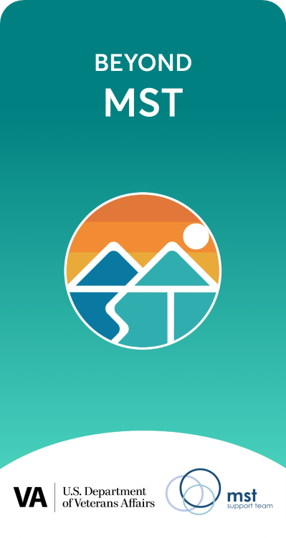
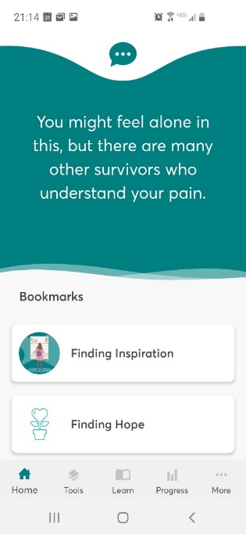
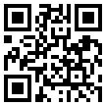
Beyond MST Mobile App
A secure, convenient and trauma-sensitive way for survivors to access information and resources to help in coping with challenges related to MST and to improve health, relationships and quality of life
A self-help tool, which can be used alone or in conjunction with treatment
Over 30 tools and features to cope, reduce distress, feel less alone, improve well-being and find hope
Assessments to understand trauma-related symptoms and beliefs and track progress toward recovery goals
Learn more at tinyurl.com/BeyondMST
Scan the
QR Code to download Beyond MST now:

Slide 26
VHA Outreach Initiatives
MST Coordinators engage in local outreach, partnerships, and other efforts to “get the word out”
MST Support Team engages in national efforts and develops resources for use by the field
Resources are available at www.mentalhealth.va.gov/mst

Slide 27
You’re not alone

Slide 28
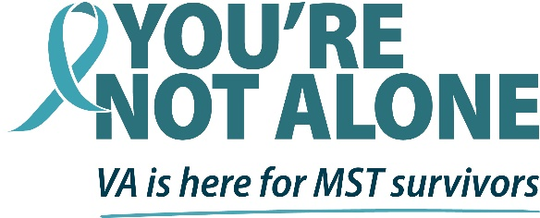
Sexual Assault Awareness Month
Every April, VHA engages in activities in honor of Sexual Assault Awareness Month (SAAM)
MST Support Team selects a national theme and engages in special national educational and awareness-raising efforts
MST Coordinators nationwide host local events such as:
Clothesline Projects: Survivors decorate t-shirts in ways that reflect their experiences of sexual trauma and recovery, and shirts are displayed
Ribbons of Support: Facilities display messages of encouragement for MST survivors written by staff, Veterans and community members
Educational trainings are conducted for staff

Slide 29
Operation song pictures

Slide 30
Sexual Assault Awareness Month 2022
VA’s 2022 MST SAAM campaign reprises the successful 2021 theme while featuring a new look and feel and emphasizing VA’s resources for MST survivors
It can be tremendously affirming for MST survivors to learn that someone believes them, takes their experiences seriously and believes in their ability to heal
We invite you to help share this message of help and healing!

Slide 31
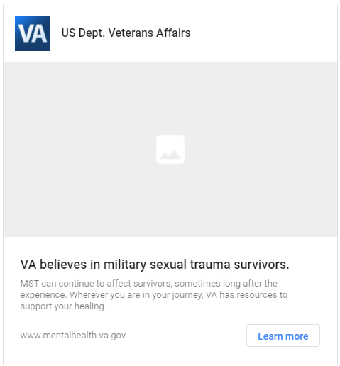
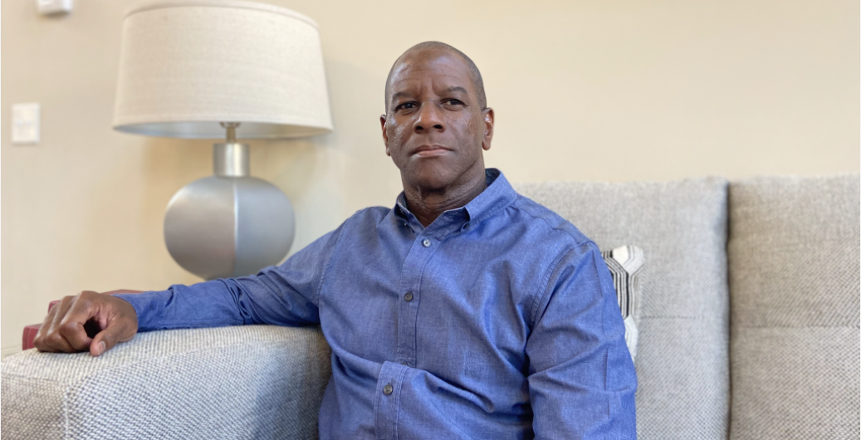
National SAAM Campaign
VHA implements a national digital advertising campaign annually for SAAM
Includes paid media on a variety of platforms such as posts on social media, Internet and other media channels, brief informational videos and ads in venues such as digital billboards, wellness kiosks and convenience stores
In 2021, resulted in over 98 million ad impressions, more than 20 million video/audio completions, and ~240,000 visits to VHA’s MST-specific internet page
Social media and other resources are made available for partners to share

Slide 32
Resources and Ways to Learn More

Slide 33
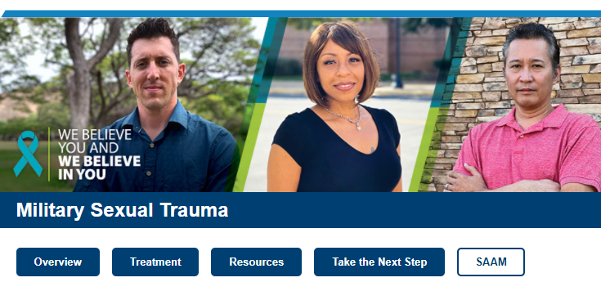
VHA’S MST-related Internet Resources
Visit and share VA’s MST internet website
www.mentalhealth.va.gov/mst
Information about VA services, copies of outreach materials and coping resources for Veterans
SAAM materials, including shareable social media content, available on the SAAM page at www.mentalhealth.va.gov/SAAM

Slide 34
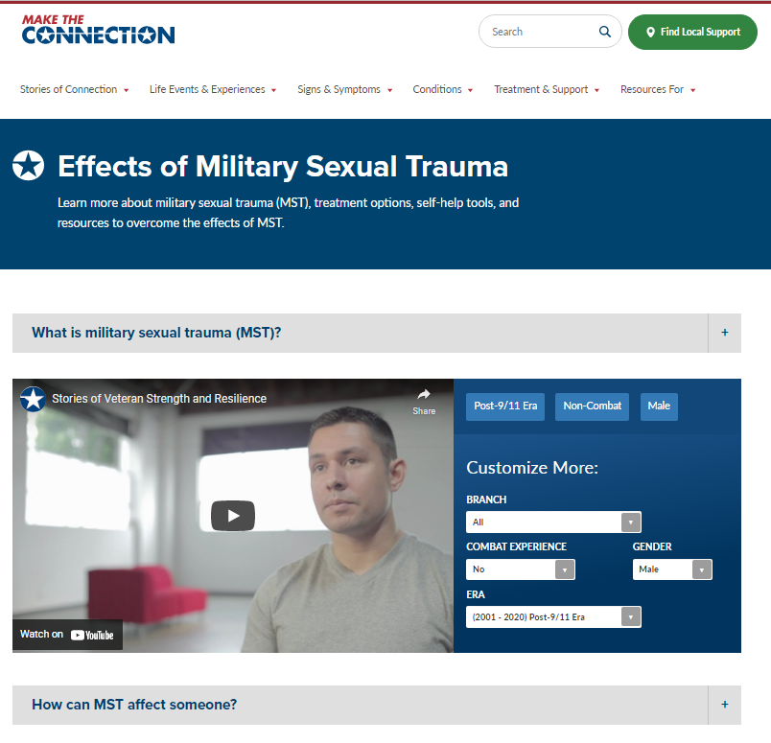
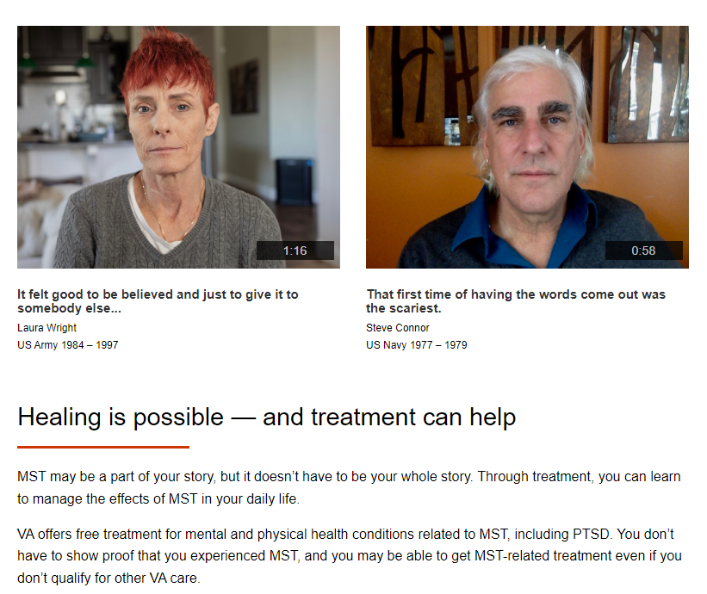
Stories of Veterans’ Recovery
View videos of MST survivors discussing how MST has impacted them and how treatment has helped at these two websites:
Make the Connection: www.maketheconnection.net/conditions/military-sexual-trauma
AboutFace: www.ptsd.va.gov/apps/aboutface/learn/mst.html

Slide 35
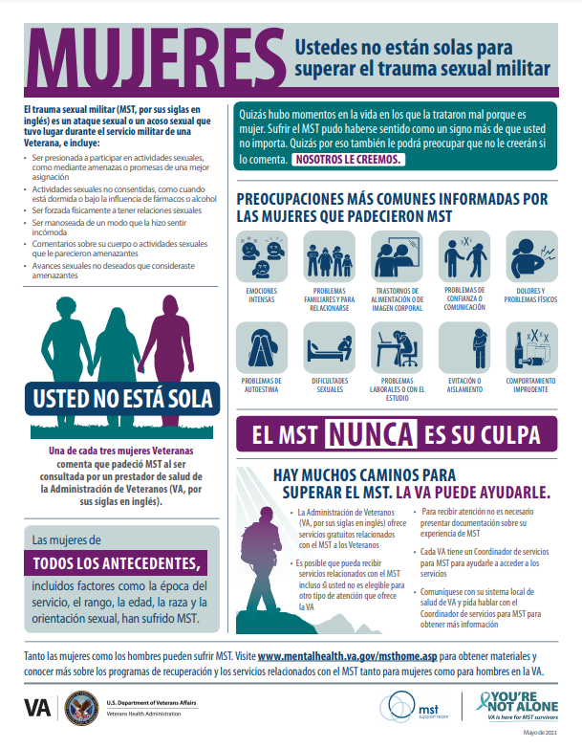
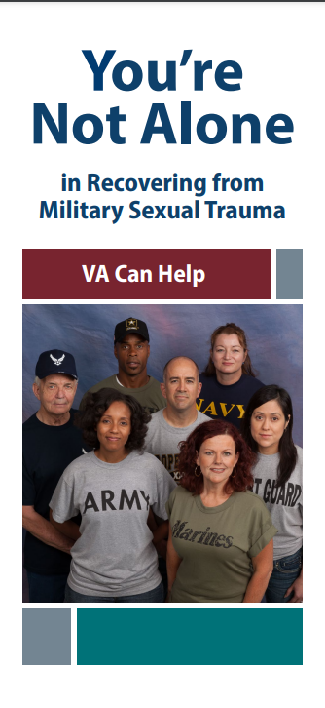
Other Important Resources
MST Resources page mentalhealth.va.gov/msthome/resources includes, among other helpful items:
Women and MST Infographic (English / Spanish)
Gender-inclusive brochure for MST Survivors (English / Spanish)
Fact Sheet on VA Disability Compensation for Conditions Related to MST
Beyond MST app: Helpful not just for MST survivors, but for those who support them
Women Veterans Mental Health website www.mentalhealth.va.gov/women-vets
Notes:
that it’s a good learning/education resource for partners/supporters, too)

Slide 36
Contact information
We appreciate your partnership in supporting MST survivors during SAAM, and all year round.
jessica.keith@va.gov

