Slide 1
Simulations for Clinical Excellence in Nursing Services
SCENS

Slide 2
End of Life: Inpatient
SCENS
End of Life:
Inpatient

Slide 3
Disclaimer
SCENS
The sensitivity of the content discussed during this scenario may trigger emotional or physiological responses
Please inform the faculty if this is uncomfortable for you

Slide 4
Learning Objectives
SCENS
Perform the appropriate interventions when providing care for the patient experiencing end of life
Initiate facility specific Hospice and palliative care consultation
Communicate effectively when managing care for the patient experiencing end of life

Slide 5
Why?
SCENS
Center for Health Equity Research and Promotion
The PROMISE Center
Performance Reporting and Outcomes Measurement to Improve the Standard of care at End-of-life
Define and disseminate best practices contributing to improved outcomes for Veterans near the end of life and their families
The National Bereaved Family Survey
VA Comprehensive End of Life Care initiative (CELC)
VA Hospice and Palliative Care
Palliative Care National Clinical Template (PC-NCT)
Notes:
Center for Health Equity Research and Promotion
The PROMISE Center
Performance Reporting and Outcomes Measurement to Improve the Standard of care at End-of-life
Define, identify, and disseminate best practices contributing to improved outcomes for Veterans near the end of life and their families
The Bereaved Family Survey
19 item survey focused on aspects of care the Veteran received during the last month of life
Within two weeks after the time of death
VA Comprehensive End of Life Care initiative (CELC)
VA Hospice and Palliative Care
Palliative Care National Clinical Template (PC-NCT)

Slide 6
National Bereaved Family Survey
SCENS
Sample Questions
How often were the staff kind, caring, and respectful?
How much of the time were the staff willing to take time to listen?
How often did the staff provide the medication and medical treatment that the Veteran wanted?
How often did the staff who took care of the Veteran keep you or other family members informed about the Veteran's condition and treatment?
How much of the time did the staff provide you and the Veteran with the spiritual support you would have liked?
Family perceived pain management was optimal, very good, or poor?
(U.S. Department of Veterans Affairs, 2015)

Slide 7
Palliative Care vs. Hospice Care
SCENS
Palliative care
Comfort care
Emphasis on quality of life, not quantity
Mitigate suffering
May involve curative measures
Does not have time restrictions
Hospice
Comfort care
Terminally ill
Within six months of death
Not seeking curative measures
Notes:
Palliative care
Comfort care
Emphasis on quality of life, not quantity
Mitigate suffering
May involve curative measures
Does not have time restrictions
Hospice
Comfort care
Terminally ill
Within six months of death
Not seeking curative measures

Slide 8
Hospice and Palliative Care
SCENS
Hospice provides palliative care
Advocate for the patient and family
Team approach
Holistic
Views dying as a normal process
Integration of spiritual and psychological aspect of dying

Slide 9
Palliative Care
SCENS
Verify required documentation
Advance directive
Allow family visitation at all times
Explain the process of dying
Morphine
Non-essential medications
Blood tests and/or diagnostics
Vital signs
Artificial fluids
Mouth care
Oxygen versus compressed air
Grieving process
Cultural and spiritual needs
Talk to the patient
Notes:
Verify required documentation for palliative care
Advance directive
Allow family visitation at all times
Explain the process of dying
Morphine
Relieves pain
Reduces oxygen demands
Discontinue non-essential medications
Blood tests/diagnostics
Check policy on discontinuation of Blood tests/diagnostics
Vital signs
Check policy on discontinuation of vital signs
Discontinue artificial fluids
Evidence shows no benefit
Bodily functions are decreased
Mouth care
Communicate clinical expectations
Grieving process
Denial
Anger
Bargaining
Acceptance
Cultural and spiritual needs
Talk to the patient
The patient can still hear

Slide 10
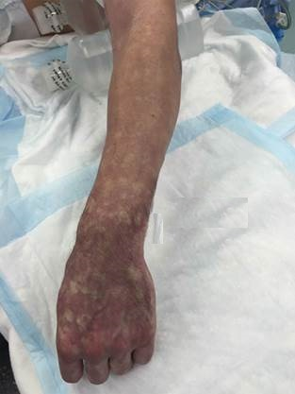
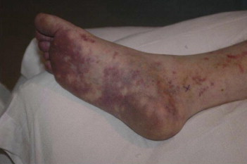
Signs and Symptoms of End of Life
SCENS
Decreased level of consciousness
Change in breathing pattern
Death rattle
https://youtu.be/LgY8pZgtDjQ
Mottling
Decrease in body temperature
Decreased bodily functions
Notes:
**Pre-start audio clip at beginning of sounds. Then minimize.
Decreased level of consciousness
Change in breathing pattern
Cheyne Stokes
Kussmall’s (diabetes)
Death rattle
Suctioning not beneficial
Anticholinergics may help
Mottling
Body temperature decreases
Decrease bodily functions
Decreased urinary output
Decreased hunger
Decreased bowel function

Slide 11
Facility-Specific
SCENS
Policies and procedures
Palliative consult process
Who to contact
What to document
Resources available
Process after death
Who to notify
Post mortem care
Special ceremonies for Veterans
Release/transport of the body

Slide 12
Priorities
SCENS
Verify advance directives including code status
Patient-centered care
Utilize therapeutic communication
Psychosocial needs
Spirituality
Anticipate any needs for equipment, supplies, and medications
Appropriate interventions
Emphasis on the goal of a “good death”
Dignified with controlled symptoms
Notes:
Verify advance directives including code status
Living will
Do not resuscitate orders
Durable power of attorney
Healthcare surrogate
Patient-centered care
Utilize therapeutic communication
Psychosocial needs
Spirituality
Anticipate any needs for equipment, supplies, and medications
Appropriate interventions
Emphasis on the goal of a “good death
Dignified ”with controlled symptoms

Slide 13
Potential Issues
SCENS
Psychosocial
Distraught family members
Equipment or supplies
Medication
What if…?

Slide 14
Summary
SCENS
Reviewed the appropriate interventions when providing care for the patient experiencing end of life
Discussed facility specific Hospice and palliative care consultation
Described effective communication when managing care for the patient experiencing end of life

Slide 15
Questionmark
SCENS

Slide 16
End of Life: Inpatient Info
SCENS
Stanley Goodman
Eighty-nine (89) year-old male is an inpatient admitted 24 hours ago for altered mental status (AMS) who is unresponsive due to a fall resulting in a subarachnoid bleed. The spouse/family member is at the bedside.
Past Medical History:
Dementia
Fibromyalgia
Rheumatic fever
Falls
30 year one pack per day smoker
Past Surgical History:
Mitral valve replacement 20 years ago
Medications:
Pregabalin 100 mg three times daily
Donepezil 5 mg one time daily at bedtime
Allergies:
Hydromorphone and oak tree pollen
Notes:
Provide ISBAR communication after patient introduction

