Slide 1
Simulations for Clinical Excellence in Nursing Services
SCENS

Slide 2
SCENS
Fall:
Inpatient

Slide 3
Learning Objectives
SCENS
Implement facility specific fall protocol
Demonstrate the use of Safe Patient Handling and Mobility (SPHM) equipment
Communicate effectively when managing care for the patient who has sustained a fall

Slide 4
Why?
SCENS
Significance of falls consequences
The VHA Handbook 1050.01: VHA National Patient Safety Improvement Handbook
The Joint Commission: 2016 National Patient Safety Goals
American Nurses Association: The National Database of Nursing Quality Indicators (NDNQI)
VHA Safe Patient Handling and Mobility Program
Notes:
Significance of falls consequences
Aging patient population
Higher acuity
Injuries
Complications
The VHA Handbook 1050.01: VHA National Patient Safety Improvement Handbook
Identify risks
Patient safety alerts
Patient safety measures
Emphasize prevention rather than punishment
The Joint Commission: 2016 National Patient Safety Goals
Communication among caregivers
Improve safety of using medications
Reduce harm with clinical alarm systems
The National Database of Nursing Quality Indicators (NDNQI)
NDNQI #2 and #3
Patient Falls and Patient Falls with Injury
Injury level
Measure process and outcome
VA SPHM program
Prompted 30-40% reduction in nursing injuries since its induction in the VA system in 2006
Nursing staff and debilitating back injuries
More than any other occupation

Slide 5
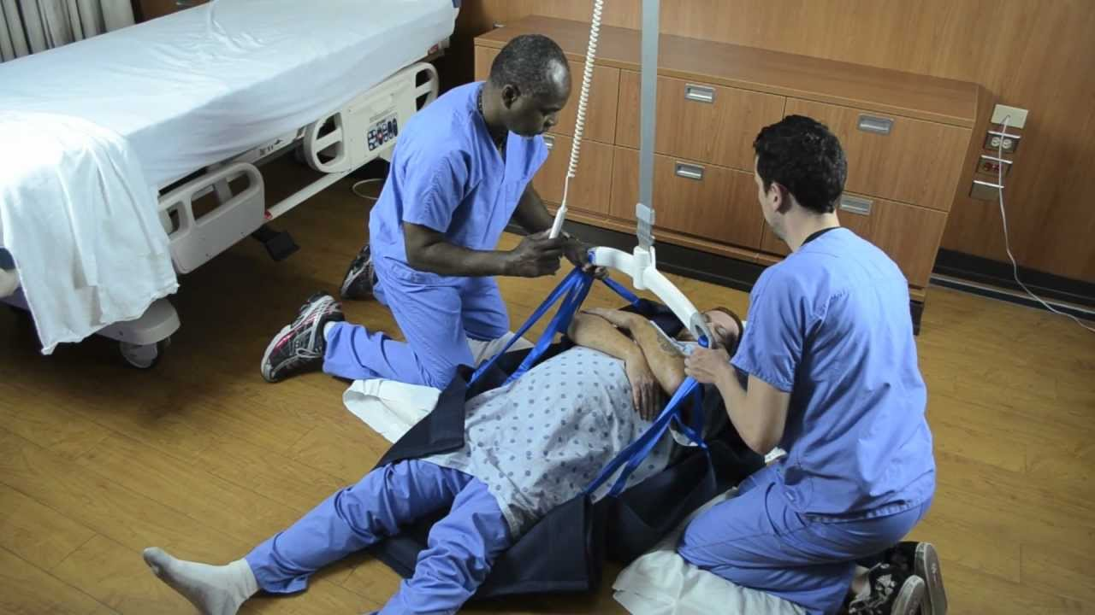
Fall Risk Screening
SCENS
Morse Fall Scale
Hendrick’s scale
SCENS

Slide 6
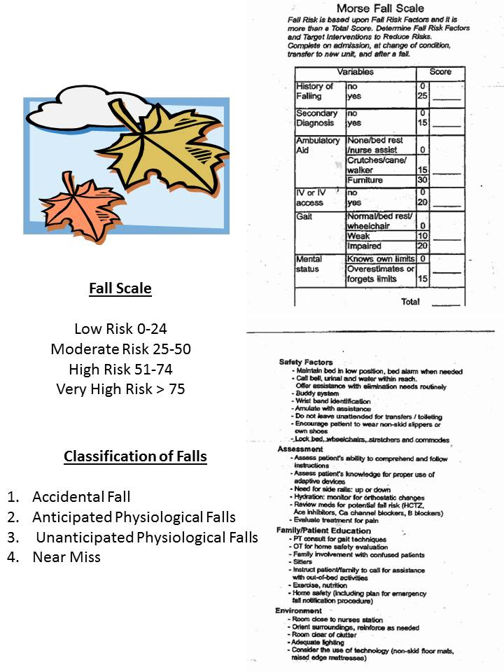
Fall Risk Assessment
SCENS
Morse Fall Scale
Notes:
<Discuss facility specific fall risk assessment and protocol here>

Slide 7
Fall Prevention
SCENS
History of falls?
Secondary diagnosis?
  i.e. CHF and on diuretics requiring multiple trips to the restroom
Ambulatory aid?
Intravenous therapy?
Unsteady gait?
Altered mental status?
Score less than 25 is low risk
Score requiring bed alarm
Interventions to prevent falls
  Obstacle free environment
  Appropriate footwear
  Call light and necessary items within reach
  Cords out of the way
  Floor clean and dry
  Proper lighting
  Sitter if necessary
  High risk for falls identifiers
Notes:
History of falls?
Secondary diagnosis?
i.e. CHF and on diuretics requiring multiple trips to the restroom
Ambulatory aid?
Intravenous therapy?
Unsteady gait?
Altered mental status?
Score less than 25 is low risk
Score requiring bed alarm <discuss facility policy>
Interventions to prevent falls
Obstacle free environment
Appropriate footwear
Call light and necessary items within reach
Cords out of the way
Floor clean and dry
Proper lighting
Sitter if necessary
High risk for falls identifiers
Wrist bands
Door signs
<Discuss facility specific fall prevention interventions here>

Slide 8
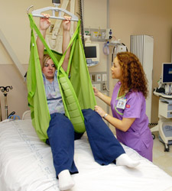
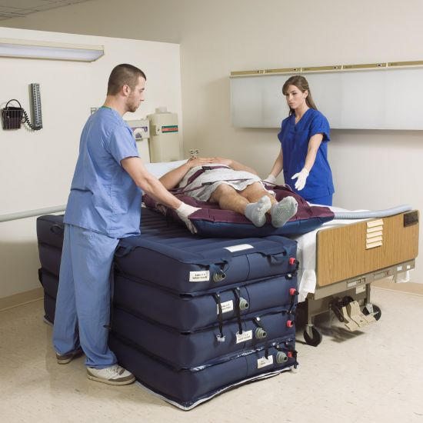
Safe Patient Handling and Mobility (SPHM)
SCENS
VA no lift policy
Use of assistive devices to safely mobilize patients reducing injuries to the patient and care providers
Notes:
<Ask the learners if they have completed the Safe Patient Handling and Movement (SPHM) training>
VA no lift policy
<Review the use of Hovermatt or designated equipment to be used to transfer the patient who has sustained a fall from the floor to the bed>

Slide 9
Post Fall Checklist
SCENS
Post Fall Checklist
  Blood glucose (history of diabetes)
  Vital signs (orthostatic blood pressure if patient complains of dizziness prior to fall)
  Notify the provider, manager/supervisor, etc.
  Physical therapy consult?
  Complete diagnostics/labs if ordered
  Post fall note with update on interventions to prevent future falls
  Update the care plan
Notes:
<Discuss facility process for the patient who has sustained a fall>

Slide 10
Post Fall Huddle
SCENS
Post Fall Huddle
  Primary nurse coordinates a to be complete within specific time frame at the bedside (i.e. 2 hours)
  Include: The veteran, primary nurse, provider, witness, and nurse manager
Root Cause
  Non-punitive
Notes:
Safe Patient Handling and Movement (SPHM) equipment

Slide 11
Facility Specific
SCENS
Equipment
State licensure
Scope of practice
Certifications
Job descriptions
Accountability
Documentation
  Fall risk assessment (Morse Fall Scale, Stratify Fall Scale, etc.)
  Electronic Patient Incident Reporting (ePIR)
  Post fall assessment

Slide 12
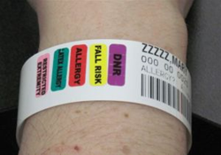
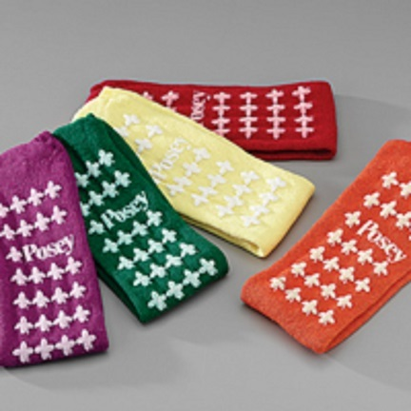
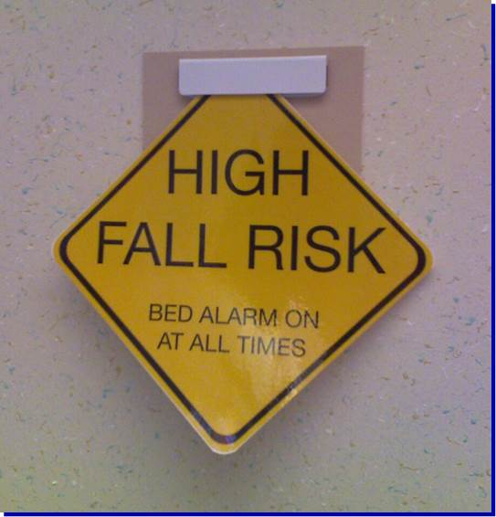
Priorities
SCENS
Place an emphasis on safety
Identify risk factors
Fall prevention measures
Know when and who to call for assistance
Anticipate the need for equipment, supplies, and medications
Perform targeted assessment
Utilize fall risk assessment tools
Priority interventions

Slide 13
Potential Issues
SCENS
Psychosocial
Coexisting problems
Equipment
Medication
Complications
Case management?
Home environment after discharge
What if…?

Slide 14
Summary
SCENS
Discussed facility specific fall protocol
Reviewed the use of Safe Patient Handling and Mobility (SPHM) equipment
Provided communication methods for managing care for the patient who has sustained a fall

Slide 15

SCENS

Slide 16
SCENS
Fall: Inpatient
John Bernstein
Seventy five (75) year-old male admitted with pneumonia and dehydration
Past Medical History:
Hypertension
Pneumonia
Deaf in the right ear but refuses to wear his hearing aid
History of falls
Past Surgical History:
Cholecystectomy
Medications:
Metoprolol 100 mg two times daily
Allergies:
No know drug allergies (NKDA)
Notes:
Provide ISBAR communication prior to scenario.

