Slide 1
Simulations for Clinical Excellence in Nursing Services
SCENS

Slide 2
Infusion: IV Start and Antibiotics
SCENS
Infusion:
IV Start and Antibiotics

Slide 3
Learning Objectives
SCENS
Discuss the appropriate steps to initiate intravenous access with at saline lock
Demonstrate the steps required to initiate an intravenous antibiotic infusion
Discuss effective communication when caring for the patient receiving an intravenous antibiotic infusion

Slide 4
Why?
SCENS
VHA Directive 1014: Safe Medication Injection Practices
VHA Directive 1070: Adverse Drug Event Reporting and Monitoring
VHA Directive 1164: Essential Medication Information Standards
The VHA Handbook 1050.01: VHA National Patient Safety Improvement Handbook
The Joint Commission: 2016 National Patient Safety Goals
National Action Plan for Adverse Drug Event Prevention
Infusion Nurses Society
Notes:
VHA Directive 1014: Safe Medication Injection Practices
VHA Directive 1070: Adverse Drug Event Reporting and Monitoring
The VHA Handbook 1050.01: VHA National Patient Safety Improvement Handbook
Patient safety alerts
Patient safety measures
Emphasize prevention rather than punishment
The Joint Commission: 2016 National Patient Safety Goals
Goal 1: Accuracy of patient identification
Goal 2: Effectiveness of communication among caregivers
Written procedures
Timeliness
Goal 3: Safety of using medications
Reduce likelihood of patient harm
Patient education for better outcomes
Written protocols
Follow-up monitoring
Safety practices
National Action Plan for Adverse Drug Event Prevention
US Department of Health and Human Services
Infusion Nurses Society
Research and evidence-based practice
Current best evidence
Validate and improve nursing practice

Slide 5
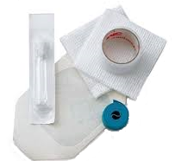

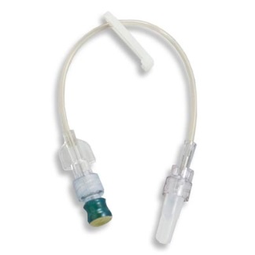
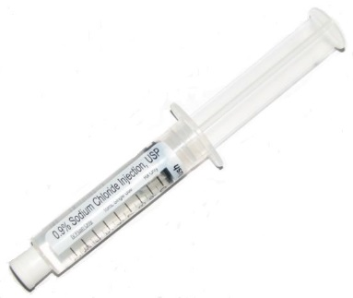
Preparation
SCENS
Verify orders
Explain the procedure to
the patient
Supplies
Inspect supplies
Hand hygiene
Notes:
Verify orders
Explain the procedure to the patient
Supplies
Hand hygiene
Wash hands and disinfect with alcohol
Personal protective equipment
Gloves

Slide 6
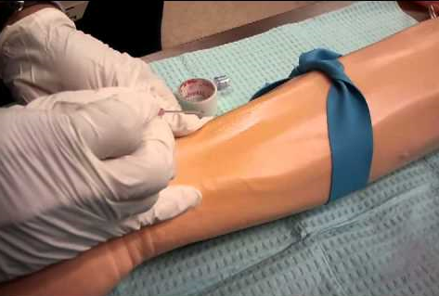
Initiating a Saline Lock
SCENS
Selection and preparation
of the site
Asepsis
Technique
Dressing
Label
Notes:
Selection and preparation of the site
Hand associated with less risk of infection vs. wrist or upper arm
Avoid bumps or bifurcations of vessels
Palpate (should have a good bounce and be soft)
Local warming of insertion point for beneficial results
6cm x 6cm area
Allow antiseptic to dry for 20 seconds
Preferred choice is 2% chlorhexidine gluconate in 70% isopropyl alcohol; alternatives are 10% povidone iodine or 70% alcohol
Asepsis
Technique
Apply tourniquet above selected site
Bevel upwards
Insert needle and when blood is seen, partially withdraw the needle and advance the cannula
Release the tourniquet
Attach luer lock (If using pig tail extension, flush with saline initially)
Dispose of needle in appropriate receptacle as soon as soon as possible
Secure and cover with a sterile transparent dressing
Flush the cannula with saline
Dressing
Label
Date, time, and initials
Documentation
Location, size of cannula, how the patient tolerated the procedure

Slide 7
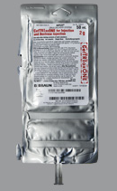
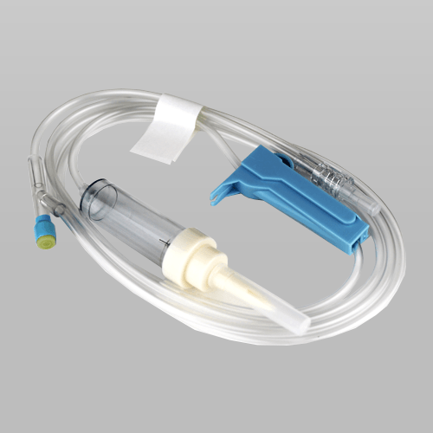
Antibiotic Infusion
SCENS
Verify orders
Explain procedure to the patient
Inspect equipment
Prepare the infusion
Rights of medication administration
Initiate infusion
Patient education
Adverse reactions
Notes:
Verify orders with another nurse or per protocol
Explain procedure to the patient
Inspect equipment
Prepare the infusion
Label
Utilize aseptic technique
Spike the bag taking care not to contaminate tip
Squeeze and release the drip chamber to fill level
Open clamp and run through to expel air from tubing
Take care not to allow fluid to drip from the end to prevent contamination
Resistant microorganisms
Rights of medication administration
Initiate infusion
Advise the patient to notify the nurse or ring the call bell for adverse reactions
Provide the call bell
Be specific
Itchy
Warm feeling
Difficulty breathing
Tongue swelling
Rash
Hives

Slide 8
Facility Specific
SCENS
Protocol
Equipment/Supplies
State licensure
Scope of practice
Certifications
Accountability
Documentation
Notes:
Protocol
<Discuss facility specific process>
Equipment/Supplies
<Review the use of equipment/supplies available>
State licensure
<Discuss who may do what based on licensure>
Scope of practice
Certifications
Job descriptions
Accountability
Documentation
<Discuss pertinent documentation>

Slide 9
Priorities
SCENS
Safety
Infection control
Identify risk factors
Identify patient allergies
Anticipate any potential needs
Provide patient education
Priority interventions
Notes:
Safety
Infection control
Identify risk factors
Identify patient allergies
Anticipate any potential needs
Equipment
Supplies
Medications
Assistance
Provide patient education
Priority interventions

Slide 10
Potential Issues
SCENS
Psychosocial
Coexisting problems
Equipment or supplies
Complications
What if…?
Notes:
Psychosocial
Uncooperative patient
Equipment or supplies
Dislodgement
Occlusion
Unsuccessful attempts
How many before utilizing another approach
Complications
Infiltration
Adverse reaction
Phlebitis
What if…?

Slide 11
Summary
SCENS
Discussed the appropriate steps to initiate intravenous access with at saline lock
Demonstrated the steps required to initiate an intravenous antibiotic infusion
Described effective communication when caring for the patient receiving an intravenous antibiotic infusion

Slide 12

Questions
SCENS

Slide 13
Infusion: IV Start and Antibiotic
SCENS
Donna Right
Thirty four (34) year-old female requiring intravenous antibiotic infusion for the treatment of osteomyelitis of the right tibia positive for staphylococcus aureus after an open fracture due to a motor vehicle accident three months ago.
Past Medical History:
Twelve (12) year one pack per day history of smoking
Motor vehicle accident three months ago
Open fracture of the right tibia
Osteomyelitis of the right tibia
Past Surgical History:
Right inguinal hernia repair
Open reduction of a fracture of the right tibia three months ago
Medications:
Ipratropium bromide inhaler 2 puffs 3 times a day
Multivitamin daily
Allergies:
Sulfa
Notes:
Provide ISBAR communication prior to scenario.

