Slide 1
Simulations for Clinical Excellence in Nursing Services
SCENS

Slide 2
Infusion: IV start and Blood
SCENS
Infusion:
IV Start and Blood

Slide 3
Learning Objectives
SCENS
Discuss the appropriate steps to initiate intravenous access
Demonstrate the steps required to initiate blood infusion therapy
Discuss effective communication when caring for the patient receiving an intravenous blood infusion

Slide 4
Why?
SCENS
The Joint Commission: 2016 National Patient Safety Goals
Interdisciplinary guidelines to reduce variability in transfusion practices
VHA Directive 2011-011: Transfusion Verification and Identification Requirements for All Sites
VHA Directive 1185: Transfusion Utilization Committee and Program
VHA Handbook 1106.01: Pathology and Laboratory Medicine Service (P & LMS) Procedures
Vista Blood Establishment Computer software (VBECS)
Infusion Nurses Society Standards of Practice
Research and Evidence-based practice
Notes:
Life-threatening
Acute and unexpected
Interdisciplinary guidelines to reduce variability in transfusion practices
The Joint Commission: 2016 National Patient Safety Goals
Goal 1: Accuracy of patient identification
Eliminate transfusion errors related to patient misidentification
Goal 2: Effectiveness of communication among caregivers
Written procedures
Timeliness
Universal Protocol
Pre-procedure verification process
VHA Directive 2011-011: Transfusion Verification and Identification Requirements for All Sites
VHA Handbook 1106.01: Pathology and Laboratory Medicine Service (P & LMS) Procedures
The VHA Handbook 1050.01: VHA National Patient Safety Improvement Handbook
Patient safety alerts
Patient safety measures
Emphasize prevention rather than punishment
VHA Handbook 1106.01: Pathology and Laboratory Medicine Service (P & LMS) Procedures
Vista Blood Establishment Computer software (VBECS)
Research and Evidence-based practice

Slide 5
Types of Transfusion Reactions
SCENS
Hemolytic
Allergic
Febrile
Transfusion related acute lung injury (TRALI)
Volume overload
Bacterial contamination
Hypotensive
Graft vs. Host
Non-immune hemolysis
Post Transfusion Purpura
Notes:
Hemolytic
By human error**
Acute (sudden) Fever, chills, lumbar pain, chest pain
Hemoglobinemia and hemoglobinuria
Sense of impending doom
Disseminated Intravascular Coagulation (DIC)
Delayed (4-8 days post-transfusion)
Falling hematocrit
Positive direct antiglobulin (Coombs) test
Allergic
Urticaria
May cause laryngeal edema and/or bronchospasm
**May sometimes continue the infusion with antihistamines per healthcare provider
Anaphylaxis
Dyspnea
Stridor
Cardiovascular instability
Febrile
Rise in temperature of 1.8˚F from baseline
Transfusion related acute lung injury (TRALI)
Sudden non-cardiogenic pulmonary edema
Volume overload
Diuretics between
Bacterial contamination
Hypotension, shock, fever, chills, nausea and vomiting, respiratory distress
Hypotensive
10mm Hg drop in BP
During transfusion
Resolves with discontinuation of transfusion
Graft vs. Host
Rash, fever, diarrhea, cytopenia, and liver dysfunction
3-4 weeks post transfusion
Non-immune hemolysis
Hemoglobinemia and hemoglobinuria
Post Transfusion Purpura
Profound thrombocytopenia

Slide 6
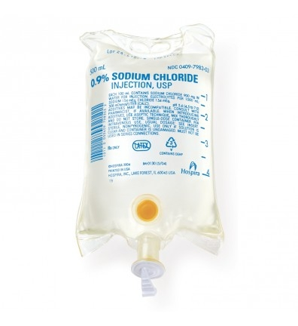
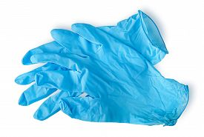
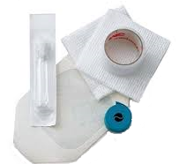
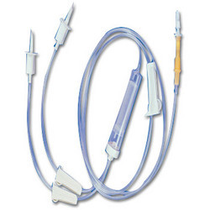
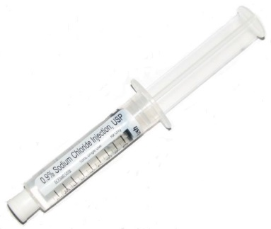
Preparation
SCENS
Verify orders
Explain the procedure
to the patient
Supplies
Inspect supplies
  Nothing smaller than 20G
Hand hygiene
Personal Protective equipment
Notes:
Verify orders
Explain the procedure to the patient
Supplies
Nothing smaller than a 20G IV catheter
Some facilities want blood tubing connected directly to IV catheter without saline lock tubing <check policy>
Hand hygiene
Wash hands and disinfect with alcohol
Personal protective equipment
Gloves

Slide 7
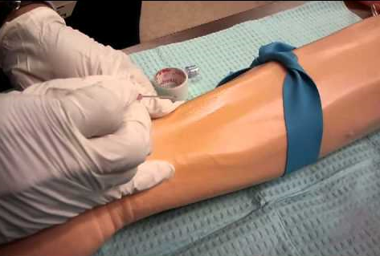
Starting an IV
SCENS
Selection and preparation
of the site
Asepsis
Technique
Dressing
Label
Notes:
Selection and preparation of the site
Hand associated with less risk of infection vs. wrist or upper arm
Avoid bumps or bifurcations of vessels
Palpate (should have a good bounce and be soft)
Local warming of insertion point for beneficial results
6cm x 6cm area
Allow antiseptic to dry for 20 seconds
Preferred choice is 2% chlorhexidine gluconate in 70% isopropyl alcohol; alternatives are 10% povidone iodine or 70% alcohol
Asepsis
Technique
Apply tourniquet above selected site
Bevel upwards
Insert needle and when blood is seen, partially withdraw the needle and advance the cannula
Release the tourniquet
Attach luer lock (If using pig tail extension, flush with saline initially)
Dispose of needle in appropriate receptacle as soon as soon as possible
Secure and cover with a sterile transparent dressing
Flush the cannula with saline
Dressing
Label
Date, time, and initials
Documentation
Location, size of cannula, how the patient tolerated the procedure

Slide 8
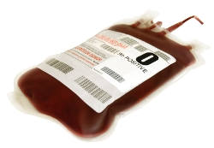
Initiating a Blood Transfusion
SCENS
Verify orders
Who can hang blood?
Explain procedure to the patient
Inspect equipment
Prepare the blood infusion
Verification
Initiate infusion
Patient education
Adverse reactions
Notes:
Verify orders with another nurse or per protocol
Who can hang blood?
Explain procedure to the patient
Inspect equipment
Prepare the blood infusion
Ensure blood tubing is primed with normal saline and hanging prior to picking up the blood
Utilize aseptic technique
Spike the bag taking care not to contaminate tip
Squeeze and release the drip chamber to fill level
Open clamp and run through to expel air from tubing
Take care not to allow fluid to drip from the end to prevent contamination
Resistant microorganisms
Verification
Initial vital signs
2 nurses
Patient identifiers
Blood identifiers
Expiration date
Signatures
Initiate infusion
Remain with the patient for the first 15 minutes or per protocol
Advise the patient to notify the nurse or ring the call bell for adverse reactions
Provide call bell
Be specific
Itchy
Warm feeling
Difficulty breathing
Tongue swelling
Rash
Hives

Slide 9
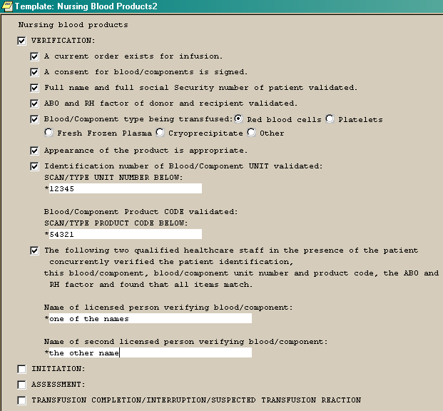
Facility Specific
SCENS
Protocol
Equipment/Supplies
State licensure
Scope of practice
Certifications
Accountability
Documentation
Notes:
Protocol
<Discuss facility specific process>
Equipment/Supplies
<Review the use of equipment/supplies available>
State licensure
<Discuss who may do what based on licensure>
Scope of practice
<discuss your facility policy and licensing credentials>
Certifications
<discuss your facility policy>
Job descriptions
Who can pick up the blood
<discuss your facility policy>
Accountability
Who can initiate blood
Who can monitor blood
<discuss your facility policy>
Documentation
<Discuss pertinent documentation>
<discuss your facility policy>
VistA Blood Establishment Computer Software (VBECS) in CPRS

Slide 10
Priorities
SCENS
Safety
Infection control
Identify risk factors
Identify patient allergies
Monitor time of start of infusion
Anticipate any potential needs
Provide patient education
Notes:
Safety
Infection control
Identify risk factors
Identify patient allergies
Monitor time of start of infusion
No more than 4 hours or per protocol
Anticipate any potential needs
Equipment
Supplies
Medications
Assistance
Provide patient education

Slide 11
Potential Issues
SCENS
Psychosocial
Equipment or supplies
Inappropriate or lack of
documentation
Patient identification errors
Complications
What if…?
Notes:
Psychosocial
Religious preferences?
Equipment or supplies
Inappropriate or lack of documentation
Baseline information
Vital signs
Consent form
Patient identification errors
Follow protocol
Do not skip steps
Complications
Priority interventions
Who to call
What to document
Where to document
Packaging of the blood product
Protocol
What if…?

Slide 12
Summary
SCENS
Discussed the appropriate steps to initiate intravenous access Demonstrated the steps required to initiate blood infusion therapy
Described effective communication when caring for the patient receiving an intravenous blood infusion therapy

Slide 13

Questions
SCENS

Slide 14
Infusion: IV Start and Blood
SCENS
Manuel Garcia
Seventy seven (77) year old male four (4) hours status post colon resection for removal of a sigmoid colon mass 4 hours ago by Dr. Moore. Vital signs are stable and he is on 2 liters of oxygen via nasal cannula. He has a midline abdominal incision with a dry sterile dressing. Bowel sounds are hypoactive. He has an 18 gauge IV in his right antecubital with Lactated Ringers at 125 mL/hr. His Foley is draining clear yellow urine. His hemoglobin of is 6.8 mg/dL and hematocrit 21 mg/dL. Dr. Moore is aware. He just examined him and is entering orders.
Medications:
Lisinopril 2.5 mg one time a day
Docusate sodium 100 mg one time a day
Allergies:
Sulfa
Past Medical History:
Hypertension, hemorrhoids, constipation, and rectal bleeding
Past Surgical History:
Hemorrhoidectomy
Notes:
Provide ISBAR communication prior to scenario.

