Slide 1
Simulations for Clinical Excellence in Nursing Services
SCENS

Slide 2
Medication Interruption
SCENS

Slide 3
Learning Objectives
SCENS
Recognize factors that could potentially lead to medication errors
Implement measures to prevent errors associated with interruptions during medication administration
Demonstrate effective communication when implementing measures to prevent medication errors associated with interruptions

Slide 4
Why?
SCENS
VHA Patient Safety Improvement Handbook
National Patient Safety Goals
Institute for Safe Medication Practices
The effect of safe zones on nurse interruptions, distractions, and medication errors

Slide 5
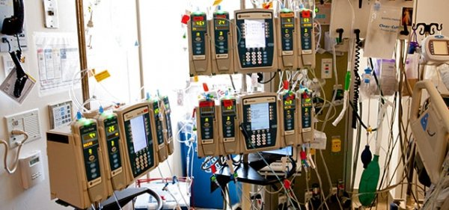
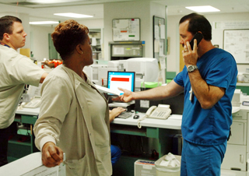
Medication Administration Interruptions
SCENS
Average of 6.7 interruptions per hour
21% occur during medication administration
Institute for Safe Medication Practices
Distractions
Interruptions
Error Theory
Environmental factors
Notes:
Nurses experience an average of 6.7 interruptions per hour
21% occur during medication administration
Institute for Safe Medication Practices
Strategies to prevent errors
Improving the work environment for medication preparation, dispensing and administration
Institute of Medicine
Distractions
Interruptions
Error Theory
A “capture error” occurs when 2 actions overlap
Environmental factors
Keep medication areas free from clutter, distraction, and noise

Slide 6
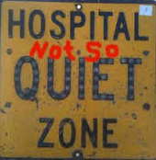
Types of Interruptions
SCENS
Patients
Family members
Alarms
Missing equipment
Malfunctioning equipment
Phone calls
Call light
Bed alarms
Emergencies
Most interruptions are from other personnel and conversations

Slide 7

Airline industry
SCENS
The “Sterile Cockpit Rule”
MedSafe protocol
“Medication Zone”
“No Interruption Zone”
“Healthcare Sterile Cockpit”
Notes:
The “Sterile Cockpit Rule”
No interruptions or distractions when pilots are performing critical tasks
Take off
Landing
MedSafe protocol
Dr. T.M. Pape
“Medication Zone”
“No Interruption Zone”
“Healthcare Sterile Cockpit”

Slide 8
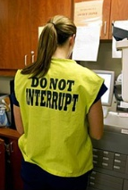
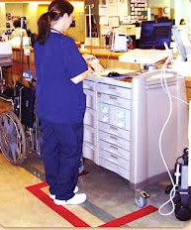
Strategies to Reduce Interruptions
SCENS
Safe zones for medication
administration
Checklists
Vests
Sashes
Lighted lanyards
Do not disturb sign
Diversion strategies

Slide 9

Priorities
SCENS
Safety
Follow policies and protocols
Avoid interruptions and distractions
Communicate with team members
Provide patient education
Notes:
Safety
Follow policies and protocols
<discuss facility policy here>
Rights of medication administration
Anywhere from 5-9 but 5 although evidence leans toward 5 (follow policy)
Drug
Patient
Dose
Route
Time
Double check
Find out who is qualified to do the double check
Match with diagnosis and indications
Dose
Appropriate for the patient
Timing
Route
Monitoring
Communicate with team members
Provide patient education

Slide 10
Summary
SCENS
Discussed factors that could potentially lead to medication errors
Reviewed measures to prevent errors associated with interruptions during medication administration
Demonstrated effective communication when implementing measures to prevent medication errors associated with interruptions

Slide 11

Questions
SCENS

Slide 12
Medication Interruption Scenario
SCENS
Donna Right
Thirty four (34) year-old female requiring intravenous antibiotic infusion for the treatment of osteomyelitis of the right tibia positive for staphylococcus aureus after an open fracture due to a motor vehicle accident three months ago.
Past Medical History:
Twelve (12) year one pack per day history of smoking
Motor vehicle accident three months ago
Open fracture of the right tibia
Osteomyelitis of the right tibia
Past Surgical History:
Right inguinal hernia repair
Open reduction of a fracture of the right tibia three months ago
Medications:
Ipratropium bromide inhaler 2 puffs 3 times a day
Multivitamin daily
Allergies:
Sulfa
Notes:
Provide ISBAR communication prior to scenario.

