Slide 1
PPE & N95 Management: Key Questions/Considerations
HCI Infection Control Team
Scope: PPE and Respiratory Protection while caring for COVID19 Patients.
Key Issues
Who actually needs Respiratory Protection (RP)?
What are the Normal v. Contingency RP Considerations?
How should we maintain PPE discipline?
CDC Strategies for Optimizing the supply of RP.
What are the Alternatives for a N95?

Slide 2
Infection Control Team Members
Marla Clifton
Kathleen DeRoos
Craig Brown
Wendy Kady
Robert Pearlman
Gio Baracco
Carter Mecher
Troy Knighton
Ben Guerrero

Slide 3
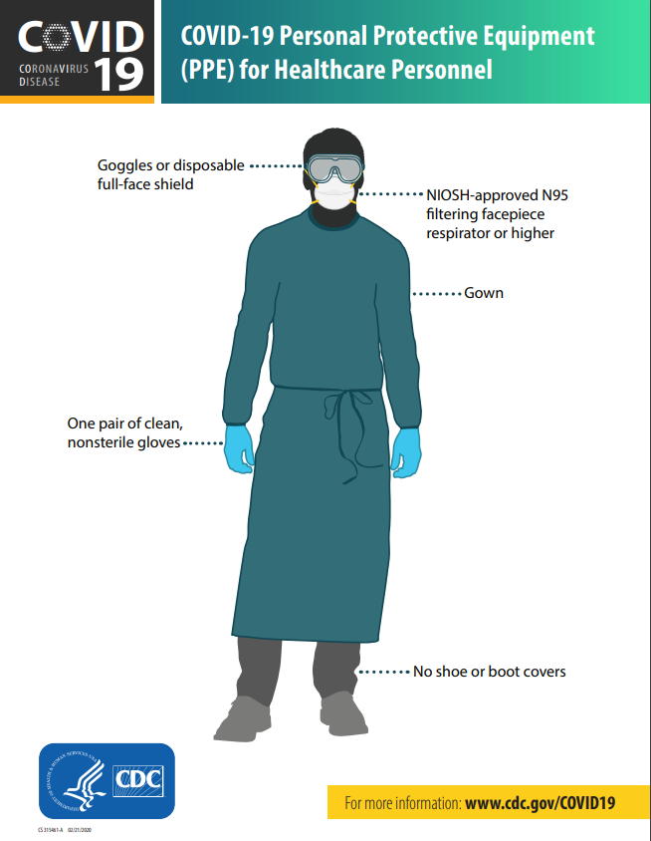
COVID-19: How can we protect Veterans and staff?
Personal Protective Equipment
For the most current CDC recommendations on Personal Protective Equipment, visit: https://www.cdc.gov/coronavirus/2019-ncov/infection-control/control-recommendations.html
For CDC guidance on donning (putting on) and doffing (taking off) PPE safely: https://www.cdc.gov/hai/prevent/ppe.html
Note: PPE recommendations may differ by setting and type of exposure, and may change as knowledge of the virus evolves.

Slide 4
COVID19: Who Needs a Respirator (N95 or higher)?
Clinicians who are directly caring for an infectious patient
Spread of respiratory viruses from person-to-person happens among close contacts (within 6 feet)
Aerosol generating medical procedures (AGMP) with an infectious patient
RP
Eye protection
Gowns
Gloves
In other care areas the significant risk will be environmental transmission from fomites
Use excellent hand hygiene or alcohol hand rub
Don’t touch your face
Routine environmental surface cleaning/disinfection

Slide 5
Normal v. Contingency RPP Considerations
Limit who is enrolled in RPP by risk potential for occupational exposure.
The more people enrolled the
More medical clearances required
More fit testing are required
More time it will take to complete
More RP you burn through
Less RP you will have for care of infectious patients
The more changes to different respirator models & sizes the more fit testing required for all classes of respirator.
Notes:
Strategies for optimizing PPE: https://www.cdc.gov/coronavirus/2019-ncov/hcp/respirator-supply-strategies.html

Slide 6
New OSHA Guidance on COVID19 and Fit Testing Posted March14, 2020
OSHA suggested that annual fit testing may be suspended if:
Make a good faith effort in complying with 19CFR1910.134
Use only NIOSH certified RP
Implement CDC and OSHA Strategies for Optimizing Supply of N95s
If a previous fit tests exists with the same model, style, and size of RP that is used to respond to COVID19
Inform workers that employer is suspending annual fit testing
Explain to workers the importance of the user seal check
Conduct a fit test if employee changes in physical condition that could affect RP seal
Remind workers that they should inform supervisor if the integrity and or fit of filtering facepiece is compromised.
https://www.osha.gov/memos/2020-03-14/temporary-enforcement-guidance-healthcare-respiratory-protection-annual-fit

Slide 7
Maintain PPE Discipline
Assign a team who is capable to manage supplies, who will:
Establish a burn rate of PPE
Tracks who requests and how much by work area
Protect PPE from theft (MAJOR ISSUE)
Lock up PPE and monitor who has access – Guard 24/7
Ensures service lines requesting PPE have a legitimate need
Resist providing to those that don’t provide care of infectious patients
Considerations for reducing burn rate:
Limit the number of staff who provides direct care of infectious patients
ASK, Is it absolutely necessary for that number of staff to enter the AIIR or Cohort care area ?
Could other services, i.e. Social Work be done by video chat?
Cohort multiple patients in a large room to reduce donning and doffing PPE
NOTE: Exiting/entering individual AIIR requires the clinician to don/doff PPE between rooms

Slide 8
CDC STRATEGIES FOR OPTIMIZING SUPPLY OF N95 RESPIRATORS
Conventional Capacity
Contingency Capacity
Crisis Alternate Strategies
Notes:
https://www.cdc.gov/coronavirus/2019-ncov/hcp/respirators-strategy/index.html

Slide 9
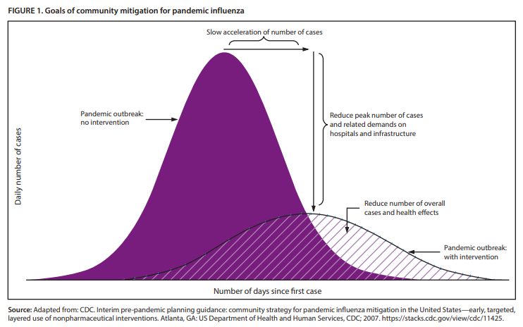
RPP Strategy Decisions
Consider
Status of PPE & N95/respirator inventory
Status of your supply chain
What are the PPE & N95/respirator burn rates
Keep in mind - Reality
What the potential situation will look like in a month from now
Assume no resupply within the month
You may NOT have experienced the patient surge, yet
Most of our facilities are experiencing PRE surge
The Strategies may be applicable for supply of other PPE

Slide 10
CONVENTIONAL CAPACITY Strategy
Criteria
Normal continuum of care practices w/o limited resources
Hierarchy of Controls
Engineering Controls
AII Rooms
Physical Barriers
Administrative Controls
Patient / visitor access and source control (masking)
Exclude all HCP not directly involved in patient care
Personal Protective Equipment
N95
Surgical N95s only for direct patient care setting with airborne fluid hazards (e.g., splashes, sprays)
Use alternatives where feasible
NOTE: Surgical 95 is irrelevant in treating COVID19, only relevant in where pressurized spray or stream of blood environment, ie. Surgery or ED
Do these first!
Notes:
https://www.cdc.gov/coronavirus/2019-ncov/hcp/respirators-strategy/conventional-capacity-strategies.html

Slide 11
Aerosol-Generating Medical Procedures (AGMPs)
Any procedure carried out on a patient that can induce the production of aerosols of various sizes, including droplet nuclei.
Examples of AGMPs include, but are not limited to:
Collection of Nasopharyngeal cultures/swabs, per CDC
Non-invasive positive pressure ventilation (BIPAP)
Continuous positive airway pressure (CPAP)
Endotracheal intubation; respiratory/airway suctioning
High-frequency oscillatory ventilation
Tracheostomy care
Chest physiotherapy
Aerosolized or nebulized medication administration
Diagnostic sputum induction; bronchoscopy procedure
Autopsy of lung tissue

Slide 12
CONTINGENCY CAPACITY Strategy
Criteria
No significant impact on care or safety of the HCP
Potential impending shortage of N95 respirators
Administrative Controls
Decrease length of stay for medically stable patients
Personal Protective Equipment
Extended Use (cohorted groups)
Wearing the same N95 respirator and/or other PPE for repeated close contact encounters, without doffing the respirator/PPE between encounters
Use Beyond Manufactures Shelf Life for fit-testing/training – During Contingency Capacity Strategy
Notes:
https://www.cdc.gov/coronavirus/2019-ncov/hcp/respirators-strategy/contingency-capacity-strategies.html

Slide 13
CRISIS ALTERNATE Strategy
Criteria
Not commensurate with U.S. standards of care
Periods of expected or known shortages
Personal Protective Equipment
Use Beyond Manufactures Self Life RP for HCP – During Crisis Alternate Strategy
Cohorted patients
Limited re-use of respirators for direct patient care
Same respirator used by one HCP for multiple encounters with different patients but doffing after each encounter
Use foreign certified RP
Prioritizing use by activity type (distance & care)
When respirators are no longer available
See CDC Guidelines
Notes:
https://www.cdc.gov/coronavirus/2019-ncov/hcp/respirators-strategy/crisis-alternate-strategies.html

Slide 14
Crisis Alternate Strategy Facemask v. Respirator
Notes:
https://www.cdc.gov/coronavirus/2019-ncov/hcp/respirators-strategy/crisis-alternate-strategies.html

Slide 15
BEYOND MANUFACTURER DESIGNATED SELF LIFE
CDC’S Release of Stockpiled N95 Filtering Facepiece Respirators Beyond the Manufacturer-Designated Shelf Life: Considerations for the COVID-19 Response
FDA Coronavirus Disease 2019 (COVID-19) Emergency Use Authorization Information
Appendix B List of Authorized Surgical N95s

Slide 16
What Are the Alternatives to N95s
Particulate filter designations
Filter designations that may be used in Healthcare
Potential Courses of Action between different types of air purifying respirators

Slide 17
RP Particulate Filters
Formerly
HEPA
Efficiency – Filters out the most penetrating aerosol size (approximately 0.3 micrometer)
Notes:
https://www.cdc.gov/coronavirus/2019-ncov/hcp/respirator-use-faq.html
The first part of the filter's classification uses the letters N, R, or P to indicate the filter's ability to function when exposed to oils. "N" means Not resistant to oil; "R" means somewhat Resistant to oil; and "P" means strongly resistant to oil, or oil-Proof.
This rating is only important in work settings where oils may be present, because some oils can reduce the effectiveness of the filter.
The second part of the classification -- the number-- refers to the filter's ability to remove the most-penetrating particle size during "worst case" testing.
Filters that remove at least 95 percent of these particles are given a 95 rating. Those that filter out at least 99 percent receive a 99 rating, and those that filter out at least 99.97 percent - essentially 100 percent - receive a 100 rating.
Using this classification method, an N95 filter is not resistant to oil and removes at least 95 percent of the most-penetrating particles.

Slide 18
Which filter designation can be used in healthcare environment?
An N-95 is preferred by healthcare for its effectiveness and low cost, except for surgery and other invasive procedures areas.
N-95s have the lowest efficiency rating.
Oil rating in healthcare is NOT a concern.
All other respirator efficiencies and oil proof designations are effective.
CDC recommends all other NIOSH certified efficiencies and oil ratings in their guidance for Covid-19.
Notes:
https://www.cdc.gov/niosh/npptl/topics/respirators/factsheets/respsars.html

Slide 19
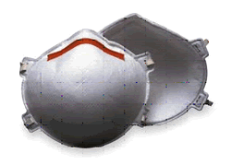
Course of Action 1: Order Different Models of Filtering Facepieces
Positives
All efficiencies are relevant
Oil rating is NOT relevant
Higher efficiencies are more protective
Disposable
Same training as N-95
Negatives
Higher the efficiency the higher the cost
Higher the efficiency the higher the resistance to breathing
Higher the oil rating the higher the cost
Air could be more moist or hotter while breathing inside the mask
Higher the efficiency and oil rating the more it’s likely going available for purchase.

Slide 20
Course of Action 2: Order PAPRs
Positives
If loose fitting hood – No fit testing required
Excellent protection
Reusable
Excellent to use as a buffer for fit testing
Negatives
Should not use if sterile field is required or if HCW may be infectious to patient
Most expensive option >$800 per unit
Requires more respirator and battery maintenance
If batteries stored for long time the potential for of a weak charge and capacity of battery life may be reduced.
Depending on model decontamination could be complex; therefore, higher potential for HCW getting infected
Bulky
Could intimidate the patient
If PAPR is used in one area and other areas a N-95, there could give the perception that one group is getting better protected than others, respectively

Slide 21
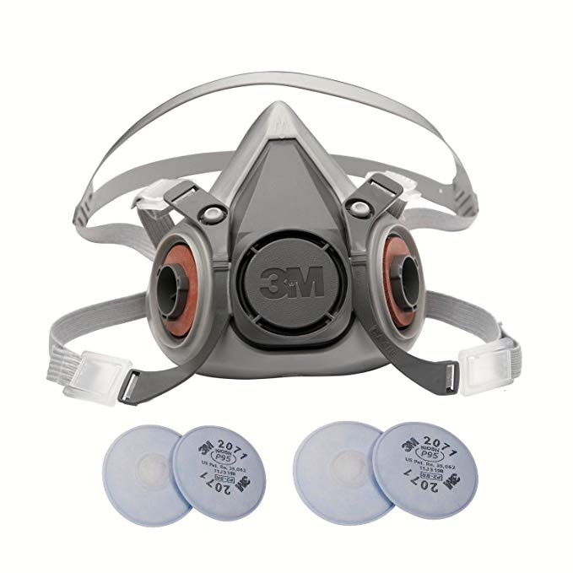
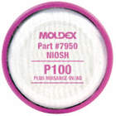
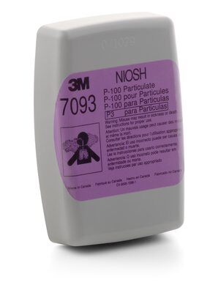
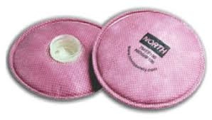
Course of Action 3: Order Elastomeric Respirators
Positives
Better fitting than filtering facepieces
Better protection than N-95
Respirator is cleanable & reusable
In some cases the filter housing can be decontaminated; therefore, reuse filter might be an option
Configurable N, P, R & 95, 99, 100
Easier to exhale than N-95
Negatives
Should not use if sterile field is required or if HCW may be infectious to patient
Requires some low intensive maintenance
More expensive than N-95 but less than PAPR
Requires more training than N-95
Depending on the make and model it can be complex to clean – no standardized cleaning protocol from CDC
Harder to communicate with elastomeric respirators
Could intimidate the patient

Slide 22
In the end it’s the seal that matters. All other filter efficiencies are an option.

Slide 23
PPE & N95 Management
HCI Infection Control Team
Scope: PPE and Respiratory Protection while caring for COVID19 Patients.
Key Issues
Who actually needs an Respiratory Protection (RP)?
What are the Normal v. Contingency RP Considerations?
How should we maintain PPE discipline?
CDC Strategies for Optimizing the supply of RP?
What are the Alternatives for a N95

