Slide 1
SCENS

Slide 2
SCENS
Wound Care

Slide 3
Learning Objectives
SCENS
Perform a focused skin/wound assessment
Employ facility specific infection control measures
Implement wound care orders
Communicate effectively when managing care for the patient with a wound

Slide 4
Why?
SCENS
Statistics for Veterans
Agency for Healthcare Research and Quality
National Guideline Clearinghouse
Wound, Ostomy and Continence Nurses Society
American Diabetes Association Standards of Care in Diabetes-2016
Joint Commission: 2016 Hospital National Patient Safety Goals
VHA Handbook 1050.01
VA/DoD Clinical Practice Guideline : Management of Diabetes Mellitus (DM) 2010
Research and evidence-based practice
Notes:
Statistics for Veterans
Discuss facility specific wound statistics
American Diabetes Association Standards of Medical Care in Diabetes-2016
Complications of diabetes
Joint Commission: 2016 Hospital National Patient Safety Goals
Goal 2: Effectiveness of communication among caregivers
Written procedures
Timeliness
Goal 7
Risk of health-care associated infections
Infection control
Hand hygiene compliance
Goal 15
Safety risks
VHA Handbook 1050.01
VHA National Patient Safety Improvement Handbook
Patient safety
Proactive risk assessment
Goals
VA/DoD Clinical Practice Guideline: Management of Diabetes Mellitus 2010
Related problems and complications
Skin assessment
Eye care
Foot care
Self-management
Research and evidence-based practices

Slide 5
Types of Wounds
SCENS
Venous
Arterial
Pressure ulcers
Trauma
Wounds associated with diabetes
Other types of wounds

Slide 6
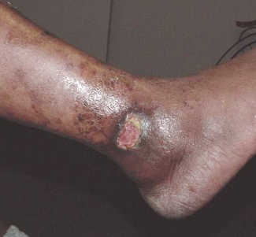
Venous Ulcers
SCENS
Characteristics
Usually located in the medial ankle area
Painless
Aching – Relieved with elevation
Surrounded by brown/black, itchy, scaly and reddened skin
Skin thick and hardened
Hair present
Edema present
Pulses present
Risk Factors
Varicose veins
History of deep vein thrombosis
Sitting or standing for long periods of time
Multiple pregnancies
Obesity

Slide 7
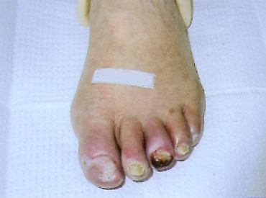
Arterial Ulcers
SCENS
Characteristics
Toes; heel; lateral ankle
Painful
Pain relieved by lowering the leg below the level of the heart
Intermittent claudication
Pale, cyanotic, or mottled
Dependent rubor
Pallor upon elevation
Thin skin; punched out appearance
Cool or cold to touch
Nails are thickened
Hair loss
No edema
Pulses decreased or absent
Risk Factors
Uncontrolled Diabetes
Hypertension
Smoking
Renal disease
Increased age
Obesity

Slide 8
Pressure Ulcers
SCENS
Braden Risk Assessment Scale
Sensory perception
Moisture
Activity
Mobility
Nutrition
Friction and shear
16 or less are at risk
15-16 = low risk
13-14 = moderate risk
12 or less = high risk

Slide 9
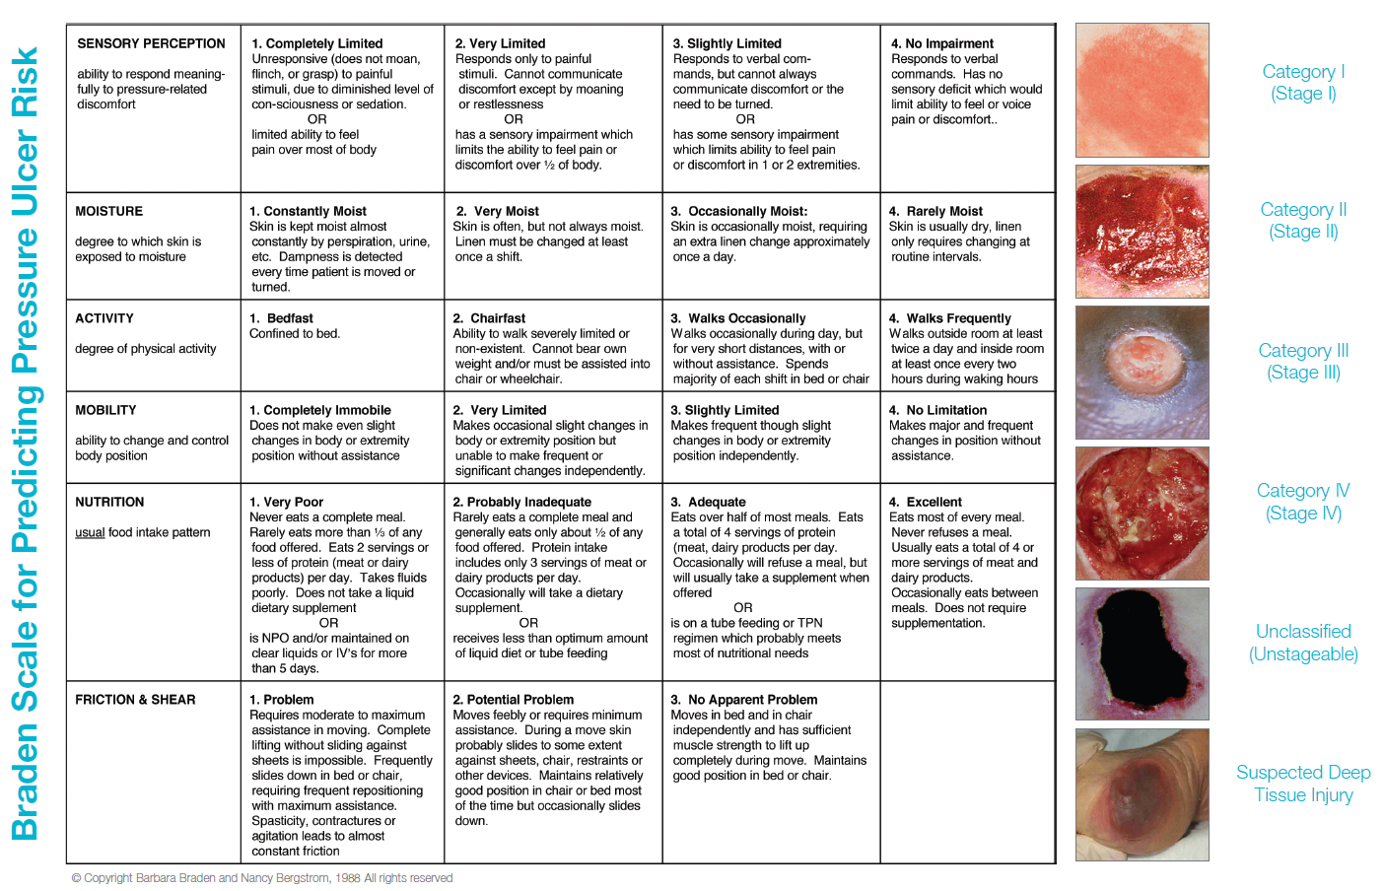

Slide 10
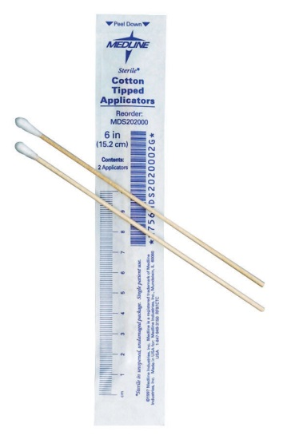
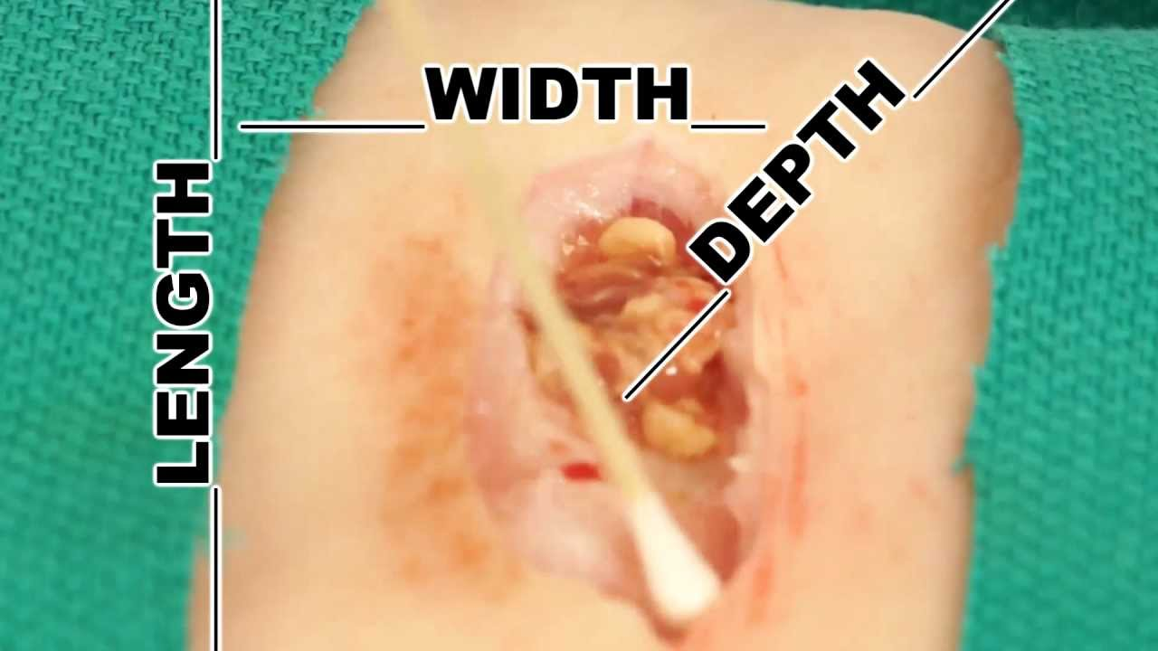
Wound Assessment
SCENS
Patient history
Risks
Communication
Wound assessment tool
Patient/family teaching
Documentation
Notes:
Provide facility specific wound assessment tool

Slide 11
Wound Care
SCENS
Pain
Personal Protective Equipment (PPE)
Signage
Types of dressings
CDC 2017 Guideline for Isolation Precautions
Standard precautions
Contact precautions
Droplet precautions
Airborne precautions
Resistant Organisms
Notes:
Pain
Medicate the pain for pain prior to dressing change
Put on PPE
Signage
Types of dressings
Dry sterile
Wet to dry
Debridement
Hydrogel (no excess fluid wounds, painful wounds, necrotic, pressure ulcers, donor sites, burns, or infected wounds)
Alginate (mod or high amount of drainage wounds, venous ulcers, packing wounds and pressure ulcers)
Collagen (chronic wounds, bed sores, surgical wounds, 2nd degree or high burns)
Hydrocolloid (burns, light to moderately draining wounds, necrotic wounds, wounds under compression wraps, pressure and venous ulcers)
Wound vac
Uses a vacuum dressing to promote healing
Infection control
What type of precautions?
Remove PPE
Proper disposal of old dressings and used PPE
CDC 2017 Guideline for Isolation Precautions
Standard precautions
Hand hygiene
Gloves
Mouth, nose, eye protection
Gown
Handling of devices and equipment
Laundry
Contact precautions
Private room preferred
Gloves
Gown
Limit transport outside room
Use disposable devices and equipment where possible.
Keep non-disposable items in the room
Droplet precautions (Meningitis, Mumps, Parvovirus, Pertussis, Rubella, etc.)
Airborne precautions (Herpes Zoster, Measles, Monkeypox, Mycoplasma Pneumonia, Tuberculosis, etc.)
Resistant organisms
Methicillin Resistant Staphylococcus Aureus (MRSA)
Carbapenem Resistant Enterobacteriaceae (CRE)
Multidrug-resistant Acinetobacter baumannii (MDR-Ab)
Vancomycin-Resistant Enterococcus (VRE)
Clostridium Difficile
Extended-spectrum beta-lactamases (ESBL)

Slide 12
Facility-Specific
SCENS
Protocols
Wound care consult
Equipment
State licensure
Scope of practice
Certifications
Job descriptions
Accountability

Slide 13
Potential Issues
SCENS
Psychosocial
Equipment or supplies
Disabilities
Assistance with dressing changes
Hygiene
Home environment
Discharge planning
What if…?

Slide 14
Summary
SCENS
Reviewed components of a focused skin/wound assessment
Discussed facility specific infection control measures
Reviewed implementing wound care orders
Discussed effective communication techniques when managing care for the patient with a wound

Slide 15
SCENS

Slide 16
Wound Care
SCENS
Norman Bronson
Fifty six (56) year old male with a painful ulceration on the right outer ankle which has progressively been getting worse. He has a history of methicillin resistant staphylococcus aureus (MRSA).
Past Medical History:
Legally blind
Hypertension
Type 2 diabetes (has not taken his medication in over 8 months)
Methicillin resistant staphylococcus aureus (MRSA)
Past Surgical History:
None
Medications:
Glyburide 5 mg daily
Enalapril 2.5 mg daily
Aspirin 81 mg daily
Allergies:
No know drug allergies (NKDA)
Notes:
Provide ISBAR communication prior to scenario.

