Slide 1
Engaging the Wisdom of Older Veterans to Enhance VA Health Care, Research and Services
Our Team: James Dixon, Serena E. Douglas, MA, Robert Fleak, MSCE, Vernon Moore, Susan Martin-Sanders, R.N., MSEd, Thomas M. Schultz, J. Pat Sullivan, J. David Yates, Certified Recovery Coach, Terry Holiway-Yates, Caregiver
James Alsphaugh⁺
Thomas R. Feller, BS⁺
Lance Van Sickle⁺
OVET Coordinator and Facilitator: Kathryn Nearing, PhD, MA

Slide 2
Geriatric Research Education and Clinical Center
Veterans Affairs (VA) center of excellence focused on aging
First GRECCs established in 1975
Today, national network is comprised of 20 GRECCs
VA Eastern Colorado GRECC funded in 2014
Older Veteran Engagement Team established in 2017

Slide 3
Eastern CO GRECC Older Veteran Engagement Team (OVET)
OVET meets monthly
OVET provides feedback/ input on research and clinical demonstration projects
Older Veterans and care partners have a voice in research and creating services and supports
Mission: To enhance services and benefits for all Veterans through research and the engagement of older Veterans and caregivers.
“What a novel idea – to go to the end user first!” – OVET member

Slide 4
Researchers: Why consider including OVET in your research process?
Can promote:
Transparency and trust in the research process
Relevance of research
Success in applying for funding
Federal funding agencies (including the VA) are increasingly requiring “stakeholder engagement”
Opportunities for Veteran input demonstrate a robust research environment
Veteran engagement enhances the rigor of the research design, and validity and reliability of research results
Responsiveness to the 5Ts (including older adults in research)

Slide 5
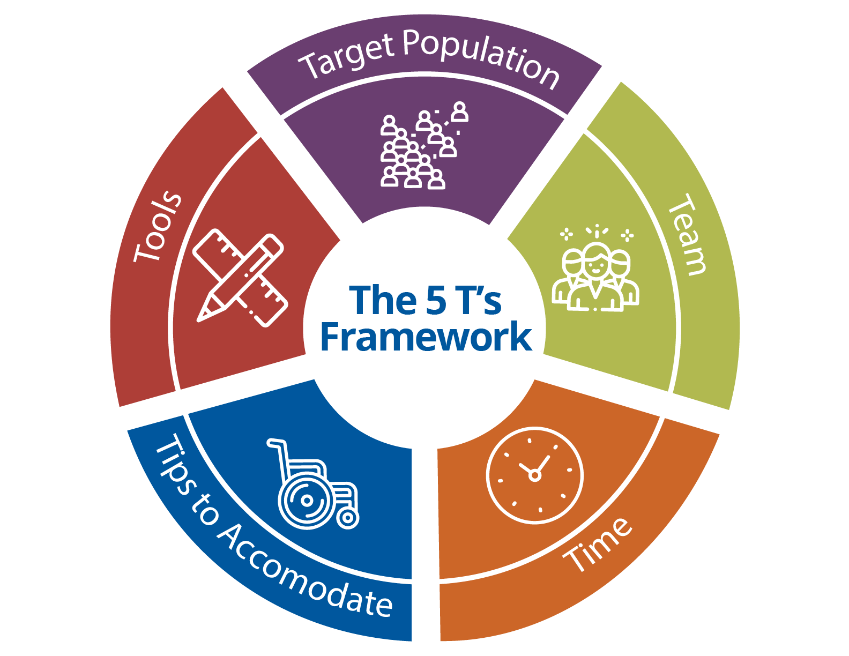
Research 5Ts | Examples
Team and Target Population | Demographics of OVET: Reflect US Veteran population ≥ 65 Inclusive of conditions most prevalent among older Veterans (e.g., osteoarthritis, TBI, PTSD, substance use disorder, experience with homelessness) Includes older Veterans who do/do not receive care through VA and caregivers
Tools | Team reviews and provides feedback on: Recruitment and data collection tools. Feedback addresses topics explored, language, best timing or ways to reach older Veterans and caregivers. Research protocols, providing perspectives as older adults re: participant burdens/benefits (e.g., suggesting older adults receive health information such as cholesterol panel if blood draw is part of study)
Time | OVET considers time required of study participants in relation to travel and time of day: OVET provides perspectives re: acceptability, feasibility of study visits (e.g., traveling for study visits is often burdensome; consider time of day to avoid driving during high-volume times and when it may be dark) Suggested home visits for 24- and 48-hr blood draws required of research protocol Suggested adding a tele-exercise option for Gerofit (research is studying participant satisfaction and outcomes)
Tips to Accommodate | OVET creatively problem-solves ways to improve recruitment and retention: Routinely recommend caregiver involvement OVET feedback has informed Tip Sheets to help Veterans and care partners set up VA-issued tablets to improve access to telemedicine. OVET urged development of Tip Sheet to help Veterans and care partners think about what to do before, during and after telemedicine appointment. OVET helped design project to make assistive hearing devices available in clinics serving older Veterans.
The 5Ts: Preliminary Development of a Framework to Support Inclusion of Older Adults in Research (wiley.com)

Slide 6
Healthcare Providers: Why consider including OVET in your quality improvement efforts?
Can promote:
Transparency and trust in the healthcare system
Responsiveness of health services to Veterans at
different ages and with different health needs,
anti-ageism
Quality of work, quality of care, quality of life
Reputation of the healthcare system

Slide 7
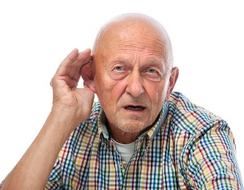
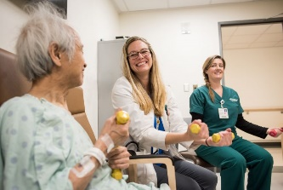
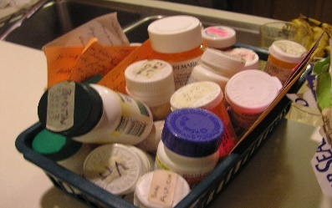
Geriatric 5 Ms
https://www.va.gov/covidtraining/docs/HIA_TipSheet_Geriatric_5Ms_19.pdf
Multi-complexity
Mind
Mobility
Matters Most
Medications
Notes:
PHOTO CREDITS:
Mind: This Photo by Unknown Author is licensed under CC BY-NC-ND
Mobility: This Photo by Unknown Author is licensed under CC BY-NC-ND
Matters Most: This Photo by Unknown Author is licensed under CC BY-SA-NC
Medications: This Photo by Unknown Author is licensed under CC BY

Slide 8
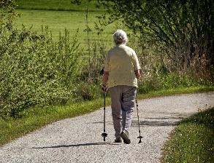
Geriatric 5Ms | OVET Topics, Feedback and Impact
Mind Maintaining mental activity Helping manage dementia Helping treat, prevent delirium Working to evaluate, treat depression | Hearing Aid Troubleshooting Guide (Audiology Trainee) OVET Feedback: Add key illustrations, change order of some information, add a “Tips and Tricks” section informed by OVET members’ own tried and true methods (e.g., for replacing a battery; seeding the device). Involve care partners in training and make sure they know about the information booklet. Response: Audiology extern used all suggestions and began distributing information during hands-on training sessions for new hearing aid wearers. He also involved care partners in this training. Outcome: 44% decrease in the total number of follow-up appointments due to lack of basic hearing aid skills. Veterans were more satisfied and self-sufficient with their devices.
Mobility Maintaining the ability to walk and/or maintain balance Preventing falls and other types of common injuries | Gerofit Exercise Program for Older Veterans (Advanced Research Fellow) OVET feedback: Major barrier to participating in regular exercise program: travel (drive time and traffic). Response: Extended center-based exercise program hours from mid-morning to mid-afternoon (accommodated those who prefer to exercise in morning/afternoon; avoided rush-hour traffic). Added a home-based exercise component, which allowed program to pivot quickly during COVID-19 lock-down. Outcome: Primary care providers, emergency medicine physicians and Fall Prevention Clinic refer patients to Gerofit.

Slide 9
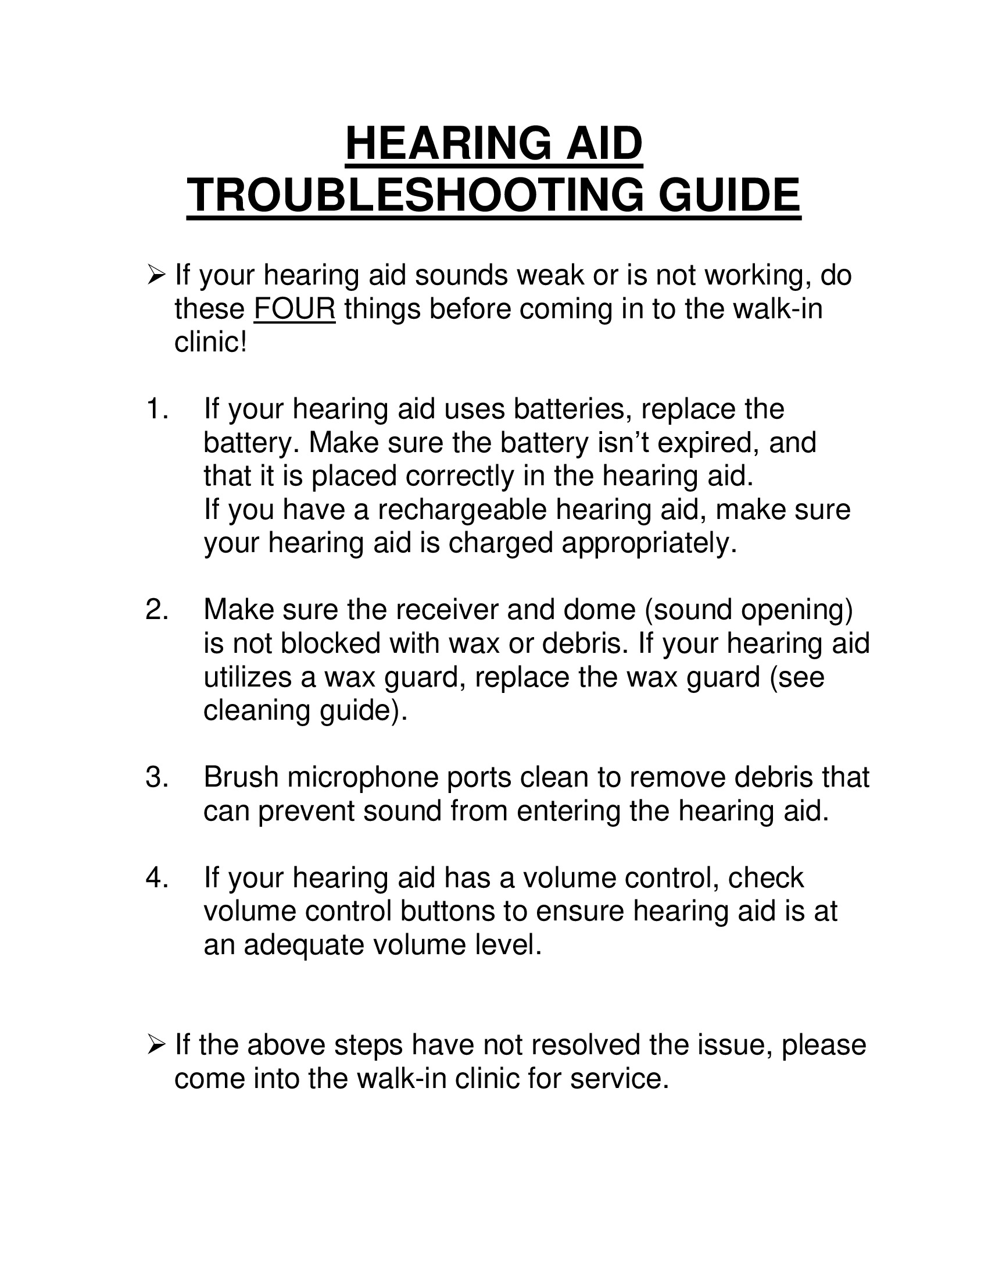
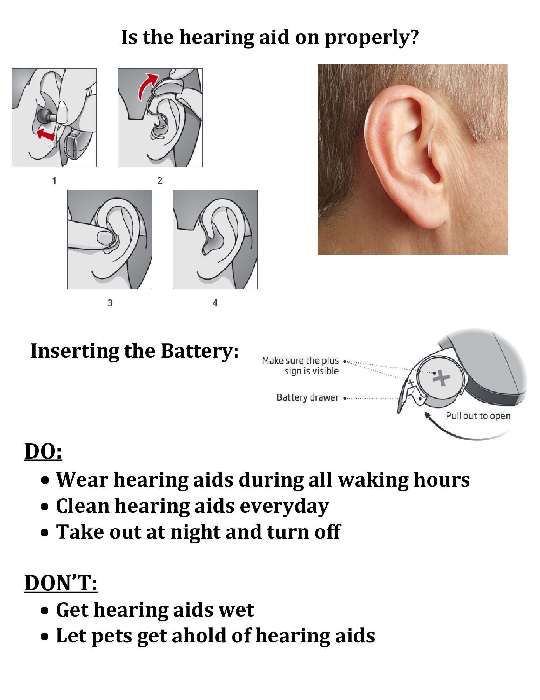
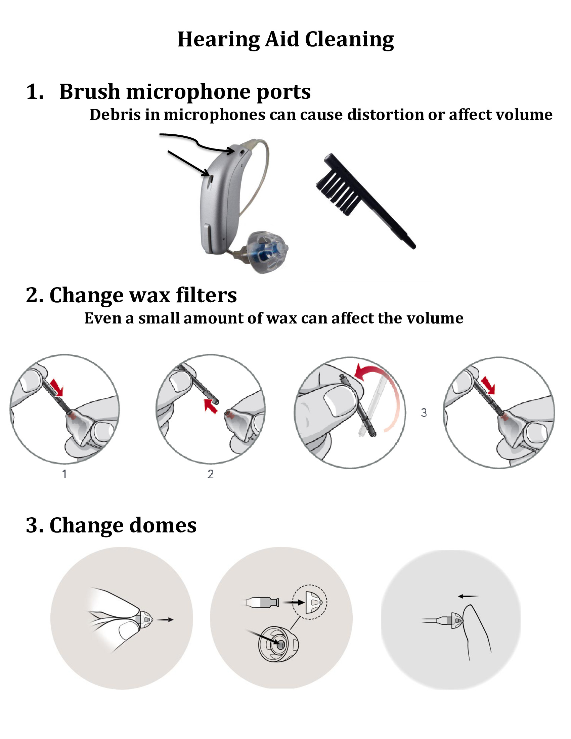
Information Resource Packet for New Hearing Aid Wearers

Slide 10
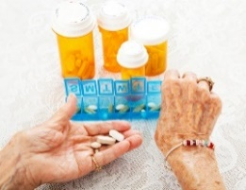
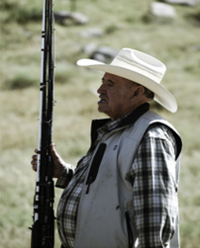
Geriatric 5Ms | OVET Topics, Feedback and Impact
Medications Reducing polypharmacy, de-prescribing Prescribing treatments for older person’s needs Building awareness of harmful medica- tion effects | Establishing a Fall Prevention Clinic at VA Medical Center (Advanced Research Fellow) OVET feedback: Make clinic interdisciplinary (e.g., include pharmacist and podiatrist); staff with providers knowledgeable about conditions more prevalent in Veterans that increase fall risk (e.g., TBI). Response: New clinic staffed with a team including a geriatrician, geriatric PT, OT and geriatric pharmacist. Linked with other programs (e.g., Gerofit) to support fall prevention, enhanced mobility and independence. Outcome: New Fall Prevention Clinic opened in May 2021 after delay due to COVID-19.
Matters Most Making sure a person’s individual, personally meaningful goals and preferences are reflected in treatment plans | Safety in Dementia Caregiver Decision Aid to address firearm access (GRECC Researcher) OVET Feedback: Recommended expanding priority populations to reach. Firearm access/storage is equally relevant to those with PTSD and TBI. Depression, bipolar disorder and stroke could also affect safe handling of firearms. Be direct about the focus: firearm access, safety, prevention of intentional and unintentional injury. Response: Currently conducting a trial to evaluate the effectiveness of reaching priority populations through different channels (e.g., social media, trusted organizations, etc.) Outcome: Disseminating information, including a Firearm Life Plan, through the VA. Goal is to make tools available through talk therapy groups and caregiver support services.

Slide 11
Students, Trainees: Why engage OVET (i.e., “stakeholders”) today and in your future?
“I greatly appreciated the participants' identification of barriers, but also their extremely insightful and creative ways of addressing those barriers or concerns. I found the conversation very engaging and fruitful. Personally, knowing that I have the support of such an engaged group also gave me the confidence to continue to pursue this research.”
- GRECC Advanced Research Fellow

Slide 12
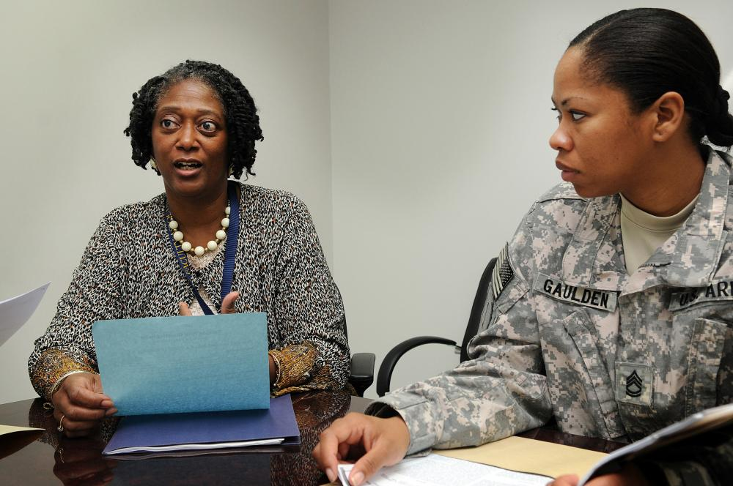
Benefits of Participation: Perspective of Presenters/Guests
“We feel the input from OVET will help our research become more valuable and meaningful to those it is intended to help.”
“The meeting with OVET was important to the design and development of appropriate patient/caregiver-friendly materials regarding research participation.”
“ … the discussion informed our plans for a communication strategy …”
Notes:
From Presenter Evaluation Forms
Photo credit:
https://www.dvidshub.net/image/181488/post-traumatic-stress-disorder-overseas-clinicians-review

Slide 13
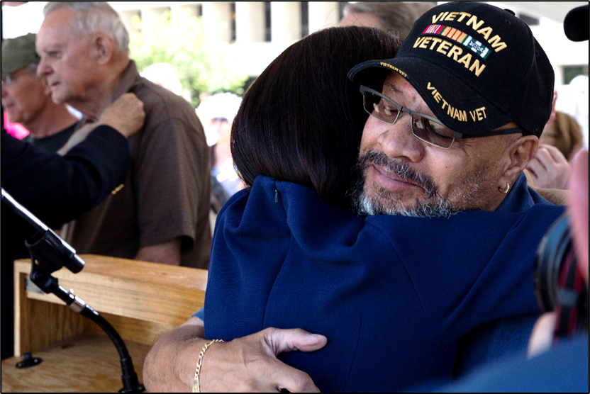
Benefits of Participation: Perspective of Older Veterans
“Increased awareness and education about available programs and resources”
“Learning how to age well (nutrition, physical activity)”
“Introduced me to other Veterans with similar concerns”
“Good variety of topics that are of general interest”
“Gave me a chance to meet people, associate, get out and learn from other[s].”
Notes:
From annual Year-in-Review meeting (verbatim notes)

Slide 14
Interested in OVET Feedback/Input?
Contact Kathryn Nearing Kathryn.nearing@va.gov
Schedule meeting (It is never too early to get OVET input.)
Submit completed Presentation Request Form at least 2 weeks prior to meeting
Plan to join team meeting 10:15- 11:45 am on scheduled date
Give a brief overview presentation (10-15 mins). Questions will guide discussion.
Receive detailed meeting notes (usually within 2 weeks)
Complete brief evaluation (what you plan to use, what you cannot use and context)

