Slide 1
20
Reasons
Doctors Like Working for
Veterans Health Administration
June 2016

Slide 2

Reason #1- Let Us Worry About the Bottom Line
Freedom to practice medicine and focus on the patient without the distractions of running a business
VA doctors do not have the ‘overhead’ of running an individual or group medical practice
No need to build patient base to create revenue
30 minutes standard visit length in VA, compared with an average of 20 minutes outside VA

Slide 3
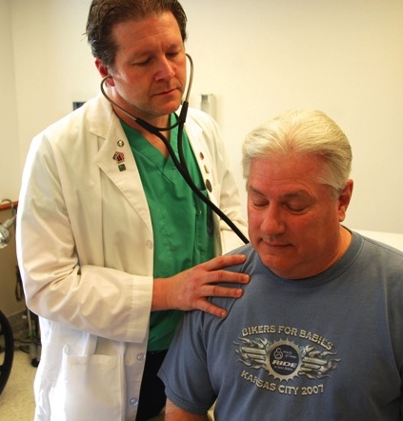
Reason #2 – Why not join the #1 Health Care System in the country
340,000 employees VA-Wide
9 million enrolled Veterans
Nobel Prize winners
High performance on Quality Indicators
Licensure valid in all 50 states
Over 1,200 locations
Career opportunities to fit every lifestyle

Slide 4

Reason #3-Groundbreaking Research Opportunities
Doctors get to participate in research
Salary support for awardees to pursue research and training
Clinical innovations projects
Part of broader academic and clinical communities of practice
Dynamic collaborations with its universities, federal agencies, nonprofits, and private industry
Impacting health of Veterans and the Nation

Slide 5
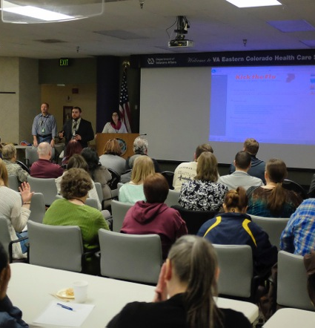
Reason #4-Teaching Residents, Medical Students through Academic Affiliations
Over 120,000 trainees in over 40 health professions disciplines
  41,000 physician residents
  23,000 medical students
  27,000 nurse trainees
  27,000 other associated health disciplines
VA is affiliated with over 1,800 unique educational institutions across over 7,000 training programs
VA is affiliated with over 90% of allopathic medical schools and over 85% of osteopathic medical schools
Over 70% of VA physicians have faculty appointments and spend some portion of their time in education and research activities

Slide 6

Reason #5-Great Work/Life Balance
49 Days of annual paid time off
  26 days paid vacation
  13 days paid sick leave
  10 paid federal holidays
Predictable work schedules and a focus on quality vs. volume
Many outpatient doctors work a M-F schedule with little to no on-call

Slide 7
Reason #6-Robust Benefits Package
Federal Employees Retirement System (FERS), or Civil Service Retirement System (CSRS), or CSRS-Offset;
Thrift Savings Plan (TSP)
Health insurance options are excellent, and this is one of the few places in the country that has a pension for doctors as well as a good 401K.
Federal Employees Health Benefits (FEHB) Program
Flexible Spending Accounts (FSA)
Federal Employees Dental and Vision Insurance Program (FEDVIP)
Federal Long Term Care Insurance (FLTCI) Program
Federal Employees’ Group Life Insurance (FEGLI) Program
Federal Leave Program
26 days of paid annual leave starting the first year and the ability to accumulate up to 86 days
13 days of sick leave each year with no limit on accumulation
10 paid Federal holidays
Military Leave, up to 15 days a year for active reservists and National Guard members
Predictable scheduling
Reduced paperwork
Elimination of billing hassles
Malpractice insurance
Education Debt Reduction Program

Slide 8
Reason #7-Comprehensive Professional Development
Access to a nationally recognized CME program accredited with commendation for a six year term by the ACCME
Continuing education delivered via face-to-face, virtual, and blended options
Cutting-edge simulation and education gaming modalities
Annual CME reimbursement of $1,000 and possible paid absence to attend for qualifying physicians
Education Debt Reduction Program (EDRP) offering up to $120,000 over 5 years for qualifying physicians
Doctors are supported and empowered by VA training and coaching in patient-centered communication skills that promote patient engagement, health behavior change and self-management
Nation’s leading provider of continuing medical education (CME) credits/hours
VHA doctors can earn CME credits at no cost through VHA’s accredited Accreditation Council for Continuing Medical Education (ACCME) activities

Slide 9
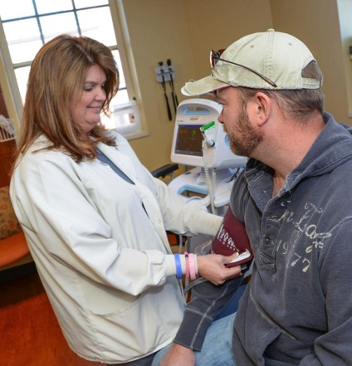
Reason #8-Best Mission in the Federal Government
With the words, “To care for him who shall have borne the battle and for his widow, and his orphan,” President Lincoln affirmed the government’s obligation to care for those injured during the war and to provide for the families of those who perished on the battlefield.

Slide 10
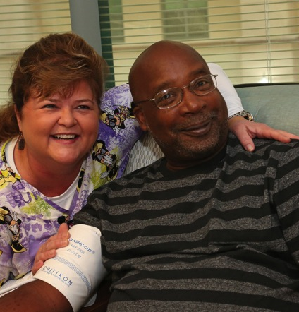
Reason #9-A team to support you in caring for your patients
Team-based model of care: VHA’s model of Patient-centered medical home “Patient Aligned Care Teams (PACT)
Interdisciplinary team-based care
Care coordination
Population health management
Mental health integration in clinical practice and clinical pharmacists embedded in primary care

Slide 11
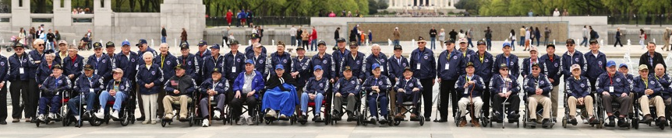
Reason #10– Best Patients in the World
Opportunity to give back to America’s greatest heroes
Opportunity to care for patients from military discharge through their lifespan
                21.7 Million living Veterans in the USA from World War II, Korean War, Vietnam, Gulf Wars, Post 911 and peace time eras
8.97 Million Veterans enrolled in VHA Health Care
6.2 Million Veterans treated in VHA in 2015
  “As we express our gratitude, we must never forget that the highest appreciation is not to utter words, but to live by them.” —John F. Kennedy
Veterans – Defenders of Freedom
https://www.youtube.com/watch?v=X2QnyMiYyOc

Slide 12
Reason #11- Provide Holistic and Comprehensive Care
“Our ‘whole health’ model of care is a key component of the VA’s proposed future delivery system. This model incorporates physical care with psychosocial care focused on the veteran’s personal health and life goals, aiming to provide personalized, proactive, patient-driven care through multidisciplinary teams of health professionals.”
David J. Shulkin, M.D.
N Engl J Med 2016; 374:1003-1005
Whole health model with personalized, proactive, and patient-driven care
Complementary and Integrative Health
Strong partnerships and motivated teams to create comprehensive health care for patients
Diverse group of patients interested in learning more about holistic approaches to care
The VA benefits package covers all the critically important services that are so often unavailable or require a big paperwork battle to obtain outside VA

Slide 13
Reason #12-Government Malpractice Insurance
VA physicians are covered under the Federal Tort Claims Act - 28 U.S.C. § 1346 and 28 U.S.C. § 2671
Medical personnel have statutory immunity from “individual” malpractice liability while acting within scope of employment
  VA physician cannot be sued in civil court for the malpractice (tort) claim
  Government malpractice: providers don't feel as threatened by the malpractice climate while working for the government because they are told that if a patient sues a VA doctor, they are not really suing the doctor but instead are suing the federal government. Thus, less junk lawsuits.
Separate medical malpractice insurance is not required to be maintained
Legal remedy is against the Government; not against the individual federal employee
Medical malpractice claims are processed by VA legal staff in the Office of General Counsel
  VA physician does not have to retain private legal counsel
  Requests for depositions by claimants counsel must be approved and coordinated by VA legal staff

Slide 14
Reason #13-Competitive Salaries
Public Law 108-445 permits VA to construct a pay system allowing for enhanced recruitment and retention.
VHA physician and dentist pay, under Title 38, has three elements
  Base pay component is set by statute
  Market pay is intended to reflect the recruitment and retention needs for the specialty or assignment of a particular physician or dentist at a facility.
  Performance pay to recognize the degree to which an individual achieves defined goals and performance objectives - earn up to an additional 7.5% of salary not to exceed $15,000 annually
Approved VA salaries guaranteed and not affected by patient base, RVUs
Indefinite employment tenure
No significant restriction on moonlighting
No coventry clause and no non-compete

Slide 15
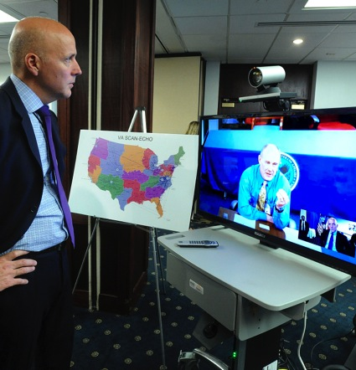
Reason #14-Access to the Latest Technology
State-of-art tools - speech recognition capabilities, mobile devices and a variety of renowned knowledge-based resources.
Virtual technologies (telemedicine, connected health, etc.)
VA providers and community health care providers can query and retrieve Veterans’ health information with each other’s organizations for treatment
VA Direct - lets VA users send and receive encrypted health information with non-VA partners
World leader in telehealth, last year more than 677,000 Veterans accessed VA care through telehealth

Slide 16

Reason #15-Electronic Medical Record – 25 years of Experience
25 years of experience with electronic health record
Access to patient’s health record from VA, Department of Defense and a rapidly growing number of community providers
VA’s online HealtheLiving Assessment provides proactive, actionable health information to Veterans about the impact of their current lifestyle choices
The online Veterans Health Library has 24/7 comprehensive, consistent, patient-focused health information to Veterans and their families
Clinicians are able to graph lab results and vital signs over time

Slide 17

Reason #16- Innovative Clinical Care
It is an exciting time to be in VHA as we develop a new model of health care focused around Whole Health
VHA supports clinical innovations through resources, grants, and research
VHA recognizes strong innovative and best practices related to Whole Health and clinical care
VHA is actively looking into methods for increasing complementary and integrative health services delivery
VHA has created a new curriculum around Whole Health that has been launched nationally to train and educate the workforce

Slide 18
Reason #17 – Leadership Development
Healthcare Leadership Talent Institute (HLTI) whose key goal is to establish an integrated system to identify, develop and manage VHA talent to meet the need for high performing transformational healthcare leaders aligned with the VHA mission and strategic direction.
The leadership development offered by VHA to its leaders has been designed and is delivered to maximize the application of the learning to the VHA clinical environment with specific emphasis on the development of health care related leadership competencies.
In addition to physicians having a variety of clinical, research, and teaching opportunities, there are also opportunities for clinical leadership roles such as service chiefs, Chief of Staff (COS), Chief Medical Officer (CMO), Chief Executive Officer, etc.
VHA is developing a two-year Physician Retention and Leadership Development Training Program to ensure that physicians who join VHA have the necessary training, relationships, and experiences to successfully integrate into VHA, and to succeed as clinical leaders.

Slide 19

Reason #18– Flexible Work Schedules
Potential for full-time or part-time opportunities, and in some cases block schedules and condensed work weeks.
PRN option (VA term is fee basis).
Telework
  You might even be eligible to work from home on a regular or ad hoc basis
  Working remotely gives you all the flexibility you need, helping you balance work and family responsibilities
Vary your arrival and departure times
  Working longer but fewer days during your pay period

Slide 20
Reason #19 – Endless Opportunities to Live & Work Anywhere in the U.S.
1,227 Sites of care throughout the U.S.**
168 Medical Centers
1,047 Outpatient Clinics
135 Community Living Centers
113 Domiciliary Rehabilitation Treatment Programs
60 Mobile Sites of Care
300 Readjustment Counseling (Vet) Centers
80 Mobile Vet Centers
**NOTE: The number of sites of care is NOT a total of the categories listed below, as several of the sites are also listed in multiple categories (e.g., there are 135 CLCs within the 168 medical centers)
Source: VSSC QES 1st Qtr FY16

Slide 21
Reason #20 – Being Part of an Elite Healthcare Community
VA’s reputation for quality healthcare and its role in academics and medical research ensures VA physicians are a part of an elite healthcare community
VA groundbreaking work in cardiovascular disease, diabetes, genomics, prevention, geriatrics, integrated health sets the pace for medicine in U.S.
Collaboration with Military Health System and Services, to include direct care and research
Providers retiring or separating from the Military Health System have ability to continue to serve our Nation’s heroes
The groundbreaking achievements of VA investigators—more than 60 percent of whom also provide direct patient care—have resulted in three Nobel prizes, seven Lasker awards, and numerous other national and international honors

