Slide 1
Supportive Services for Veteran Families (SSVF) Webinar Series February 16, 2012
Audio can be accessed through the following conference line:
Conference Line: 1-866-266-3378
Passcode: 8224620015

Slide 2
Agenda
Webinar Format
SSVF Hot Topics
Legal Resources for Veterans
Overview of Monitoring Procedures for SSVF Grantees
Overview of SSVF Program Office and FSC Audit Plan

Slide 3
Webinar Format
Webinar will last approximately 2 hours
Participants’ phone connections are automatically “muted” due to the high number of callers

Slide 4
Submitting Questions During the Webinar
Questions can be submitted via email at SSVF@va.gov
Questions will be answered either individually or through the publication of a Question and Answer resource.

Slide 5
Webinar Presentation Materials
Material from this webinar will be available in the near future on the SSVF Website: http://www.va.gov/homeless/ssvf.asp

Slide 6
SSVF Hot Topics

Slide 7
Maximizing SSVF Effectiveness and Outcomes with Legal Services Legal Service Resources for Veterans February 16, 2012
United States Department of Justice, Access to Justice Initiative
Legal Services Corporation
Pine Tree
Legal Assistance

Slide 8
People go to legal aid offices for free help with:
Basic Necessities
Housing (foreclosure, eviction, living in unsafe housing, need for reasonable accommodations)
Getting or keeping government benefits (food stamps, TANF, SSI, disability)
Getting needed medical help
Safety and Stability
Child support, custody or visitation
Abuse, dating violence or stalking
Access to healthcare
Divorce
School services (discipline or special ed)
Economic Security
Job problems (hiring, firing, unemployment appeals, getting paid the right amount or on time, drivers and professional licenses)
Government benefits
Taxes (filing or getting the earned income credit or refund check)
Debt collection and credit problems
Victim of a scam (bad checks, email and phone offers
Tax credits
Bankruptcy
Image from secure3.convio.net
Veterans also have these problems -- which often have legal solutions.

Slide 9
Studies Confirm Need for Legal Services among Veteran Families
Legal problems are among the top ten unmet needs of homeless veterans
Lack of access to legal services is #4 barrier to veteran families seeking to exit/avoid homelessness

Slide 10
Data and analysis provided by:

Slide 11
Range of Free Legal Services
Comprehensive Advocacy and Direct Services for veterans and military families
Impact Litigation
Representation, Advice & Counsel
Clinics
Online Technologies for self-help and pro bono
Document assembly
Statesidelegal.org
Use of Volunteers
Law firm projects
Pro bono attorneys and Paralegals
Law students/interns
Outreach, education and legal information
Veterans and families
Current service members
Community providers

Slide 12
Typical Legal needs of SSVF families
Cases for veteran families at Pine Tree Legal in 2011 involved a broad range of issues:
34% housing (esp. eviction, unsafe housing, and reasonable accommodation)
34% family (child custody and/or child support, guardianship, domestic violence)
15% consumer (esp. debt collection and contracts/warranties)
7% income benefits (esp. Social Security, SSDI)
8% other (taxes, employment, health, etc.)

Slide 13
Legal Aid programs are especially important in reaching low-income women veterans

Slide 14
How to learn more about legal needs of SSVF families
VHA Directive 2011-034:
It is VHA policy to encourage staff to refer homeless Veterans to legal service providers or referral services for assistance with matters such as child support or outstanding warrants or fines, and to provide office space to legal service providers, when possible. ..In addition, staff may refer homeless Veterans to the Legal Services Corporation’s Web site which lists local legal service providers: www.statesidelegal.org
.

Slide 15
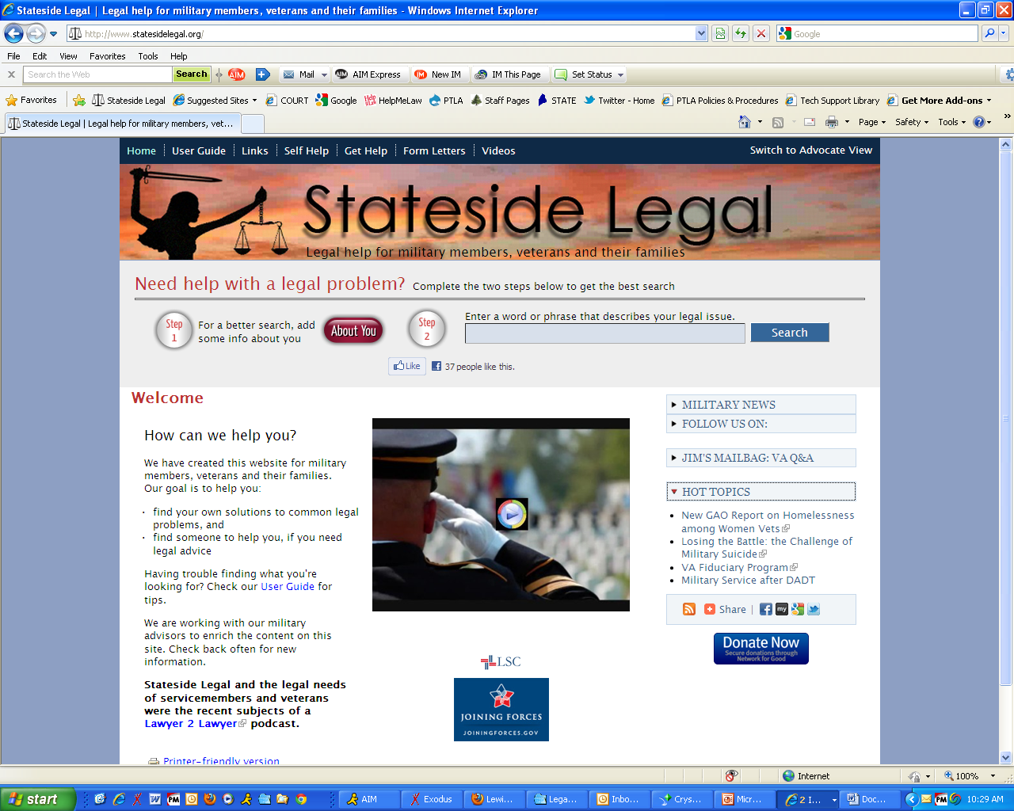
www.Statesidelegal.org has important information for SSVF Families:
Homeless Veterans Resource Guide
VA Caregiver Support
Foreclosure Help for Servicemembers under the SCRA
Fair Housing Rights
Disability Benefits: Military, VA and Social Security
Unemployment Compensation for Ex-Servicemembers
Don’t Leave Money on the Table: Tax Credits and Public Benefits
What I Need to Know about the New Electronic Benefit Rule
Divorce in Military Families – How It’s Different and What You Need to Know

Slide 16
StatesideLegal.org educates families and caseworkers about legal rights
To get help enforcing those rights use the “Get Help” tab for links to local legal aid programs

Slide 17
The Value of Legal Services
In 2011, legal services by Pine Tree Legal Assistance generated $2.50 in savings/revenue to clients for every $1 spent on program services;
98% of 959 eviction proceedings receiving extended legal service were resolved in favor of the Pine Tree client.
Negotiations to get extra time to find alternative housing avoided 11,725 days of homelessness for Pine Tree clients (including families).

Slide 18
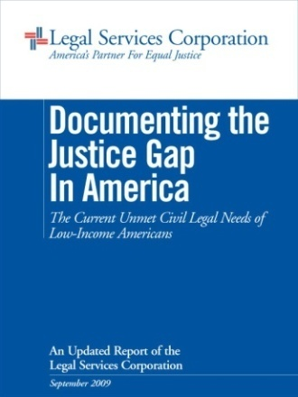
Legal Services Corporation
America’s Partner for Equal Justice
The Justice Gap
LSC’s 2005 and 2009 Justice Gap Reports describe a crisis in representation.
Only 20% of the civil legal needs of low-income Americans are being met.
On average, low-income households experience 1-to-3 legal problems per year, and roughly 1-in-5 were addressed with the assistance of a lawyer.
For every client served by a grantee, at least one eligible person seeking help was turned down because of limited resources.

Slide 19
Importance of SSVF subcontracts in securing legal services
2012 LSC funding cuts have reduced capacity at local legal services by 15%
IOLTA funds dropped significantly nationwide
Many funders limit services to only specific types of issues (e.g., domestic violence) or client populations (e.g. Native Americans)
SSVF subcontracts allow local legal aid programs to prioritize referrals of eligible veteran families and provide them with the full range of needed assistance

Slide 20
Bottom Line:
Ensuring SSVF participants get the help they need for long-term stability often requires civil legal services.

Slide 21
Next Steps
Identify local legal aid providers by using “find help” at StatesideLegal.org or contact Cheryl Nolan who can make an introduction.
Consider sub-contract arrangement to ensure legal services for SSVF participants.
Encourage cross-referrals between SSVF grantee and legal aid program.
Consider partnerships on an upcoming “stand-down” event.
Invite legal aid representatives to participate in your State response to the VA “homeless action plan.”

Slide 22
For More Information:
Melanca Clark
Senior Counsel, Access to Justice Initiative
U.S. Department of Justice
(202) 514-7173
Melanca.Clark@usdoj.gov
Nan Heald
Executive Director
Pine Tree Legal Assistance
207-774-4753
Nheald@ptla.org
Karen Lash
Senior Counsel, Access to Justice Initiative
U.S. Department of Justice
(202) 307-3573
Karen.Lash@usdoj.gov
Cheryl Nolan
Program Counsel
Legal Services Corporation
(202) 295-1561
NolanC@lsc.gov

