Slide 1

The HUD-VASH Program:
Permanent Supportive Housing
For Chronically Homeless Veterans
Nancy Campbell, National Director HUD-VASH

Slide 2
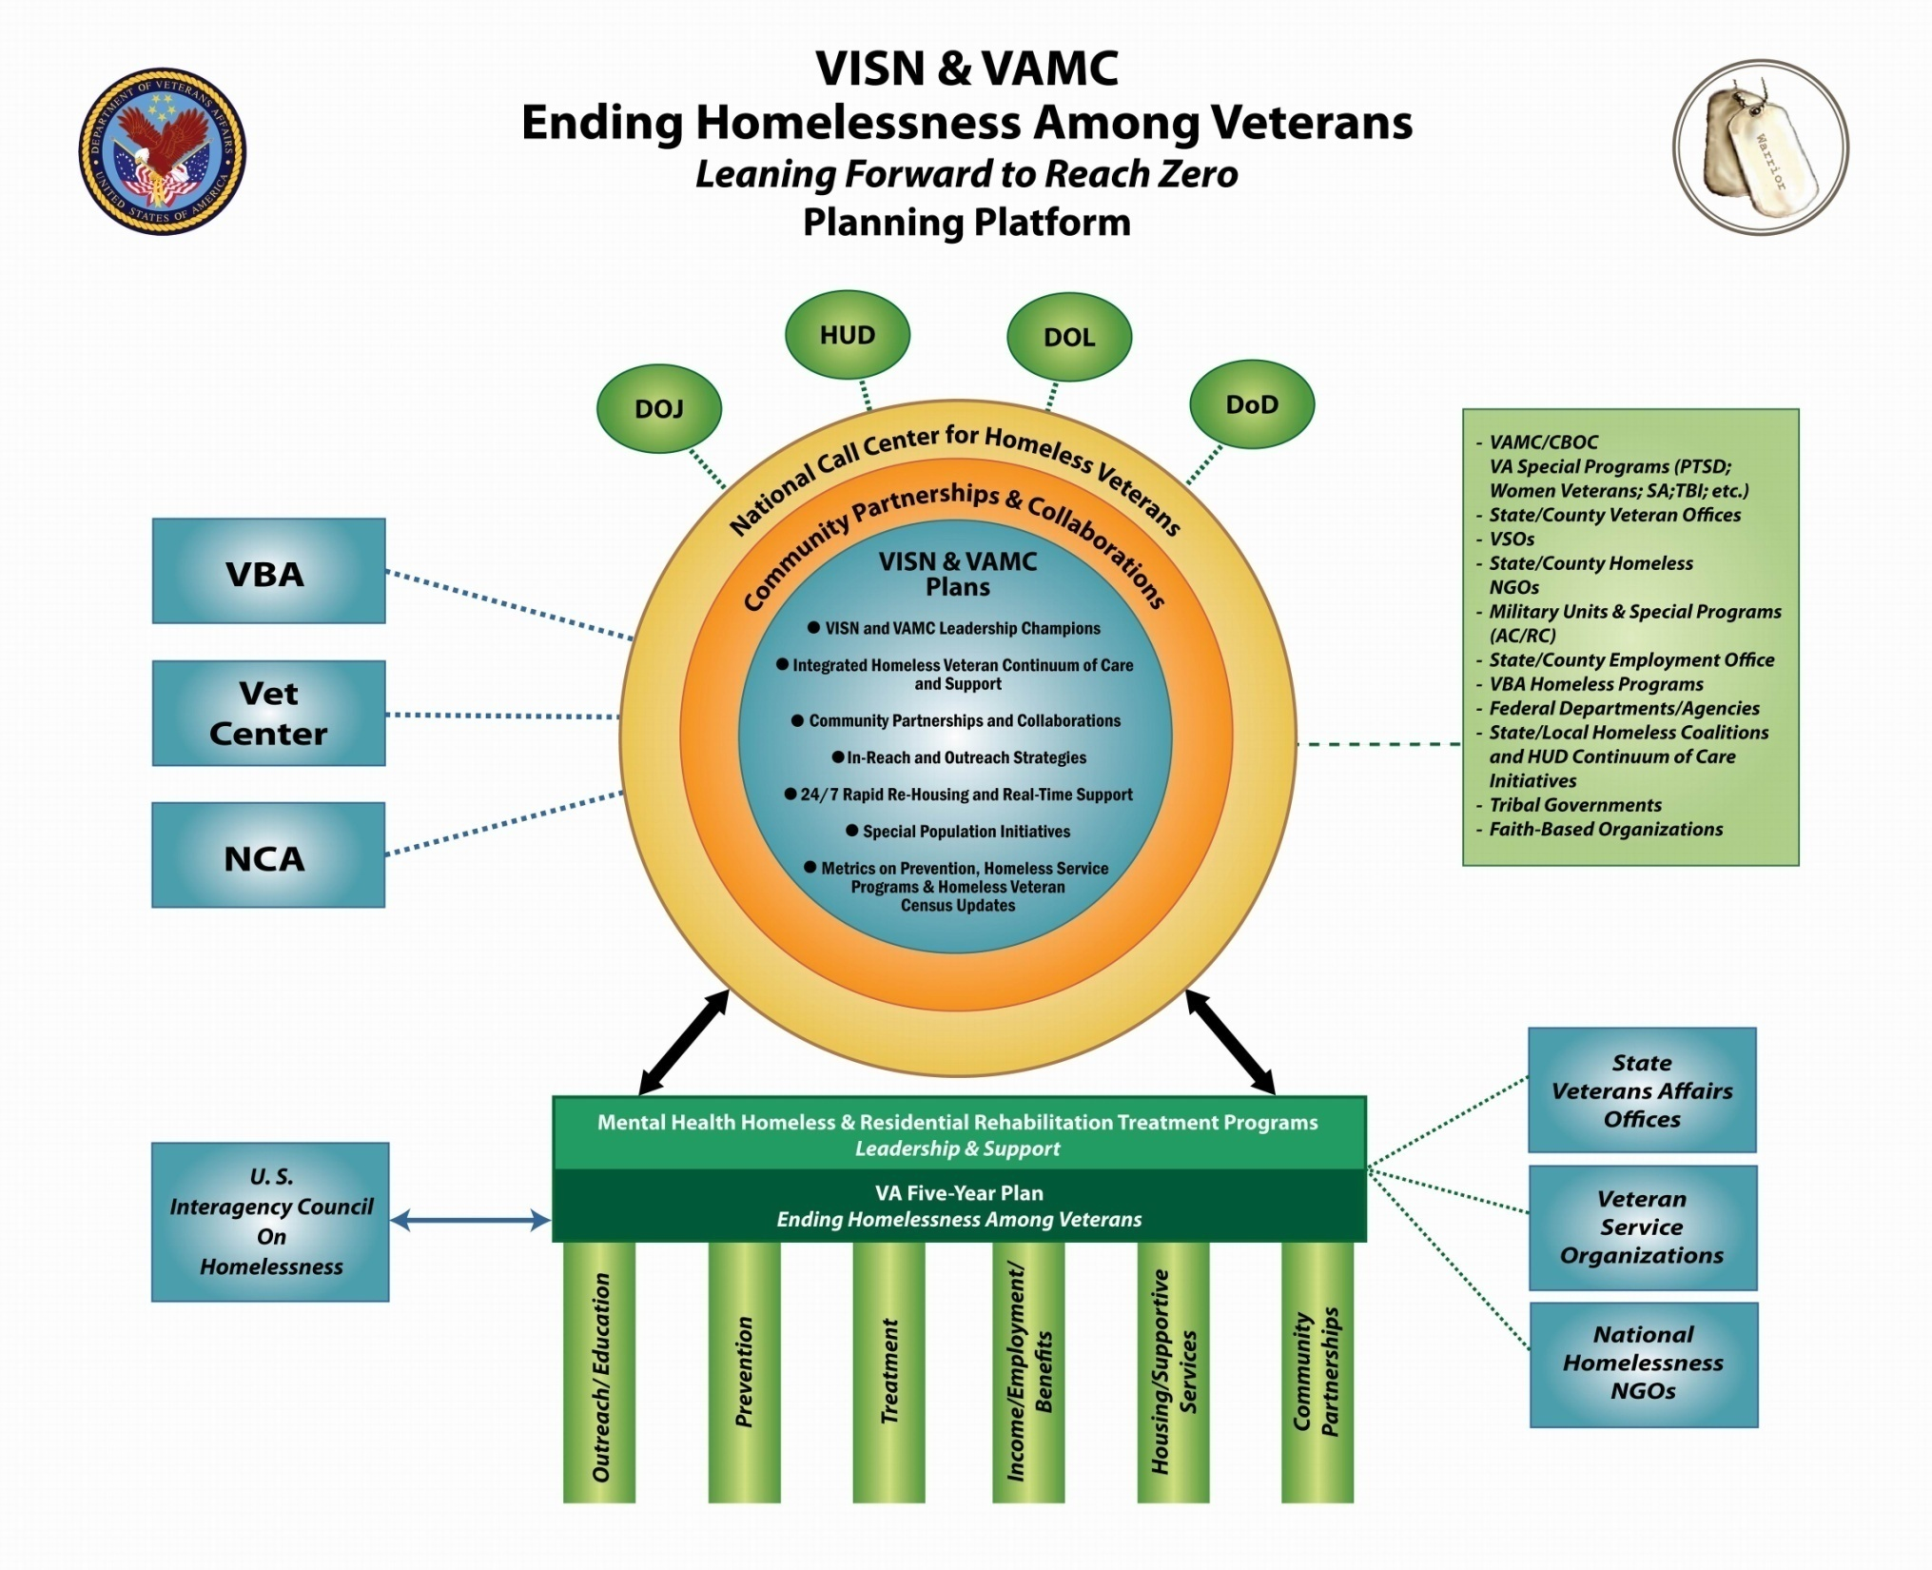

Slide 3
Housing and Supportive Services
VA is moving from a transitional housing service model to a permanent housing services model.
This strategy includes:
  the expansion of vouchers and beds,
  efforts to create new housing resources in the community,
  efforts to connect with other VA services and community agencies to provide supportive services.
VA provides transitional and permanent housing solutions for Veterans through the Grant and Per Diem Program, the Health Care for Homeless Veterans Contract Residential Care program and the HUD-VASH program.
Supportive Services help Veterans and families secure housing and stabilize, providing the supports necessary to ensure that they are able to access other needed community-based services and sustain their housing. For Veterans that have been chronically homeless, such supports need to be ongoing, readily accessible, and attached to housing.

Slide 4
Housing and Urban Development-Veterans Affairs Supportive Housing (HUD-VASH) Program
A collaborative program between HUD and VA
Veterans receive VA provided case management and supportive services to support stability and recovery from physical and mental health, substance use, and functional concerns contributing to or resulting from of homelessness.
HUD provides subsidized rental assistance in the form of a Housing Choice Voucher. Many of the requirements that pertain to other Section 8 voucher programs are waived.
VA determines eligibility for health care and whether veteran meets the definition of being homeless. HUD determines income eligibility and whether or not veteran is on a lifetime sex offender registry.

Slide 6
Chronic Homelessness
Unaccompanied individual with disabling condition who has been homeless for 1 continuous year or 4+ times in 3 years (HUD, 2011)
16.8% of individuals experiencing homelessness are chronically homeless (HUD, 2011)
Psychiatric disability, substance abuse, medical co- morbidities more prevalent within chronically homeless population than episodically or transitionally homeless (Kertesz, et al., 2005; Burt, et al., 2001; Kuhn & Culhane, 1998)
Services cost an average of $40,500/year for chronically homeless multi-system users (Culhane, Metraux, & Hadley, 2002)

Slide 7
Role of HUD-VASH Within the Continuum:
Working with Others to Target and Serve the Most Vulnerable
VA has set target goal of 65% in HUD VASH being chronically homeless.
Remaining 35% still available for other vulnerable, high priority groups – veterans with families, women, OEF/OIF
Rapid Results Housing Boot Camps have successfully engaged 20+ high profile communities to focus on targeting the CH
Efforts underway to better integrate with VA Outreach staff and Community Solutions 100K Campaign
Closer cooperation with CoCs on defining, locating and engaging the chronically homeless; better education on VA eligibility criteria
Expansion and utilization of other options for families i.e. Supportive Services for Veterans Families (SSVF)

Slide 8
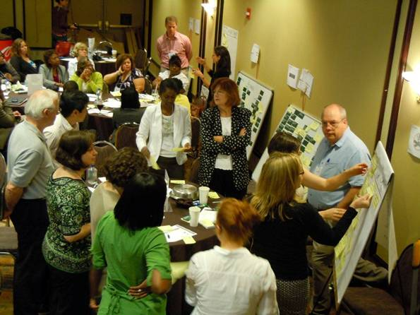
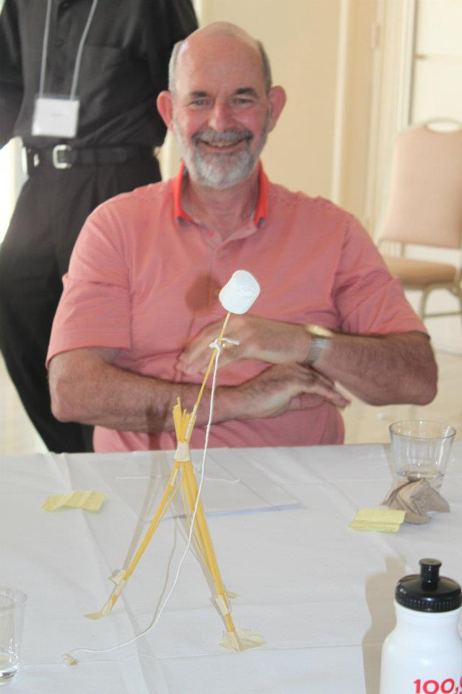
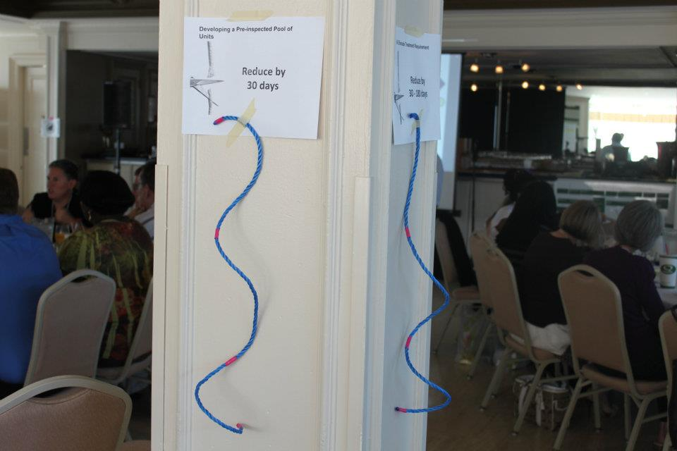
The Rapid Results Institute put on “boot camps” for 20 VASH communities, bringing together HUD, PHA, VA, and CoC staff into community centered groups to map their processes and come up with ways to improve them in creative and collaborative ways
Attendees at the San Diego boot camp think of new ways to approach their goals

Slide 9
Housing First Implementation
HUD-VASH Housing First Demonstration Pilot
  14 VAMCs across the country participating
  50 vouchers/site set aside for Housing First
  Funding for Assertive Community Treatment/Intensive Case Management teams
  Evaluation at the program and Veteran level
Notes:
Preliminary outcomes: ~89% of those Veterans housed through HF were still housed with HV voucher 1 year after move in.

Slide 10

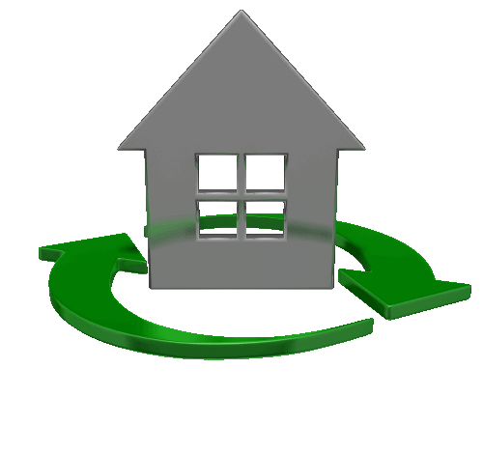
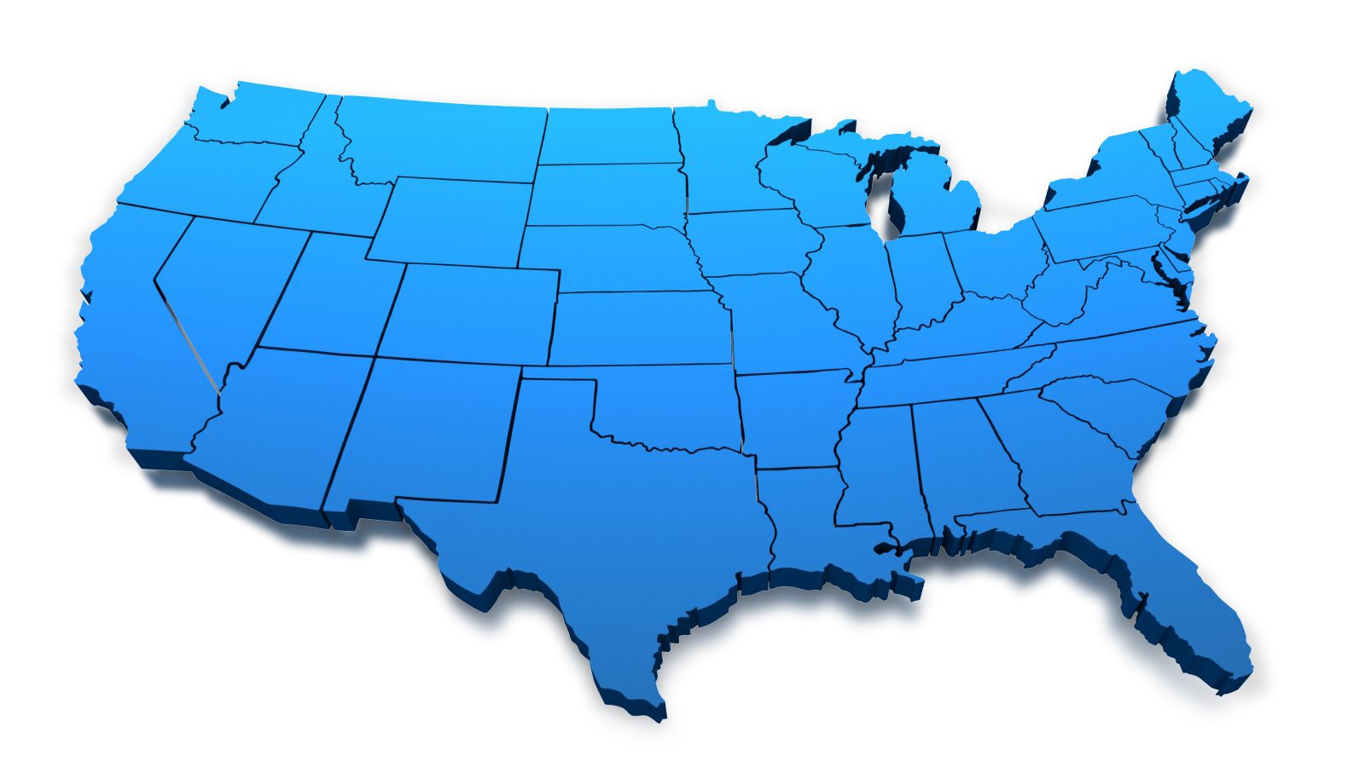

Housing First
Leading the Way to Ending Veteran Homelessness
New York
State
Portland
Detroit
Boston
San
Francisco
New York
City
Chicago
Philadelphia
Washington
DC
Denver
Los
Angeles
Dallas
New
Orleans
Bay Pines

Slide 11
Housing First
  It is the policy of the VA, strongly supported by HUD and USICH
  Being rolled out nationally to all VAMCs. Each facility has now completed a baseline Housing First assessment and implementation plan with their partner Public Housing Authority.
  Most striking barrier and need is for move-in assistance, utility and rent deposits
  Collaboration and integration with our community partners is vital to our Veterans success!

