Slide 1
Supportive Services for Veteran Families (SSVF) Program
SSVF Grant Agreements and
HHS Payment Management System
Monday, July 23, 2012

Slide 2
Congratulations on your
2012 SSVF awards!
2

Slide 3
PY 2012 SSVF
Applications Summary
Approximately $100 million awarded through 151 grants in 49 states, Puerto Rico and the District of Columbia
$61.1 million for renewal
$38.7 million for new applicants
Announced Notice of Funding Availability (NOFA) December 2011
Received 500 applications
83 Renewals
417 New applications
Applications were received from 49 states, DC and Puerto Rico
Average amount of funds requested: $666,461 per award
Total amount of funds requested: more than $300 million

Slide 4
PY 2012 SSVF
Grant Award Sites
NH
1
WA
6
VT
1
ME
1
MT
1
ND
1
MN
1
OR
5
MA
2
ID
1
WI
3
NY
11
SD
2
MI
3
WY
RI- 1
NE
1
IA
2
PA
5
NJ
3
CT
2
NV
4
OH
3
UT
1
IL
4
IN
2
DE
1
CA
21
CO
2
WV
1
VA
2
KS
1
MO
4
KY
1
MD
2
TN
4
NC
3
DC
2
AZ
3
NM
1
OK
1
AR
1
SC
2
AL
1
GA
3
MS
2
TX
10
LA
2
AK
1
FL
11
PR
1
* Represents all grantees, including renewals
GU
Number of Grant Awards
VI
HI
1
0 - 3
4 - 9
10 +

Slide 5
2012 SSVF Award Updates
Award Amounts
MOAs are final
Website will be updated in the coming weeks
Mentor Program
New grantees will be assigned mentor programs.
Mentors will be selected from current SSVF grantees.
Mentors will host on-site training and be available for ongoing consultation.
Post Award Conference
September 19, 20 (Dallas, TX)
Audience: New Grantees, Mentors, Select Renewal Grantees
5

Slide 6
Next Steps
Accepting Grant Award for 2012
Sign and return Memorandum of Agreement (MOA) to SSVF Program Office no later than August 3, 2012. Original signatures only.
Do not date the MOA!
Grant term is October 1, 2012 – September 30, 2013
Start-up costs for hiring staff are only allowable costs prior to October 1st
August 3rd deadline is not flexible!
6

Slide 7
Next Steps
Accepting Grant Award for 2012
HHS Forms (Read instructions carefully!)
Direct Deposit Form (SF 1199A) with original signatures
PMS / FFR User Form
All SSVF Program grantees must complete these forms even if you have an existing HHS account.
Organizations should not mail material directly to HHS Department of Payment Management
Mail to:
VA National Center on Homelessness Among Veterans
Supportive Services for Veteran Families Program
ATTN: Nicole Nash
FY 2012 Grantee Forms
4100 Chester Ave., Suite 201
Philadelphia, PA 19104
7

Slide 8
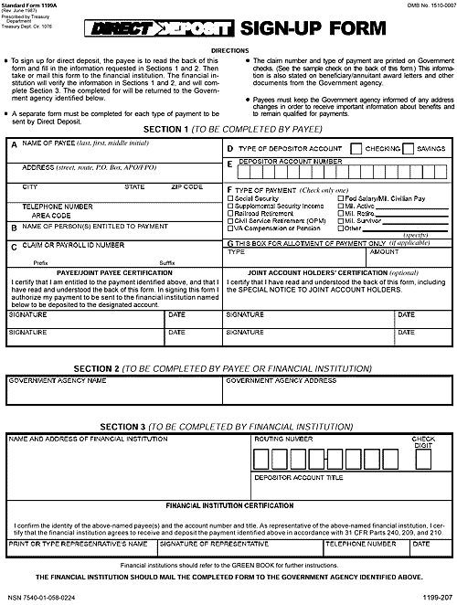
Registration Process: Required Documentation – SF-1199A
FROM THE DPM WEBSITE: www.dpm.psc.gov
Click on “Grant Recipient Info”
Click on “Forms”
Click on “SF-1199A”
Complete Section 1 and Section 2.
Bank must fill out Section 3
TO ENSURE ACCURACY WHEN COMPLETING DIRECT DEPOSIT FORM:
Box 1A: Name must match organization name on notice of Grant award
Box 1B: Must be identical to Box 1A.
Box 1C: Organization’s taxpayer identification number must be included in this field
Original signatures must exist on form
COMMON ERRORS
Corrections in Depositor Account Number and Bank Routing Number
Alternations that appear on original form are not acceptable (i.e. white out, strike overs, cross-outs, etc.)
Depositor Account Title not filled in
Depositor Account Title does not match Name of Payee
No signatures

Slide 9
DUNS # _____
ABC Corporation, Inc.
x
123 ABC Street – Suite 123
0 0 0 0 0 1 - 0 0 1 1
Anywhere US 00000
123/345-5678, ext. 910
x
ABC Corporation, Inc or left blank
Type/Print 9-Digit Tax ID #
N/A
ABC Corporation Representative
0-0-00
Awarding Agency Information
Awarding Agency Address
ABC Bank Name
123 Bank Street
Bank, US 99999
1 2 3 4 5 6 7 8 9
ABC Corporation, Inc.
ABC Bank Name Representative
ABC Bank Name Representative
123/475-0987, ext. 14
0-0-00

Slide 10
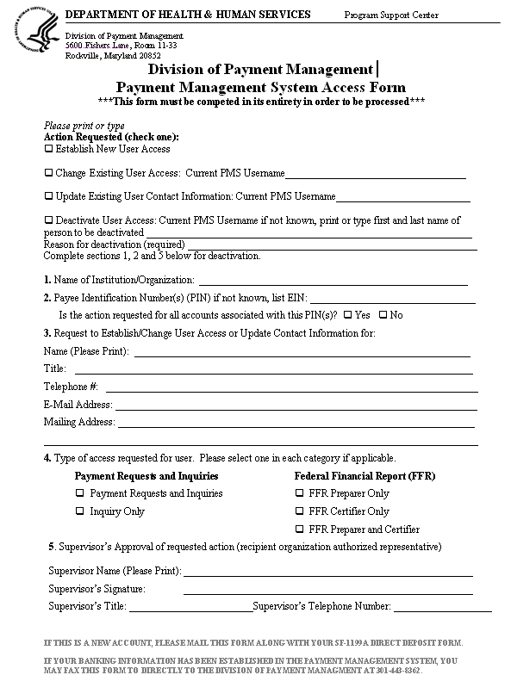
Registration Process: Required Documentation – Payment Management System Access Form
New PMS Users will not have a PMS Account Number
Existing PMS Users: the new PMS Account Number will be added to your existing profile
A form should be submitted for each individual PMS User
List all the PMS account numbers to gain access
This is the information of the individual that needs access to the Payment Management System
Check one in each category (if applicable). SSVF if a B Type Account! FFR View Only
Must have signature in order for form to be valid

Slide 11
Next Steps
SECVA to sign and date all MOAs
Grantees will receive electronic copy of final MOA
Set up HHS accounts for 2012
Grantees will receive instruction on making draws from Payment Management System at Post Award Conference
2012 Budgets
Program Office will communicate individually with each grantee to finalize 2012 budget
Current budgets will need clarification and possible modification! (Subaccounts: Administration, Service, Temporary Financial Assistance)

Slide 12
2012 NOFA VA’s Goals & Objectives
Goals and Objectives for Awards under 2012 NOFA
Enhance the housing stability and independent living skills of very low-income Veteran families occupying permanent housing across geographic regions
Rapidly re-house or prevent homelessness among the following target populations who also meet all requirements for being part of a very low-income Veteran family occupying permanent housing:
Veteran families earning less than 30% of area median income (AMI) as most recently published by HUD (http://www.huduser.org)
Veterans with at least one dependent family member
Veterans returning from Operation Enduring Freedom, Operation Iraqi Freedom, or Operation New Dawn.
Veterans located in a rural area.
Veteran families located on Indian Tribal Property.
12
12
Notes:
Approach – Insight into VA’s Expectations
SSVF funding to be used under “but for” criteria
Leverage grant funds to enhance housing stability of very low-income Veteran families occupying permanent housing
Veterans should contribute co-pays whenever possible
Encouraged to establish relationships with Continuum of Care
SSVF Program not intended to provide long-term support for participants, nor will it be able to address all the financial and supportive services needs of participants that affect housing stability; partnerships and referrals are critical (e.g. HUD-VASH, HUD’s Housing Choice Voucher programs, McKinney-Vento funded supportive housing programs, TANF)

Slide 13
Contact Information
For questions regarding your PY 2012 SSVF grant award:
Email: SSVF@VA.gov
Phone: (877)737-0111

