Slide 1
Supportive Services for Veteran Families (SSVF) Program
National Grantee Call
Homeless Prevention Eligibility Screening Disposition Form
SSVF Start Up Challenges and Successes
Quarterly Reporting and the HHS Payment Management System
October 25, 2012

Slide 2
Agenda
Program Office Updates
    John Kuhn, SSVF Director
Homeless Prevention Eligibility Screening Disposition Form
    Marge Wherley, Abt Associates
Quarterly Reporting and HHS Payment Management System
    Linda Southcott, Supervisor SSVF Regional Coordinators

Slide 3
Supportive Services for Veteran Families
(SSVF) Program
Quarterly Reporting and the HHS Payment Management System
Notes:
Introduction of speaker

Slide 4
Agenda
Quarterly Report Requirement
Quarterly Report Templates
  Overview
  Quarterly Performance Report (Fillable PDF Form)
  Attachment 1: Quarterly Financial Report (Excel)
Timeline for Submission of Reports
HHS Payment Management System
  SSVF Subaccount Breakdown
  Accessing the System Online
  Changes/Updates to HHS User Accounts
  Budget Modification Requests
Notes:
Briefly mention the agenda

Slide 5
I. Quarterly Report Requirement
38 CFR § 62.71 Grantee Reporting Requirements (subclauses c through f)
  At least once per year, or at the frequency set by VA, each grantee must submit to VA a report containing information relating to operational effectiveness, fiscal responsibility, supportive services grant agreement compliance, and legal and regulatory compliance, including a description of the use of supportive services grants funds, the number of participants assisted, the types of supportive services provided, and any other information that VA may request.
  Grantees must relate financial data to performance data and develop unit cost information whenever practical.
  All pages of the reports must cite the assigned supportive services grant number and be submitted in a timely manner.
  Grantees must provide VA with consent to post information from reports on the Internet and use such information in other ways deemed appropriate by VA. Grantees shall clearly mark information that is confidential to individual participants.
Notice of Fund Availability (NOFA) (Monitoring Section 3)
  Monitoring will also include the submittal of quarterly and annual financial and performance reports by the grantee. The grantee will be expected to demonstrate adherence to the grantee’s proposed program concept, as described in the grantee’s application.
Notes:
Establish the legislative basis for the grantee reporting requirements by reviewing the authorities and the specific requirements identified in the CFR.
Mention that the VA has determined that quarterly reporting is the optimal frequency for grantees to communicate qualitative and quantitative information about their programs, as it should enable the VA to identify operational and financial issues early enough to help the grantees resolve the issues during the grant year. The VA wants to be an active partner in the success of the grantee programs!

Slide 6
II. Quarterly Report Templates
6
6

Slide 7
II. Quarterly Report Templates
A. Overview
Qualitative Information: 3 pages in Adobe PDF (Fillable Form)
  General
  Outreach and Screening
  Supportive Services
  Participants
  Program Goals and Outcomes
  SSVF Grant Agreement Compliance
Quantitative Information: 4 pages in MS Excel format
  Annual Budget by Quarter
  Quarterly Variance Report -- Actual from Budget
  Quarterly Spending by Subcontractor
  Quarterly Draw Downs of Grant Funds
  Note: Template has been modified from FY2011 (Tabs 5-7 removed)
Companion Guide: Provides guidance on how to answer each question in the quarterly report template. The upcoming slides recap the information found in the Companion Guide.
Notes:
The quarterly report template contains questions in 6 qualitative and 7 quantitative areas.
We’ll go into more detail on the specific questions in these areas in later slides.

Slide 8
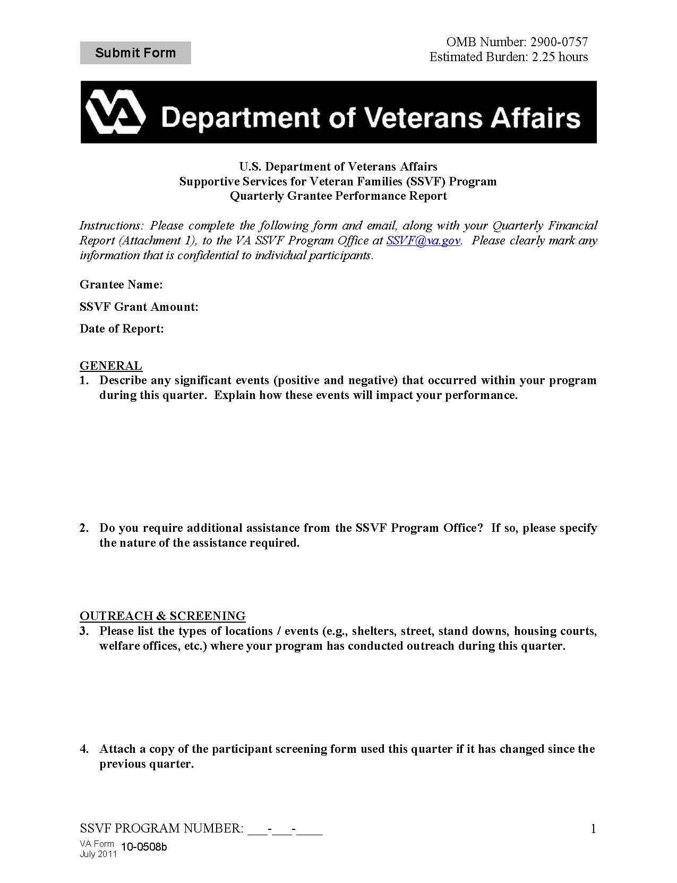
II. Quarterly Report Templates
B. Quarterly Performance Report (Fillable PDF Form)
Administrative:
  Page 1
    Grantee Name
    SSVF Grant Amount
    Date of the Report
  Bottom of each page
    SSVF Program Number (provided by VA in Grant Agreement)
  Page 3
    Insert electronic signature of authorized representative of the grantee at the bottom of Page 3 confirming validity of information contained in this report.

Slide 9
II. Quarterly Report Templates
B. Quarterly Performance Report (Fillable PDF Form)
General: 2 questions
  Describe any significant events (positive and negative) that occurred within your program during this quarter. Explain how these events will impact your performance.
    Alert the SSVF Program Office to any problems that have arisen during the quarter.
    Share any positive/noteworthy events for which your program should be recognized.
  Do you require additional assistance from the SSVF Program Office? If so, please specify the nature of the assistance required.
    Describe any issues/topics for which you would benefit from assistance from the SSVF Program Office.

Slide 10
II. Quarterly Report Templates
B. Quarterly Performance Report (Fillable PDF Form)
Outreach and Screening: 4 questions
  Please list the types of locations / events (e.g., shelters, street, stand downs, housing courts, welfare offices, etc.) where your program has conducted outreach during this quarter.
    Identify the types of places where your program is conducting outreach.
    Specific shelter names, addresses, etc. are not necessary – the SSVF Program Office is seeking high level category names only.
  Attach a copy of the participant screening form used this quarter if it has changed since the previous quarter.
    Grantees are encouraged to develop a participant screening form – see Program Guide for additional information.
    Please attach a copy of your most recent screening form version to the quarterly report or confirm that the participant screening form has not changed since you previously submitted it to the SSVF Program Office.

Slide 11
II. Quarterly Report Templates
B. Quarterly Performance Report (Fillable PDF Form)
Outreach and Screening (continued): 4 questions
  Please list any types of organizations / entities from which you have received more than an estimated 5% of your referrals during this quarter.
    Identify those organizations from whom you are receiving a substantial number (> 5%) of referrals.
    Specific shelter names, addresses, etc. are not necessary – the SSVF Program Office is seeking high level category names only.
  How many ineligible individuals were screened this quarter? Describe generally how these situations were handled and the program(s) to which individuals were referred.
    Identify the number of ineligible individual households screened this quarter.
    Describe generally where you referred these individual households and/or how you handled the situations.
    Provide examples of the reasons why households were deemed ineligible and/or referred elsewhere.

Slide 12
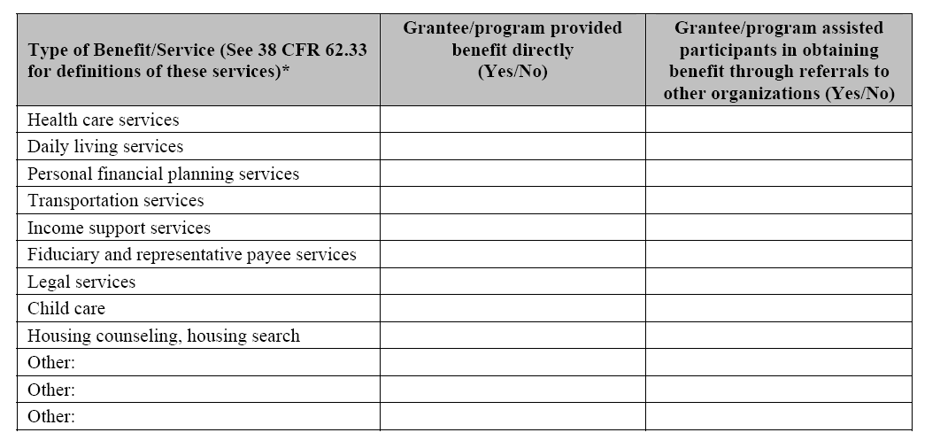
II. Quarterly Report Templates
B. Quarterly Performance Report (Fillable PDF Form)
Supportive Services: 3 questions
  During this quarter, which of the following supportive services were provided by your program (either directly or by referral)?
    Select “Yes”/”No” from drop down boxes to specify which supportive services your program provided directly using SSVF grant funds vs. via referral.
    The “Yes” box should be checked for providing directly (second column) anytime SSVF grant funds are used to provide services to a participant (Note: If you referred a participant to a subcontractor who is providing the service using SSVF grant funds, this is considered providing directly).
    The “Yes” box should be checked for providing via referral (third column) anytime you refer participants to receive services from an organization that is not using SSVF grant funds to serve that participant.
    List any additional supportive services provided either directly or via referral using SSVF grant funds.






Yes


No

















Slide 13
II. Quarterly Report Templates
B. Quarterly Performance Report (Fillable PDF Form)
Supportive Services (continued): 3 questions
  List the three supportive services most requested by participants and describe how your program delivered those supportive services.
    Cite the three supportive services offerings (please be as specific as possible – e.g. temporary financial assistance for rental arrears, referrals for legal services, etc.) that are most popular among your participants.
    Briefly explain how those services are provided.

Slide 14
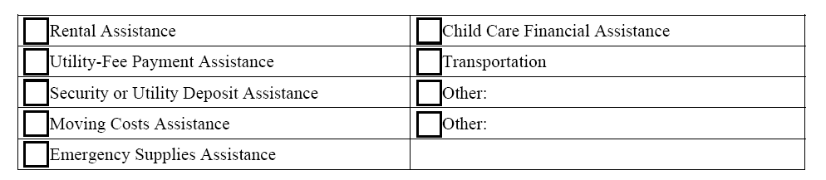
II. Quarterly Report Templates
B. Quarterly Performance Report (Fillable PDF Form)
Supportive Services (continued): 3 questions
  During this quarter, which of the following other supportive services were provided by your program? (See 38 CFR 62.33 and 38 CFR 62.34 for descriptions of these supportive services.)
    Check the boxes of those other supportive services that your program provided.
    List any other supportive services not specifically mentioned in table. (Note: All “other supportive services” not listed in table must have been pre-approved by VA.)

Slide 15
II. Quarterly Report Templates
B. Quarterly Performance Report (Fillable PDF Form)
Participants: 1 question
  Describe any issues that arose this quarter with respect to participant safety (e.g., domestic violence, suicide risk, etc.) and indicate how those issues were handled.
    Describe any instances in which participant safety was a concern.
    DO NOT include any identifiable participant information in the report. If a critical incident occurred during the quarter, describe the incident in the quarterly report without including any identifiable participant information. However, be sure to alert your Regional Coordinator immediately following any critical incidents.
    NOTE: Grantees should use the SSVF Incident Report form to the SSVF Program Office. Incidents should be reported within 24 hours or the 1st working day after event takes place. Please only FAX completed form to SSVF Program Office. (Template provided by SSVF Program Office and sample can be found in SSVF Program Guide, Exhibit B15.)

Slide 16
II. Quarterly Report Templates
B. Quarterly Performance Report (Fillable PDF Form)
Program Goals and Outcomes: 2 questions
  As this is a new initiative, VA is interested in learning about best practices in the field. Please describe an interesting/notable participant case from this quarter (describe the household composition, their needs, the services provided, and the outcomes).
    Highlight notable participant cases from this quarter.
    DO NOT include any identifiable participant information in the report.
  Confirm that your program’s data for 100% of participants has been exported from HMIS and uploaded to the SSVF Data Repository not less than on a monthly basis. If not, please explain why.
    Grantees must confirm that all participant data has been exported and uploaded to the SSVF Data Repository on a monthly basis by HMIS System Administrators.
    If your program has not uploaded to the SSVF Data Repository at least monthly, please provide a specific explanation of situation, including any relevant documentation from your HMIS System Administrators.

Slide 17
II. Quarterly Report Templates
B. Quarterly Performance Report (Fillable PDF Form)
SSVF Grant Agreement Compliance: 1 question
  Have you complied with all the terms of your supportive services grant agreement this quarter? If no, please explain.
    Confirm you have complied with all terms of your supportive services grant agreement.
    If there are any terms with which you have not complied, please identify those terms and provide a specific explanation of the situation.
Electronic Signature
    Insert electronic signature of authorized representative of the grantee at the bottom of Page 3 confirming validity of information contained in this report.
    Either insert scanned signature image or type in name and title
    (Note: Form must be returned in fillable PDF format)
SUBMIT FORMS ELECTRONICALLY TO REGIONAL COORDINATOR

Slide 18
II. Quarterly Report Templates
C. Attachment 1:
Quarterly Financial Report
Overview:
  Tab 1 – Quarterly SSVF Grant Funds Budget (from approved application)
  Tab 2 – Quarterly Variance Reporting
  Tab 3 – Quarterly Spending by Subcontractor
  Tab 4 – Quarterly Draw Downs
General:
  Grantee is responsible for filling in yellow cells only.
  All non-yellow cells are locked and populate automatically.
  VA will import each grantee’s approved budget into Tab 1 of the workbook and provide a customized template for each grantee at the beginning of each grant award period.
  Tabs 2 through 4 must be completed on a quarterly basis and submitted to VA.

Slide 19
II. Quarterly Report Templates
C. Attachment 1:
Quarterly Financial Report
Tab 1 – Quarterly SSVF Grant Funds Budget:
  This worksheet will be pre-populated with the grantee’s approved application budget and the data cells will be locked in the customized quarterly report template sent to each grantee.
  If the grantee receives approval to change the budget, the SSVF Program Office will send a revised report template that reflects the budget changes.

Slide 20
II. Quarterly Report Templates
C. Attachment 1:
Quarterly Financial Report
Tab 2 – Quarterly Variance Reporting:
  Budget line item updates to Tab 1 will be automatically reflected on Tab 2.
  Insert SSVF Program Number (provided by VA in Grant Agreement).
  Insert actual SSVF grant funds spent on a line item basis each quarter.
  Explain all positive and negative variances in “Explanation of Any Variance” column. An explanation is required for all variances, regardless of size.

Slide 21
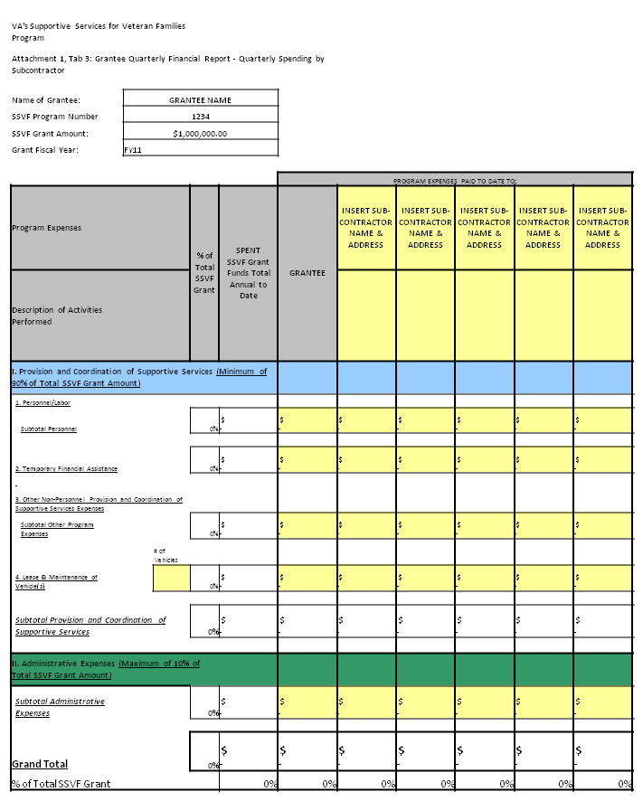
II. Quarterly Report Templates
C. Attachment 1:
Quarterly Financial Report
Tab 3 – Quarterly Spending by Subcontractor:
  Input names and mailing addresses for each subcontractor in the designated yellow cells.
  Per 38 CFR § 62.2, a “subcontractor” means any third-party contractor, of any tier, working directly for an eligible entity.
  Landlords, utility companies and other entities receiving temporary financial assistance payments from a grantee on behalf of a participant are not considered subcontractors.
  Indicate total cumulative funds spent to date by subcontractor for each line item for the current grant fiscal year.

Slide 22
II. Quarterly Report Templates
C. Attachment 1:
Quarterly Financial Report
Tab 4 – Quarterly Draw Downs:
  Input the amount of SSVF grant funding the grantee has drawn down by quarter using the HHS Payment Management System.
  All other cells in Tab 4 will populate automatically.
  Explain any variances between the amount of funds drawn down and the amount of funds spent at the bottom of the worksheet.

Slide 23
III. Timeline for Submission of Reports
Quarterly Reporting Period | Due Date
Q1: 10/1/2012– 12/31/2012 | Q1: 01/22/2013
Q2: 01/01/2013 – 03/31/2013 | Q2: 04/22/2013
Q3: 04/01/2013 – 06/30/2013 | Q3: 07/22/2013
Q4: 07/01/2013 – 09/30/2013 | Q4:11/15/2013
SUBMIT FORMS ELECTRONICALLY TO
REGIONAL COORDINATOR
Notes:
Establish the legislative basis for the grantee reporting requirements by reviewing the authorities and the specific requirements identified in the CFR.
Mention that the VA has determined that quarterly reporting is the optimal frequency for grantees to communicate qualitative and quantitative information about their programs, as it should enable the VA to identify operational and financial issues early enough to help the grantees resolve the issues during the grant year. The VA wants to be an active partner in the success of the grantee programs!

Slide 24
HHS Payment Management System
24
24

Slide 25
IV. HHS Payment Management System
A. SSVF Subaccount Breakdown
SSVF Grant Subaccount Breakdown:
  Approved budgets are registered in HHS Payment Management System in four (4) subaccounts. Grantees may request payments from some or all of the SSVF subaccounts.
  Administration (capped at 10% of total budget)
  Services (budgeted funds for the provision and coordination of supportive services
  Temporary Financial Assistance for Rapid Re-Housing (minimum of 60% of budgeted funds)
  Temporary Financial Assistance for Prevention
 |  | FY2012 SSVF HHS Payment Management System Accounts
 |  |  | Subaccount Table:
 |  | Renewal Grantees | ADM-R12 | SERVICES-R12 | TFAR-R12 | TFAP-R12
 |  | First Year (New) Grantees | ADM-12 | SERVICES-12 | TFAR-12 | TFAP-12
Program # | HHS Acct# | Organization Name | 0001 | 0002 | 0003 | 0004
R12-CA-022 | D4444B1 | We Serve Veterans | $100,000 | $600,000 | $180,000 | $120,000

Slide 26
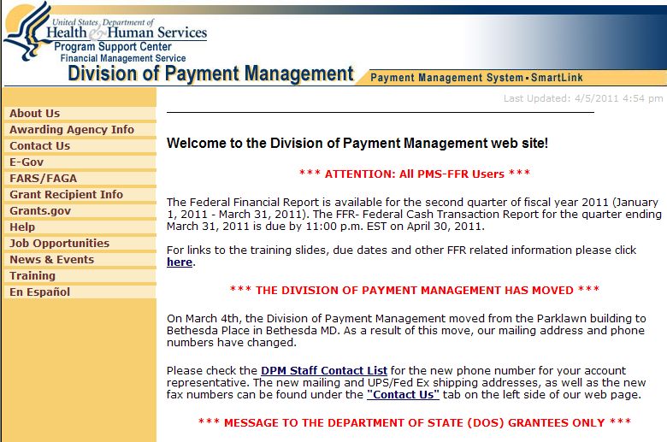
IV. Payment Management System
B. Accessing the Site
Go to: www.dpm.psc.gov
Click on “Payment
Management System”
Review messages on this page

Slide 27
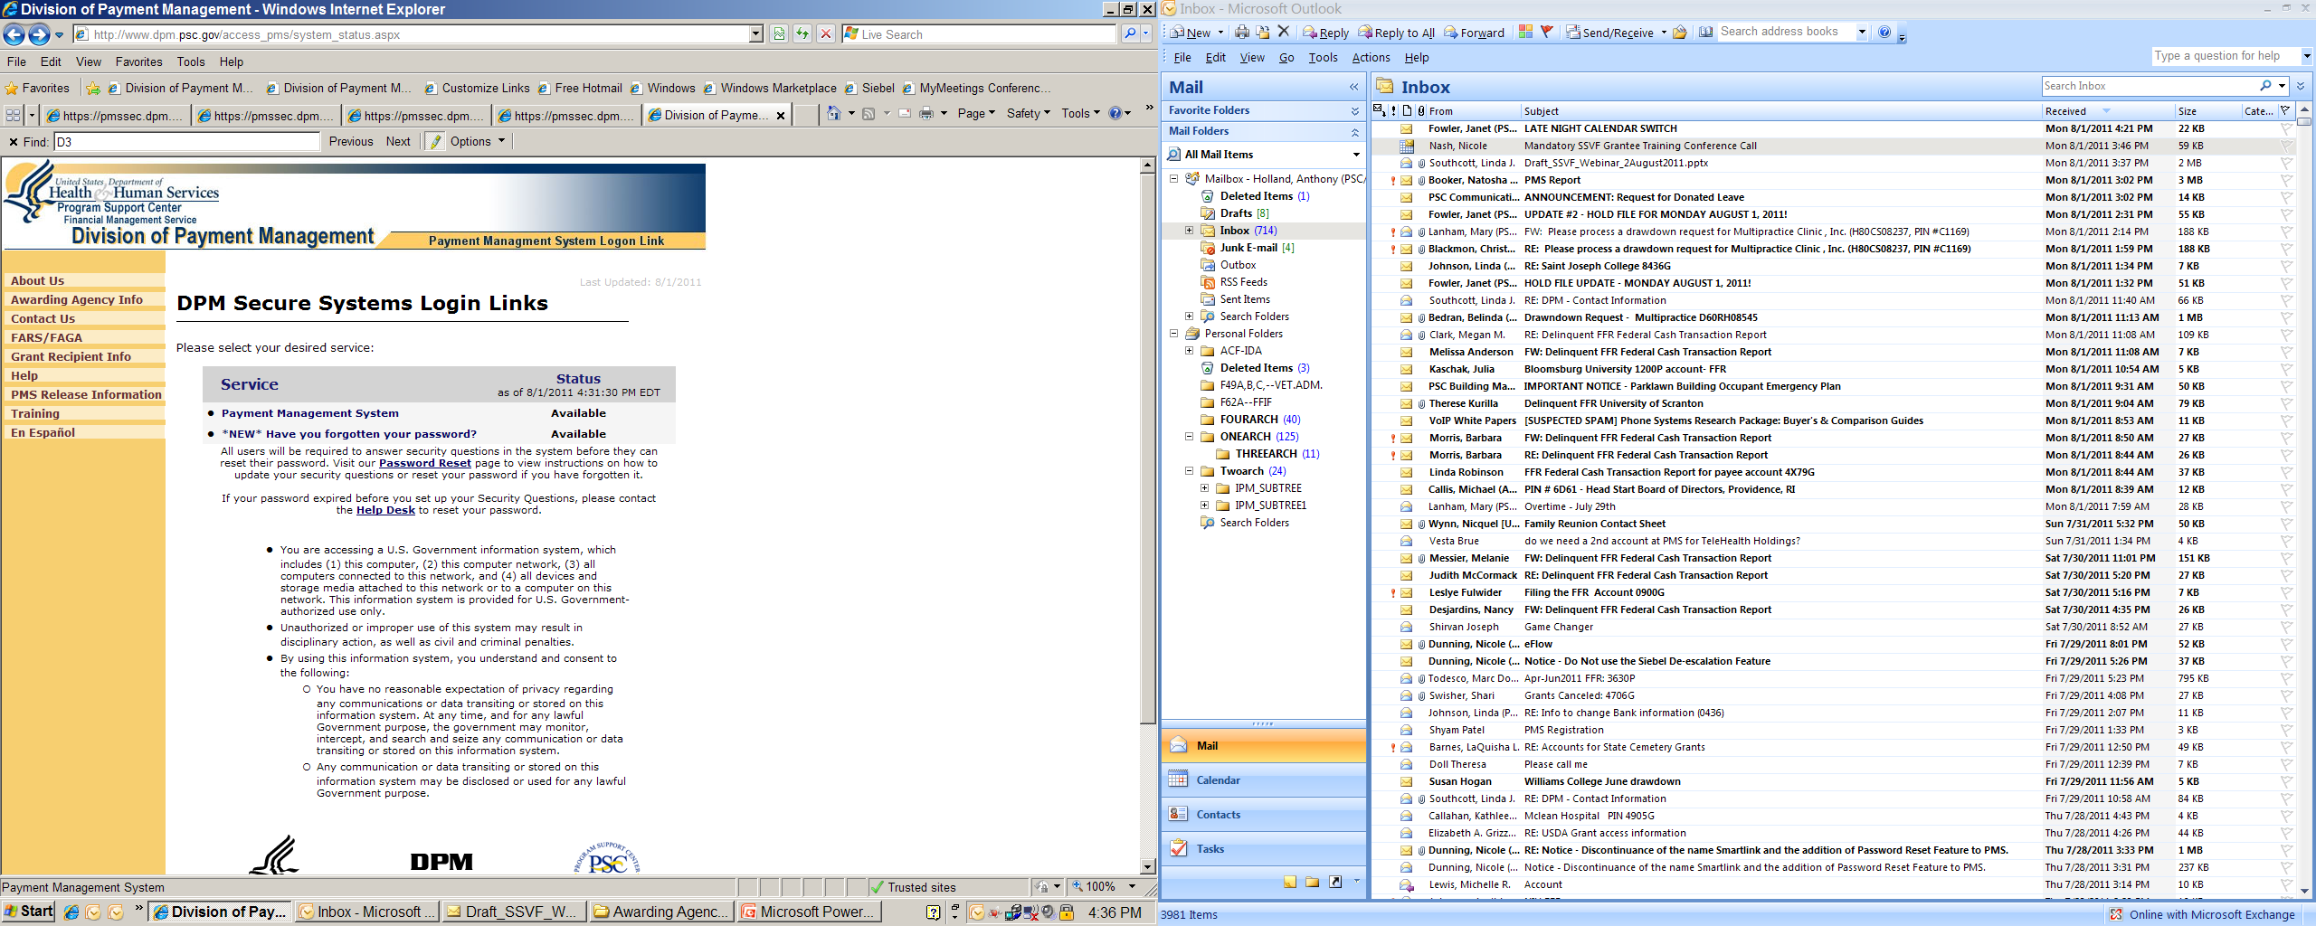
Payment Management System
Accessing the Site
Click on
“Payment Management
System”
Notes:
Our first training exercise will be to complete the logon process for the system.
We are going to assume you can start your computer, access your internet service provider and get to web sites.
When you click on Payment Management System on the DPM Homepage, the DPM Secure Systems Login Links page will appear.
You will see service selection boxes and system status boxes????. If the status is listed as “Available” the system is up and running for normal business.
If the status is “Off Line” we are probably closed and will start up again during normal business hours,. or on rare occasions when you see this message during business hours we may be performing a system upgrade or system maintenance.
To access the Payment Management System logon screen, click on the words Smartlink Payment Request or Payment Management System”.

Slide 28
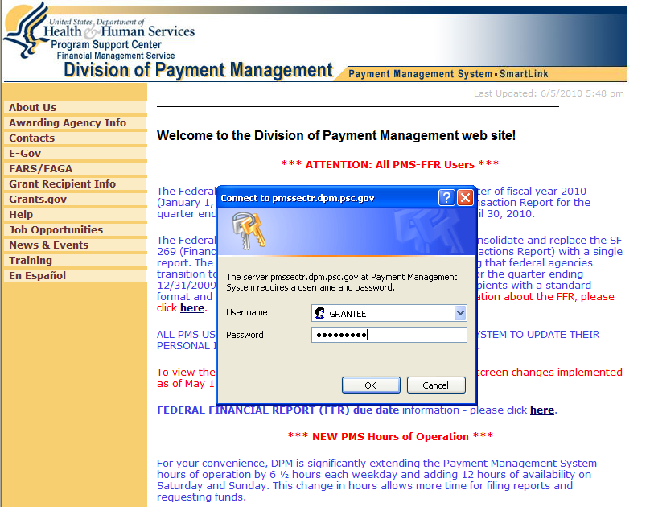
Payment Management System
Accessing the Site
User name: Established by DPM
(For training: All upper case -
e.g. , JPSMITH)
Password: Initial password is issued by
DPM and must be changed by users.
New password must be at least
nine alpha-numeric and/or special
characters (e.g., #Grantee1)
*For first time users,
the initial password
is provided by DPM.

Slide 29
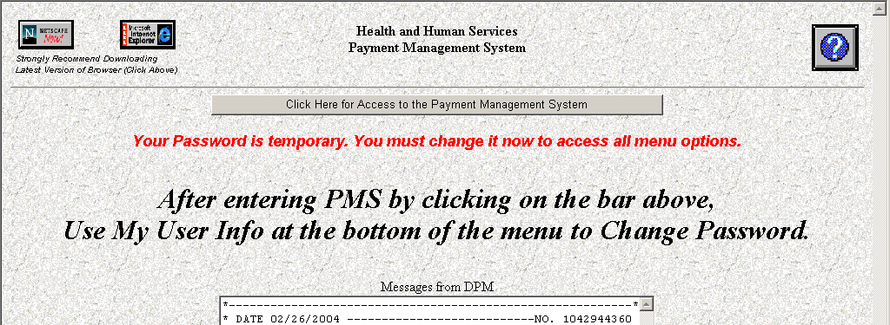
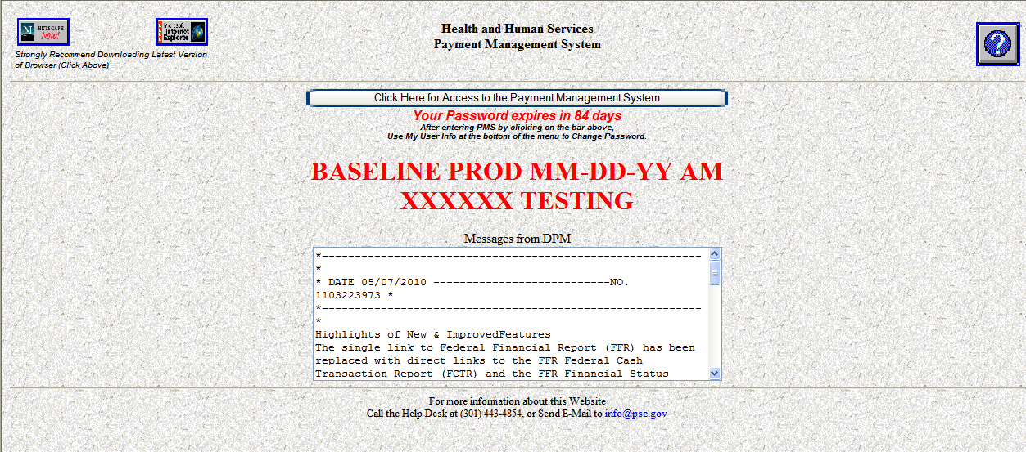
Payment Management System
Accessing the Site
Review for new messages; then click on
Click Here for Access to the Payment Management System

Slide 30
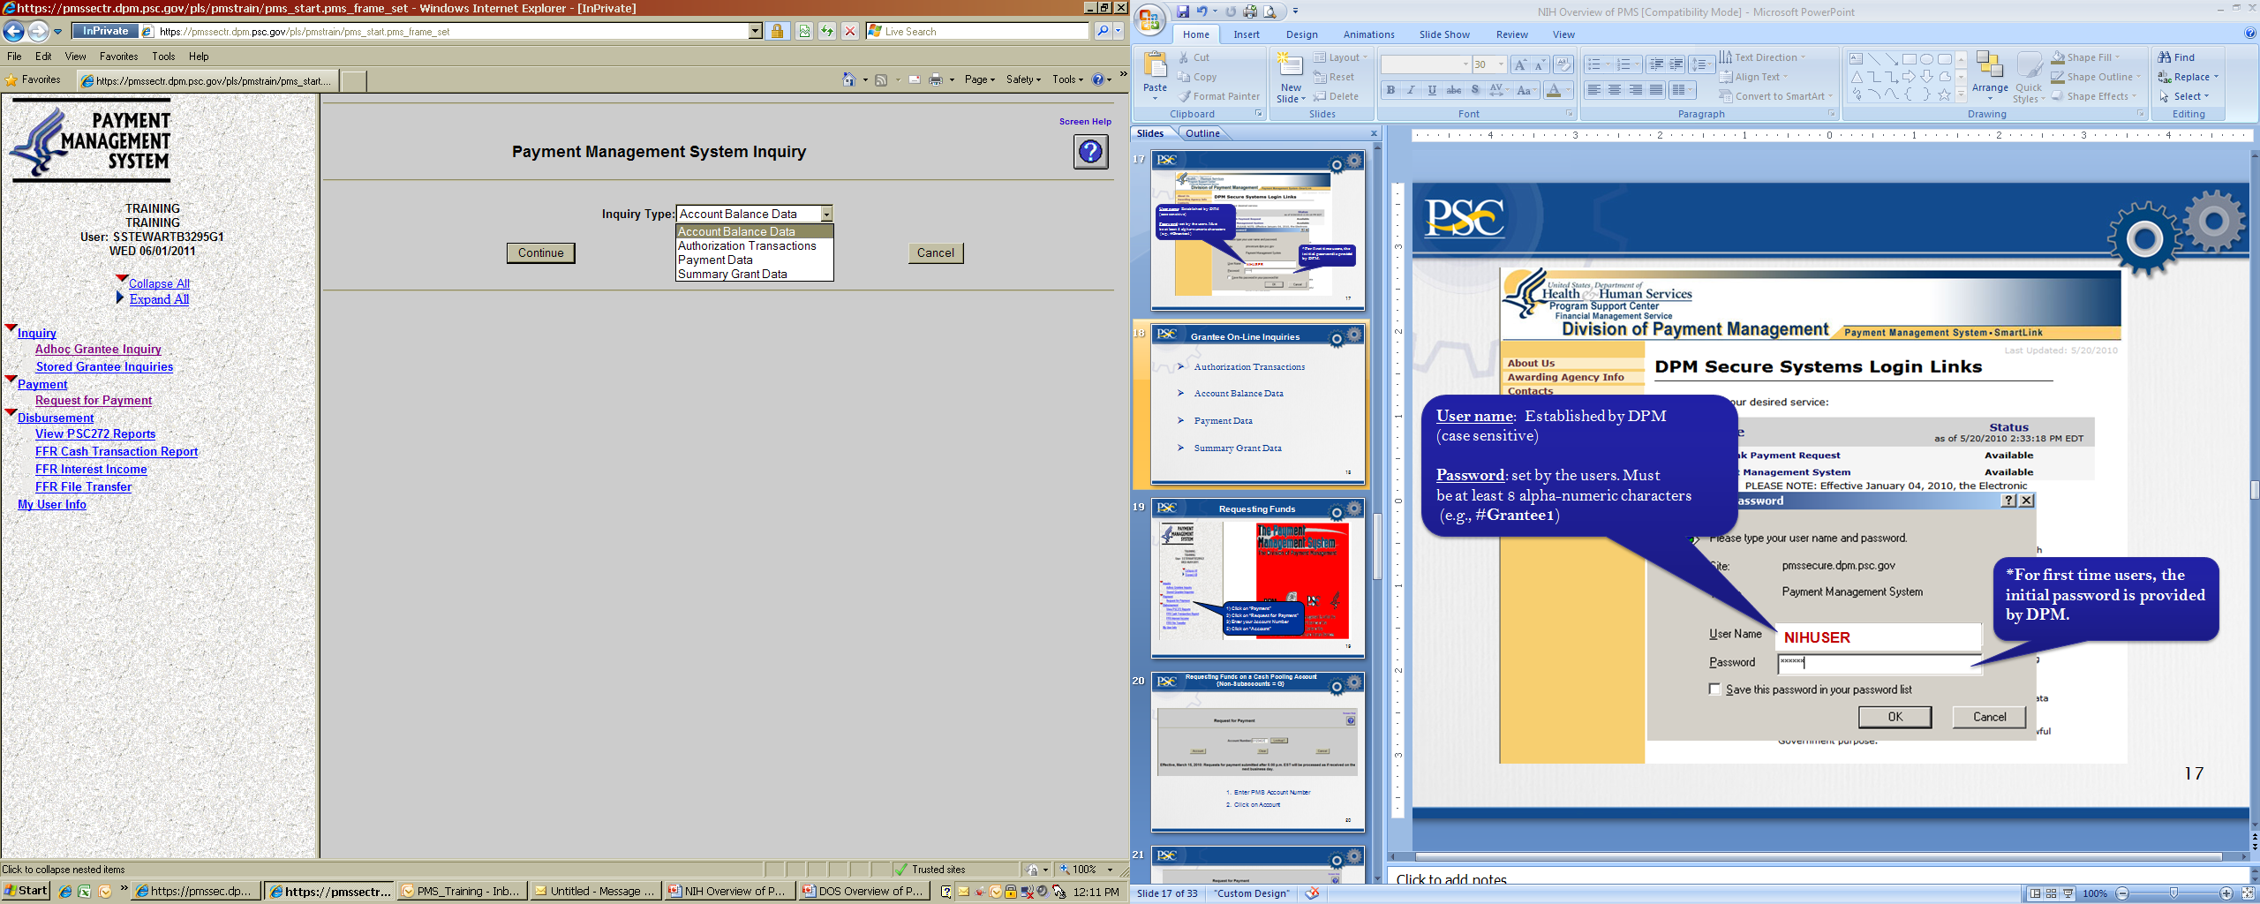
Grantee On-Line Inquiries
1) Click on “Inquiry”
2) Click on “Adhoc Grantee Inquiry”
3) Select Inquiry Type from the dropdown menu
5) Click on “Continue”

Slide 31
Grantee On-Line Inquiries
Account Balance Data
    Authorized grant award information, payments made and funds available
Authorization Transactions
    Award amount, budget period and date posted in PMS
Payment Data
    Payment History including payments deposited and rejected
Summary Grant Data
    Grant expenditures will equals payments

Slide 32

Payment Management System
Requesting Payments
Payment requests may be made as often as needed:
Daily
Weekly
Monthly
Bi-monthly
Monthly drawdowns are encouraged by VA.
Remember: Funds must be spent within three business days!

Slide 33
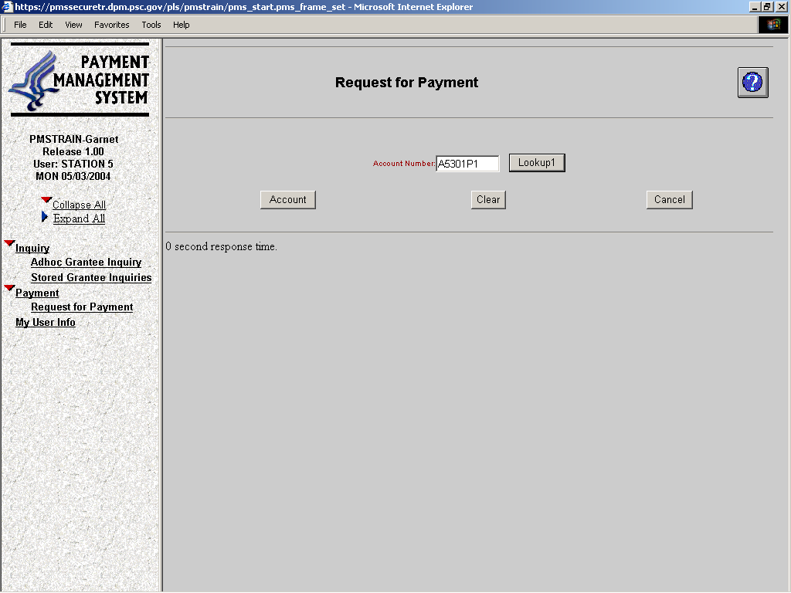
Making a Payment Request:
2AA5B
1) Click on “Payment”
2) Click on “Request for Payment”
3) Enter your Account Number
5) Click on “Account”
Notes:
We will now go through the payment request process.
Use the left-hand menu to access the payment request function:
Click Payment
Click Request for Payment
This brings up the Account Selection screen. PMS users can have access to one or more Payee Accounts under their user names.
On the Account Selection screen enter your Payee Account Number (PAN) in the Account Number field. If you do not remember your Payee Account Number, click on the Lookup1 button, then click on the Find button to access a list of Payee Account Numbers associated with your user name. Next, click on the Payee Account Number you want to use and click Return.
Click Account.

Slide 34
Making a Payment Request:
Enter DUNS
UPDATE Requestor Information or Click the Check Box If No Changes Are Required
Enter Payment Due Date
Enter Expected Disbursement Amount
Enter Cash on Hand
Enter Payment Request Amount
Click on “Continue”
Notes:
On the Request for Payment screen, the DUNS field appears under your account number. DUNS stands for data universal numbering system. DUNS numbers are issued by Dun and Bradstreet (D&B) and consist of nine digits. OMB prescribes DUNS numbers for tracking grant money dispersals.
The Request for Payment screen has four required fields:
First is the Payment Due Date. This is the date your requested payment will be deposited in your bank. For standard accounts this is the next business day. For same-day payment it is the day the request is being made. Payment due dates may also be “warehoused” up to 30 days in advance, that is, preset for future payments. Warehousing must be set up through your DPM Liaison Accountant.
Second is the Expected Disbursement Amount. This is the amount of checks being cut to cover grant program expenses or the amount of expenses to be paid using the funds from this drawdown or payment request.
Third is the Cash on Hand. This is the amount of cash in your bank account remaining from previous funds requests. Optimally this number should be zero.
Fourth is the Payment Request Amount. This is the Expected Disbursement Amount minus the Cash on Hand.. We expect accounts to go to, or close to, a zero balance after planned disbursements have been made.
Click Continue.

Slide 35
Making a Payment Request:
2AA5B
123456789

Slide 36
Making a Payment Request:
2AA5B
123456789
ADM-12 SUBACCT
SERVICES-12 SUBACCT
TFAR-12 SUBACCT
TFAP-12 SUBACCT

Slide 37
Making a Payment Request:
2AA5B
123456789
ADM -12 SUBACCOUNT
SERVICES-12 SUBACCOUNT

Slide 38
Making a Payment Request:
2AA5B
ADM-12 SUBACCOUNT
SERVICES-12 SUBACCOUNT

Slide 39
Making a Payment Request:

Slide 40
Payments of SSVF Grants
Grantees are encouraged to make monthly drawdowns
Per the SSVF Program NOFA, Grantees are subject to the following limitations:
Time Period | Limitation on Cumulative Requests for Grant Funds
During 1st Qtr of Grant Award Period | May not exceed 35% of the total grant award without written approval by VA
End of 2nd Qtr of Grant Award Period | May not exceed 60% of the total grant award without written approval by VA
End of 3rd Qtr of Grant Award Period | May not exceed 80% of the total grant award without written approval by VA
End of 4th Qtr of Grant Award Period | May not exceed 100% of the total grant award

Slide 41
IV. HHS Payment Management System
C. Changes/Updates to HHS User Accounts
Grantee Changes to HHS User Accounts
  Add or change the registered user
  Add or change agency information (name change, address)
  Add or change agency bank account
  Grantees should submit appropriate forms to HHS Account Liaison, Anthony Holland (email: Anthony.Holland@psc.hhs.gov)
  - HHS User Access Form
  - Direct Deposit Form

Slide 42
IV. HHS Payment Management System
D. Changes to HHS Subaccounts
Grantee Changes to HHS Subaccount Totals
  All requests for changes to subaccount totals must be submitted to the Regional Coordinator. HHS does not increase or decrease funding amounts in the Payment Management System.
REMINDER:
Significant Changes – submit written request to Regional Coordinator BEFORE implementing a significant change; if VA agrees, will issue written approval
Examples:
  Change in grantee or any identified subcontractors
  Change in area or community served
  Additions or deletions of supportive services being provided
  Change in budget line items more than 10% of grant award

Slide 43
For More Information
For questions regarding quarterly reporting and other SSVF requirements, please contact your Regional Coordinator.
Please refer to the SSVF Grantee Resource Website at: http://www.va.gov/homeless/SSVF.asp
Email questions to: SSVF@va.gov
Thank you!

