Slide 1
The 2019 Low Demand Fidelity Review Process: An Introduction and Review of Logistics
M. Scott Young , PhD
Research Assistant Professor
University of South Florida
Paul Smits, LCSW
Senior Policy Analyst
University of South Florida

Slide 2
Overview
What is Fidelity Measurement?
Why Assess Fidelity?
The Key Dimensions of Low Demand Fidelity
The 2019 Fidelity Assessment Process
Logistics of the 2019 Fidelity Assessment Process
Can Some Program Variation Be Expected?
Results of the Assessment
A Brief Look at the Fidelity Instruments
Questions / Discussion

Slide 3
What is Fidelity Measurement?
Degree to Which a Program and/or Intervention is Administered as it was Intended
Fidelity Plays an Important Role in Guiding Implementation of New Models / Programs
Offers an Objective Way to Monitor and Provide Structured Feedback Concerning Program Development and Change over Time
Use of a Structured, Standardized Fidelity Scale Allows Comparisons Between Programs and Facilitates Mapping of Processes and Outcomes

Slide 4
Why Assess Fidelity?
Studies Indicate that Programs are More Effective When Administered as They Were Intended
Program Modifications are Sometimes Implemented in Response to Different Populations and/or Settings
Sometimes Staff who have Worked in Traditional Homeless Programs want to go Back to the “Traditional Model” and what is Familiar and Comfortable
Evidence of Outcomes Does Not Inform How to Implement a Program
The Notice of Funding Availability states that grantees must participate in, “an annual fidelity assessment process as established by VA.”

Slide 5
The Key Dimensions of Low Demand Fidelity
Characteristics of Veterans Served
Physical Characteristics of Your Facility
Staffing
Outreach Services
Targeting and Eligibility
Approach to Substance Use
Service Provided to Residents
Coordination with Other Services
Program Rules and Explanations
Program Entry and Exit Procedures

Slide 6
The 2019 Fidelity Assessment Process
GPD Liaison and Program Manager Confer with Program Staff to Complete the Fidelity Instrument in Collaboration as a Team
Each Low Demand GPD Program Should Provide One Consensus Response for Each Item That Best Describes Your Program Based on:
Program Policies and Procedures
Available Administrative Data
Performance Data
Incident Management
Review of Staff Meetings
Each Low Demand GPD Program Should Complete the Tools Once Annually
Not Multiple Submissions from Different Staff is Same Program

Slide 7
Logistics of the 2019 Fidelity Assessment
Annual Process
1st Review Scheduled Approximately 6 Months after Program Start Date
Should be Completed by GPD Liaison and Program Manager in Collaboration with Program Staff
Based on Honor System
Distributed via Email with Two Microsoft Word Attachments
Responses Should be Typed Directly into the Attachments, Saved, and Returned via Email
Should be Returned via Email by 06/30/2019
Consultation for Technical Assistance is Available (psmits@usf.edu and syoung1@usf.edu)

Slide 8
Can Some Program Variation Be Expected?
Though all Sites Share a Common Target Population, it is Anticipated that they Will Vary on How They Implement the Low Demand Model
We Want to Capture this Variability to Help Understand Program Nuances

Slide 9
Results of the Assessment
Will be Shared Individually with Each Site
Trends will be Shared on Technical Assistance Calls
Differentiation is Expected and often Demonstrates Programs Adjusting to Local Needs and Conditions
Results Will be Used to Foster and Guide Discussion among Different Sites
Opportunity on the Instrument to Provide Feedback

Slide 10
A Brief Look at the Fidelity Instruments

Slide 11
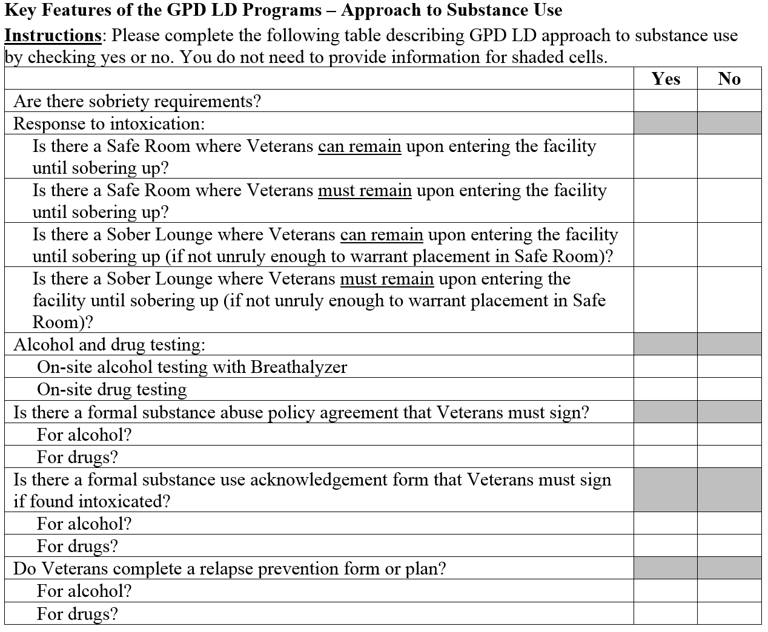

Slide 12
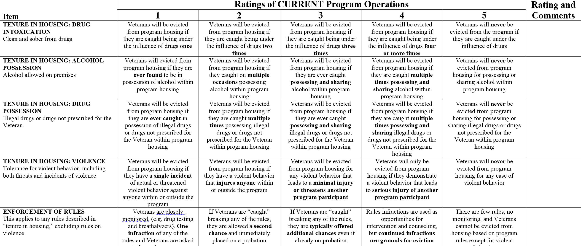

Slide 13
Questions? / Discussion
Reminder, please complete and submit the Two Attachments by 06/30/2019

