Slide 1
HUD-VASH SSVF Health Care Navigator Community of Practice
Session #5
Notes:
Katie

Slide 2
(RE)Introductions
Who is here today?
Name / Organization / Job
State/Catchment area
Notes:
Katie

Slide 3
Approaching role with Equity
Notes:
LaMont

Slide 4
Equity Considerations
What are the demographics of your agency clientele?
Does your caseload match the demographics of your agency clientele?
If not, why?
Is there action or further review needed?
Are you seeing disparities or service gaps?
With referrals?
With services offered? Or services received?
With vaccinations?
With dis-enrollments?
Who are you partnering with to review/address any disparities noted?
Veterans with lived expertise?
Meaningful partnerships with community advocacy groups?
Always ask….What could be the driver for any difference noted?

Slide 5
Vaccine Coordination
Notes:
Joyce

Slide 6
Vaccine Coordination - VAMC
Contact Homeless Program Manager at local VAMC as soon as possible.
All Veterans enrolled in SSVF, whether they are currently homeless or housed, are considered homeless under the VHA’s vaccine plan.
Veterans will probably need to go to the VAMC for vaccination – grantee should facilitate transportation through grantees, VAMC or partner resources.

Slide 7
Vaccine Coordination – non-VAMC
Contact local CoC to determine if they are planning for vaccine distribution for people experiencing homelessness and program staff.
If CoC is not working on a vaccine distribution plan, then contact local public health department
Follow-up on community process to include SSVF program in vaccine distribution to homeless programs. Stay up to date on changes in vaccine plan for community.

Slide 8
Vaccination Tracking
Notes:
Joyce

Slide 9
NEW: Vaccination Tracking Request
The SSVF Program Office would like HCNs to begin tracking vaccination efforts for Veterans enrolled in the program
Depending on program size, may need non-HCN SSVF staff to assist
Tracking can be integrated into an existing tool or be done separately
Tracking tools must be kept confidential and secure within the SSVF organization. Tools should include, at a minimum:
Veteran name or HMIS identifier (preferred for security)
Date of Vaccination offer(s)
1st vaccination shot
2nd vaccination shot, if applicable
Priority is on most vulnerable Veterans but ALL Veterans served by SSVF should have vaccination support and to extent possible, vaccination decisions/activities tracked
Samples and guidance will be provided by the SSVF Program Office but tracking and vaccination support should start now.

Slide 10
Vaccination Considerations
Veterans who initially decline an opportunity to be vaccinated should be offered additional opportunities to agree with HCN support
HCNs should help educate Veterans on vaccine safety and process
No Veteran should be required to get vaccinated, but VA is committed to ensuring as many Veterans as possible do get vaccinated to protect them and their communities

Slide 11
Internal Coordination
Notes:
Katie

Slide 12
Coordination with Housing Case Manager
Role of Housing Navigators
conduct housing barrier assessments
assist with documentation
assist with completing housing related paperwork
identity housing preferences
connect Veteran to landlords
assist with lease up process
provide help with move-in costs (deposit, rent, utilities)
Role of Health Care Navigators
assist with healthcare enrollment
help gain access to appointments
help develop care priorities based on Veteran desires
identify barriers to health care goals
help with transportation to health care appointments
encourage communication with health care providers
ensure coordination of care
Notes:
We’ve discussed this before
Both housing navigators and health care navigators are specialty providers. You each have a unique roll within your specialty.
Because some agencies are more familiar with housing navigators, it may be helpful to explain your role using housing navigators as a reference point.

Slide 13
Coordination with Supervisor
Evaluating job performance, enhancing strengths, identifying and improving weaker areas, and accountability
Review of client caseload, client plans, and client issues
Discuss current status of individual health goals/plans with intentional conversations about how to plan for case closing. “Beginning with the end in mind.”
Review developed processes and procedures to make improvements and reduce barriers to care
Review documentation to ensure meets agency standards
Discuss the HCN’s role as a team member on-site and when working with community collaborators
Discuss how HCN work fits into the context of the agency/program
Notes:
supervision is to help you grow. Supervisor should highlight and celebrate your successes, and constructively work with you on areas where you can improve
You should be able to staff specific cases with your supervisor to discuss how your work fits in to the bigger picture of the veteran’s care, as well as what it will look like to end your work with the veteran – what is the end goal and how are you a part of it?
Supervisor should help you problem solve when you identify gaps in service or barriers to care
Documentation is important – track your work, make sure others who view the chart have a sense of what has already been done, what needs done, if they need to help the veteran reach out to you, etc
And 6. You should be included in discussions of how your agency functions in the community. Your team should always have you in mind as an available option for Veterans who need it

Slide 14
External Coordination
Notes:
Katie

Slide 15
NEW: VAMC Privacy Guidance
VA Medical Centers are expected to collaborate with Health Care Navigators (HCN) who are working with Supportive Services for Veterans Families (SSVF) grantees to coordinate health care services for Veterans. SSVF participants are enrolled in a VA funded program and HCNs are health care providers authorized to schedule or inquire about health care appointments on behalf of the Veteran to coordinate VA care. Additionally, it is of particular importance that HCNs are able to confirm that Veterans enrolled in SSVF have received COVID-19 vaccines as these homeless Veterans are a VA priority group for the vaccine. Furthermore, HCNs are authorized In instances where an ROI is not immediately available in the clinical record, as these disclosures are covered by the Privacy Act system of records, “Patient Medial Records-VA”, 24VA10A7 Routine Use 43, HIPAA Privacy Rule under treatment and 38 U.S.C. 7332(b)(2)(H).
Notes:
Katie
-This guidance discusses ways that you’re able to communicate with VA Medical Centers regarding your clients’ needs – things like setting or confirming appointments, sharing basic info with the VA care team
-Of course it’s ideal that you’ll be with the Veteran when they call their care provider, or that you’ll call them with the Veteran with you. But --
-For example, you can call a provider and give an update like “Mr. Jones is interested in discussing his Diabetes medication next month.” The clinic may not be able to confirm that the Veteran is a patient there, but they can take the info and share it with the provider.
-We’ll talk about this a bit more on the next slide….

Slide 16
Coordination with VAMC
SSVF Health Care Navigators will establish working relationships with VAMC staff to ensure coordination and collaboration.
Routine Use 30 states that the VA may disclose relevant healthcare and demographic information to health and welfare agencies, housing resources, and community providers, consistent with good medical-ethical practices, for Veterans assessed by or engaged in VA homeless programs for purposes of coordinating
VA Memo dated Oct 10, 2019 Coordination of Homeless Services requires all VAMCs to establish an SSVF Point of Contact (POC)
VA Memo dated July 16, 2020 Protocol for Homeless Veterans.. requests that VAMCs offer immediate appointments to Veterans residing in SSVF hotels
Notes:
-Understand the reality that, although this guidance exists, many clinics are not familiar with it and you may hit some roadblocks.
-This is where it’ll be important to make contact within different programs so that clinics get to know who you are and that you have the ability to communicate with them in this way. Getting to know the social workers seems most effective!
-***********Privacy training 3/19 – this will give you way better info

Slide 17
Coordination with VAMC
Each VAMC should have an assigned SSVF POC; role and activity of POC likely varies across country
VA SSVF POCs may assist HCN in understanding how Veterans receive primary care appointments
VA SSVF POCs may assist with the initial coordinating process and with bridging initial communications with other VA teams such as MHICM, HPACT, HBPC and Mental Health (see appendix)
Reach out to your SSVF Regional Coordinator or review the spreadsheet included with this presentation for POC contact information
SSVF Program Office is working to identify VA-related privacy barriers and offer more guidance

Slide 18
Coordination with non-VAMC Systems
Some Veterans will want to engage in non-VA services or may live in areas where non-VA services are more readily available/accessible
Each HCN should become familiar with the process to enroll in Non-VA health care benefits and should compile a resource guide
Health Care Coverage
Behavioral Health Supports
Veteran family members may be eligible for or need support in accessing non-VA health care system

Slide 19
Survey: What are your biggest concerns with coordination as an HCN?
Notes:
Katie: Type in chat

Slide 20
Case Conference and Coordination Tools
Notes:
Joyce

Slide 21
Case Conference
Notes:
Joyce

Slide 22
Case Conferencing
To ensure holistic, integrated assistance across providers/teams for all Veterans receiving HCN services;
To review health related progress and barriers related to each Veteran’s housing goals;
To identify and track systemic barriers and strategize solutions across multiple providers;
To clarify roles and responsibilities and reduce duplication of services.

Slide 23
Case Conferencing – Client Level
Current Status: For example, changes or no changes since last meeting.
Veteran Needs : Veteran’s needs or preferences for supports and health care planning
Critical Health Barriers: Review and problem-solve any identified barriers.
Safety Concerns: Address any and all safety/urgent health concerns with concrete plans as needed.
Vaccination Efforts and coordination needs.
Next Steps: What followup steps need to be completed before the next meeting?

Slide 24
Coordination – Key Partners
In order to use finite Case Conferencing time to facilitate actual housing outcomes for Veterans, you must have the right people participating to support the collective brainstorming and work to reach that goal. The following people/roles should be considered for active participation in the Case Conferencing/Coordination Process:
• SSVF Case Managers
• SSVF Housing Navigators
• HUD-VASH Case Managers
• GPD Case Managers
• VA Coordinated Entry Specialists
• SSVF Health Care Navigators
• Veterans with Lived Expertise and/or Vets Center
• Community Advocacy Groups
• Local CoC and Coordinated Entry Specialists

Slide 25
Coordination –System Level
Understand: Foster a deep understanding of each others’ programs and staff roles.
Communicate: Share (in a respectful way) when you see opportunities for improvement.
Review: Take notes and track data. Engage in frequent reviews.

Slide 26
Tracking and Coordination Tools
Notes:
Katie

Slide 27
Tracking Tool Considerations
Keep it simple
Are there existing reports or tools that can be used “as is” or adapted for your purposes- instead of creating something new?
What is the least amount of information that you need to accomplish your task?
Keep it synced
What is your plan to keep the information updated and relevant?
Keep it safe
How are you minimizing the amount of PHI used/shared? E.g. HMIS ID versus name?
How are you keeping the data safe and secure?

Slide 28
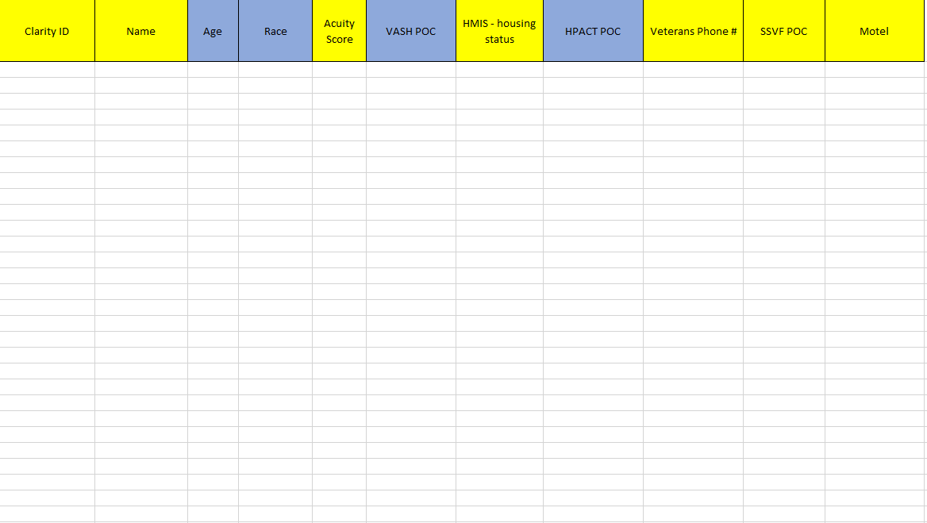
Sample Tracking Form – EHA Version
Notes:
Please note that the resource slide #35 references a sample tracking log that will be shared with HCNs. The document is being updated now and will be emailed separately. The sample tracking form will not be a required form for them to use, however safely and securely tracking the data points that we discuss will be, e.g, they can modify an existing form that they use.

Slide 29
Survey: What are some of the questions that you have about privacy and confidentiality?
Notes:
Katie

Slide 30
Notes:
Katie

Slide 31
Resources for Review
SSVF Race Equity Webinar: Centering Race Equity through Data
https://youtu.be/JEaaX7EJb0E
SSVF Race Equity Webinar: Race Equity and Inclusion Efforts in SSVF Programs https://youtu.be/JytwiubZEFo
SSVF Case Conferencing Overview (distributed)
SSVF sample EHA and vaccination trackers (distributed)
Health Disparities and Medicare https://www.kff.org/medicare/report/racial-and-ethnic-health-inequities-and-medicare/
Notes:
LaMont

