Slide 1
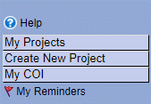
MY COI
Ensure you have an IRBNet Account - gov.irbnet.org
If you do not already have an account - Self register here
A COI Form, (OGE 450 ALT) is required for all personnel listed on a VA-Project Cover Sheet with an “Investigative” Role, (PI, Co-PI, Co-I, Sub-I):
Initially, upon New Project Submission
Upon being added to an ongoing project
Upon Continuing Review to primary overseeing Review Board
Interim; personal or financial situation changes that reasonably put you in conflict with this study

Slide 2
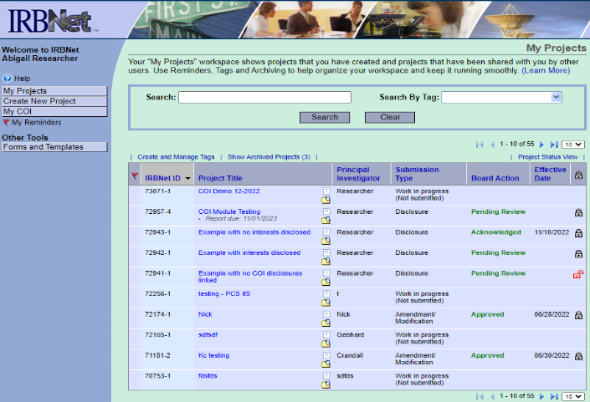
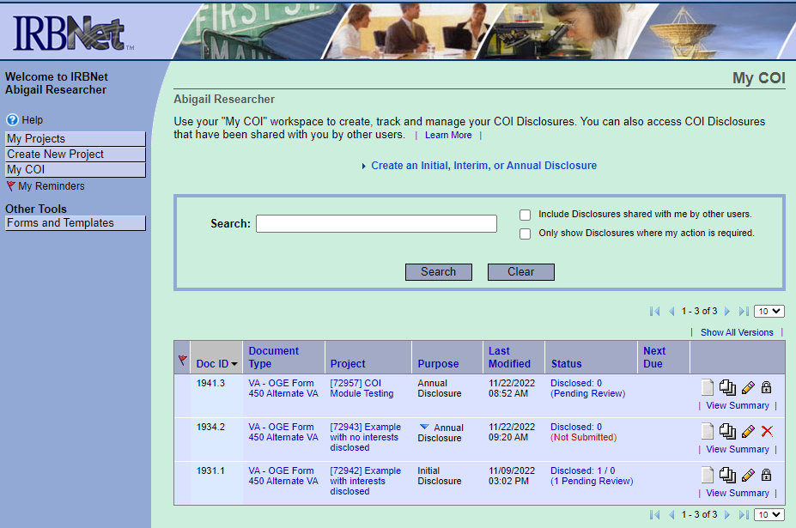
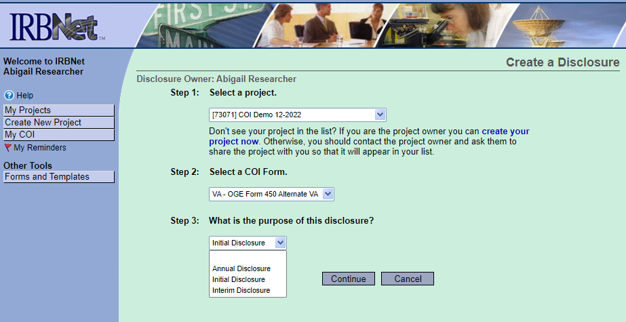
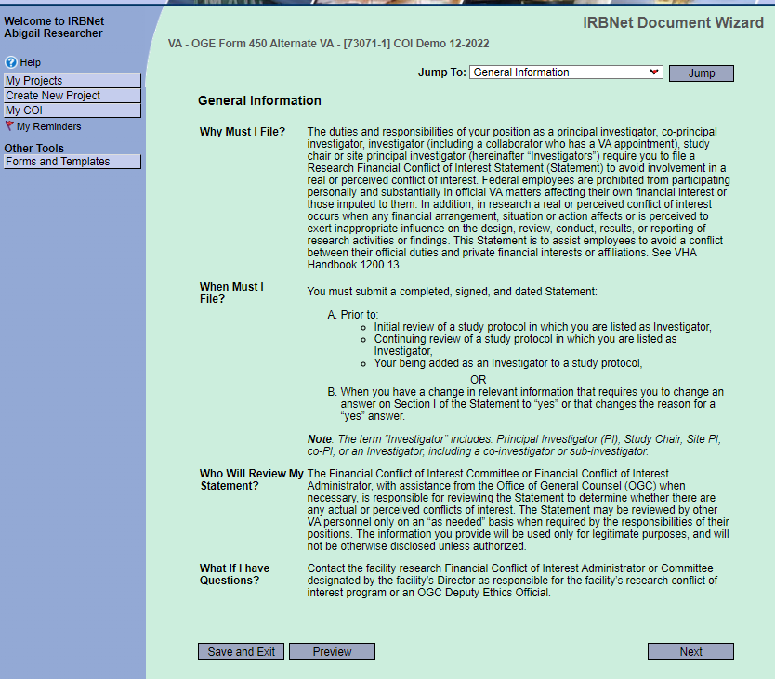
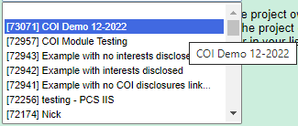
Creating Your COI Disclosure
Select
Select
If the project you have in mind is not listed, it means you have not been ‘Shared’ to it yet.
Contact Study Coordinator or PI
You may have to expand
if you are ‘Shared’ on more than 10 projects
Lists all COIs you have created in the past.
If asked to edit a Pending COI use the pencil icon
Remember to expand if needed
1
2
Select applicable project
The Disclosure Form
FYI
Select
3
Select
applicable purpose
4
Select
Select

Slide 3
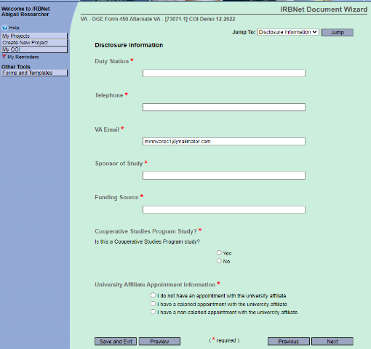
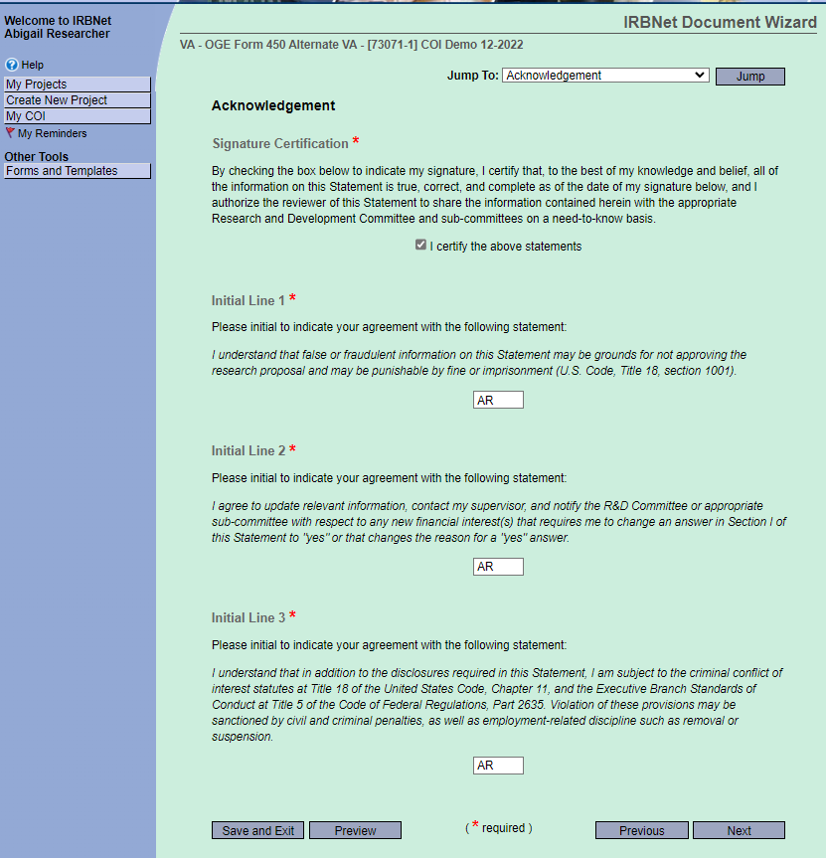
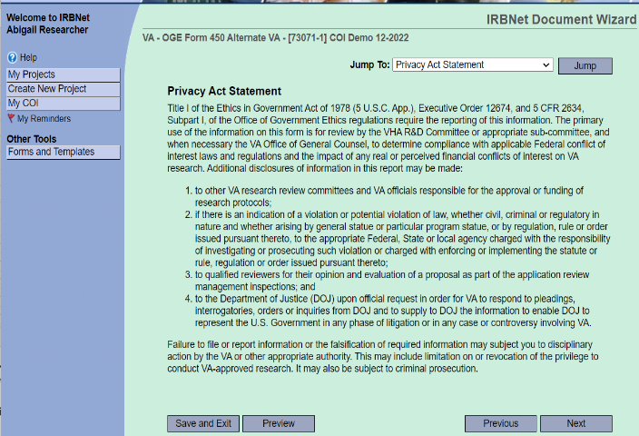
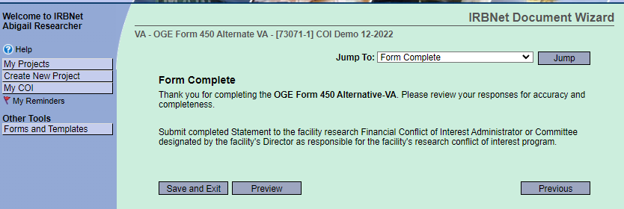
All fields with must be filled in
Answer a series of questions from the following topics
(9 questions in all):
Income & Compensation = 1
Business Relationships = 4
Intellectual Property = 1
Non-Publicly Traded Companies = 1
Specific Types of Financial Interests = 2
618 – MPLS VA
is sufficient
Certify, Enter initials & select Next
This will apply your digital signature
Sponsor will pre-populate if listed in the IRBNet Project Overview
- Type “None” if not applicable
Ask PI if unknown
Type “None” if unfunded
Select after each topic
5
6
7
Select
Select
FYI
9
Select
8
NOTE - Any documentation that you wish to accompany your COI Statement, will have to be sent externally to the Study Team member who will attach it to the Disclosure Package prior to Submitting to the Conflict of Interest Board.
Select

Slide 4
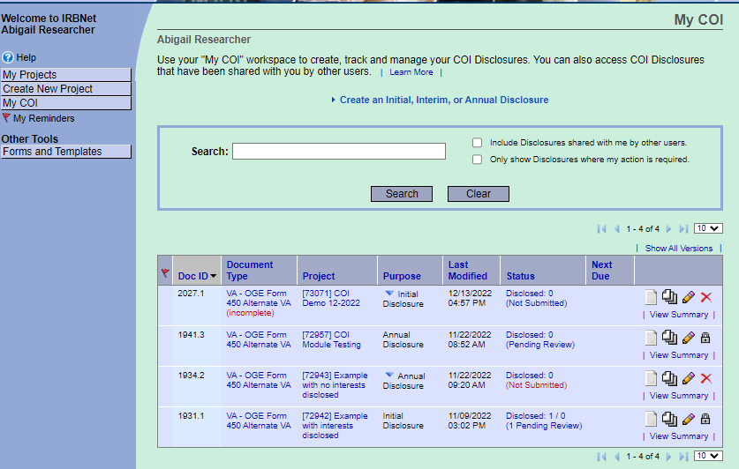
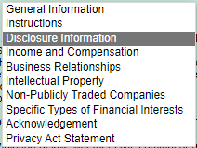
Creating Your COI Disclosure
Checking your work
Ensure you selected the appropriate Purpose. If done correctly, at this point the status should be (Not Submitted)
You must go through the entire form until the NEXT button is no longer available or you will see the
‘(incomplete)’ indicator in your COI list.
Remember, all form fields with must be filled in
Use pencil icon to edit. The form is ‘complete’ by selecting ‘Save and Exit’ from the ‘Form Complete’ page.
At any time, you can navigate to a section of the form that you may wish to update or review.
Just highlight the desired page and select Jump.
Select

