Slide 1
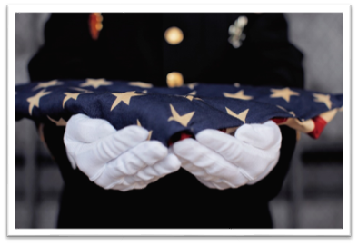
VETERAN HEALTH ADMINISTRATION
Survivors Assistance and Memorial Support (SAMS) program
Survivor Series
June 24, 2026

Slide 2

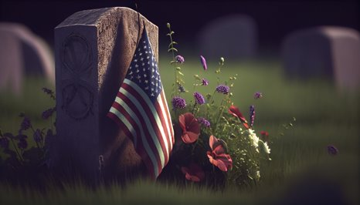
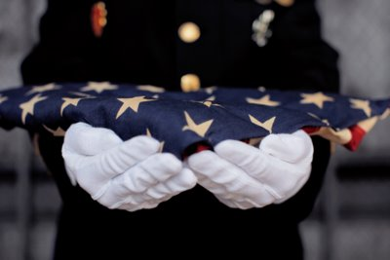
Agenda
  Welcome
  Introduction to SAMS
  SAMS Implementation
  Veterans Signals
  Pathfinder Challenge

Slide 3
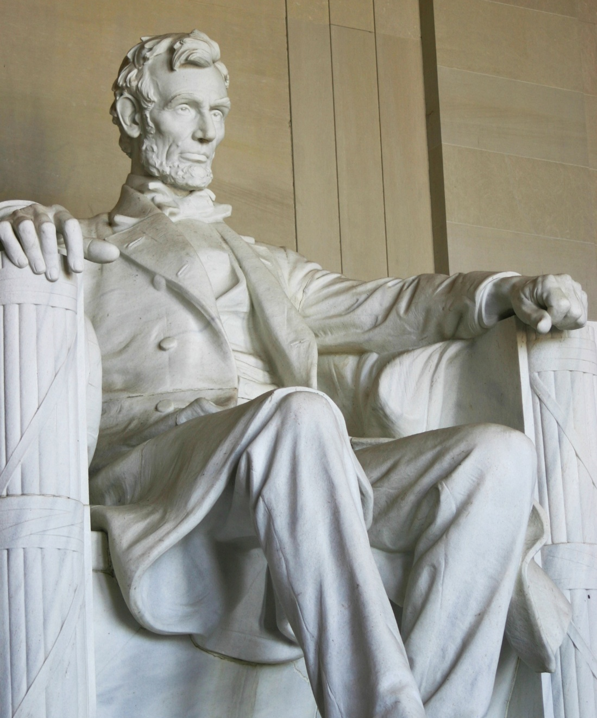
Our Mission
VA is re-affirming its commitment “to care for those who have served in our nation’s military and for their families, caregivers, and survivors.”
Every Veteran and their survivors deserve great care and support through times of transition and loss.
The SAMS Program will develop and standardize decedent processes across the VA enterprise to enhance the Veteran and survivor experience.

Slide 4
How We Got Here
500K+
Veteran deaths
annually
21K
Decedents in VHA
Variation in Decedent Affairs processes
SAMS Program under Care Management and Social Work Services (CMSW)
National media
stories
Lack of oversight of Decedent Affairs processes
Office of Inspector General investigation, report, and outcome
20-30K
Estimated calls to VA facilities by survivors
67%
of survivors report needing help with final arrangements

Slide 5






Voice of the Survivor
“We were at a loss with dad's burial and memorial benefits. No one provided any assistance, so we were on our own to figure it out.”
“We never received any help to find funeral and cremation services in the area since we were from out of state.”
“We wish the VA would have given us information about having military honors at his funeral.”
"Staff need to be more knowledgeable on VA benefits. What we were told were two different things."
“I was told what to do about the funeral, but I’m still not sure how to do it. I needed more help.”
"It was really hard to get in touch with someone -
I had to fly down and sit in an office.”

Slide 6

Purpose and Vision
The Veterans Health Administration (VHA) is establishing the SAMS Program to provide personalized, supportive services to families, caregivers, and survivors at the end of a Veteran's life and after a Veteran dies. SAMS also ensures Veterans without identified family receive a dignified burial to honor their service.
The SAMS Program is committed to:
  Providing consistent support using standardized tools and best practices.
  Increasing trust in VA through improved visibility of services.
  Veterans and survivors receiving high-quality, reliable, consistent, and compassionate care.

Slide 7
Supporting Survivors
The loss of a loved one is never easy, and
no one should have to experience the feelings
of grief alone. Everyone can help support
survivors through compassionate care.
  Offer condolences.
  Acknowledge the loss.
  Allow time for the survivor to express emotion.
    Survivors may experience a range of emotions.
    Periods of silence are needed even if you feel uncomfortable.
    Avoid comparing survivor’s experiences to your personal experiences or beliefs.
      Each loss is unique.
      Stay clear of statements such as:
        I know how you feel. My ____ died a few years ago.
        You should do _____, _____, _____. It really helped me.
  Offer support and connect to resources like the local SAMS Specialist.
Please accept my heartfelt condolences.
My deepest sympathy to you and your family.
It can be overwhelming to navigate all of this. I will help you get connected to resources to support you.
I’m so sorry to hear about [name of deceased Veteran]. My heart goes out to you and your family.
I’m so sorry for your loss.
My thoughts are with you and your family during this difficult time.

Slide 8
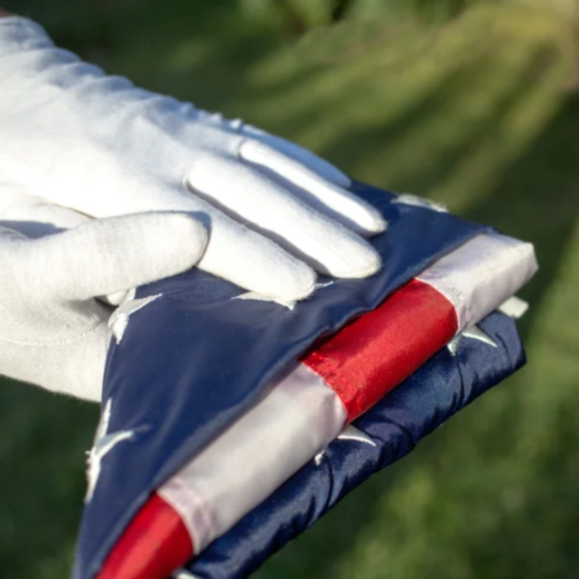
Veterans Whose Remains are Unclaimed
VA makes every effort to locate a Veteran’s next-of-kin (NOK), but in some cases, there are no known survivors, or the survivor(s) is unable to assume responsibility of the Veteran’s remains.
If a Veteran does not have a NOK to claim their remains and arrange for their interment, VA will help coordinate a final resting place that is a lasting tribute to their service.
VA works with Veteran service groups, funeral industry partners, public administrators, and caring volunteers to ensure the dignified interment (including ceremonies of remembrance, markers, and entitled honors) of Veterans whose remains are unclaimed.
No one is born alone, and in a perfect world, no one should ever die alone.
- Sandra Clarke, CCRN
Founder, No One Dies Alone Program

Slide 9

Our Path Forward
The SAMS Program is designed to provide a single point of contact at VA medical centers for assistance with:
  Pre-planning and preparedness resources
  Navigating eligible survivor benefits
  Information on planning memorial services
  Linkage to available grief and bereavement support resources
SAMS will be available to all eligible Veterans and survivors.
  The SAMS Program will be implemented at all VA medical centers in a phased approach.
  The first cohort of sites began implementing in late 2024, with remaining sites beginning implementation through the end of 2026.

Slide 10
SAMS Implementation
All facilities begin implementation before the end of FY26
All facilities fully implement SAMS by end of FY27
Launched Implementation at 21 sites
Ongoing implementation plans at the VISN level
Ongoing implementation plans at the VISN level
FY 2025
FY 2026
FY 2027

Slide 11
Veterans Signals (VSignals)

Slide 12
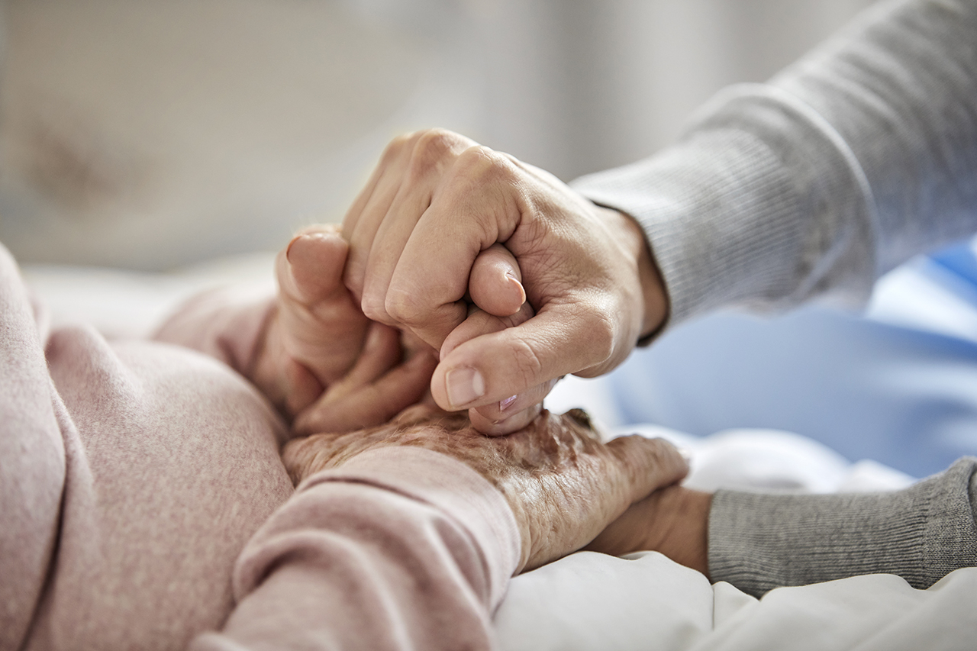
SAMS VSignals Goal
“To fulfill President Lincoln’s promise to care for those who have served in our nation’s military and their families, caregivers, and survivors.” This mission drives our goal to improve trust with our Veterans, their families, caregivers, and survivors.
To capture survivor feedback, assess the quality of support provided, and identify areas for improvement.
To assess if SAMS is providing personalized, supportive services to families, caregivers, and survivors at the end of a Veteran's life and after a Veteran dies.​​

Slide 13
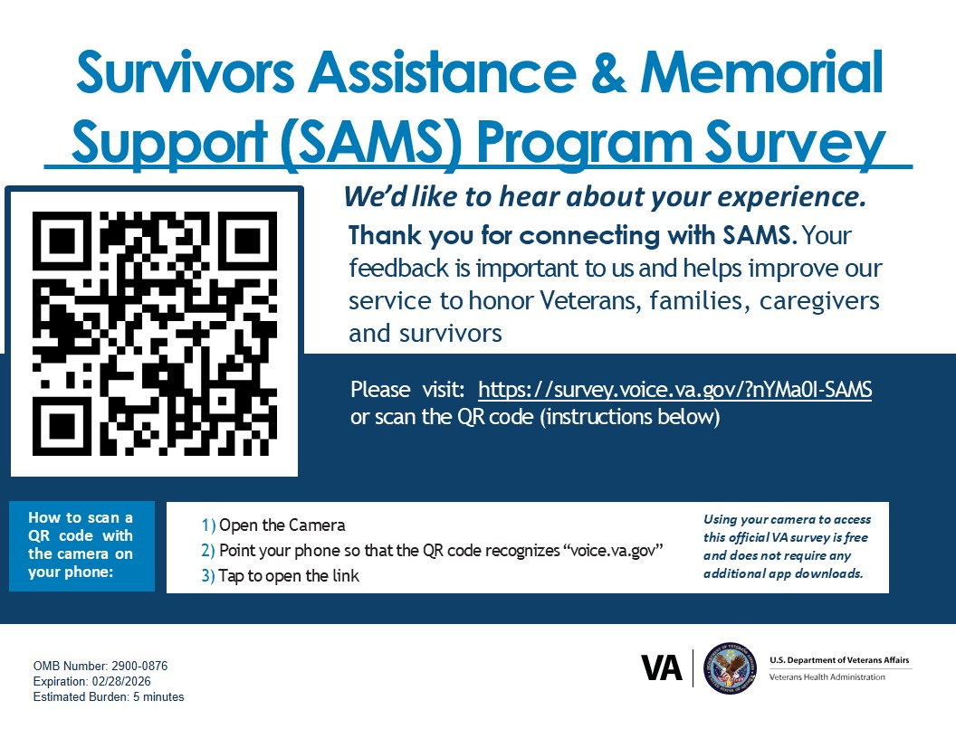
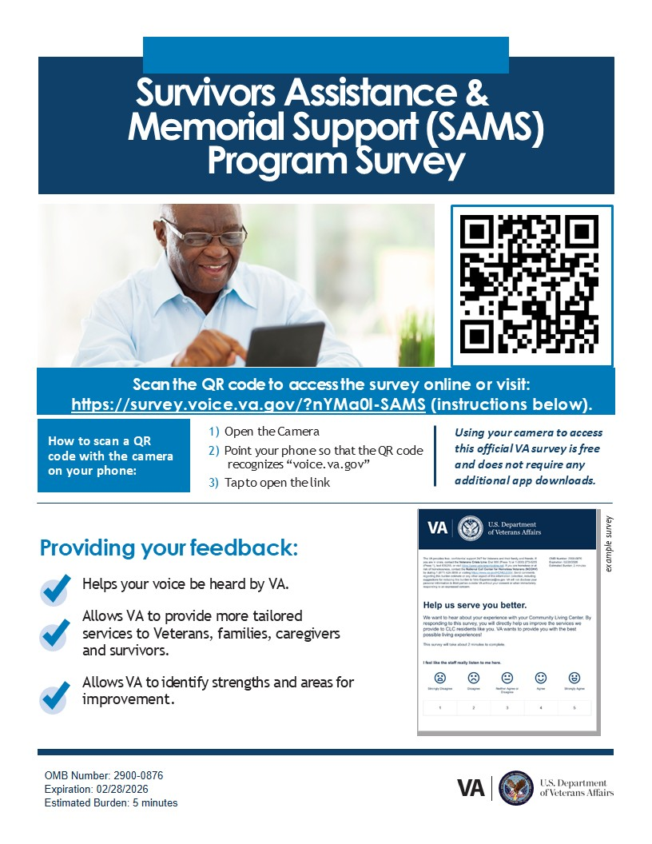
SAMS VSignals Survey

Slide 14
Pathfinder Challenge

Slide 15
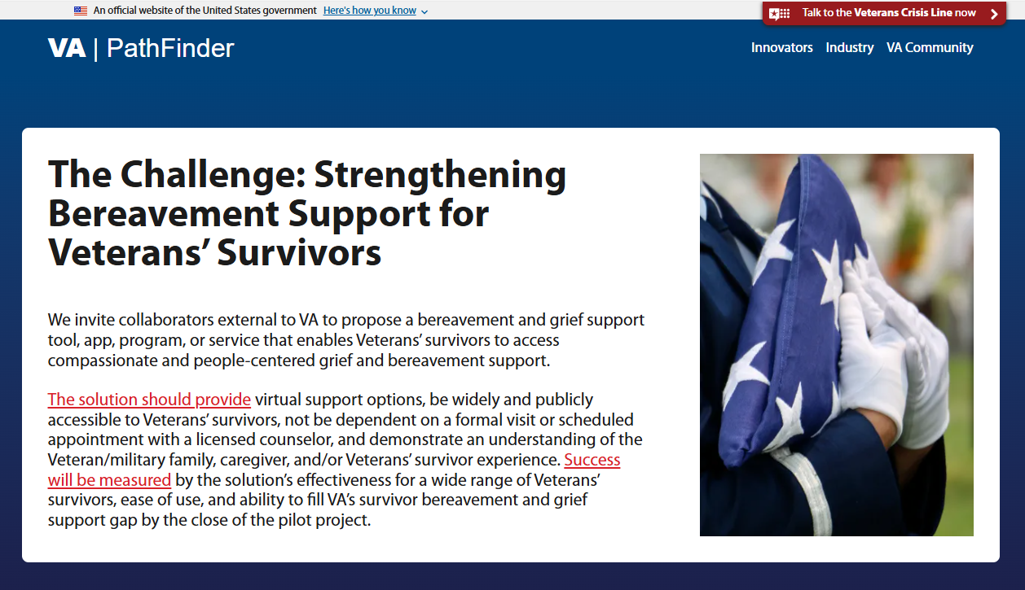
Pathfinder Challenge
Pathfinder Challenge

Slide 16
Pathfinder Challenge Criteria
Desired Outcomes
Veterans’ survivors will experience increased support from VA in navigating grief after the loss of a Veteran
Staff will be better equipped with appropriate tools to provide support to Veterans’ survivors in their transition
The system will close a key service gap and increase access to care for Veterans’ survivors
Requirements
Must be usable by all survivors of Veterans, 18 years of age and older, at all levels of technological ability
If the support includes bereavement counseling, it must be via licensed, credentialed, or certified grief providers
Must provide information or a direct connection to 988 and crisis services
Must comply with VHA Policy and Directives
Must not require the integration of a separate technological platform into VA systems
Must be at the “test” phase of maturity –model developed, ideating, prototyping, and redesigning a minimum viable product to determine feasibility and functionality

Slide 17

Feedback
We greatly value your input and would love to hear from you. Please share any feedback you may have with us.
Connect with the
National SAMS Program:
VHASAMS@va.gov

