Slide 1
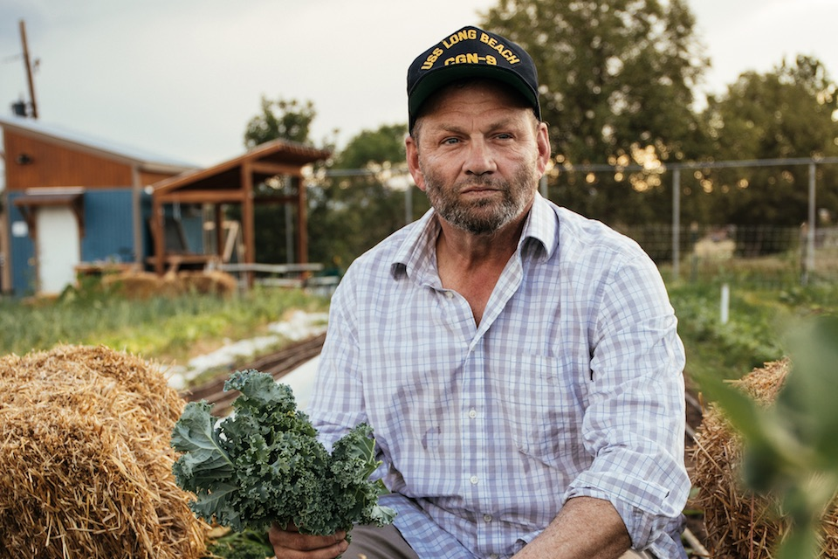
Whole Health Skill-Building: Food & Drink
Name of Instructor(s)
Date
Location
Photo: modernfarmer.com
Notes:
Instructorsl in for each different course you teach

Slide 2
In this course, we will focus on
The power of “Food and Drink” to influence your health
How you can make Food & Drink part of your Personal Health Plan
Tips for buying and preparing food
Mindful eating
The role of dietitians
Where you can go (online, reading materials, experts) to learn even more
How to set a Food & Drink goal

Slide 3
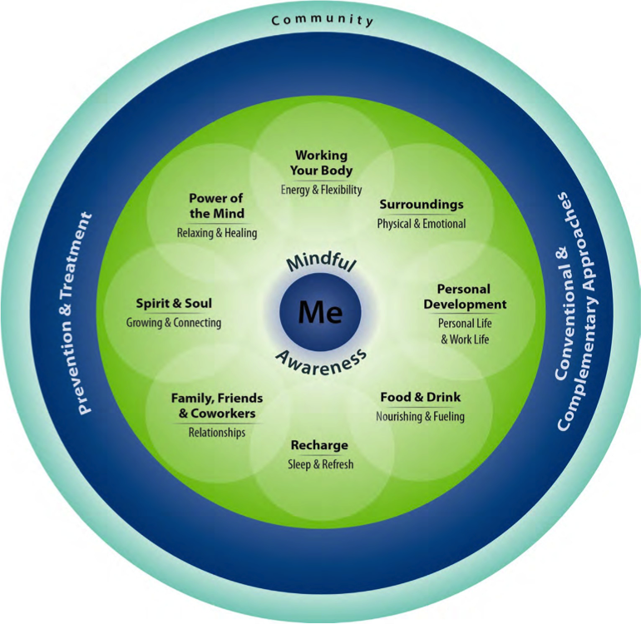
Let’s Discuss: How Do Food & Drink Affect Your Health?
Let food be thy medicine and medicine be thy food.
-Hippocrates
Notes:
Instructor shares story
Emphasize the word activity over exercise

Slide 4
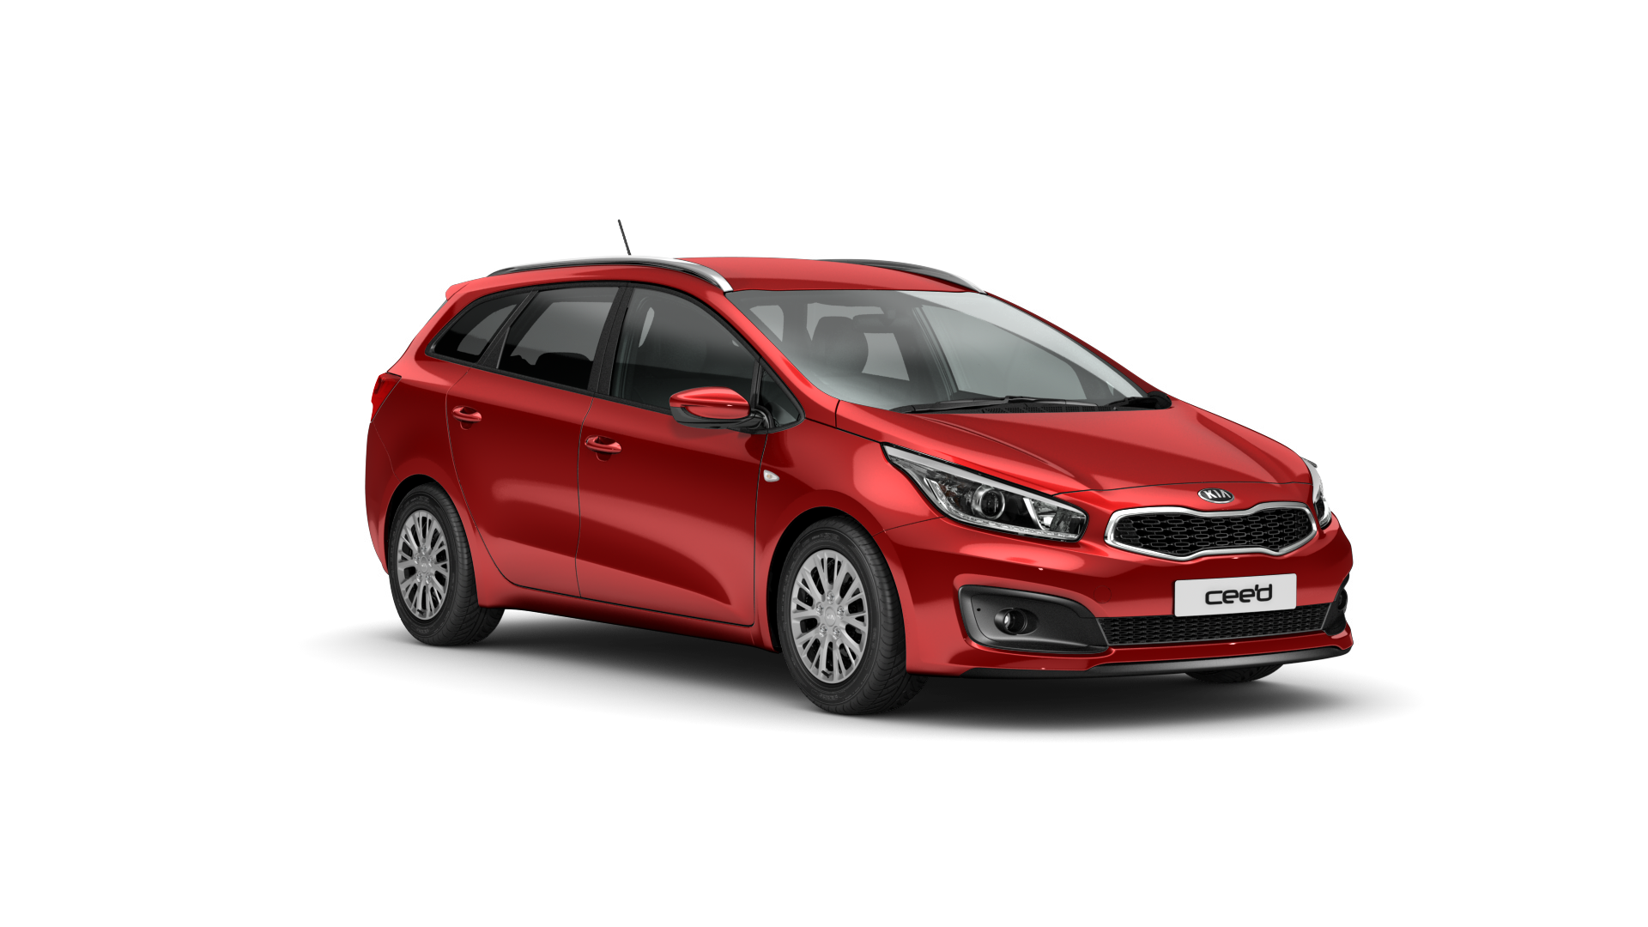
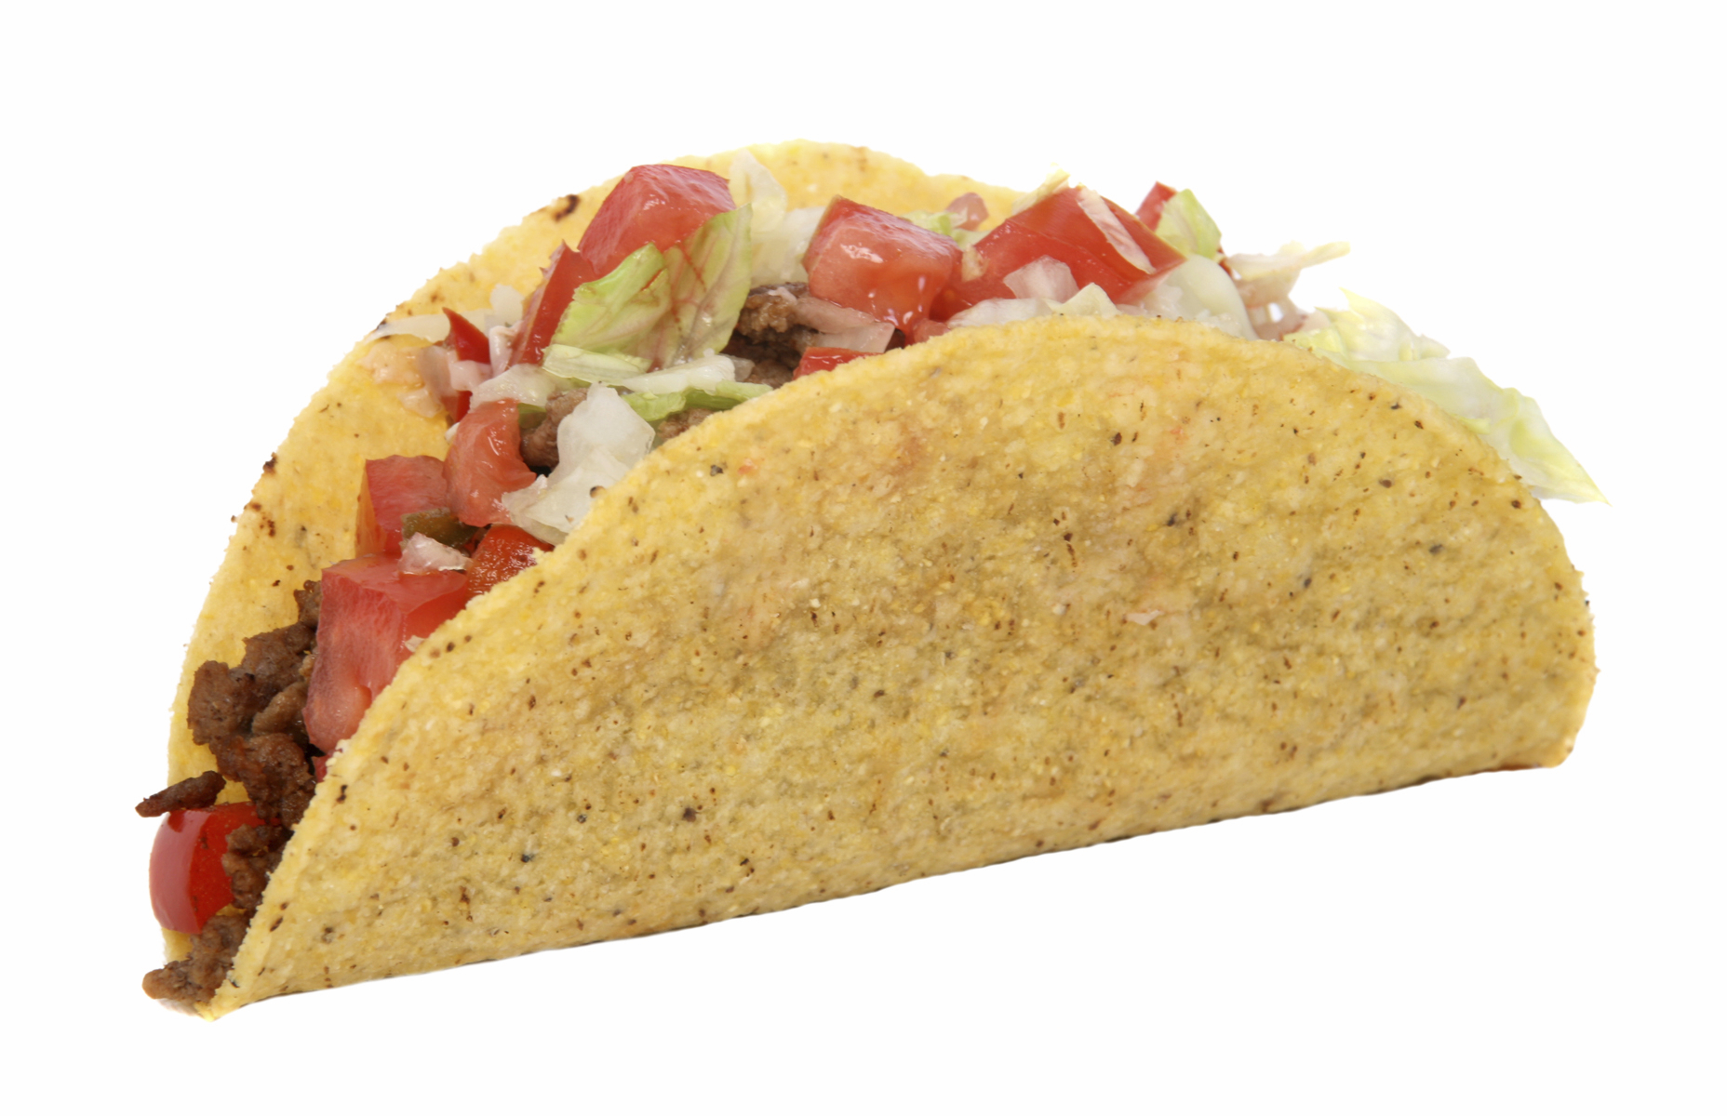
Our Body Mechanics: From Parts to the Whole
Photo: kia.com
Photo: CariD.com
Photo: Pathwayz.org
Photo: pixabay.com

Slide 5
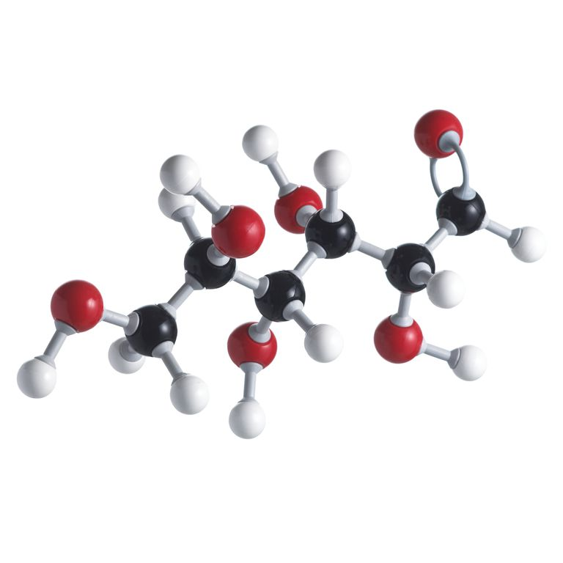
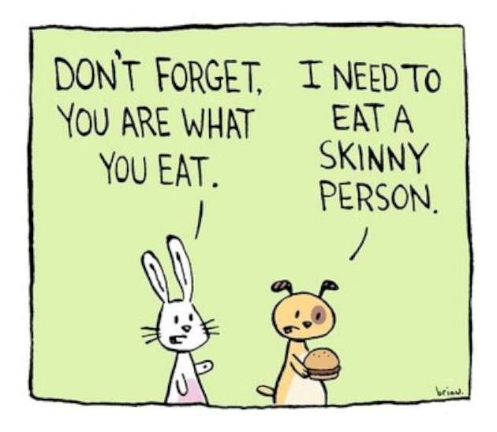
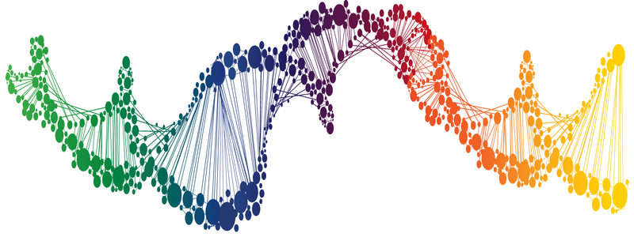
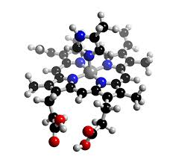
You Really Are What You Eat
Everything is broken down into molecules
Those molecules affect how your body works
Those molecules turn into you!
Notes:
Instructor shares story
Emphasize the word activity over exercise

Slide 6
Why Food and Drink Matter
Healthy Eating Also Helps You Feel Good
Blood flow
Brain function
Energy level
Digestion
Breathing
Mental health
Pain
...and many more areas of health
Photo: USDA.gov
http://www.who.int/dietphysicalactivity/publications/trs916/summary/en/
Notes:
Instructor shares story
Emphasize the word activity over exercise

Slide 7
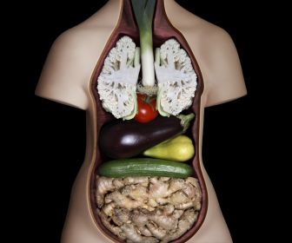
Why Food and Drink Matter
Healthy Eating Helps Prevent
Obesity
Heart disease
Stroke
Diabetes
Cancer
Mental health
Pain
...and many more health issues
Photo: 360yourlife.com
http://www.who.int/dietphysicalactivity/publications/trs916/summary/en/
Notes:
Instructor shares story
Emphasize the word activity over exercise

Slide 8
Small Group Exercise: Best....Meal....Ever!
Form groups of 2 or 3
Choose someone to go first
Each person takes a few minutes
Describe one of your best meals ever
What made it great?
Notes:
Divide into groups of four
To put this in perspective, it can help to try the following exercise for each table.
Usually comment on the value of the wisdom of the group, and how many sites comment this is the first time they have met some of the people in their sites, at least face to face.
Take some time to explore more about the “why” of how they chose the meal. Usually, other aspects of the circle of health come up, especially related to relationships and surroundings.

Slide 9
Large Group Discussion: Best Meal Ever
What came up for you?
A great meal is made up of good food... and more
Company
Conversation
The setting
Good memories
Photo: artofmanliness.com
Food & Drink connects to the other self-care circles in the Circle of Health
Notes:
As evidenced by what came up during the small group exercise

Slide 10
Food & Drink: Important Reminders
This can be complex – good to get support (dietitians)
Pay attention to habits – alcohol, binge eating, eating disorders
Get your nutrients
Be cautious if you have health issues, especially things like diabetes, liver or kidney problems, stomach problems

Slide 11
Zeroing in on Options
Make One Small Change
Create Your Own Food & Drink Plan
Work with a Dietitian
Learn More About Preparing Meals
Food & Drink
Nourishing & Fueling
Tailor Your Eating to Your Health Needs
Eat Mindfully
Notes:
Create an activity plan.
Flexibility

Slide 12
Make One Small Change
Create Your Own Food & Drink Plan
Work with a Dietitian
Learn More About Preparing Meals
Food & Drink
Nourishing & Fueling
Tailor Your Eating to Your Health Needs
Eat Mindfully

Slide 13
Personal Food & Drink Plans: Some “Food for Thought”
Don’t just think in terms of “diet”
People don’t follow through if it feels like a punishment
Not all calories are created equal
Careful about ‘good and bad’ labels
Consider your budget and what you have access to
Photo: newkidcenter.com
Notes:
Guide to Writing an Activity Prescription, p. 68 of Passport

Slide 14
Personal Food & Drink Plans: More Food for Thought
Different Options
Add (increase) something
Remove (decrease) something
Change a habit
Photo: myprotein.com
Notes:
Guide to Writing an Activity Prescription, p. 68 of Passport

Slide 15
The Food & Drink Plan: Adding
When you add something, you don’t have to add too many extra calories (unless you need them)
Examples
More veggies and fruits
More fiber
More water
More nuts

Slide 16
The Food & Drink Plan: Removing
Shouldn’t feel like a big sacrifice
Examples
Smaller servings
Cut back desserts each week
Drink fewer sweetened drinks
Eat less processed food
Cut back on sugar
Eat less animal fat

Slide 17
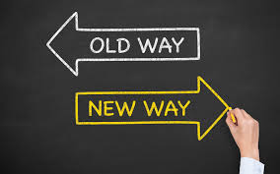
The Food & Drink Plan: Changes
Simple changes can make a big impact
Examples
Eat out less often, if you tend to eat less healthily when you do
When you eat, really focus on eating (focus on the food and not the TV, sit down, leave your work space). Talking with others is okay
Think about when you eat during the day, and how many meals and snacks you have
Eat the rainbow

Slide 18
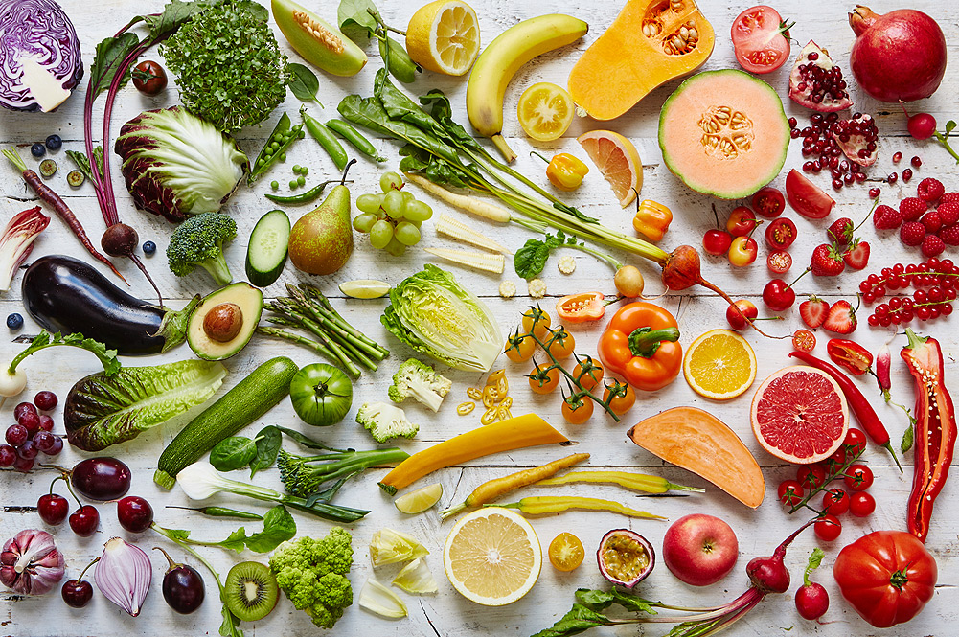
The Power of Color

Slide 19
But NOT like this!
Notes:
Of course people can say they eat a variety of colors and eat like this

Slide 20
Remember...
Always go back and ask why healthy eating and drinking matter
Remember, every little bit counts
Start gently and slowly build up
Do a combination of changes, if you like
Work with other people who can support you – ask for help!
Examples:
“Starting next Monday, I am going to cut back to 1 soda a day and drink water in place of the other sodas.”
“I will go out for fast food only twice a week, instead of four times.”
“I will cut back on my salt intake to under 2,000 mg a day, like my dietitian asked me to do.”
“I will only eat half a bowl of ice cream at night, instead of a full bowl.”

Slide 21
Make One Small Change
Create Your Own Food & Drink Plan
Work with a Dietitian
Learn More About Preparing Meals
Food & Drink
Nourishing & Fueling
Tailor Your Eating to Your Health Needs
Eat Mindfully

Slide 22
Classes
Know what is available at your site
Many sites have Healthy Teaching Kitchens where you can learn cooking skills
Some dietitians teach classes on how to shop for healthy food, including on a budget
Online classes can also be an option
Notes:
Can add in local resources here.

Slide 23
Try it out!
Demonstration

Slide 24
Make One Small Change
Create Your Own Food & Drink Plan
Work with a Dietitian
Learn More About Preparing Meals
Food & Drink
Nourishing & Fueling
Tailor Your Eating to Your Health Needs
Eat Mindfully

Slide 25
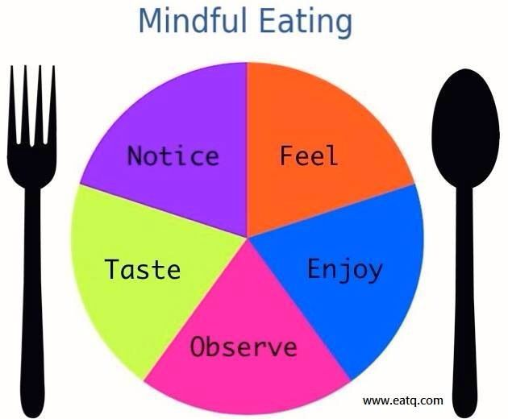
Mindful Awareness- An Eating Meditation...
Photo: total-yoga.org
Eating slowly and intentionally is not usually part of life in the military!
This next activity might seem strange, but you might be surprised what you can learn
You might notice more about what goes on in your mind (or does not) as you eat
You will tune into your senses and, if you wish, your emotions related to food
Notes:
Body scan meditation – get a script

Slide 26
Let’s Discuss: Eating Meditation
How was that?
What did you notice?
Thoughts
Emotions
Sensations
How does this compare to how you usually eat?
Could this exercise tie in to other day-to-day activities besides eating?

Slide 27
Make One Small Change
Create Your Own Food & Drink Plan
Work with a Dietitian
Learn More About Preparing Meals
Food & Drink
Nourishing & Fueling
Tailor Your Eating to Your Health Needs
Eat Mindfully

Slide 28
There are many different ways to eat
Based on general patterns
High fat, low carb
High carb, low fat
Intermittent fasting
Calorie control
Vegetarian or Vegan
Note that this isn’t to say you must follow one specific eating plan or approach!

Slide 29
There are many different ways to eat
Popular diets:
Weight Watchers
Zone
Jenny Craig
Paleo
Atkins
South Beach
Mediterranean
Eating recommendations created by medical groups or individuals
American Diabetes Association diets
DASH (hypertension) diet
Glycemic Load
Ornish
Dietary Guidelines for Americans

Slide 30
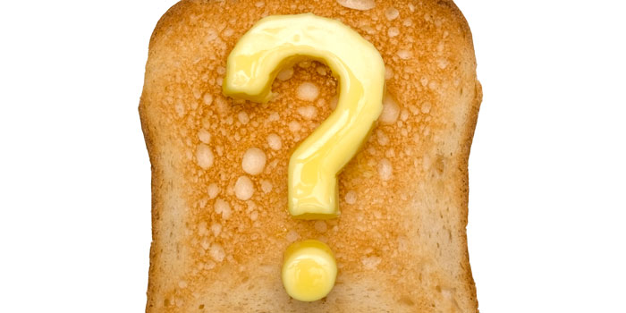
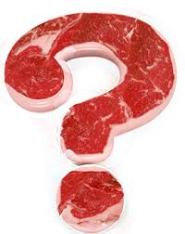
So, How Do You Decide?
You have to ask what is sustainable for you
Different approaches to eating work better for different people
Ask your health care team (dietitian) for help
Consider how your health issues tie in
Start small – set goals you know you can reach
The eating plans people succeed with are the ones they keep following!

Slide 31
Some Examples
Certain foods may trigger headaches in some people
Certain approaches to eating can help with Crohn’s and colitis
Type 2 diabetes can improve a lot based on how you eat
How you eat affects cholesterol and weight
Healthy eating can help prevent heart disease, stroke some cancers, and other problems
Certain ways to eat are better for kidney and liver disease
Ask for a dietitian to help you out!

Slide 32
Make One Small Change
Create Your Own Food & Drink Plan
Work with a Dietitian
Learn More About Preparing Meals
Food & Drink
Nourishing & Fueling
Tailor Your Eating to Your Health Needs
Eat Mindfully

Slide 33
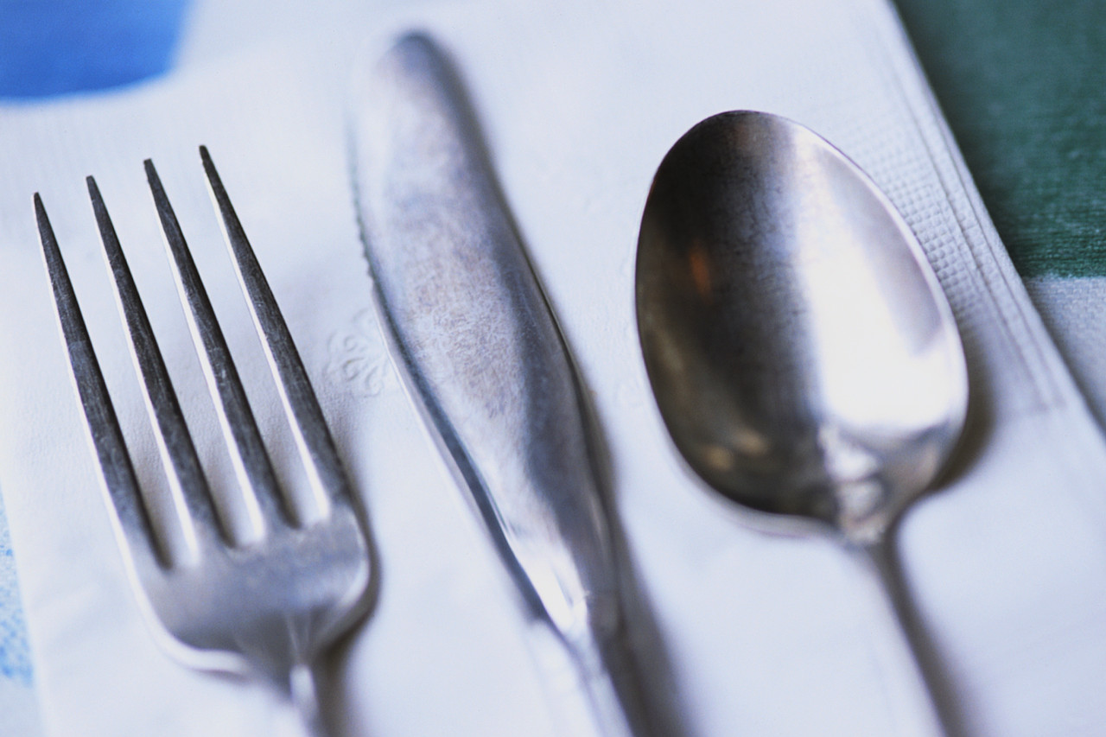
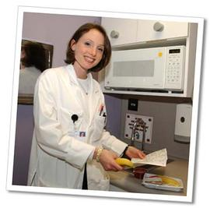
Nutrition & Food Services (NFS)
Registered Dietitian Nutritionists (RDN) make the connection between science & food choices.
Notes:
NFS:
1800 Registered Dietitian Nutritionists (RDN)
200 Dietetic Technicians
6000 food service supervisors and staff
>8000 total staff
>100 Dietetic Interns placed in 12 VA internships annually.
>37 Million Meals served to hospitalized Veterans each year.
RDNs comprise >70% of MOVE Program staff.
RDNs are the healthcare professionals that provide evidence based medical nutrition therapy to patients. They are uniquely qualified to manage the medical nutrition needs of patients with multiple or complex disease states, and counsel patients in nutrition therapy toward positive behavior change.

Slide 34
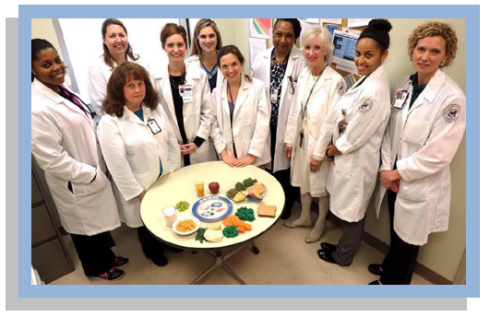
NFS Nutrition Professionals… Experts in Action!
Pay close attention to the research
Are an important part of the team
Follow a specific care process
Gather info
Help figure out what is going on
Come up with nutrition plans
Teaching
Counseling and support
Notes:
Registered Dietitian Nutritionists use the professional practice NCP to provide evidence based MNT, counseling and education. While other healthcare professionals may offer general nutrition information, the RDN is your partner to fully develop and implement a nutrition care plan for the Veteran.
VHA Handbook 1109.08 Nutrition Care Process Handbook https://www.va.gov/vhapublications/ViewPublication.asp?pub_ID=2990

Slide 35
Make One Small Change
Create Your Own Food & Drink Plan
Work with a Dietitian
Learn More About Preparing Meals
Food & Drink
Nourishing & Fueling
Tailor Your Eating to Your Health Needs
Eat Mindfully

Slide 36
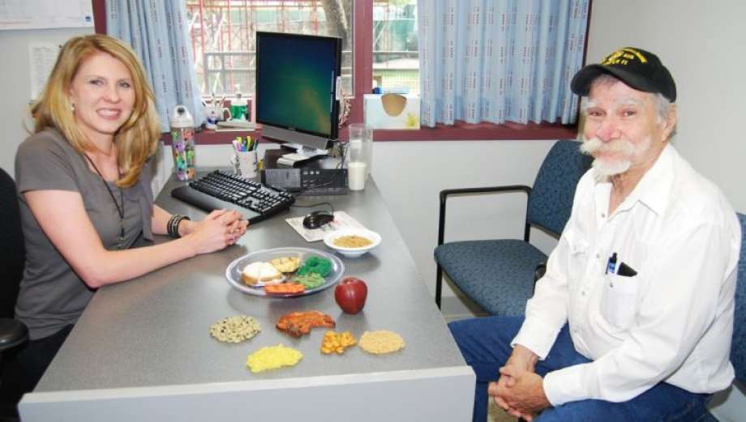
Set a Goal! Make One Small Change
Photo: chron.com
All the topics so far can guide you
Personal Food and Drink Plans
Meal prep, classes, teaching kitchens
Mindful eating
Tailoring your eating to your health needs
Seeing a dietitian
All kinds of goals are possible
Add or subtract a food
Change a pattern
Time meals in new ways
Only eat when hungry
Cook with loved ones
Try a new food
Go to a farmers’ market
Other ideas?

Slide 37
Your Turn
Work with a partner
Take turns
Each person will come up with one thing they will do as part of their Personal Food & Drink Plan
You will be invited to share your goal with the group
Photo: ckddietrecipes.com

Slide 38
Setting Goals
Seven steps in goal setting
Identify the goal
Know the benefits
Know obstacles
List skills and knowledge needed
Identify who can help
Develop a plan (SMART)
Set a timeline and next steps
SMART Goals
Specific
Measurable
Action-based
Realistic
Time-bound

Slide 39
Food & Drink – Summing Up
Start with what matters
Tailor the plan to YOU!
Food & Drink can mean many things – start simple
Learn about resources, community programs, classes and other options
Be safe, be realistic
Ask for help and support (dietitians, other team members, loved ones)
Keep eating enjoyable!

Slide 40
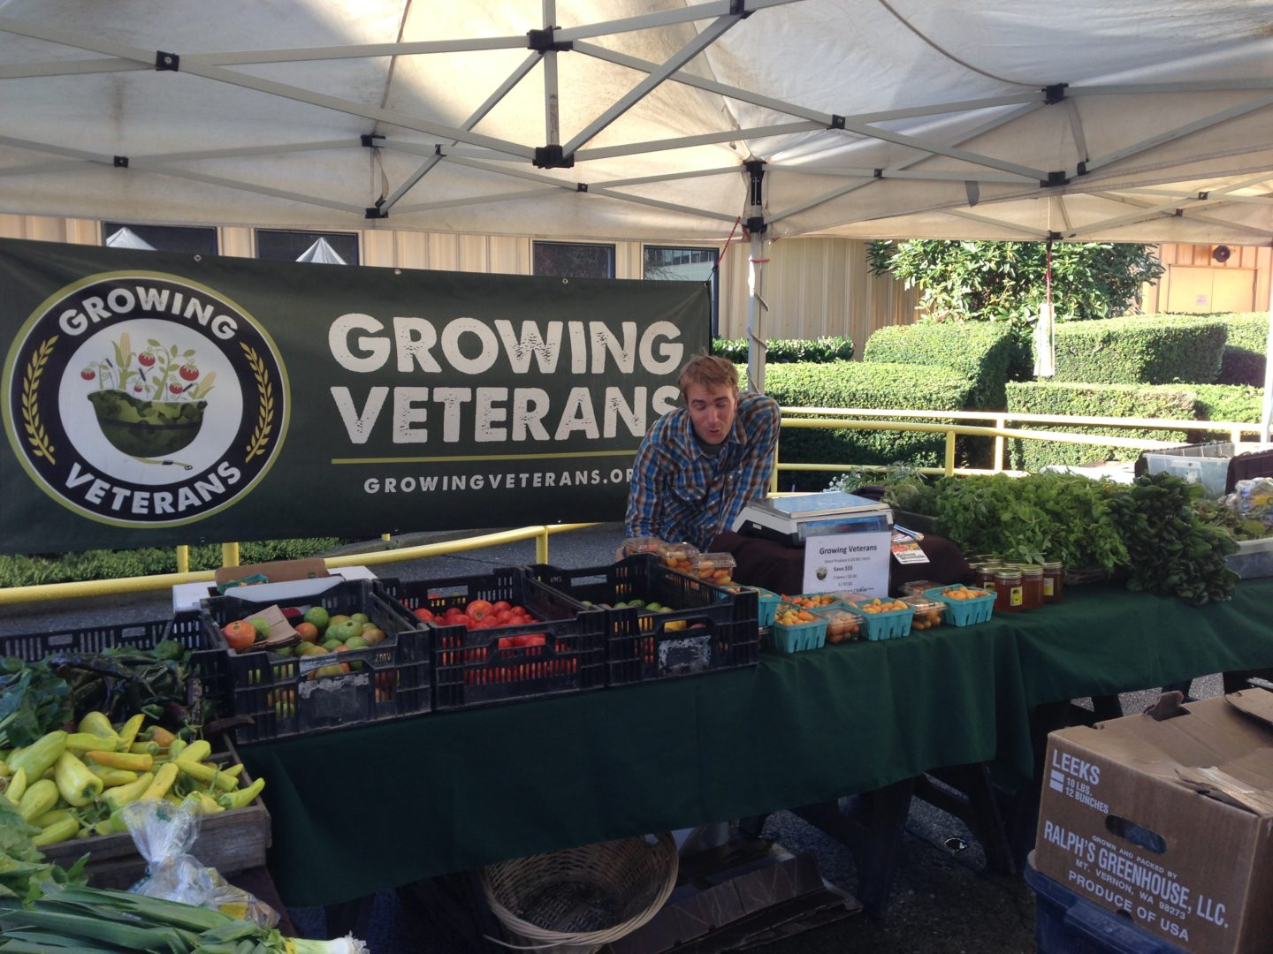
Thank You!
Photo: farmlandaccess.org

