Slide 1
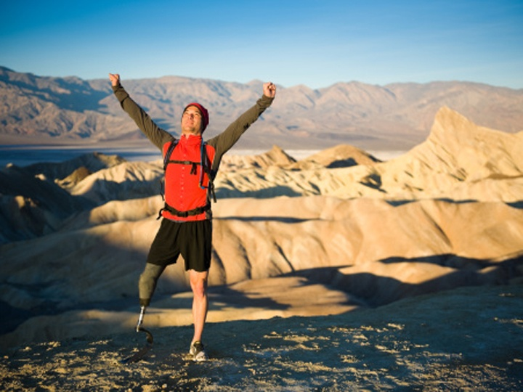
Whole Health Skill-Building: Working Your Body
Name of Instructor(s)
Date
Location
Notes:
Instructorsl in for each different course you teach

Slide 2
Today, we will talk about
What “Working Your Body” means
How you can do more of it
How Working Your Body can be part of your Personal Health Plan
How to set a Working the Body goal
Where you can go (online, reading materials, experts) to learn even more

Slide 3
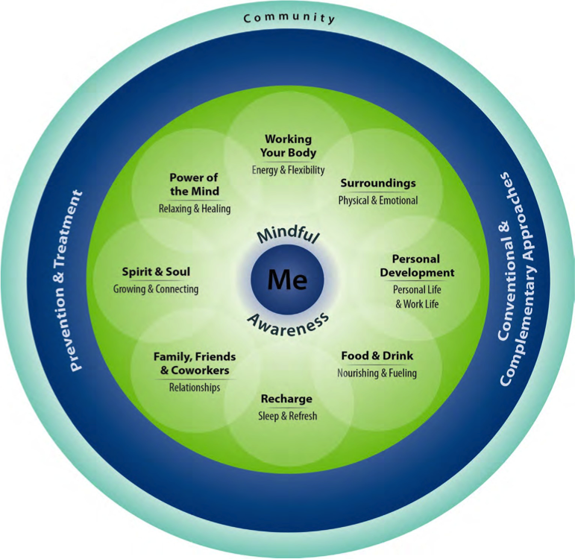
Let’s Discuss: What Does it Mean to “Work Your Body?”?
Happiness is a state of activity.
-Aristotle
Notes:
Instructor shares story
Emphasize the word activity over exercise

Slide 4
Ways to Work Your Body
All kinds of activities that help
Strength
Endurance
Flexibility
Balance
Safety
Posture
Notes:
Instructor shares story
Emphasize the word activity over exercise

Slide 5
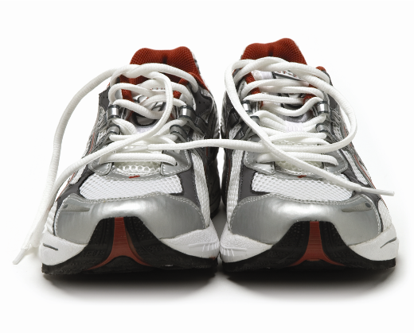
Let’s Discuss: Working Your Body- Why Bother?
Notes:
This is a good place to encourage audience participation. What do they know about benefits of physical activity.

Slide 6
Working Your Body Why Bother?
What if there was
one prescription
that could
prevent and treat
dozens of diseases,
such as diabetes, hypertension
and obesity?
-Robert E. Sallis, M.D., M.P.H., FACSM,
Exercise is Medicine™ Task Force Chairman

Slide 7
Why Bother?
Increases your lifespan
Helps prevent heart disease, strokes, type 2 diabetes, high blood pressure, obesity, and cancers
Helps you age more gracefully, so you can do more in your life for a longer time
Fights off dementia and helps you think better
Improves mental health – decreases depression and anxiety

Slide 8
Group Discussion: Your Story
Work with a partner
Take a couple of minutes each to talk about some of your favorite activities
Why do you like them?
What is one way to work your body that you would like to start doing more?
Notes:
Would just reflect on this

Slide 9
Working Your Body: Safety
Get go-ahead from your care provider
Build up gradually
Be careful about falls
Listen to your body
Let your pain be your guide – to a point
Have fun. It helps!

Slide 10
Zeroing in on Options
Make One Small Change
Create a Personalized Activity Plan
Work with an Expert
Mindful Movement
Working
Your Body
Energy & Flexibility
Take a Class
Track Your Progress
Notes:
Create an activity plan.
Flexibility

Slide 11
Make One Small Change
Create a Personalized Activity Plan
Work with
an Expert
Mindful Movement
Working
Your Body
Energy & Flexibility
Take a Class
Track Your Progress
Notes:
Create an activity plan.
Flexibility

Slide 12
Personal Activity Plans: Be FITT
FITT:
Frequency -How often?
Intensity - How hard will you work?
Type - What you will do?
Time – How long?
Notes:
Guide to Writing an Activity Prescription, p. 68 of Passport

Slide 13
Frequency – How often?
Every little bit helps
Choose an amount you can do – if it seems easy, you’ll do it
Work toward most days of the week, if that seems right

Slide 14
Intensity – How hard?
Start gently
“Can talk, can’t sing”
More of a low-key exercise = less of an intense one

Slide 15
Type - What activity?
If you enjoy it, you’ll do it more
Many options
A sport
Walking/wheeling
Classes (like tai chi or yoga)
Gardening
Dancing
Using the stairs
Stretching
Weights
Etc.... A combination?

Slide 16
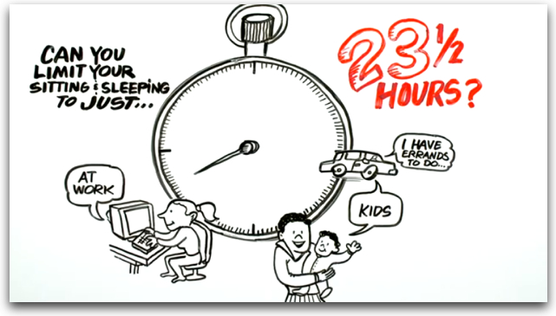
Time - How Long?
It depends on you and your goals
Start gently, build up slowly
Even a little helps
Don’t just count activity at work
http://www.youtube.com/watch?v=aUaInS6HIGo

Slide 17
Remember...
Focus on what really matters
Every little bit counts
Start gently and slowly build up
Do a combination of things
Be sure it is fun
Examples:
“Starting this week, I will walk with my dog twice a day, for 15 minutes each time. I will go fast enough that I can still talk but not sing.”
“At least once a week I will park farther away from the store so I walk more.”

Slide 18
Make One Small Change
Create a Personalized Activity Plan
Work with
an Expert
Mindful Movement
Working
Your Body
Energy & Flexibility
Take a Class
Track Your Progress
Notes:
Create an activity plan.
Flexibility

Slide 19
Mindful Awareness- A Body Scan...
Photo: tarabrach.com
Can help you notice more about what is going on with your body
Should feel safe and relaxing
Will have you notice different parts of your body, one at a time
Can be stopped any time, if you need a break
*If you note discomfort, try to simply watch it without getting caught up in it.
Notes:
Body scan meditation – get a script

Slide 20
Mindful Movement: Yoga and Tai Chi
All VA’s will be offering them in some way starting in 2018
We know they help your health
They help prevent heart attacks, improve mood, build balance, and more
Best to take a class – see what your VA has to offer

Slide 21
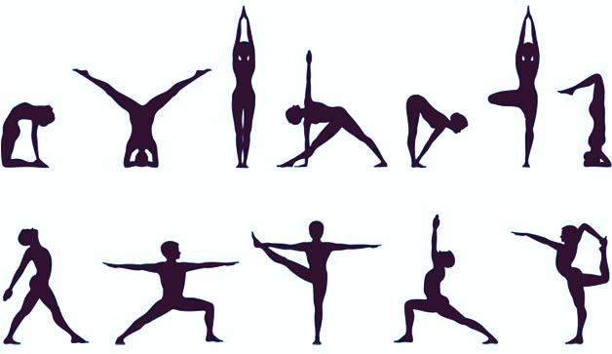
What do you know about yoga?
Photo: Yogajournal.com
Notes:
Discuss different types of yoga

Slide 22
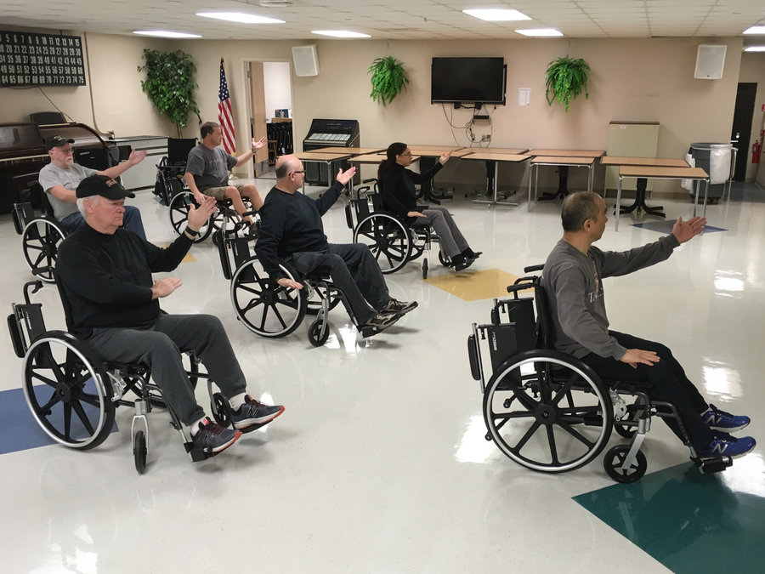
What about tai chi and qi gong?
Photo credit: npr.org

Slide 23
Make One Small Change
Create a Personalized Activity Plan
Work with
an Expert
Mindful Movement
Working
Your Body
Energy & Flexibility
Take a Class
Track Your Progress
Notes:
Create an activity plan.
Flexibility

Slide 24
Apps and Pedometers
Pedometers and wheelchair odometers can tell you how far you go
There are many different types of apps – pick ones that work for you.
General Examples (free, but have ‘in-app purchases’)
FIT Star
MyFitness Pal (tailors workouts by fitness level)
For specific activities –
Jefit for weight lifters
Cyclemeter for cyclists

Slide 25
When Choosing an App, Ask:
Is it easy to use and to get around in?
Do you trust the info it gives?
Does it give you enough info?
Does it tailor activities to your level of fitness?
Does it want you to spend a lot on in-app purchases?

Slide 26
Make One Small Change
Create a Personalized Activity Plan
Work with
an Expert
Mindful Movement
Working
Your Body
Energy & Flexibility
Take a Class
Track Your Progress
Notes:
Create an activity plan.
Flexibility

Slide 27
Classes
Know what is available at your site
Yoga, tai chi, recreational therapy, dance, Pilates, others
Some places have agreements with local YMCAs or other groups
Some VA’s have gyms
Events – wheelchair games, “walk with a doc”
Notes:
Can add in local resources here.

Slide 28
Try it out!
Demonstration

Slide 29
Make One Small Change
Create a Personalized Activity Plan
Work with
an Expert
Mindful Movement
Working
Your Body
Energy & Flexibility
Take a Class
Track Your Progress
Notes:
Create an activity plan.
Flexibility

Slide 30
Professionals
Physical therapists (PT’s)
Occupational therapists (OT’s)
Recreational therapists (RT’s)
Fitness class instructors
Personal trainers

Slide 31
Make One Small Change
Create a Personalized Activity Plan
Work with
an Expert
Mindful Movement
Working
Your Body
Energy & Flexibility
Take a Class
Track Your Progress
Notes:
Create an activity plan.
Flexibility

Slide 32
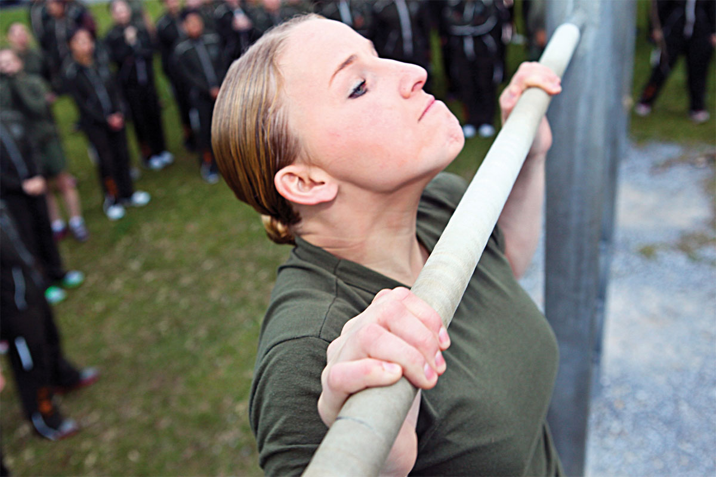
Set a Goal! Make One Small Change
Photo: Military.com
All the topics so far can guide you
Personal activity plan (FITT)
Mindful movement
App’s and devices
Classes
Professional help
Or set a different small goal
Walk with a buddy 3 times a week
Park farther away
Get a standing work station
Use the stairs as able

Slide 33
Your Turn
Work with a partner
Take turns
Each person will come up with a Personal Activity Plan
You will be invited to share your plan with the group
Photo: Military.com

Slide 34
Setting Goals
Seven steps in goal setting
Identify the goal
Know the benefits
Know obstacles
List skills and knowledge needed
Identify who can help
Develop a plan (SMART)
Set a timeline and next steps
SMART Goals
Specific
Measurable
Action-based
Realistic
Time-bound

Slide 35
Working Your Body – Summing Up
Start with what matters
Any activity is great, and Working Your Body can mean many things
Tailor the plan to YOU!
Know resources, community programs, app’s, and other options
Be safe
Ask for help and support

Slide 36
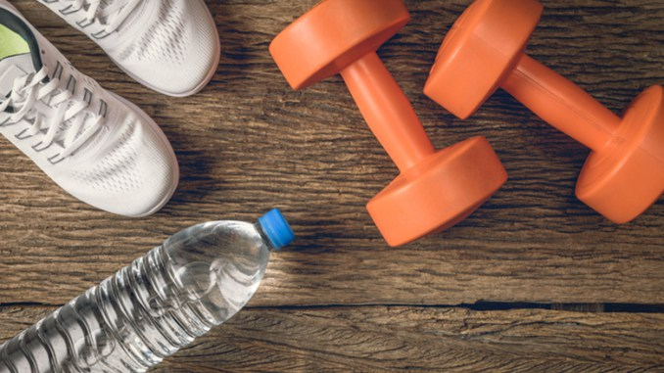
Thank You!
Photo: Foodandnutrition.com

