Slide 1
The Journey to Transformation
Whole Health Clinical Care Symposium
Face-to-Face Course
Welcome to Day 2!

Slide 2
Part 3. Planning the Journey
The Journey to Transformation: Whole Health Clinical Care
Notes:
Take a moment to take stock of where we have been and where we are going next.
This morning everyone introduced themselves, and we went over some WHCC fundamentals – we started “Reading the Map”
For this afternoon, we are going to focus on Aim statements. The focus shifts to setting the compass heading.

Slide 3
A Look Back: Where We’ve Been
Returning to the “Why”
Getting to know each other
Teasing out, What is WHCC?
Fashioning Aim Statements
Notes:
This is just a quick recap of what was covered on Day 1. Can very quickly review the titles, and then if you wish, the following slides can be used to go into more detail.
It can help to have them open their workbooks to the agenda and review Day One.

Slide 4
Where We Are Going
SWOT Analysis Revisited
Advanced Change Management
ADKAR and the People Side
Notes:
Now can share what is happening today.
Can very quickly review the agenda for Day Two, if you wish.
This is a chance to reiterate about how we will be giving them time to rethink their Aim even more – again with the caution not to necessarily jump right to “Knowledge” in the AKDAR model.

Slide 5
9. Mindful Awareness Activity/Team Building
The Journey to Transformation
Notes:
This is the only slide in this module.
The material prior to this and then this slide offer a chance.
Learning Objectives, Module 9. Mindful Awareness Activity/Team Building
Complete another new mindful awareness experience. Examples may include a partner exercise, like the “Just Like Me” activity.
Build additional connections with fellow participants.

Slide 6
10. SWOT’s Happening:
A New Lens
The Journey to Transformation
Notes:
Next, we will explore how we can get to the first stop on our journey – change and project management with appropriate sponsorship will help us get there faster than any one aspect along.
Ask them if they know what SWOT stands for.
Learning Objectives, Module 10. SWOT’s Happening.
Learn how to do a SWOT analysis related to their specific Aim Statement.
Consider how SWOT is informed by the people side of change.
Share their experiences, and learn from other groups’ sharing as well.

Slide 7
Activity: SWOT Team Analyses
SWOT = Strengths, Weaknesses, Opportunities, Threats
Complete the worksheet with your team, focusing on your Aim
Be ready to share with the large group
Notes:
Give at least 10-15min for this activity. This module is 40 minutes long, so you can likely give them even more like 20-25 minutes.
Some participants will be familiar with SWOT, others won’t. Assume many people haven’t done this before.
If you sense that participants haven’t done the prequel SWOT, give them some time to work together as a facility to discuss SWOT (10-15 min). A useful conclusion to this is to debrief with a large group discussion and prompt people to share one S, W, O, or T. Notice if your participants are highlighting more “project management” kind of issues (e.g., resources, competing initiatives, new clinics being built) vs. the “people side of change” (e.g., fatigue with constant change in the VA, staff being really invested in the old model of care, passionate staff).

Slide 8
11. Our Transportation to Success
The Journey to Transformation
Notes:
Next we will explore how we can get to the first stop on our journey – change and project management with appropriate sponsorship will help us get there faster than any one aspect alone.
Learning Objectives, Module 11. Our Transportation to Success.
Discuss the differences between project management and change management.
Become more familiar with the Prosci model of change, including the ADKAR tool.
List at least 3 negative consequences of not managing the people side of change.
Become familiar with the Prosci Project Change Triangle.
Complete the Foundations for Change Activity, including adding their thoughts to their PowerPoint presentations.

Slide 9
Planning the Journey “A plan is only as good as those who see it through.” -Anonymous
Your Aim statement sets your compass
Using the Designation Framework ideally helps your team choose the focus of your Aim
Your stakeholders will be critical partners in this journey
Typically, the next steps involves project planning
Overlooking the “people side” of change can be costly on many levels
Investing the time to integrate change management into your project plan will increase your success
Notes:
Acknowledge participants skill level with project management. Ask for show of hands of people who have managed projects across their careers.
Explain that project management is often task or action oriented and often does NOT include addressing the people side of change.

Slide 10
Planning the Journey: Prosci®
Who was familiar with Prosci® prior to the Prequel?
VA contracts with them to do training and certification in change management
Using for VA modernization
Intuitive
...So, we are modifying it for this course as well
To access training materials, can set up an account at https://store.proci.com/customer/account/login/
Notes:
Be sure to share that VA has a contract with Prosci, who delivers formal trainings and certifications in change management and practice.
Because VA has determined that Prosci’s approach is what we are using for modernization and because it is intuitive, we will be using this model to inform our work in this course and also using many of slides and materials.
All VA employees can access Prosci’s training materials by setting up an account at https://store.prosci.com/customer/account/login/

Slide 11
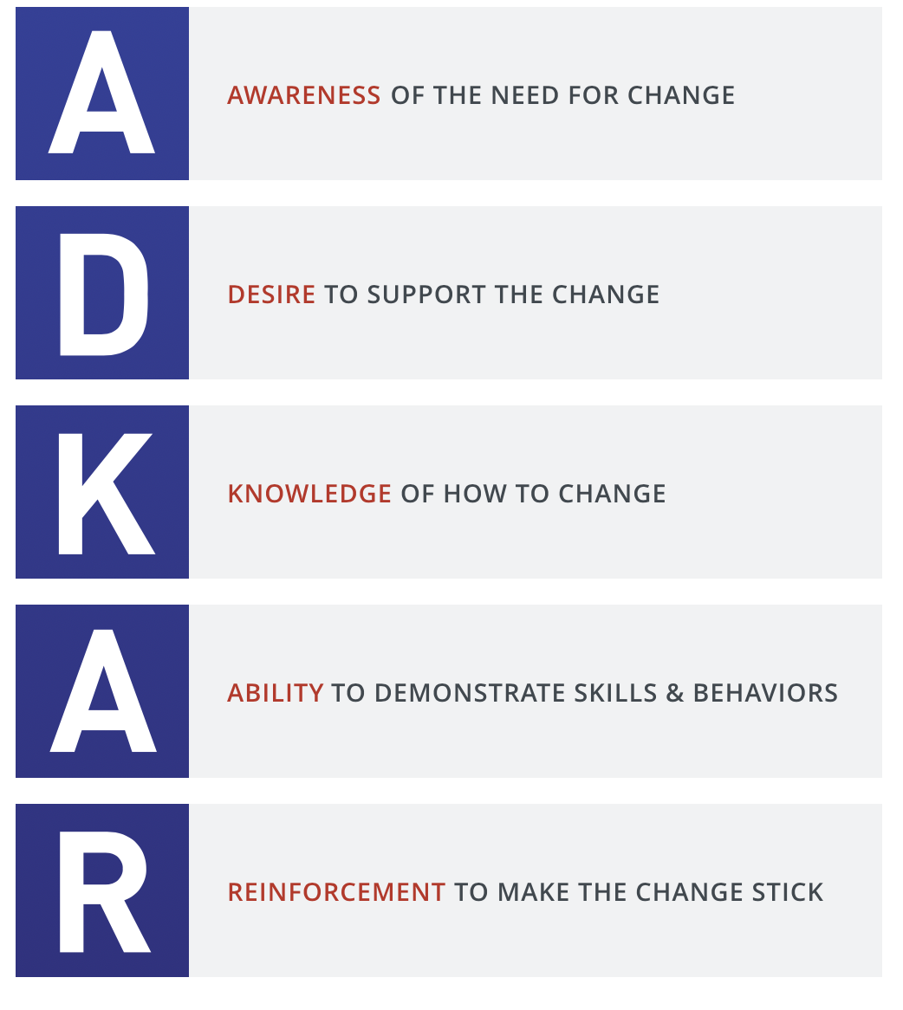
Quick Review: What Is Change Management? What is ADKAR?
Technically:
Application of a structured process and set of tools for managing the people side of change
Project Level:
A process with deliverables used on projects to support individual change milestones
Organizational Level:
A competency applied by leaders and managers to help employees through the people side of change
A strategic capability to increase organizational change capacity and to accelerate changes within an organization
Image Credit: Prosci.com
Notes:
If they did any prequel materials related to a Change Management self-study, review that now.
ADKAR are the building blocks of change management and a model to understand the journey of individual change. THESE ARE SEQUENTIAL. If we neglect to attend to any, those that follow…fall.
We will use ADKAR to organize the remainder of the courses. For each of these building blocks, we will engage in planning around the areas that are most likely to impact individual outcomes.
Link: Prosci.com

Slide 12
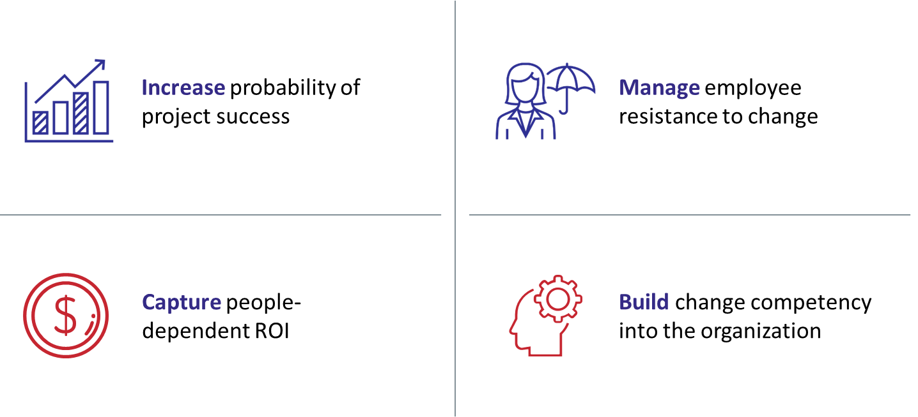
Why Change Management?
How We Will Drive Change:
From the VHA Modernization Campaign Plan
Organizational change is only as effective as the people who drive the change
Change management will be a driving force for each of our 10 lanes of effort
Prosci developed a clear and consistent model to measure the stages of individual change that a person must go through to adopt, embrace and use a new behavior - ADKAR
Image Credit: Prosci.com
Notes:
Might be helpful to pause and see if they can answer this question.
Link: Prosci.com

Slide 13
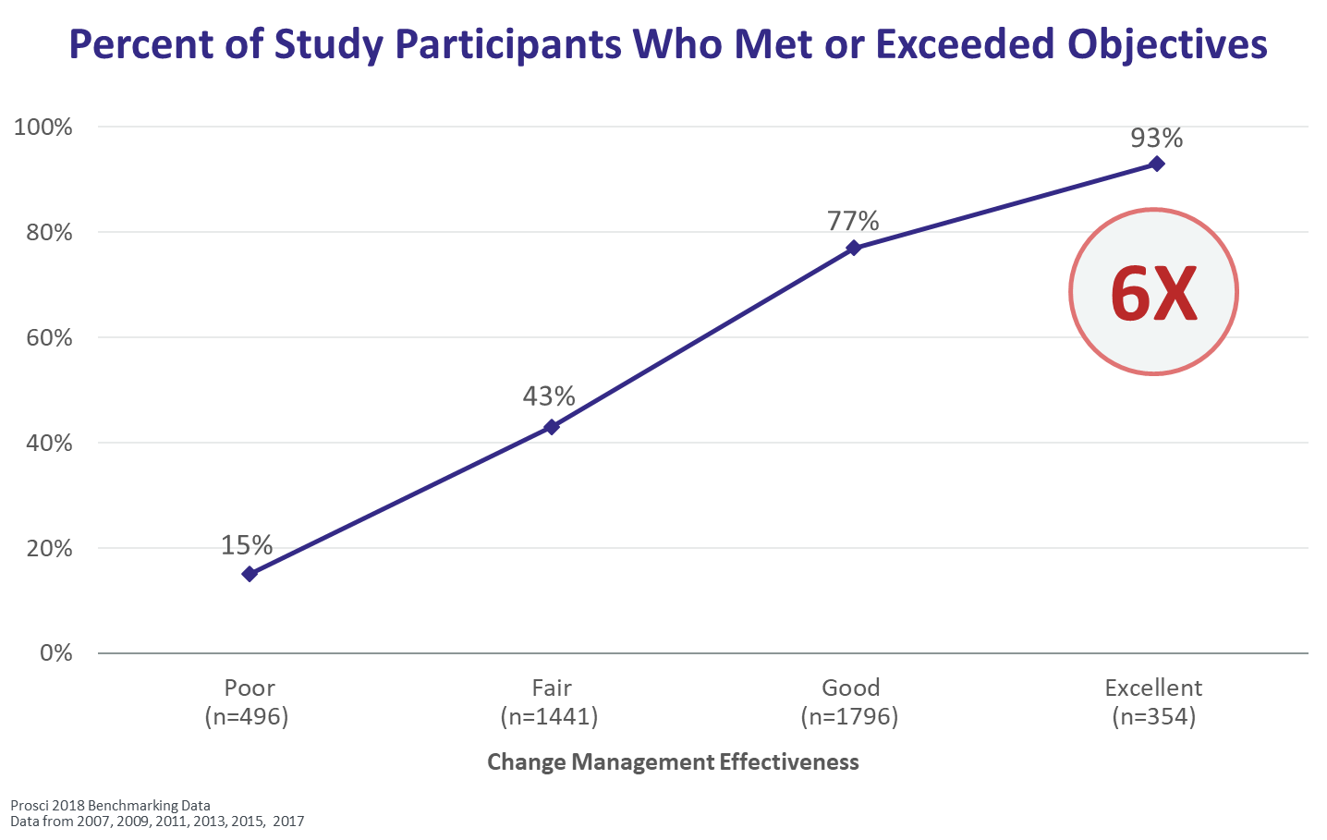
Data Supports the Connection
Notes:
This study, done in 2018 by Prosci, found that change management leads to a substantially improved likelihood of accomplishing objectives.

Slide 14
What are the consequences of not addressing the people side of change?
Your ideas?
List them in your workbook
Notes:
Give them a few minutes.
Before you show the next slide, ask them to share some of their ideas.

Slide 15
Consequences of Not Managing the People Side of Change
Lower productivity
Passive resistance
Active resistance
Turnover of valued employees
Disinterest in the current or future state
Arguing about the need for change
More people taking sick days or not showing up
Changes not fully implemented
People finding work-arounds
People revert to the old way of doing things
The change being totally scrapped
Divides are created between ‘us’ and ‘them’
NO CULTURAL TRANSFORMATION

Slide 16
Human Factors of ROI Determine/Constrain Results
Speed of Adoption
Ultimate Utilization
Proficiency
How quickly are people up and running on the new systems, processes and job roles?
How many employees (of the total population) are demonstrating “buy-in” and are using the new solution?
How well are individuals performing compared to the level expected in the design of the change?
ROI = Return on Investment

Slide 17
Connecting Change Management to Results
If people don’t change how they do their job, then it doesn’t matter what specific changes are implemented.
If people don’t change how they do their job, then we ultimately
won’t achieve what we set out to do from the beginning.

Slide 18
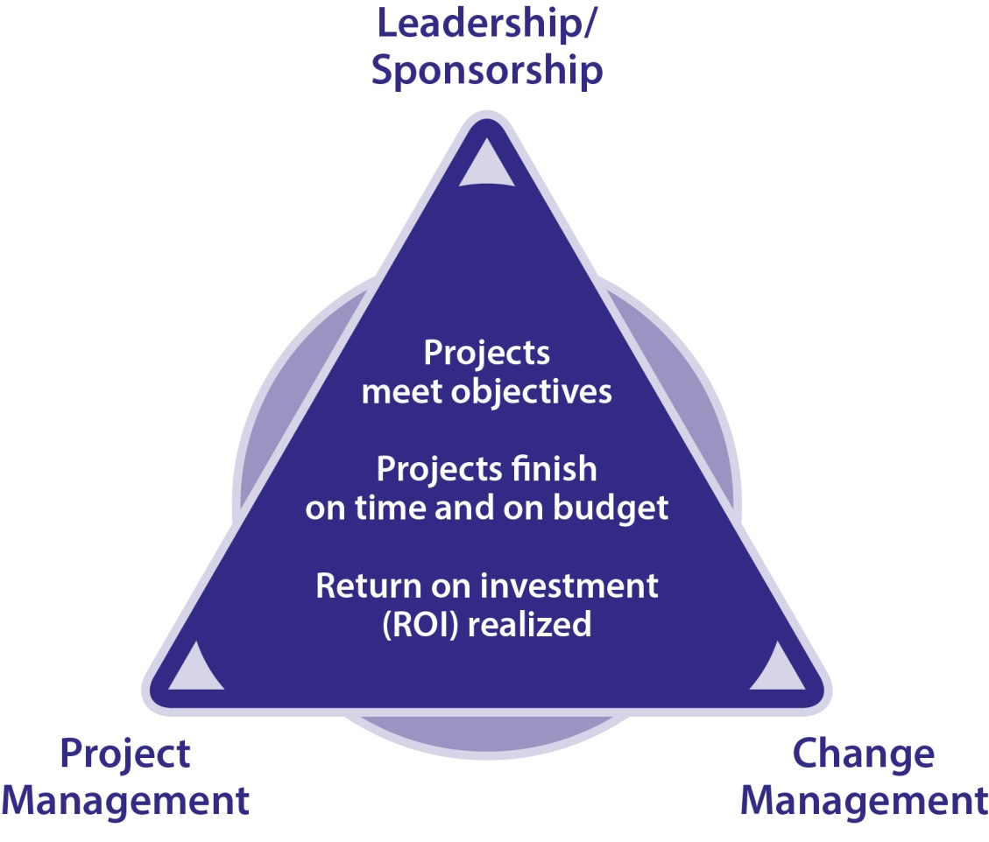
Prosci® Project Change Triangle™
AKA: The three-legged stool
Image Credit: prosci.com
Notes:
Highlight each aspect of this three-legged stool. Without any one of the legs, the effort fails –stool falls over and off you go!
During our time together, we will touch on each aspect at a level designed to broaden your thinking about WH Clinical Care transformation and planning.

Slide 19
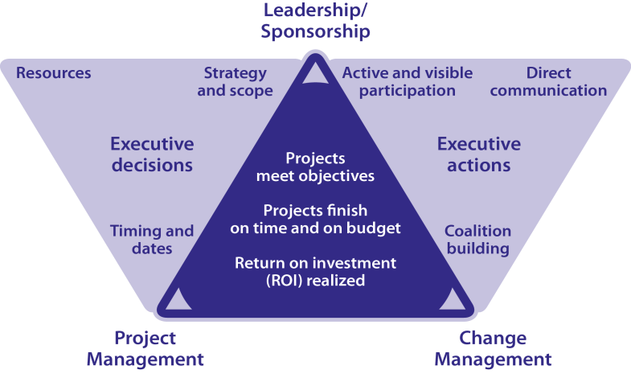
Project Change Triangle™ (PCT™): expanded for executive decisions and actions
Image Credit: prosci.com
Notes:
Review the graphic
Invite group to comment on critical aspects of project management that are necessary for success
Invite group to comment on what is needed from leadership/sponsors that is necessary for success

Slide 20
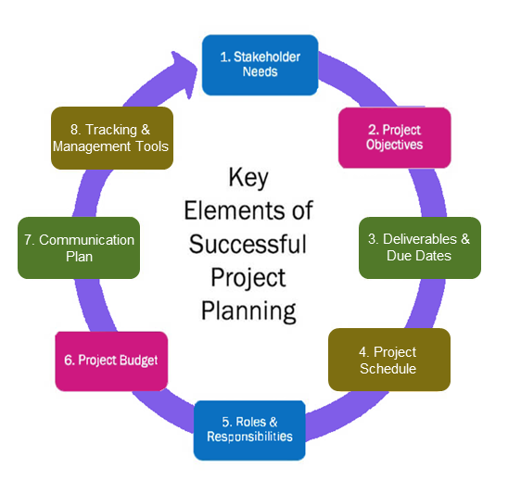
Project Management
Another leg of the 3-legged stool
May be more familiar – what are some of your experiences?
What are critical aspects of project management?
With cultural transformation, change at an individual level is the key to organizational change
Image credit: www.freshbooks.com
Notes:
Faculty: Now that we’ve covered a bit about change management, let’s look at the other two legs of this stool. Project management is often the area people are most familiar with. Invite by show of hands how many people have managed projects in their career. Invite them to share some of the critical aspects of project management. We have a lot of experience with project management – think of how many new programs or processes or directives or initiatives you’ve had to manage over your career. We often pull on our project management skills to make those happen.
But with WH CC implementation, we are talking about CULTURAL TRANSFORMATION. Sure, there may be new processes you want to put in place. And sure, you may have new projects that will support the overall shift. But at its core, we are talking about change at an individual level in order for successful organizational change.
Example: A PACT team starts using the PHI. The LPN prompts the Veteran to complete it and enters it in the chart. The provider takes a look and sees that the veteran is interested in “food and drink” and knows the person is overweight. The provider offers them a referral to MOVE!
Have they implemented a new process? Yes – boxed checked
Have the integrated a new tool into their practice? Yep
Does this reflect a change at the individual level? Sure - in the respect that that the LPN entered the PHI and the provider took a look at it.
Does this reflect a change at the individual level consistent with delivering a WH approach to clinical care? No. Why? What would we need to do to get to that point?
You might mention that including use of tools like the PHI are great and can be quite helpful as our staff and Veterans are learning to change the conversation but that using a new tool does not equal use of the WH approach. Welcome the group to process that a bit.

Slide 21
Project Management: A Case Study
A PACT starts using the PHI:
The LPN has a Veteran complete it and puts in chart
The provider sees Food and Drink is a priority (knows the Veteran is overweight).
A MOVE! referral is made.
Questions:
Have they implemented a new process?
Have they integrated a new tool into practice?
Does this reflect change at and individual level?
Does this reflect change at an individual level consistent with delivering a WH approach to clinical care?
Notes:
Example: A PACT team starts using the PHI. The LPN prompts the Veteran to complete it and enters it in the chart. The provider takes a look and sees that the veteran is interested in “food and drink” and knows the person is overweight. The provider offers them a referral to MOVE!
Have they implemented a new process? Yes – boxed checked
Have the integrated a new tool into their practice? Yep
Does this reflect a change at the individual level? Sure - in the respect that that the LPN entered the PHI and the provider took a look at it.
Does this reflect a change at the individual level consistent with delivering a WH approach to clinical care? No. Why? What would we need to do to get to that point?
You might mention that including use of tools like the PHI are great and can be quite helpful as our staff and Veterans are learning to change the conversation but that using a new tool does not equal use of the WH approach. Welcome the group to process that a bit.

Slide 22
Leadership and Sponsorship: The Third Leg of the Stool
Benchmarking studies repeatedly show that the number one predictor of change success is active and visible sponsorship
We often talk abut “leadership support.” What does that mean?
Is support enough?
What about participation and sponsorship?
What does that look like?
Notes:
Leadership and sponsorship arguably critical to successful change.
IN fact, some studies and our own experience indicate that without it, projects fail to take off, succeed or be sustained. We often use the term “leadership support”.
What does that mean? Invite ideas. Is “support” enough? While necessary, it is active and visible leadership PARTICIPATION and sponsorship that makes the difference. What might that look like?
We will go into this in a bit more detail in a bit (when we get to the sponsor roadmap section).
What does this actually look like? Especially good to highlight Support in the bottom right.

Slide 23
Team Activity: Foundations for Change
Complete the Foundations for Change Assessment in Your Workbook
You will have ~30 minutes, and then we’ll discuss
Add these to your PowerPoint slides
Notes:
For change to be successful it needs strong support in each of the three areas we just discussed. For our activity, you will complete the Foundations for Change Assessment tool to guide your initial strategy and you can reassess down the line to help keep your foundations for change strong.
Give them ~30 minutes for the activity.
Workbook Section: Foundations for Change Assessment
Remind them to add this into their PowerPoint presentation too.

Slide 24
Foundations for Change: Action Items

Slide 25
Team Debrief: Foundations for Change
What did you learn?

Slide 26
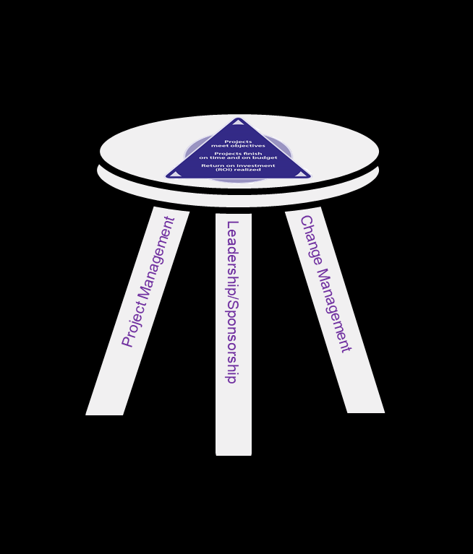
Summing it all up: The Three-Legged Stool
Where will you put some focus?
What did you learn or observe about all 3 legs?
Where are you strong?
How does this inform your action plan?
Notes:
Process – what did you learn, observe…and reflections on considering all 3 legs? Where are you strong? Where will you put some focus? Note that the gaps and ideas the team comes up with to address them will go into the action plan
Transition: Many of you have the skills and experience to address the project management components. So that is why we will focus primarily on the change management and sponsorship/leadership legs here. Let’s dive in.

Slide 27
12. Using the New Lens: ADKAR Skills
The Journey to Transformation
Notes:
Learning Objectives, Module 12. Using the New Lens: ADKAR Skills
Become even more familiar with the ADKAR model, with the ability to describe each of the 5 building blocks in detail.
Assess, according to ADKAR, where teams are in terms of the current state.
Identify barrier points and reflect on why they might exist..
Apply ADKAR to different stakeholders, using a group activity.
Complete the Impacted Groups portion of their PowerPoint presentation.

Slide 28
ADKAR
Since individual change is critical for organizational change, we need a way to understand where individuals are at on their change journey
People follow a fairly predictable path
That path is comprised of 5 key elements or building blocks: ADKAR
Image Credit: prosci.com
Notes:
Ask whether there are any system redesign or behavioral health or coaching professionals in the room.
Acknowledge that there are many mode ls of human behavior, motivation, etc. This provides a pragmatic and functional framework and language we can all use.

Slide 29
An Interview About Using ADKAR - Video https://www.youtube.com/watch?v=L_7I03LOyyk
Notes:
An Interview About Using ADKAR - Video https://www.youtube.com/watch?v=L_7I03LOyyk
This is a Prosci video featuring one of their main PR people.
Might want to call out some of the highlights of the video (e.g., helpful when he describes his ADKAR barrier when it comes to his golf game).

Slide 30
The Five Building Blocks for Successful Change 1
Change Begins with Understanding Why
Awareness
What is the nature of the change?
Why is the change needed?
What is the risk of not changing?
“I understand why”
Notes:
What would you expect to observe if someone has Awareness?
What would expect to see if they did not?
You can prompt them to consider this for individuals in various groups like leaders, managers, clinicians, veterans, etc.

Slide 31
The Five Building Blocks for Successful Change 2
Change Involves Personal Decisions
Desire
A decision to engage and participate
What’s in it for me (WIIFM)?
A personal choice
“I have decided to…”
Notes:
What would you expect to observe if someone has Desire?
What would expect to see if they did not?
You can prompt them to consider this for individuals in various groups like leaders, managers, clinicians, veterans, etc.

Slide 32
The Five Building Blocks for Successful Change 3
Change Requires Knowing How
Knowledge
Understanding how to change
Training on new processes and tools
Learning new skills
“I know how to…”
Notes:
What would you expect to observe if someone has Knowledge?
What would expect to see if they did not?
You can prompt them to consider this for individuals in various groups like leaders, managers, clinicians, Veterans, etc.
May want to highlight again that there is a temptation to jump straight to this part (”Our goal will be to host courses”), bypassing Awareness and Desire.

Slide 33
The Five Building Blocks for Successful Change 4
Change Requires Action in the Right Direction
Ability
The demonstrated capability to implement the change
Achievement of the desired change in performance or behavior
“I am able to”
Notes:
What would you expect to observe if someone has Ability?
What would expect to see if they did not?
You can prompt them to consider this for individuals in various groups like leaders, managers, clinicians, veterans, etc.

Slide 34
The Five Building Blocks for Successful Change 5
Change Must Be Reinforced to Be Sustained
Reinforcement®
Actions that increase the likelihood that a change will be continued
Recognition and rewards that sustain the change
“I will continue to”
Notes:
What would you expect to observe if change is being reinforced for an individual?
What would expect to see if not?
You can prompt them to consider this for individuals in various groups like leaders, managers, clinicians, veterans, etc.

Slide 35
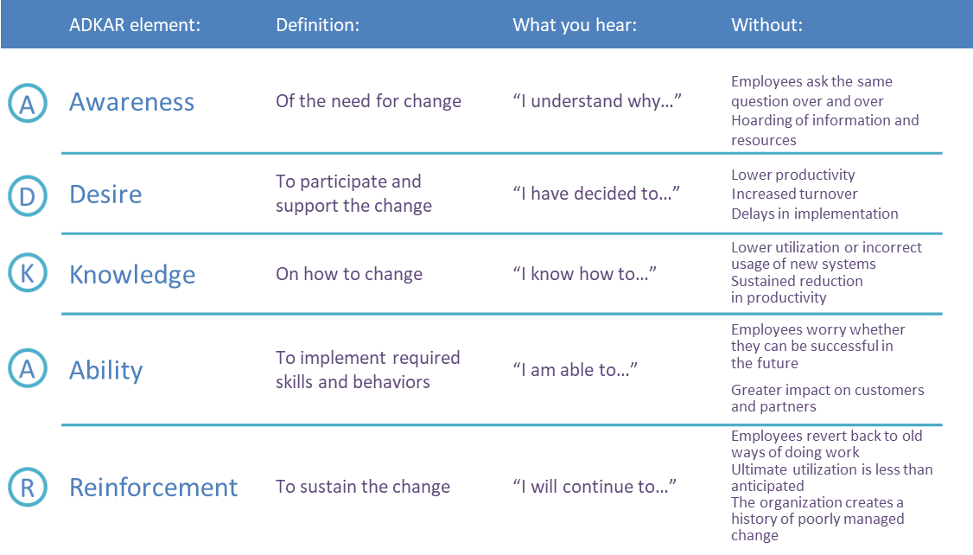
Prosci ADKAR Model
Notes:
Spend some time on this. It will help them in the next exercise.
Process this in relation to their earlier reflections on these blocks.
Invite examples from the group (personal or observational).

Slide 36
Some ADKAR Tips
Avoid leaping straight to Knowledge without adequately addressing Awareness and Desire
ADKAR helps with how you select and shape activities based on where there is the most need
To move forward, we need to identify the earliest barrier in the path
Notes:
Often, we just straight to Knowledge before we adequately address Awareness and Desire.
By using the ADKAR framework, you can better select and shape change activities to what is needed most.
To help people down the path of change, we need to identify the earliest barrier in their path.

Slide 37
Using the New Lens: Where You Are Now
Each person will do this on their own and share back with the group
Using the ADKAR Assessment Tool in your workbook, determine where you are in relation to your team’s Aim statement
Take about 10 minutes, then share
Notes:
Give them a little time to share with their groups.

Slide 38
Using the New Lens: Your Barrier Point
Now, circle your first low score (3 or below) on the chart
This is your barrier point
Take a few minutes for people in your group to share these. Use generous listening – don’t try to ‘fix’
Notes:
Have ADKAR markers up around the room.
Individually - Using the ADKAR assessment tool, have each person assess where they are at on each of the ADKAR items in relation to their team’s Aim statement.
When all are done, have them circle the first LOWEST score (3/neutral or below) on the chart.
That is their barrier point. That is what will need to be addressed for them to move forward with the change.

Slide 39
Large Group Activity: Walking in Someone Else’s Shoes
Consider clinicians who will be impacted by your Aim. Take their perspective
You will move around the room in a moment
What do we usually do to move people forward?
Anything that might work better?
Notes:
Next, ask the large group to bring to mind the clinicians that will be impacted by their Aim and do the same exercise from their perspective.
Have the group all gather at A. Then invite people to move forward to the next letter if their estimate of the clinician level of agreement is above a 3.
Likely you will see most people clump at A or D with some at K and fewer at A or R. Highlight this.
Ask some process style questions.
What do we often do to get clinicians on board? A: Send to training.
Q: What ADKAR block does training address? A: K. How will knowledge help if A&D are not addressed? A: Not much.

Slide 40
Small Group Activity: Change Participants & Impacted Groups
Why is it important to consider groups your Aim will affect?
Using the guide in your workbook, list the groups who will be impacted by your Aim
Apply ADKAR to those groups – enter into PowerPoint
Don’t fill out the last column – we’ll get there
Notes:
We’ve explored ADKAR for ourselves and started thinking about how it could apply to one group likely to be impacted by the Aim.
Now let’s brainstorm the various groups that will be impacted by the team’s Aim.
And as a team, apply ADKAR to those groups to see where they are at on the path to change.
Why does this matter?
Resistance to change is normal and should be expected.
Managing resistance effectively depends on knowing how change will impact people, their readiness for change and the content for change. ADKAR!
Orient to the worksheets – the first part gives an overview of engaging change participants and the second portion is the tool. Ask them to WAIT to complete the last column until we move into the next section and being explore plans. Advise that next we will discuss plans that can help address the barrier points they identified.
May want to show the next two slides before you have them start.

Slide 41
Impacted Groups: Barriers and Elements
Notes:
Reminder to have them put this into their PowerPoint.
This is what the slide looks like.

Slide 42
Points to Ponder
Who is involved?
Who could be impacted or affected?
Who stands to gain or lose as a result?
Who could impact your success?
Who needs this to succeed?
Who might prefer this fails?
Who will report out on this work?
Who will care about the progress?
Who will use your outcome data?
Notes:
Put this up to help participants think about groups impacted by the Aim for this exercise if needed

Slide 43
13. Bridges, Trees, and Bears – Oh My! Navigating Barriers
The Journey to Transformation
Notes:
Note this module is only 15 minutes long.
From the prior exercise, we found that we have several groups potentially impacted by the Aim.
Those groups all face barriers somewhere on the ADKAR path to change. That’s great, but what do we do about it?
There are plans to help people get past those barriers.
We are going to discuss those plans, and you are going to work with your team to develop the plans for those impacted by your Aim.
The actions you determined via the earlier exercise (addressing gaps with PM, CM and leadership/sponsorship) and the actions you determine via developing these next plans, will then be assembled into the “NEED A NAME AND A TEMPLATE FOR THIS PLAN PLAN” for achieving your Aim.
Learning Objectives, Module 13. Bridges, Trees and Bears – Oh My! Navigating Barriers.
List the 7 elements that can help to address barriers when it comes to implementing their WH Action Plans.
Explore how the 7 elements we will be discussing tie in to all of the ADKAR barrier points we discussed in the prior module.

Slide 44
Let’s Return to Our Lists of Barriers for a Moment
It may feel this way sometimes, but we have tools even for the biggest obstacles...
Notes:
Before we talk about the 7 elements, it is good to pause and review the various barriers we have identified.
Ideally, these will be listed on flip chart sheets, e.g., when we list weaknesses and threats as part of the SWOT assessment.
The jackhammer metaphor is meant to be humorous – although steadily chipping away (noisily or not) at a barrier is an apt metaphor...

Slide 45
The Lucky 7: 7 Elements to Address Barriers
Communication
Sponsorship
Resistance Management
Coaching
Nuts and Bolts
Training
Circling Back
What do you think? Any that are missing?
Notes:
Faculty: For this course, we’ve assembled elements from various sources (borrowing heavily from Prosci) that can help you address the barriers you are most likely to encounter on the journey to WH CC.
The next several modules (with a brief interlude at the end of today) focus on these, in this order.

Slide 46
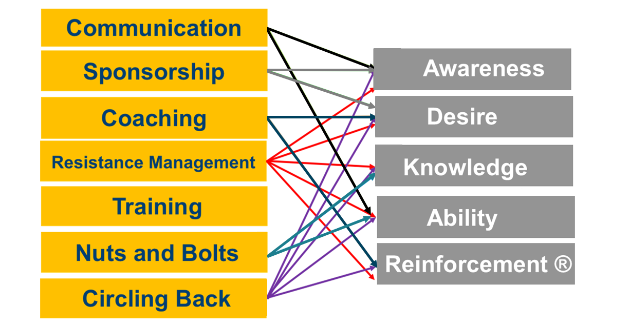
These 7 Elements help address ADKAR barrier points
Adapted from PROSCI
Notes:
https://etoolkit.prosci.com/process/phase-2-manage/develop-change-management-plans
There are five key plans that define the steps needed to support the individuals being impacted by the project.
Walk through this with the group.
If the barrier point is A, we would address this through developing a communications plan, sponsor roadmap and coaching plan. If the barrier point is D….etc.

