Slide 1


The Journey to Transformation
Whole Health Clinical Care Symposium
Face-to-Face Course
Welcome to Day 3!

Slide 2
19. Revisiting Your Aim:
New Lenses
The Journey to Transformation
Notes:
Learning Objectives, Module 19. Revisiting Your Aim: New Lenses
Take a few minutes to reframe Aim statements/overall goals in the context of what has been covered since they were written.

Slide 3
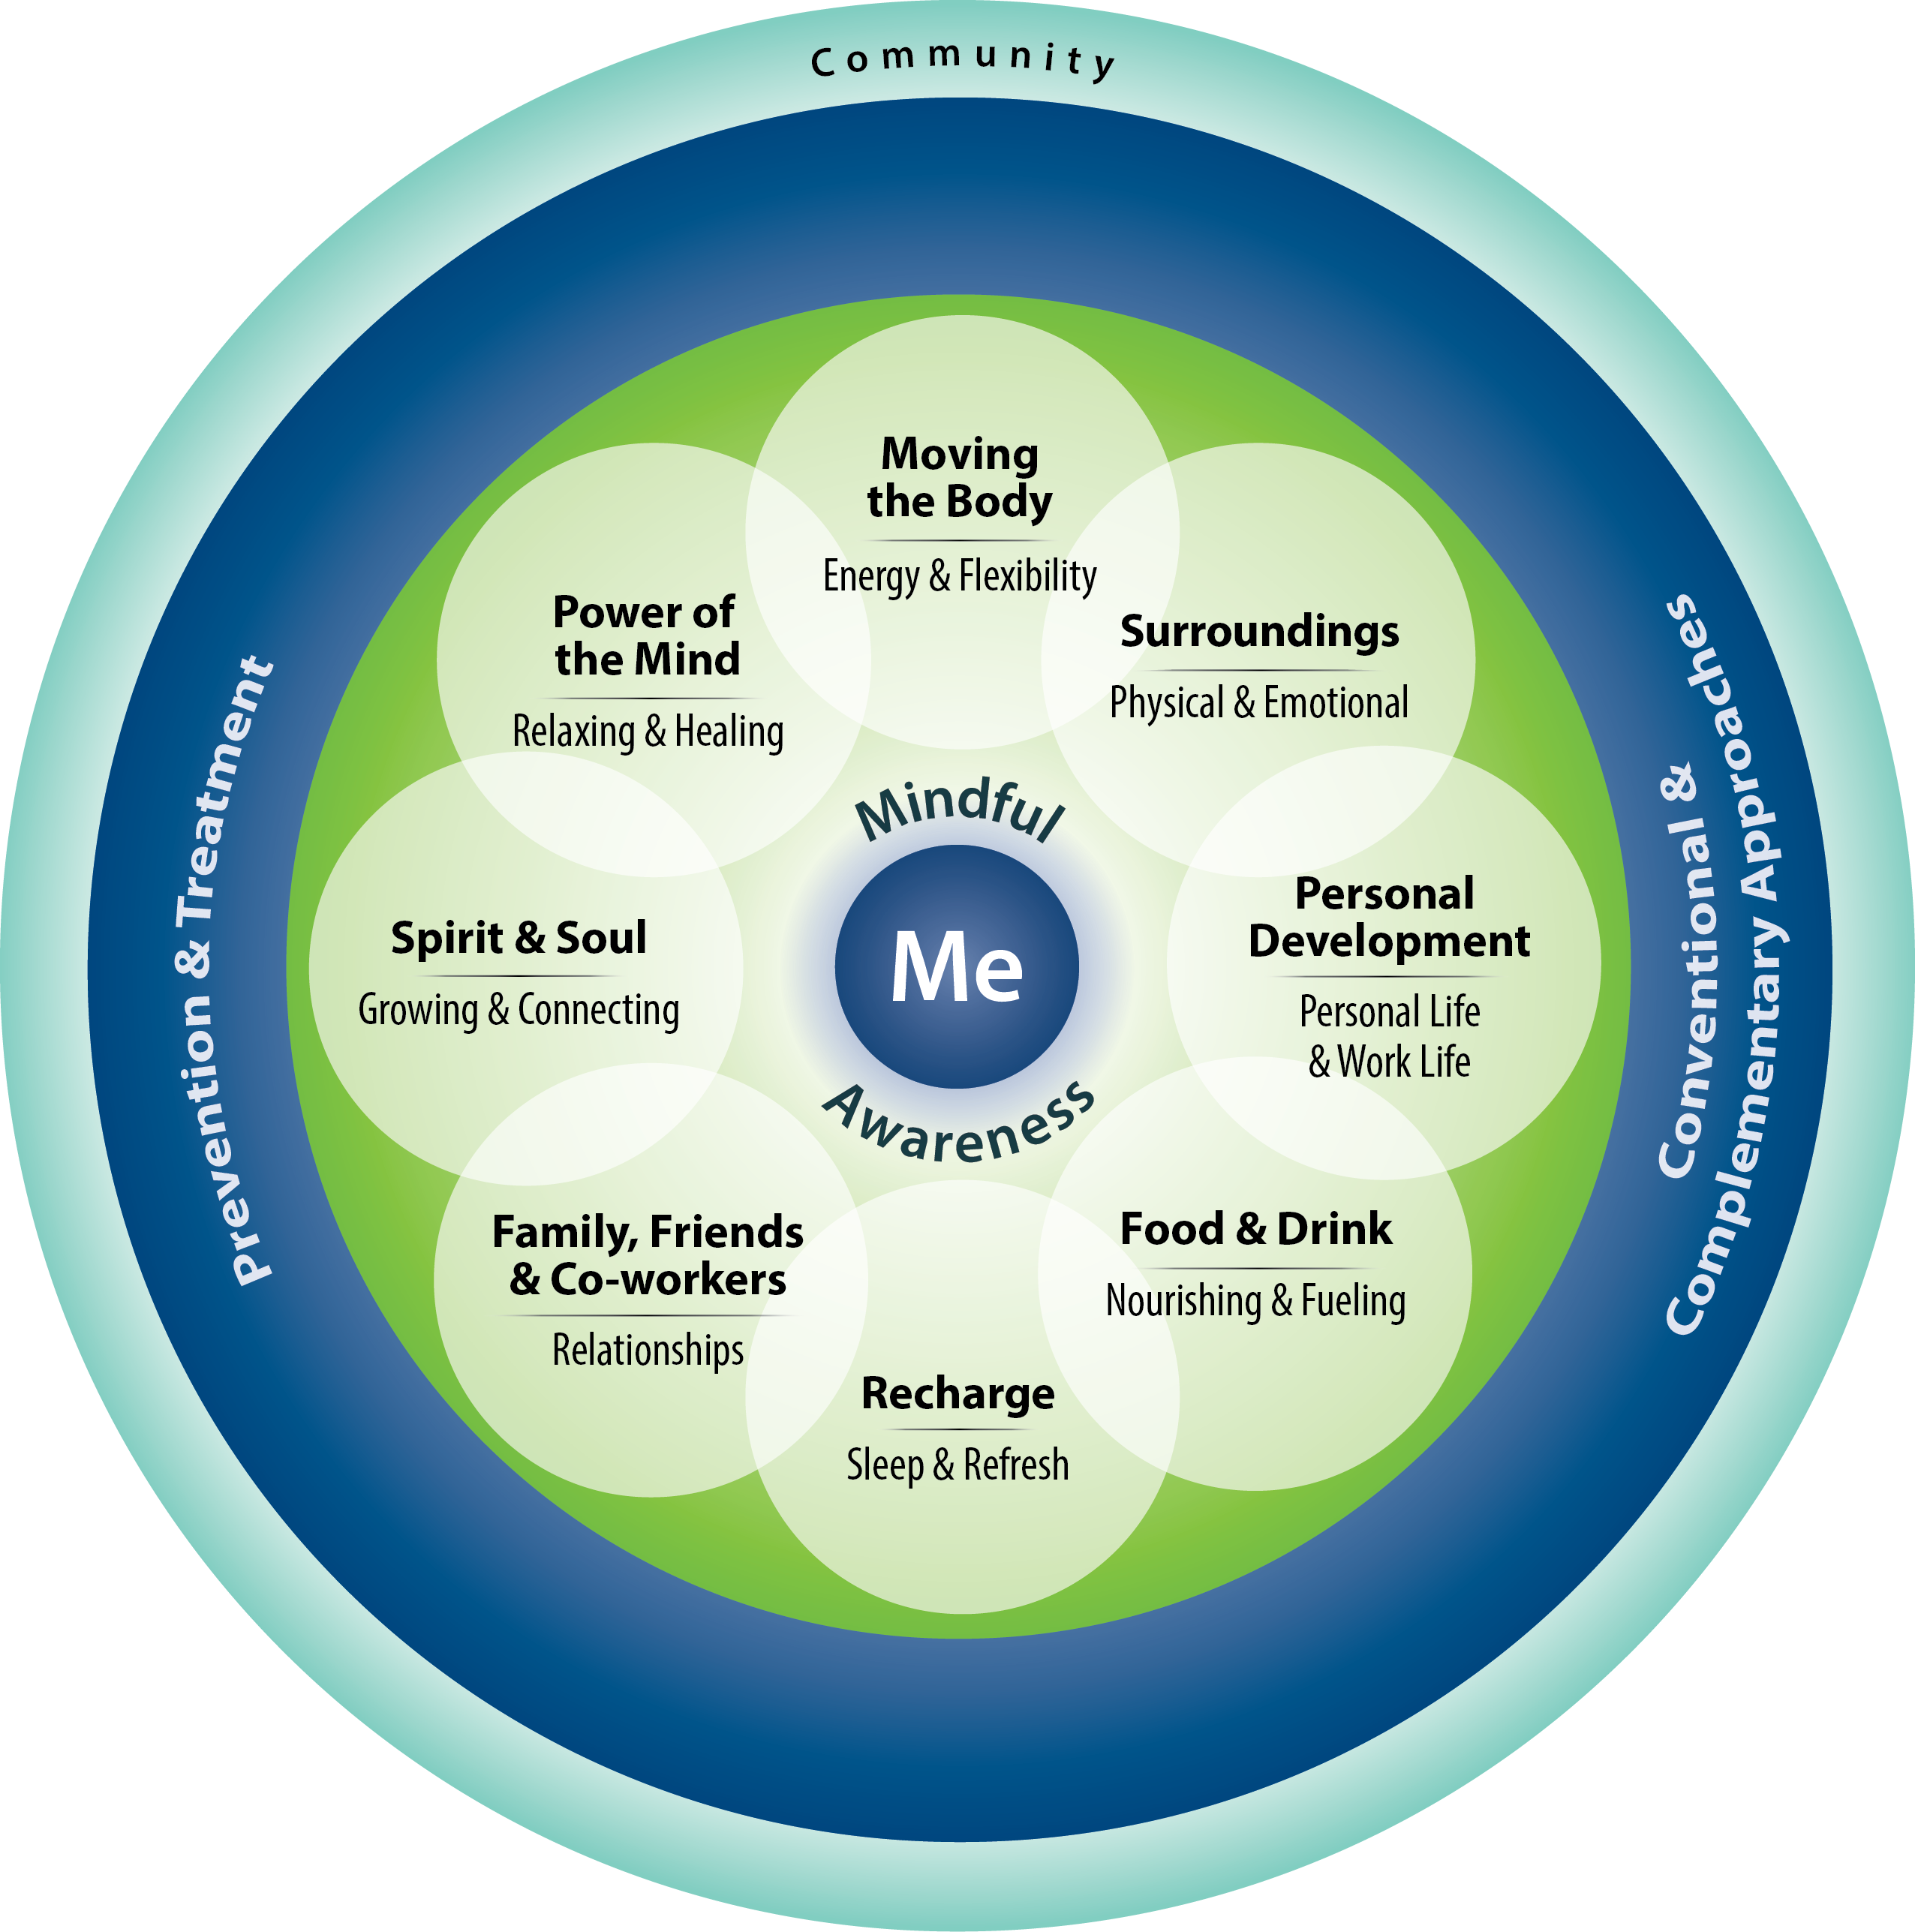
Revisiting the Circle of Health
Consider and care for the whole person
Practice across teams and over time
Actively use foundational skills (communication, relationship building and MI)
Equip using a broad range of
resources and support
Connect with MAP
Continue to provide excellent clinical care
Set shared goals that link to MAP
Notes:
This slide is optional.
A quick review of the various aspects of Whole Health Care.
All of these are relevant.

Slide 4
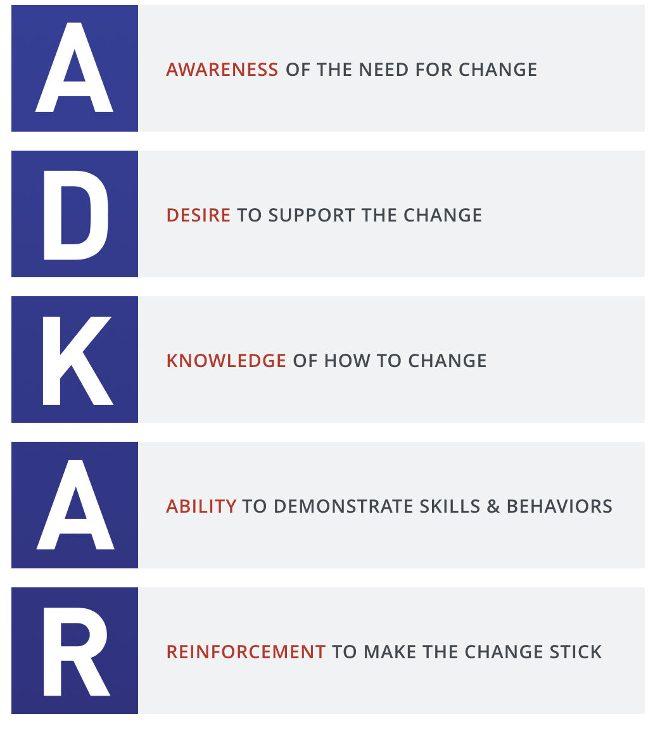
Back to ADKAR
Notes:
This slide is optional.

Slide 5
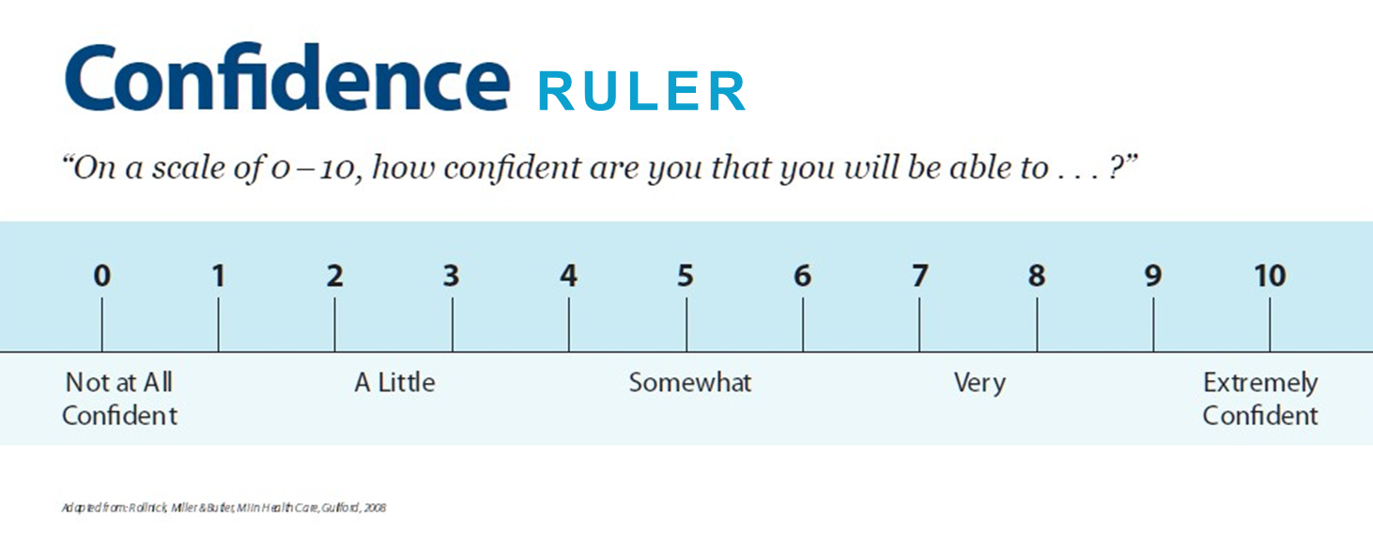
How’s Confidence at This Point?
On a scale from 1 to 10, how confident are you that you can make some changes in this area?
Notes:
This slide is optional.
Assess Readiness - On a scale of 1-10, How confident are you at this point that you could make some changes?

Slide 6
20. Element 4: Coaching
The Journey to Transformation
Notes:
Learning Objectives, Module 20. Element 4: Coaching
Describe what coaching means in a change management context
Outline what sorts of options can support managers and supervisors in making changes specific to Aims.
Complete Coaching section of the team PowerPoint presentation.

Slide 7

The Lucky 7: 7 Elements to Address Barriers - Coaching
Communication
Sponsorship
Resistance Management
Coaching
Nuts and Bolts
Training
Circling Back
Notes:
We are now moving into our fourth of the 7 elements.

Slide 8
Coaching: Overview
Intended Outcomes: Awareness/Desire/Knowledge/Ability/Reinforcement
The Key Question: How can you support managers and supervisors with making a change?
Possibilities
Ensure that the necessary sponsorship and communication activities are in place and visible to managers and supervisors
Prepare them to lead change with their employees
Enable them to introduce, manage and reinforce change
Build awareness of how a change impacts a given employee and WIIFM
Notes:
Coaching is a vital part of successful change management.
Best practices research in change management identified employee resistance as a top obstacle to successful change.
The influence that a supervisor or manager has on front-line employees is significant and will directly impact the overall engagement of employees in the change process.
This might best be introduced by asking the large group to answer the Key Question first, before having the answers appear.

Slide 9
Coaching: Overview
Intended Outcomes: Awareness/Desire/Knowledge/Ability/Reinforcement
(Continued)
More Possibilities
Create desire through personal interactions and the effective management of resistance
Develop knowledge through on-the-job training and mentoring
Foster ability by creating the right environment for employees to develop new skills and behaviors
Other thoughts?

Slide 10
Coaching Plan: Considerations
The influence that a supervisor or manager has on front-line employees is significant and will directly impact the overall engagement of employees in the change process.
Your coaching plan defines:
How your team will support managers and supervisors during the change
How they will interact with front-line employees
Your role is to fully enable these managers and supervisors to:
Fulfill their role as effective change management coaches
Manage change with their employees during the transition
Reinforce change with their employees in the new, changed environment
Notes:
Coaching during change management provides a venue for one-on-one and group meetings between employees and the people they trust the most, their immediate supervisors.
This environment allows employees to ask questions and receive clarification about the change and to comment on their specific worries and concerns about change.
It is also an opportunity to gather feedback from the front-line employees about the change and the change management efforts.
Employees are most impacted by messages from the CEO/senior leadership (covered in the sponsor roadmap) and their immediate supervisor or manager.
According to the multiple studies in change management, managers and supervisors are a preferred sender of change messages by employees.
Effective coaching can alleviate many of the reasons for resistance and build support for the change throughout the organization.

Slide 11
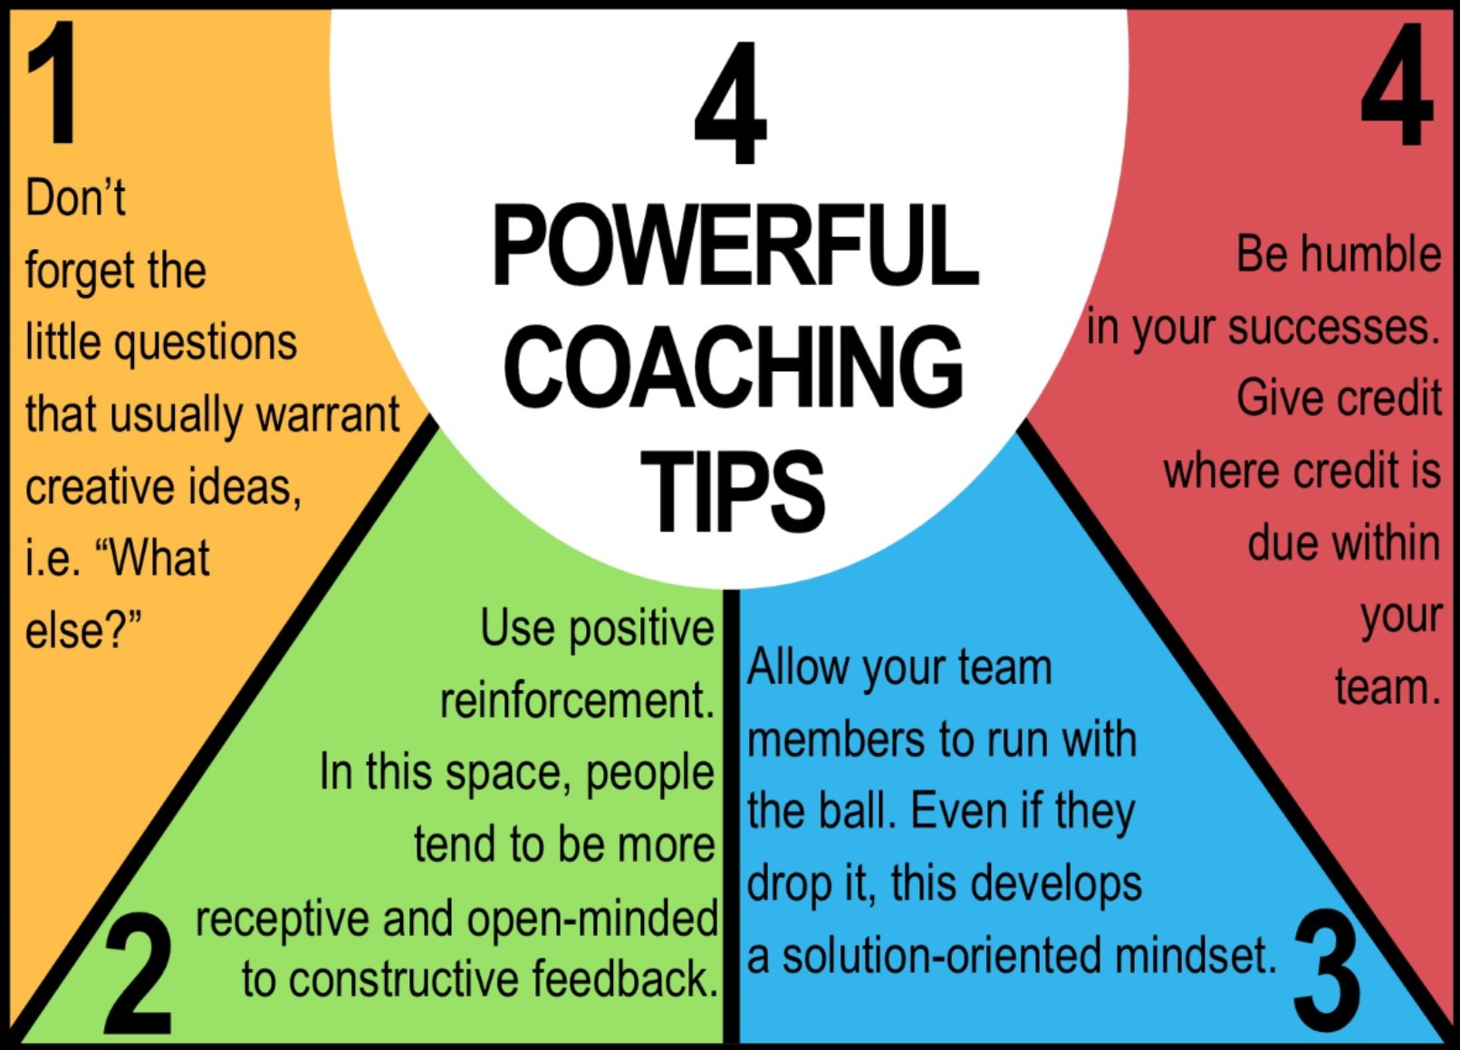
Partner Exercise: Coaching Tips
Pair up with someone from another team
Together, list 5 helpful tips that can support managers and supervisors with supporting changes
We’ll generate a list!

Slide 12
Group Activity:
Coaching Your Colleagues
Complete the Coaching section of your PowerPoint presentation
You can refer to the Prosci® Coaching Plan Template in your workbook as well and use as you see fit
Notes:
Faculty:
As a team, talk through the main points on the Resistance Management Plan template. Review the Resistance Assessment Worksheet for an example of how you might assess resistance with others. These conversations can help identify what would be needed to address Resistance.
Workbook Sections:
Resistance Management Slide Template
Resistance Assessment Worksheet
Top 10 Tactics for Managing Resistance

Slide 13

WHCC Coaching
Adapted from: Prosci
Notes:
Reminder to have them complete the activity in their PowerPoints as well.

Slide 14
21. Element 5: Nuts and Bolts
The Journey to Transformation
Notes:
Learning Objectives, Module 21. Element 5: Nuts and Bolts
Explore how fundamental aspects like documentation, tracking, and coding have an effect on WHCC.
Have an opportunity to go into more detail about these topics with faculty, as needed.
Complete Nuts and Bolts section of the team PowerPoint presentation.

Slide 15
The Lucky 7: 7 Elements to Address Barriers – Nuts and Bolts
Communication
Sponsorship
Resistance Management
Coaching
Nuts and Bolts
Training
Circling Back
Notes:
We are now moving into our fifth of the 7 elements.

Slide 16
Nuts and Bolts: Overview
Intended Outcomes: Relevant Across All Areas of ADKAR!
As a small group, discuss:
How does documentation fit in to your plan?
How do coding and tracking fit in?
What other details (logistics, paperwork, etc.) need to be addressed?
No Workbook Section this time!
Notes:
They often say “The devil is in the details.” How do details fit into the mix here?

Slide 17
Nuts and Bolts: Tips
Q&A Time: Documentation
Q&A Time: Tracking and Coding
How do I....?
Notes:
This is an opportunity to dive in more into some of the details with these topics and/or others.
Entire faculty will be available to participate/answer questions.
Discuss each of the 3 topics one at a time.

Slide 18
Group Activity:
Nuts and Bolts
Complete the Nuts and Bolts section of your PowerPoint presentation
Really try to anticipate any additional details you might need to consider
Notes:
Especially important to faculty to be spread out at the table for these discussions.

Slide 19
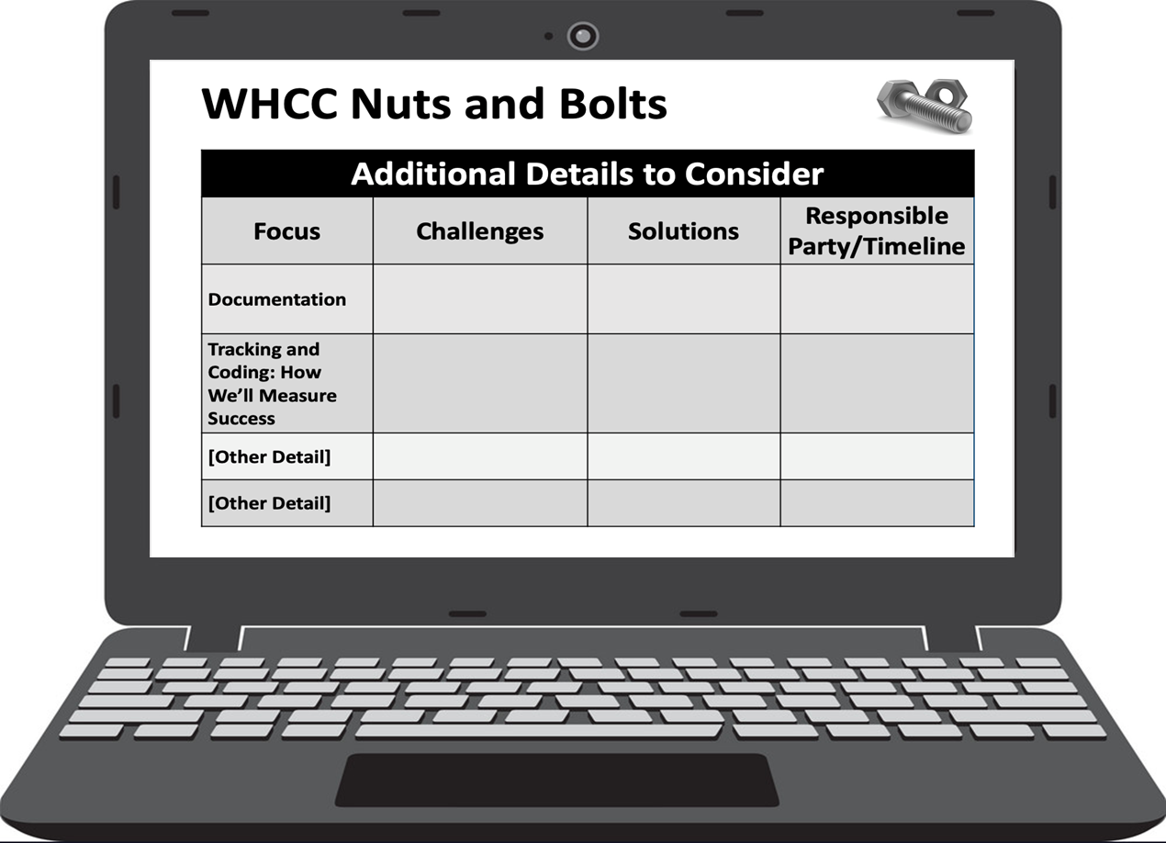
WHCC Nuts and Bolts
Adapted from: Prosci
Notes:
Reminder to complete this section of their Whole Health Action Plan PowerPoint.

Slide 20
22. Element 6: Training
The Journey to Transformation
Notes:
Learning Objectives, Module 22. Element 6: Training
Explore how fundamental aspects like documentation, tracking, and coding have an effect on WHCC.
Have an opportunity to go into more detail about these topics with faculty, as needed.
Complete Nuts and Bolts section of the team PowerPoint presentation.

Slide 21
The Lucky 7: 7 Elements to Address Barriers - Training
Communication
Sponsorship
Resistance Management
Coaching
Nuts and Bolts
Training
Circling Back
Notes:
We are now moving into our sixth of the 7 elements.

Slide 22
Training: Tips
Intended Outcomes: Knowledge/Ability
Make sure you cover Awareness and Desire, before you jump to training!
  If not, you end up with a class full of angry, voluntold people
  What other consequences have you seen?
Some more resistant providers might prefer more advanced clinical course experiences
Add to time people already have set aside like grand rounds, morning huddles, or staff meetings
Make use of others at your sites - like NWECs or FECs - to help you strategize

Slide 23
Training: Overview
Intended Outcomes: Knowledge/Ability
Identify different audiences who require training
Conduct a needs assessment for each group to pinpoint knowledge and skill gaps
Target specific audiences and build the knowledge, skills and behaviors they need both during and after the change
Document training requirements based on the current state versus the future state
Notes:
Audiences may include:
Impacted employees that will be performing their day-to-day work differently
Supervisors and managers
Sponsors
Business leaders who are needed to support the change
Customers
As faculty, what are examples you could see in a training (can mention more than courses that are on offer)

Slide 24
Considerations
Desired Outcomes: Knowledge/Ability
Start with your objectives. What knowledge and ability gaps are you wanting to fill?
Consider different forms of training, but don’t get hung up on particular courses
  OPCC&CT Live Courses
  Pre-created Half-day, 1-hour
  Online: TMS, SharePoint resources, Whole Health Library, www.va.gov/wholehealth
  Courses specific to your site (e.g., CPRS, CIH resources, clinic flow)
  Other materials, such as M.I., HPDP materials, Veteran Handouts

Slide 25
Group Activity:
Training
Complete the Training section of your PowerPoint presentation
Focus on objectives and gaps, not specific courses
Check in with faculty if you have any questions regarding any of the Whole Health educational offerings
Faculty will circulate to help out
Notes:
Process the exercise.
Invite groups to share examples of their ideas.

Slide 26
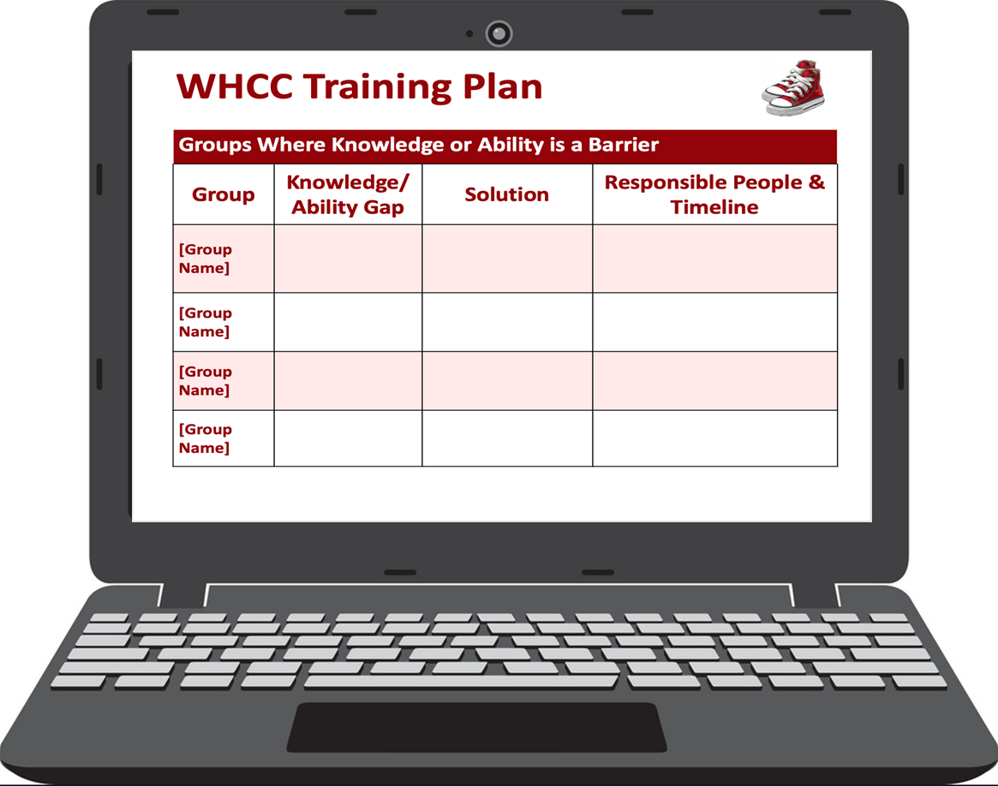
WHCC Training Plan
Adapted from: Prosci
Notes:
Group – refer back to the earlier exercise and complete for each group that has Desire as an anticipated barrier
Notes from PROSCI template
Resistance Management Actions
What type of resistance is anticipated
what might resistance look like in our organization
where are likely areas for resistance to occur
How will resistance be identified
employee feedback
supervisor input
project team issues
compliance audits
Process for resistance management by level
employees
supervisors
mid-level managers
senior managers
Resistance management training by level
targeted audiences for this training
schedule for training (or method of integrating this material into existing training for this audience)

Slide 27
Large Group Discussion
Training Debrief
Notes:
Faculty: Process the exercise. Invite groups to share examples of their ideas. Might be helpful to have each table share 1 example of resistance they expect to encounter, as a segue into next exercise.

Slide 28
23. Element 7: Circling Back
The Journey to Transformation
Notes:
Learning Objectives, Module 23. Element 7: Circling Back
Outline the Prosci 3-Phase Change Management Process
Consider how to get feedback, take corrective actions, and celebrate successes.
Complete the Circling Back activity for the team action plan PowerPoint presentation

Slide 29

The Lucky 7: 7 Elements to Address Barriers – Circling Back
Communication
Sponsorship
Resistance Management
Coaching
Nuts and Bolts
Training
Circling Back
Notes:
We are now moving into the last of the 7 elements.

Slide 30
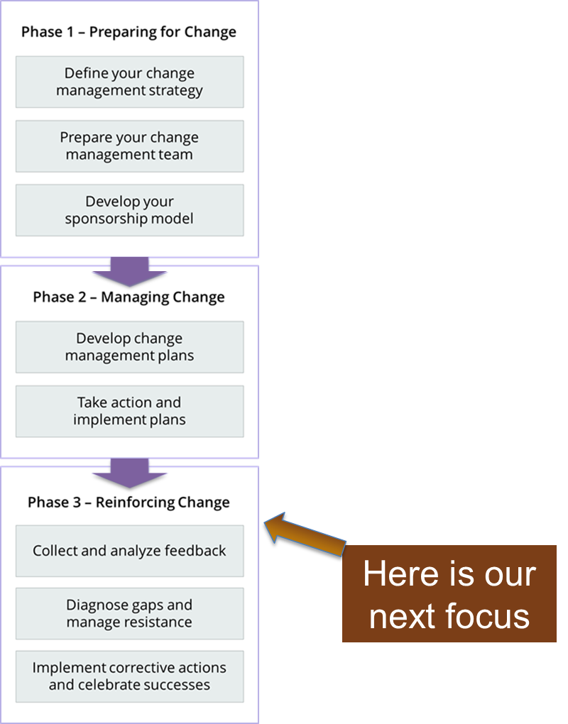
Prosci® 3-Phase
Change Management
Process
A structured process for managing the ‘people side’ of change on a project or initiative
Notes:
Prosci trains people in a 3 phase process for change management.
We are now focusing for a few minutes on Phase 3.

Slide 31
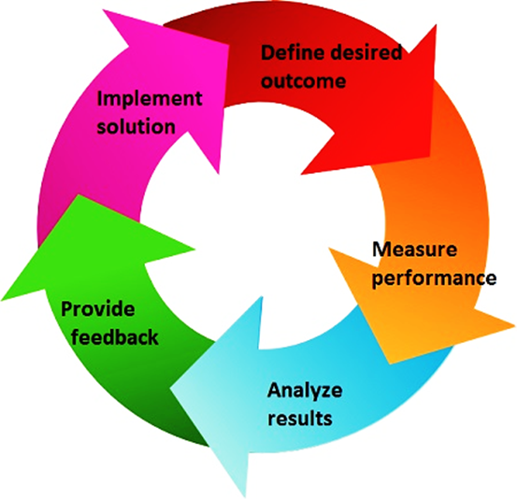
Circling Back: Overview
Several Elements Involved
Collect and analyze feedback
Diagnose gaps and manage resistance
Take corrective action
Celebrate Success
Let’s explore each one some more...
Image Credit: Michigan.gov
Notes:
There are a lot of parallels here with various quality improvement models.

Slide 32
Circling Back:
Collect and Analyze Feedback
Listen to employees and gather feedback
Audit compliance with new process, systems and job roles
Analyze the effectiveness of your change management activities

Slide 33
Circling Back :
Diagnose Gaps and Manage Resistance
Diagnosing gaps and managing resistance is an ongoing process
  This step requires close relationships with the primary sponsor and key stakeholders
  Front line supervisors also play a key role in managing resistance
Determine the root cause of resistance
  Develop plans to address these root causes
  Prepare sponsors and coaches to manage resistance

Slide 34
Take Corrective Action and Celebrate Success
Implement corrective actions if you notice problems
Celebrate successes and reinforce the change
Conduct after-action reviews and transfer ownership of the change to operational managers

Slide 35
Tips On Celebration and Reinforcement 1
Constantly seek out evidence of progress in the project
Watch for the achievement of major milestones and identify early successes even if small
Organize ways to recognize groups and individuals who have achieved success. Make it public

Slide 36
Tips On Celebration and Reinforcement 2
Use normal staff meetings or regularly scheduled department meetings as an avenue for recognition of achievement
Ensure that key stakeholders are aware of these achievements and involve managers in the chain of command to award these recognitions
Use the communications plan guidelines to develop success celebration communications

Slide 37
Group Activity:
Circling Back
Complete the Circling Back section of your PowerPoint presentation
Are there other aspects of your plan you will want/need to revisit over time?
No Workbook Section this time!
Notes:
Now that the participants know a bit about the elements and planning necessary to address potential barriers, have them return to the “Impacted Groups” slide (Slide 5 in their template).
Now they can write in which element they will use to address the barrier points they highlighted for their various stakeholder groups.

Slide 38
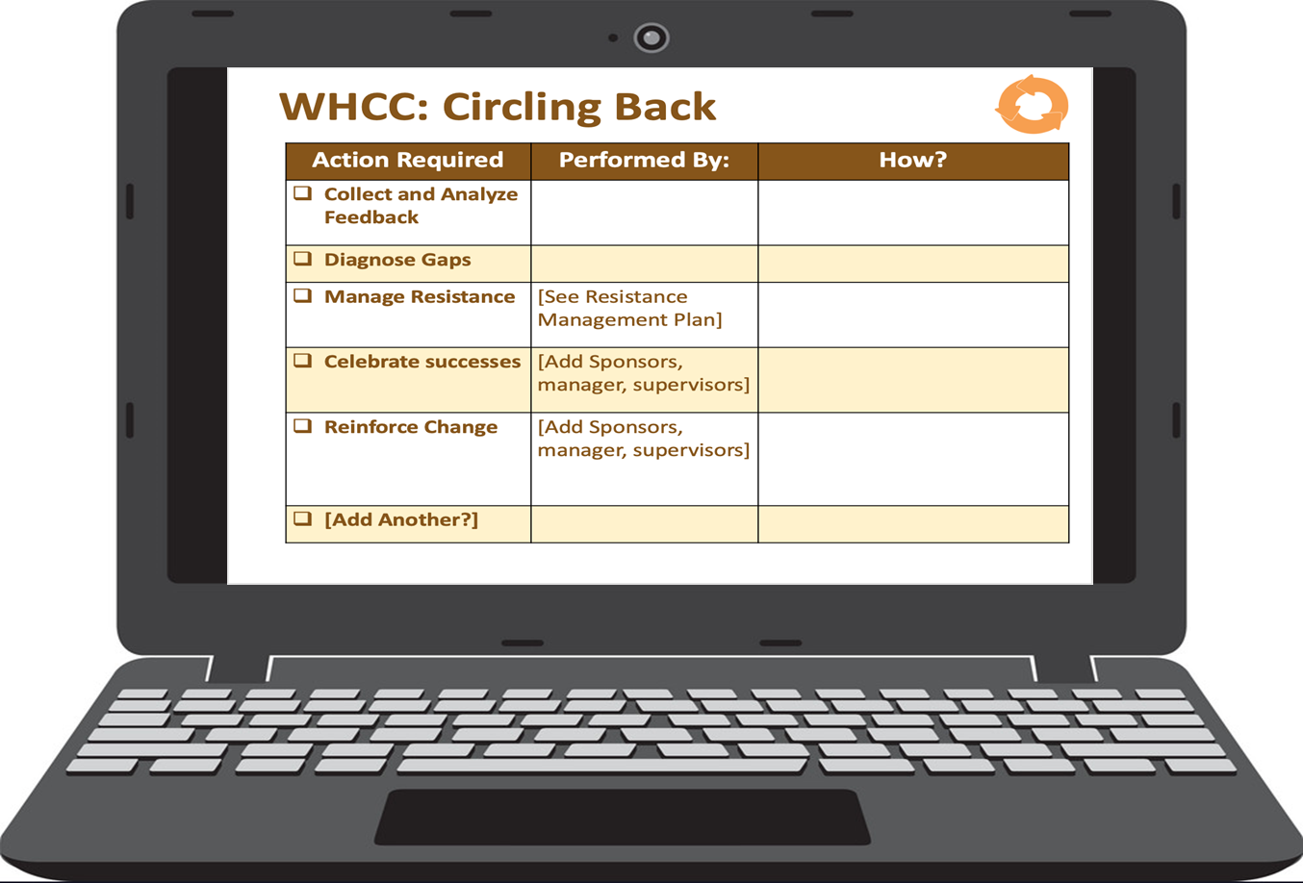
WHCC: Circling Back
Adapted from: Prosci
Notes:
Group – refer back to the earlier exercise and complete for each group that has Desire as an anticipated barrier
Notes from PROSCI template
Resistance Management Actions
What type of resistance is anticipated
what might resistance look like in our organization
where are likely areas for resistance to occur
How will resistance be identified
employee feedback
supervisor input
project team issues
compliance audits
Process for resistance management by level
employees
supervisors
mid-level managers
senior managers
Resistance management training by level
targeted audiences for this training
schedule for training (or method of integrating this material into existing training for this audience)

Slide 39
Large Group Discussion
Circling Back
Notes:
Process the exercise. Invite groups to share examples of their ideas.
Might be helpful to have each table share one example of resistance they expect to encounter, as a segue into next exercise.
Transition: Next up after lunch – group presentations!

Slide 40
This Concludes our Time with the 7 Elements
Communication
Sponsorship
Resistance Management
Coaching
Nuts and Bolts
Training
Circling Back
Any comments or questions?
Notes:
Just do a quick recap and, as time allows, see if there are any questions.

