Slide 1
DoD Physical Disability Board of Review (DoD PDBR) (Air Force Lead Component)
Mr. James Davis
Director

Slide 2
Background
2008 National Defense Authorization Act
Directed OSD to establish the Physical Disability Board of Review (PDBR) to review disability determinations
for those discharged with disability severance pay beginning on September 11, 2001 and ending on December 31, 2009
and rated at 20% or less and found to be ineligible for retirement
DoD level Board to reassess military disability ratings
Secretary of the Air Force chosen as Executive Agent to operate board
Joint Collaborative Effort: DoD Civilians, Army, Navy, Air Force, Marines, and Coast Guard involved in operation of Board
Notes:
Members separated for disability reasons with ratings of 20% or less who subsequently received VA ratings of 30% or more for the same conditions (Ratings of 30% or more from the services would have resulted in disability retirement versus discharge with severance pay) complained to their congressional members. Research revealed that the services were following same VASRD guidance as the VA but also applied service specific policies that allowed for rating adjustments. NDAA 2008 directed services to discontinue use of service specific polices and apply VASRD-only rating guidance. NDAA 2008 implemented PDBR to review ratings of those separated for disability reasons between 11 Sep 01 and 31 Dec 09 with ratings of 20% or less applying VASRD-only rating criteria.

Slide 3
DoD vs. VA Disability System
DoD
Authority: 10 USC chap 61
Determine a service member’s medical fitness for military duty
Compensate for a loss of future military earnings
Only unfitting conditions are rated
Ratings are permanent
Not bound by VA rating decisions
VA
Authority: 38 CFR
Determine service-connection of disability
Compensate for the loss of future civilian earning capacity
All service-connected injuries/illness rated
Ratings may change over time
Not bound by military rating decisions

Slide 4
What Does PDBR Review?
From the DoD PDBR Policy Instruction (DODI 6040.44):
“Provisions of DoD, Military Department regulations or guidelines relied upon by the PEB will not be considered by the PDBR to the extent they were inconsistent with the Veterans Affairs Schedule for Rating Disabilities in effect at the time of the adjudication.”
The PDBR will review:
Medical conditions determined to be specifically unfitting for continued military service, as previously determined by the Military Department Physical Evaluation Board
Upon request, medical conditions identified but not determined to be unfitting by the Physical Evaluation Boards of the Military Department concerned
Notes:
The PDBR reviews condition(s) which the service found unfitting for military duty (in other words the condition(s) prevented the member from doing their job) and may review condition(s) that the Physical Evaluation Boards reviewed but determined were not unfitting. However, the PDBR may only review conditions if the applicant requests those not unfitting conditions be considered.
The PDBR will apply the VASRD only and use the VASRD that was in effect at the time of separation.

Slide 5
Intake and Review Process
Air Force Review Boards Agency collects applications centrally at its intake unit located at Randolph AFB, San Antonio TX
The intake unit acts as liaison with Military Dept Physical Evaluation Boards (PEB) and VA Regional Offices (VARO):
Military disability case files from PEBs
Service Treatment Records, VA Rating Decisions and Compensation and Pension Exams collected from VAROs
Completed case file assembled and forwarded to PDBR for adjudication

Slide 6
PDBR Recommends Correction
Once an Applicant’s case is reviewed by the PDBR:
The Board makes recommendations and sends to the military department Designated Decision Authority (DDA) for final decision and correction of records (when appropriate)
The PDBR cannot recommend lowering a previously determined disability rating
The military department DDA closes out each case:
By notifying Applicant, VA and Defense Finance and Accounting Service of final decision
PDBR Metrics
9430: Applications received
4466: Adjudicated cases (24% re-characterized to retirement)

Slide 7
DoD-VA Collaborative Outreach
DoD and DVA Partnership to Notify PDBR Eligibles
DVA notification to PDBR eligible veterans (approx 75K)
Five mailings May 2012 – February 2014
Approximately 61K notification letters mailed
Approximately 20K with addresses unavailable
Approximately 6K registered homeless Vets

Slide 8
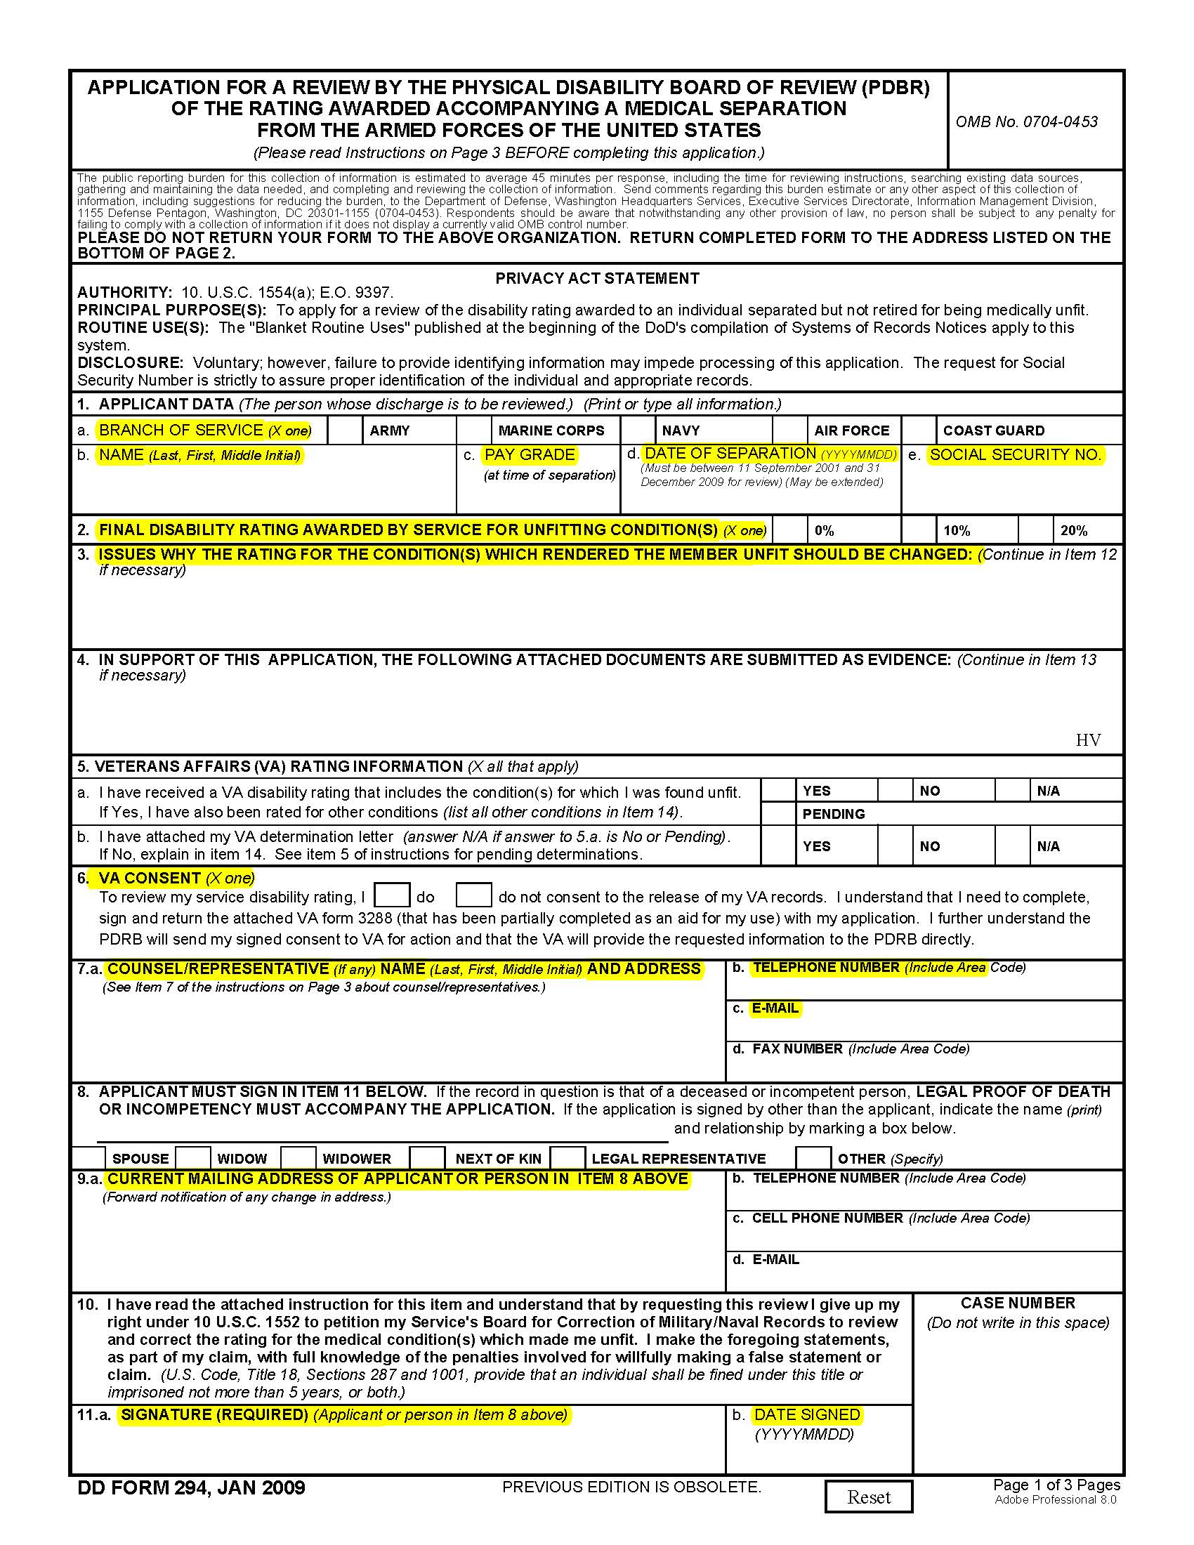
Item1: Self-explanatory
Item 2: Rating awarded by service Physical Evaluation Board - NOT VA rating
Item 3: No need to provide a rationale, PDBR will conduct a thorough review. However, must ask that all conditions be considered.
Please consider all conditions
4: PDBR will gather all necessary evidence. Ensure “HV” is annotated in lower-right corner.
Item 5: Check appropriate boxes, no need to attach letters, PDBR will gather all letters from VARO.
Item 6: Check “I Do” to consent for PDBR to gather VA records.
Item 7: enter contact info of representative assisting Vet in completing application
Instructions for blocks
#1 - 5
Instructions for blocks
#6 - 11

Slide 9
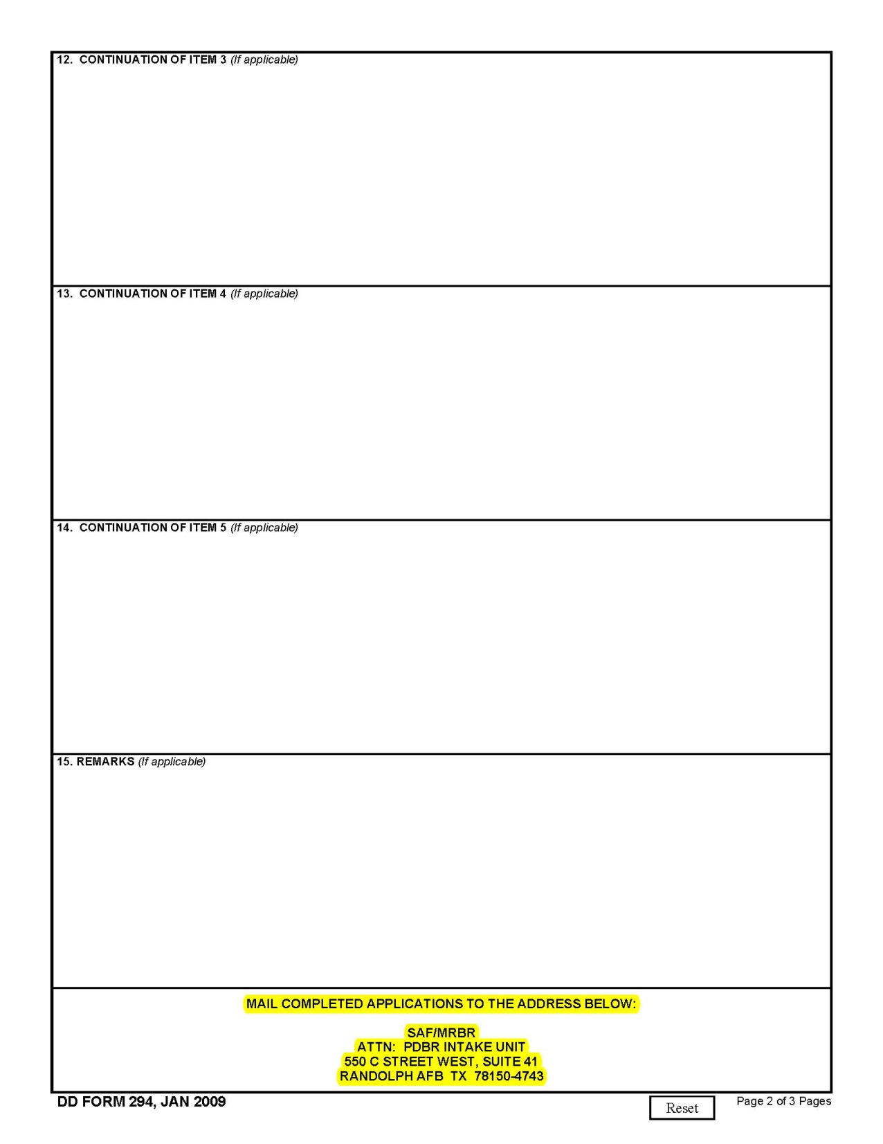
-- Email applications to:
usaf.pentagon.saf-mr.mbx.PDBRPA@mail.mil
- PDBR Mailing address may be used if applicant desires to submit significant additional supporting documentation (too large for email attachment)
Instructions for blocks
#12 - 15

Slide 10
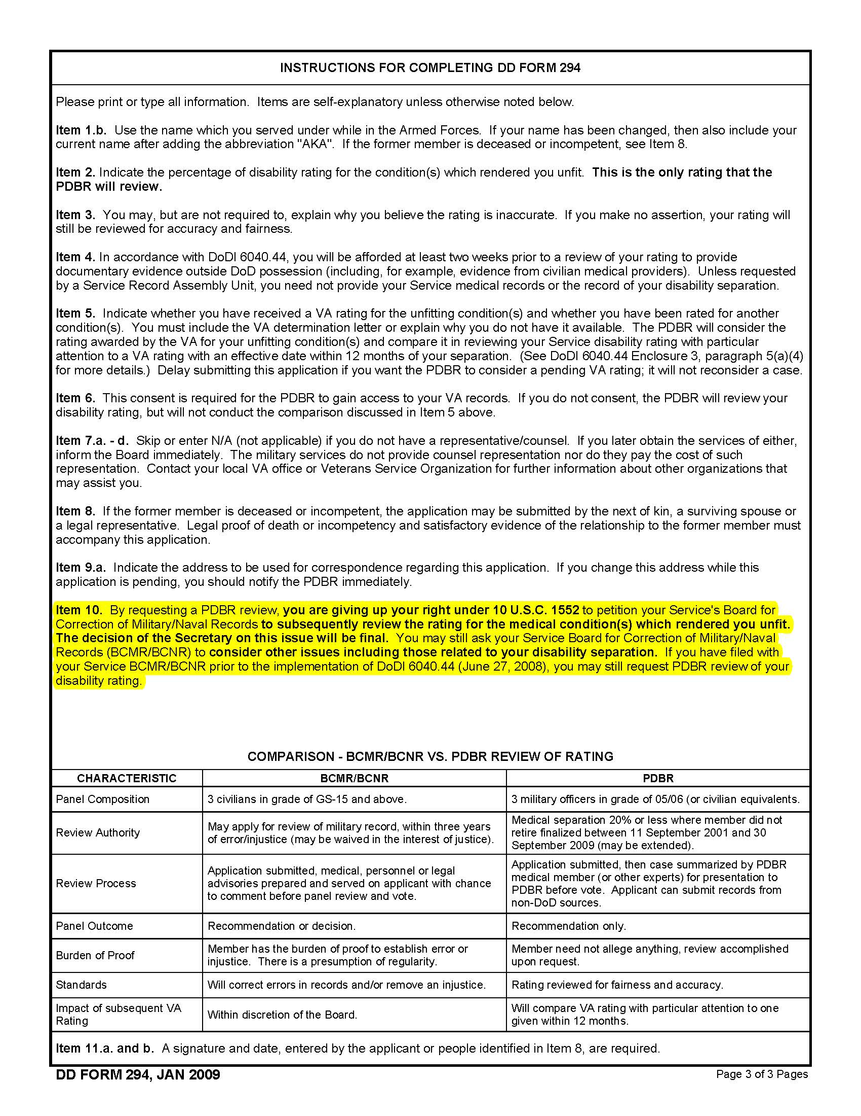

Slide 11
Scan, attach and email completed application to this address.

Slide 12
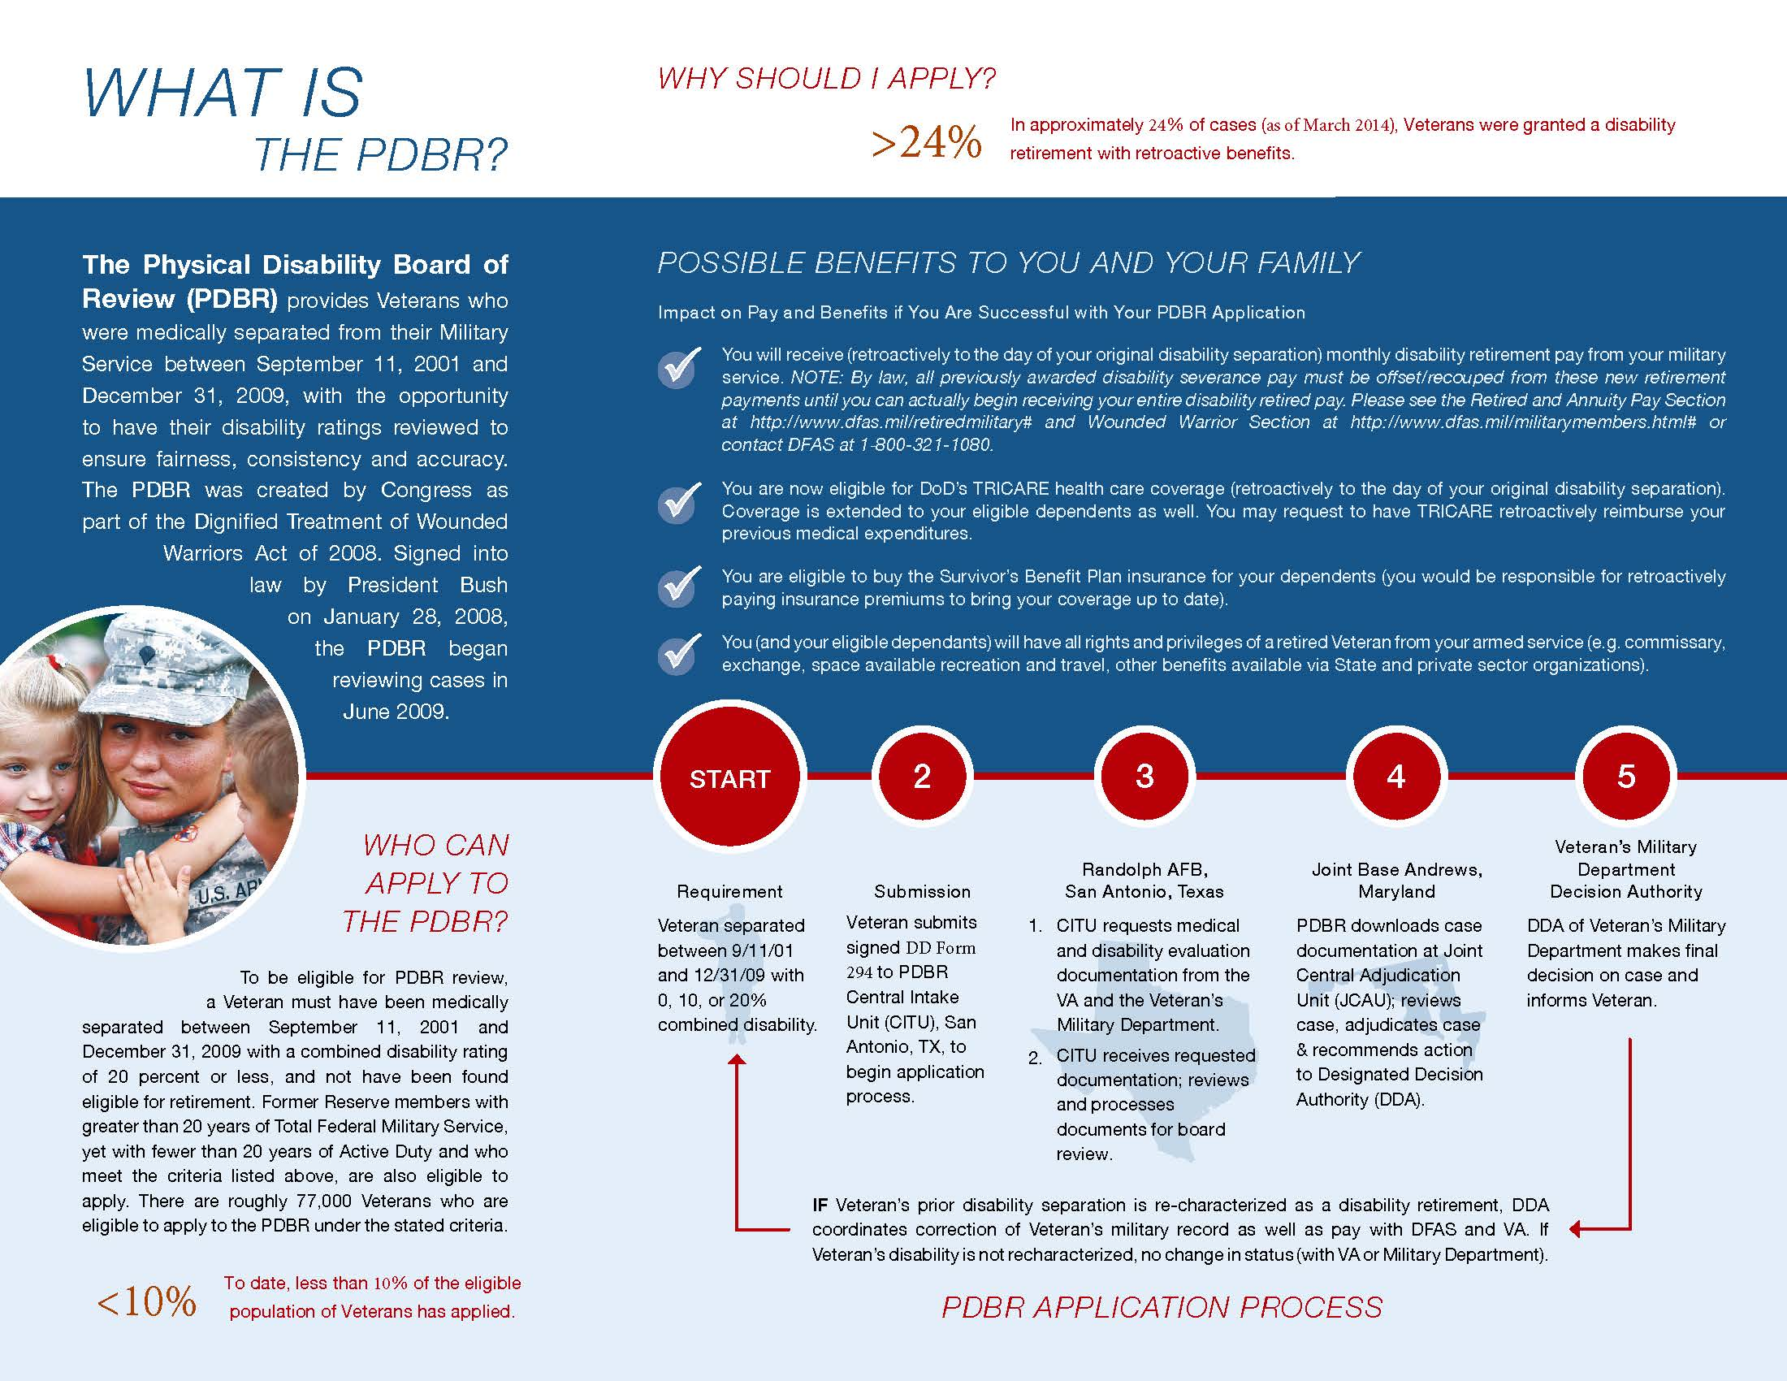

Slide 13
Bottom Line
What we need from you
Reach out to eligible Veterans
Assist in preparation of applications
Forward completed applications to PDBR
Assist in notification of final decisions
PDBR Needs You to Champion for Homeless Veterans
in Completing & Filing Necessary Actions

Slide 14
Questions
www.health.mil/PDBR
Email: usaf.pentagon.saf-mr.mbx.PDBRPA@mail.mil

