Slide 1
SSVF FY 2019 Annual Report Highlights
Mark Silverbush Abt Associates
February 17, 2021

Slide 2
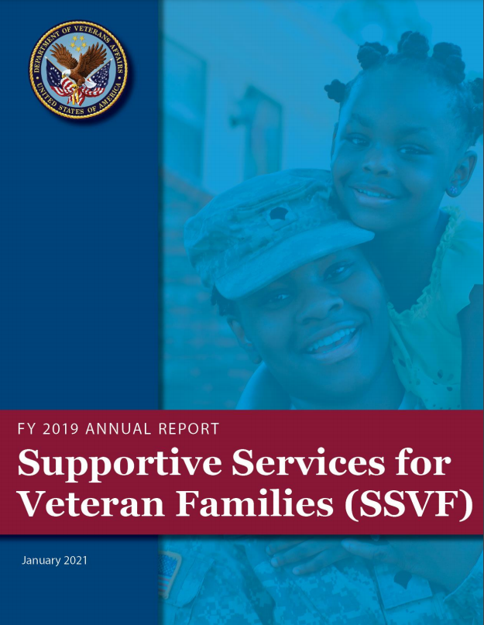
New Report Available
Located on the SSVF Homepage
Section: General Program Information and Regulations
Direct Link: https://www.va.gov/homeless/ssvf/docs/SSVF_Annual_Report_FY19.pdf
Notes:
Added a new section (Section 5) on the SSVF Rapid Resolution Initiative was added
Other Improvements
Developed and used a new report layout, including the use of photo-visual introductions to each section, new frames for client success stories and related research
Synchronized SSVF and Sheltered age data for easier comparisons (Exhibits 3.4 and 3.5)
Improved visualizations for SSVF participation time exhibits (Exhibits 4.6 and 4.7)

Slide 3
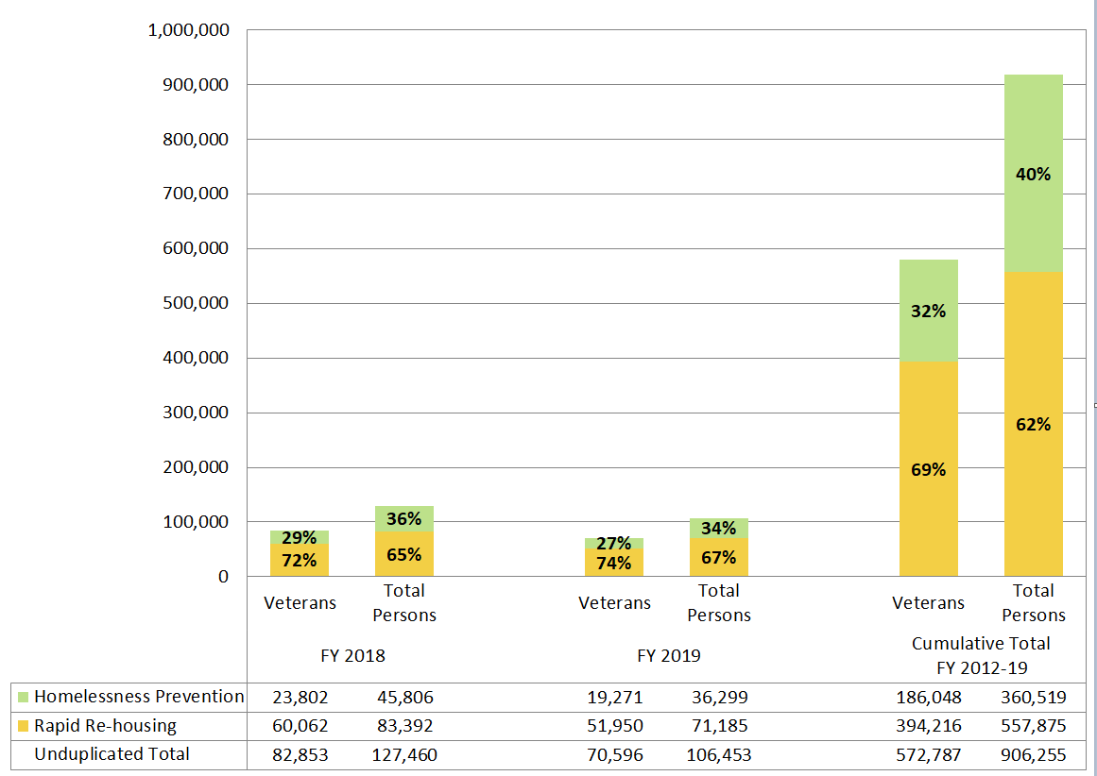
Total Persons Served, by Housing Assistance Type
Notes:
Cumulative Served
Summing all program years… 906k Persons Served, 573k Veterans Served… (expected more than 1 Million Persons served by SSVF in FY 2020)
Decreased in Persons/Vets Served from FY 2018 to FY 2019; end of all surge spending in FY 2018
Reductions in the numbers served are primarily the result of the end of “surge” funding that was available through FY 2018. This funding temporarily increased SSVF capacity – capacity that was no longer available to grantees in FY 2019.
Balance between RRH and HP
Increasingly focused on RRH vs. HP
74% of FY 2019 Vets were enrolled in RRH vs. 69% over the course of the program
HHs w/children use HP for than RRH

Slide 4
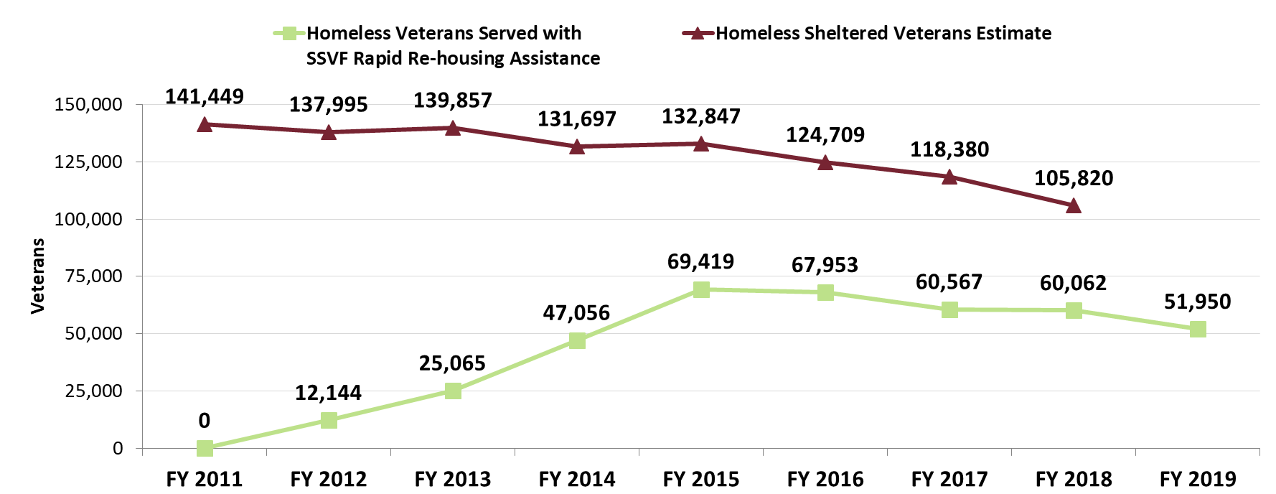
SSVF Rapid Re-housing and Annual Homeless Sheltered Veterans (FYs 2011-2019)
Notes:
Since its inception in FY 2012, SSVF rapid re-housing assistance has grown to become a central part of the U.S. response to the needs of literally homeless Veterans. In FY 2012, roughly nine (9) percent of all sheltered homeless Veterans (12,144) received help from SSVF rapid re-housing to exit homelessness. This doubled in FY 2013 to 18 percent (25,065), and doubled again in FY 2014 to 36 percent (47,056).
Over the course of the Priority 1 community “surge” effort, from FY 2015 through FY 2018, the rough percentage of SSVF Veterans receiving RRH assistance compared to the sheltered homeless Veterans rate rose. That comparable rate fluctuated between the 51 percent and 57 percent over the period. Overall, SSVF’s Priority 1 community “surge” effort period led to SSVF rapid re-housing services become an even larger part of the U.S. national response to Veteran homelessness.
In FY 2019, roughly 49 percent of the national sheltered homeless Veterans’ total received rapid re-housing assistance, assuming that the FY 2018 Veterans’ shelter total remained steady (Exhibit 1.1). While there was a modest coverage decrease from the “surge” period, SSVF rapid re-housing assistance remains a central part of the U.S. response to the needs of literally homeless Veterans.

Slide 5
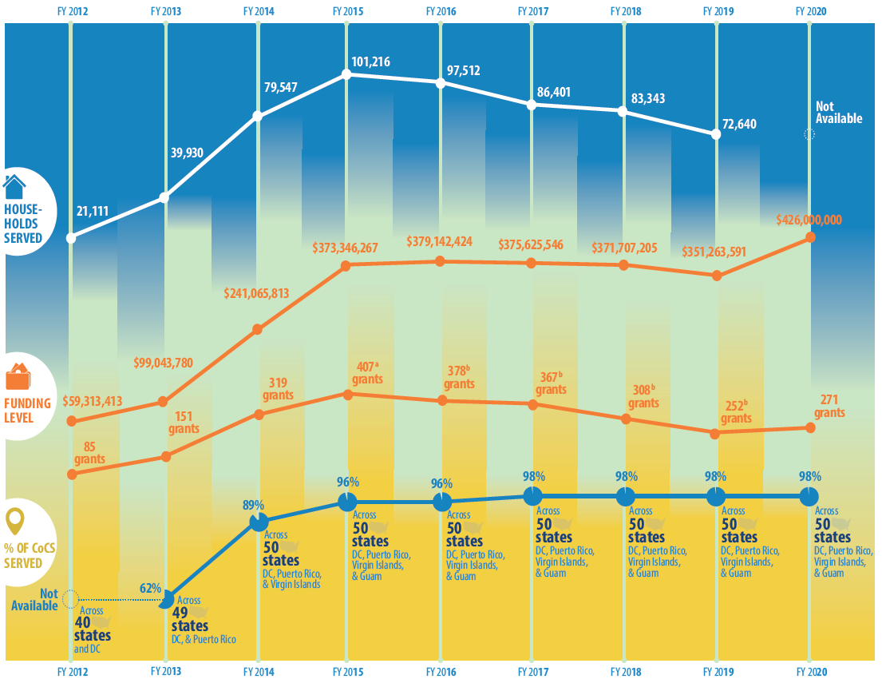
SSVF Since inception…
Notes:
HHs served and funding curves closely mirror each other.
Whereas grants were consolidated starting in FY 2016.
CoC Coverage… remained at 98% since FY 2017 (full fledged national program)

Slide 6
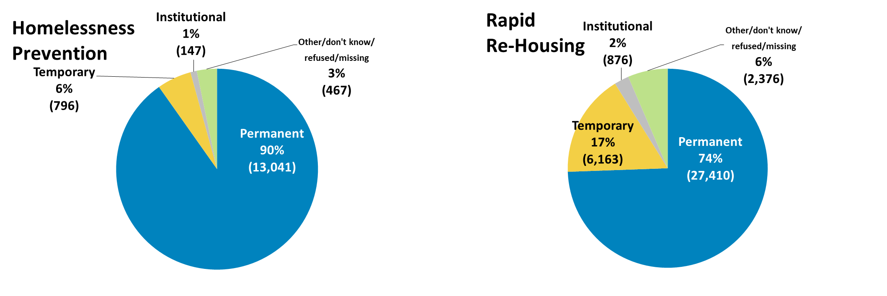
HOUSING DESTINATIONS

Slide 7
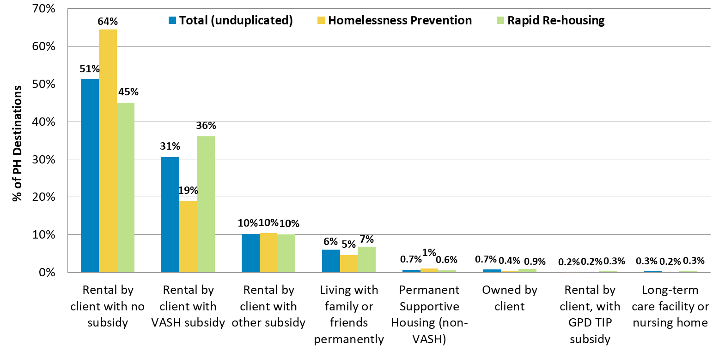
HOUSING DESTINATIONS

Slide 8
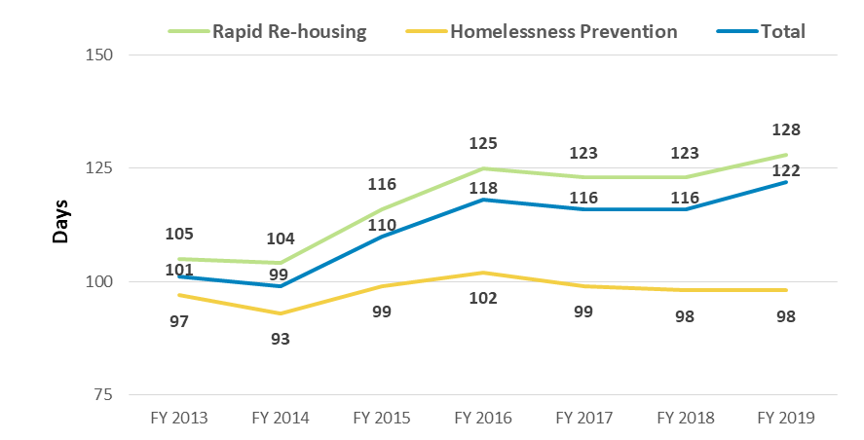
LENGTH OF PARTICIPATION

Slide 9
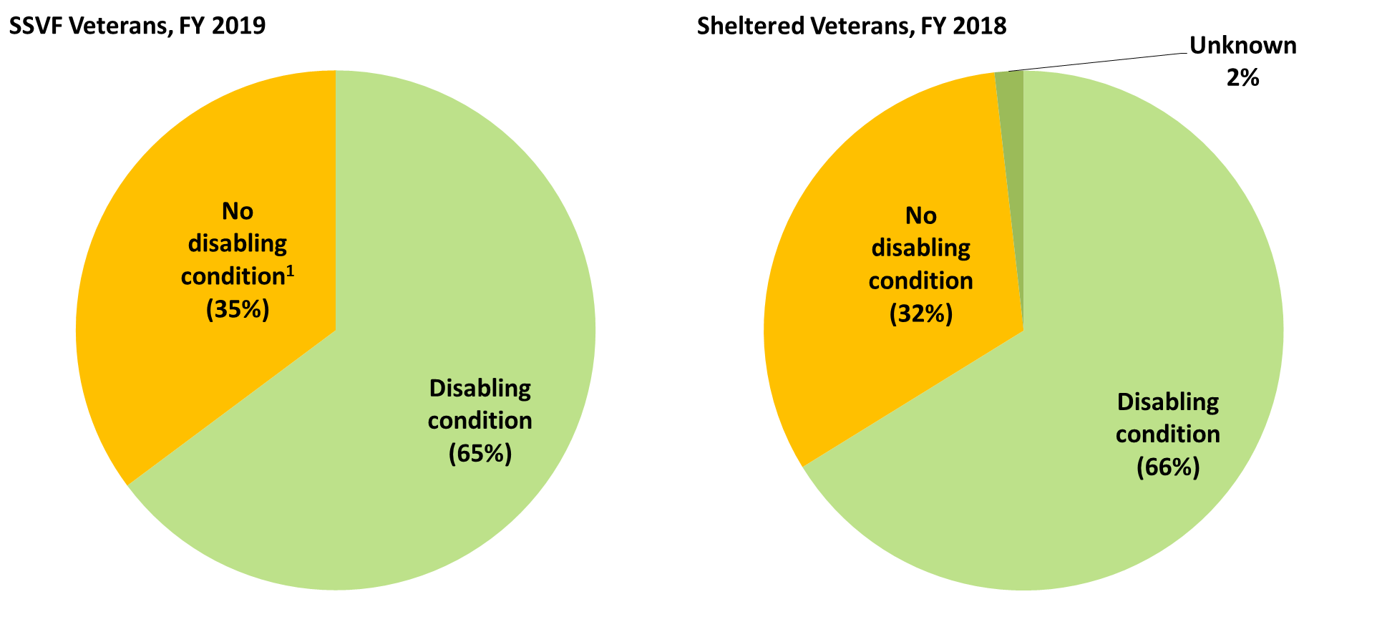
Veteran Demographic: Disabling Condition
Notes:
System Comparison: The prevalence rate of Veterans with disabling conditions evened out in FY 2019 between SSVF and sheltered Veterans.

Slide 10
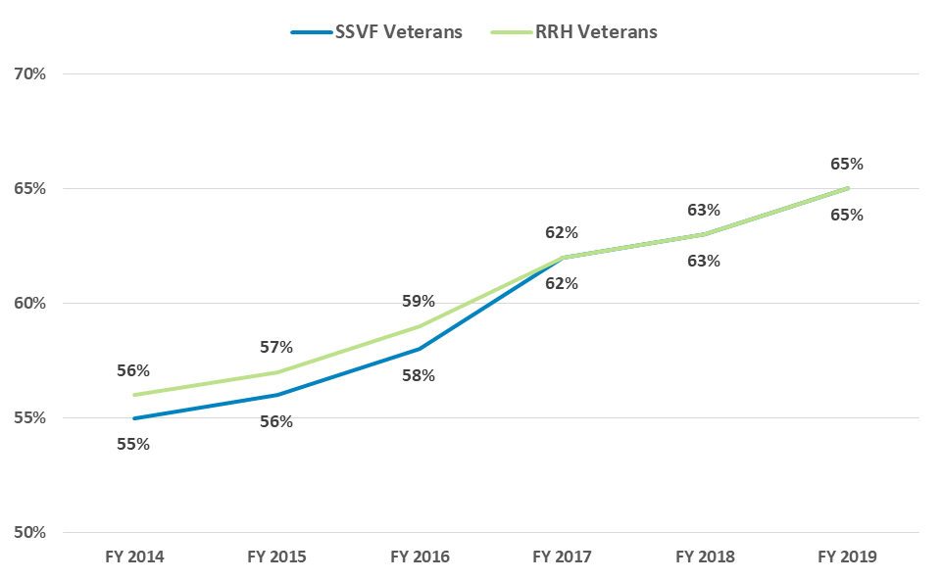
Veteran Demographic Trends: DISABLING Condition
SSVF Trend: Within SSVF, Veterans with a disabling condition has risen each year…

Slide 11
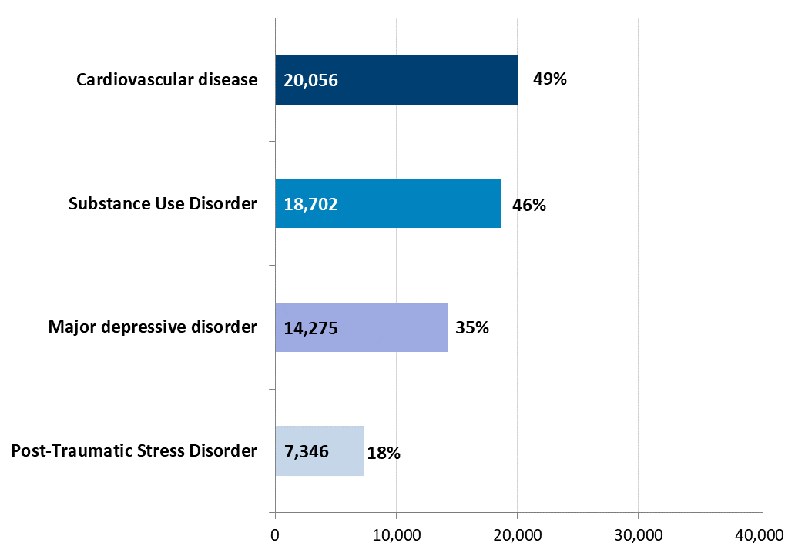
Veteran Demographic Trends: Disabling Condition
Notes:
This slide shows the major health problems found among Veterans who both exited SSVF during FY 2019 and received health care services from the Veterans Health Administration (VHA). In FY 2019, of the 51,072 Veterans who exited SSVF, 41,071 (or 80 percent) were documented to have received VHA services.
About half (49 percent) of these 41,071 Veterans had a history of cardiovascular disease, 46 percent had a substance use disorder, 35 percent had a major depressive disorder, and 18 percent had post-traumatic stress disorder.

Slide 12
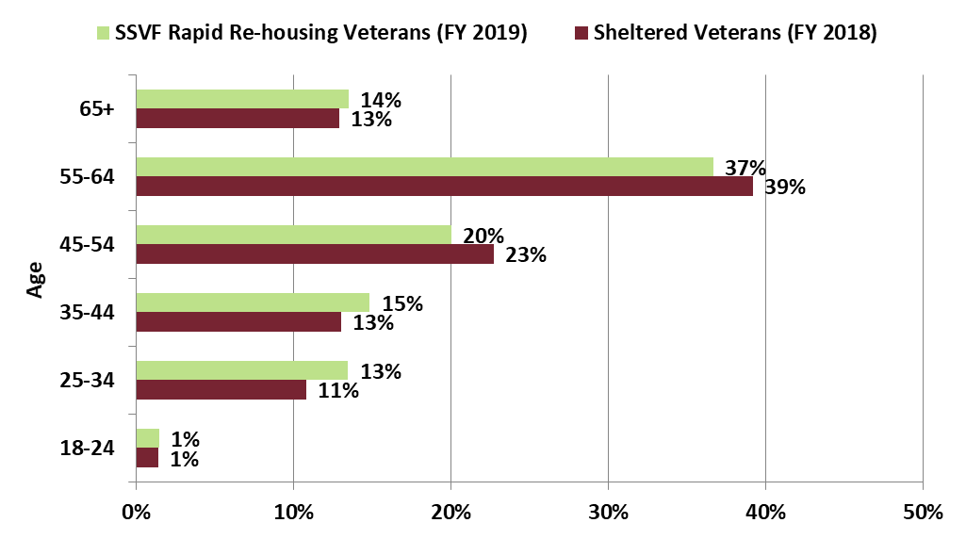
Veteran Demographic Trends: Age
System Comparison: SSVF RRH Veterans tend to be younger than sheltered Veterans.
SSVF Trend: Veterans 62+ has risen each year:
FY 2015: 13% (13% RRH)
FY 2016: 15% (15% RRH)
FY 2017: 18% (19% RRH)
FY 2018: 19% (20% RRH)
FY 2019: 22% (23% RRH)
Notes:
System Comparison: SSVF RRH Veterans tend to be younger than sheltered Veterans.
Note: In FY 2019, the SSVF program served 70,596 Veterans. Among these Veterans, 16.1 percent (11,360) served in Iraq or Afghanistan and were Veterans of Operation Enduring Freedom (OEF), Operation Iraqi Freedom (OIF), or Operation New Dawn (OND)—the highest proportion of OEF/OIF/OND Veterans served by any VA homeless initiative. Sixty-nine (69) percent of those Veterans received rapid re-housing assistance, 32 percent used homelessness prevention assistance, and one (1) percent used both assistance types.

Slide 13
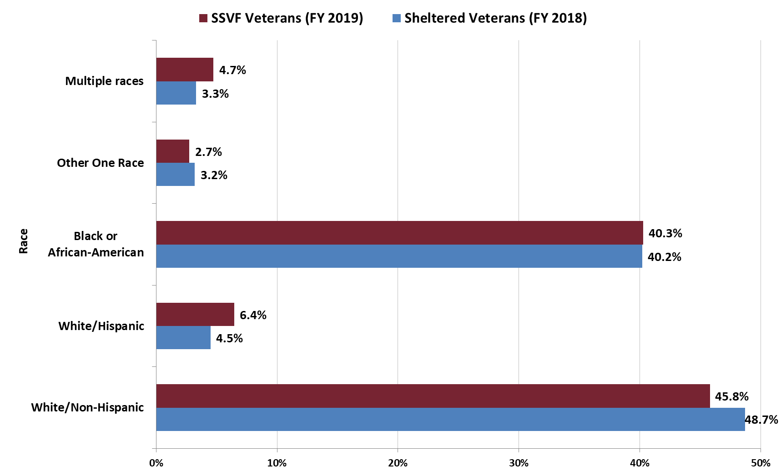
Veteran Demographics: Race/ETHNICITY
Notes:
More than half (54 percent) of the 70,596 Veterans served by SSVF were members of minority racial groups compared with 51 percent of Veterans in shelters nationwide.

Slide 14
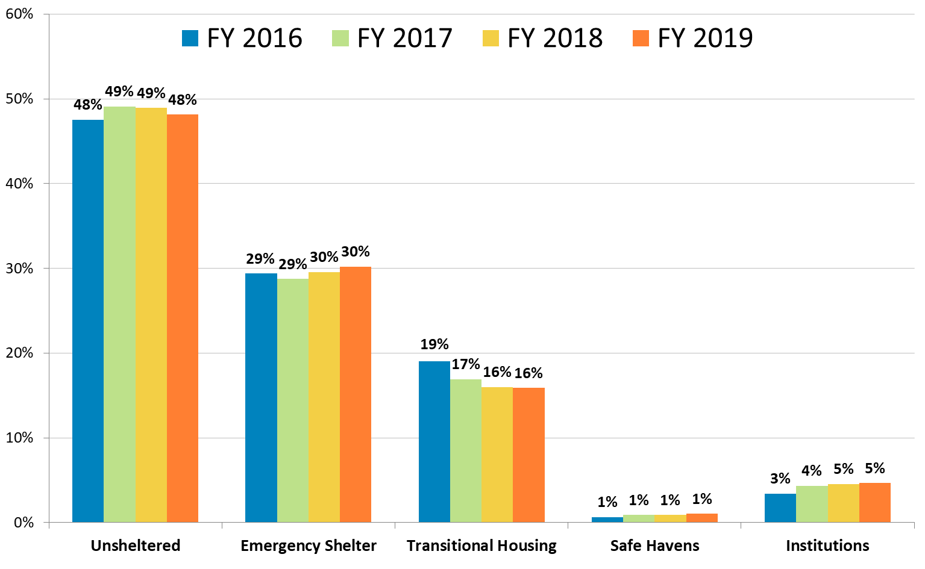
Prior Living Situations of Homeless RRH Veterans
Notes:
Of the literally homeless Veterans who received rapid re-housing services, about half (48 percent) were living in unsheltered situations (including outdoor and vehicle locations) at program entry.

Slide 15
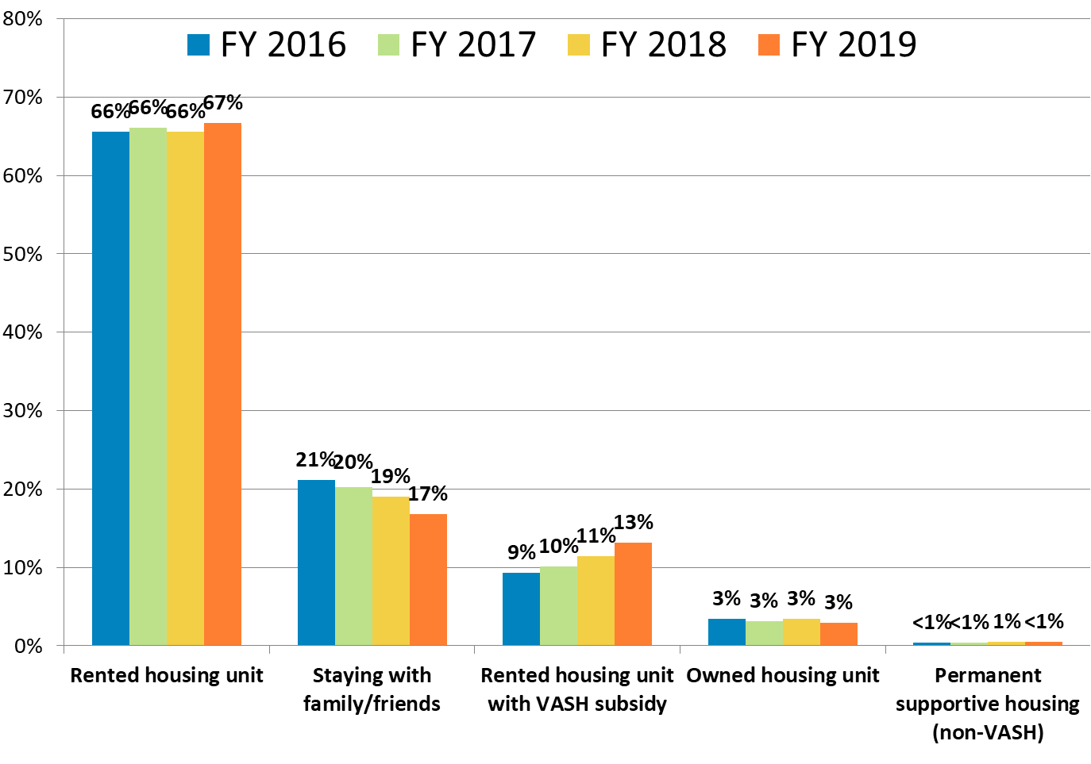
Prior Living Situations of Housed Hp Veterans
Notes:
Of the Veterans who received homelessness prevention services and entered the program from housed situations, 67 percent were in rental units and 17 percent were living with family or friends at entry.

