Slide 1
June 23, 2020

Slide 2
Overview of the Data Maturity Model Selection Process
Step 1
Establishment of a Data Governance Council Data Maturity Workgroup
Step 2
Selection of a Data Maturity Assessment and Tool
Step 3
Step 4
Conducting the Assessment
Incorporating the Results in VA Data Strategy and Corresponding Workplan
Step 5
Reporting the Results

Slide 3
Step 1: Establishment of a DGC Data Maturity Workgroup
On January 8th 2019, during the Data Governance Council (DGC) meeting a proposal was discussed on creating a workgroup to manage the development, deployment, and reporting requirements of the data maturity assessment for VA and its corresponding tool. (e.g., GAO-04-394G, 2004, ITIM: A Framework for Assessing and Improving Process Maturity).
The requirements from the DGC were:
Based on industry’s best practices
Used by the industry (i.e., government, DoD)
Can be deployed immediately without validation
Low or no costs
Compatible with DAMA-DMBOK© (Data Management Body of Knowledge)
Outcome: Derived business value that practitioners in the industry observed are: increased customer satisfaction, better productivity, efficiency and decreased risk for the practice areas assessed. Workgroup should select model, develop or obtain assessment tool, deploy and report results.
Workgroup Representatives
Office of Enterprise Integration – Chief Data Officer Office- DGC Secretariat
Office of Information Technology – Office of Enterprise Architecture (consultant)
Veterans Health Administration
Veterans Benefit Administration
National Cemetery Administration
Office of Human Resources and Administration
Office of Security and preparedness
Board of Veterans Appeals
Office of General Counsel
Veterans Experience Office
Office of Management
Office of Acquisition and Logistics

Slide 4
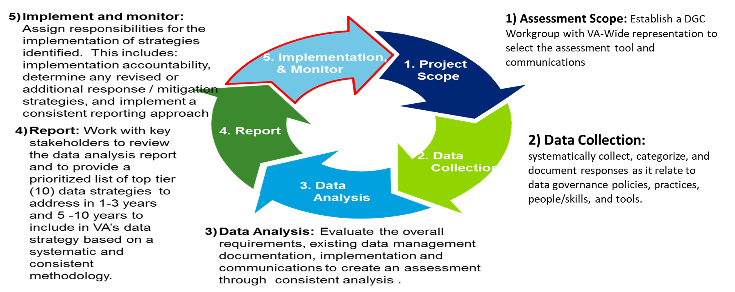
Data Maturity Workgroup Process
VA Data Governance Council
4

Slide 5
Data Maturity Assessment Workgroup Roles and Responsibilities
Assessment Roles and Responsibilities
Provide guidance and oversight to the assessment process
Approve assessment method, tool, roll out, report and recommendations
Disseminate assessment across their organizations and support improvements
CDO/DGC Members
Manage the assessment process
Facilitate organizational assessment sessions and briefings
Report out to organizations’ Senior Leadership
DGC Secretariat
Review assessment results
Validate potential strategies
Provide project management and support
Common Information
Data Stewards
Provide expertise in selected data management areas
Communicate with DGC members to reach concurrence on action plans
Benchmark the level of effort/time to achieve benefits
Participate in Assessment Training and Review Sessions to analyze the current status, and provide insight on the current risk response/
mitigation strategy and desired future state
Workgroup
Predecisional -- Draft
VA Data Governance Council
5

Slide 6
Step 2: Workgroup Selection of the Data Maturity Assessment Model and Tool

Slide 7
A multi-phased approach for the data maturity model selection.
Definition of Selection Criteria
Assess Selected Data Maturity Models Against Criteria
Obtain DGC Approval & Deployment Roadmap
Key Activities
Define the business and technical requirements for the data maturity model Define the requirements for the data maturity assessment tool | Identify Models to evaluate Evaluate Models against the criteria Select a data maturity model that best suits VA’s needs | Provide recommendations to the DGC Obtain approval of Model and tool Obtain approval of proposed assessment roll out plan
Agreed upon selection criteria | Data Maturity Assessment Model and Tool | Data Maturity
Outputs

Slide 8
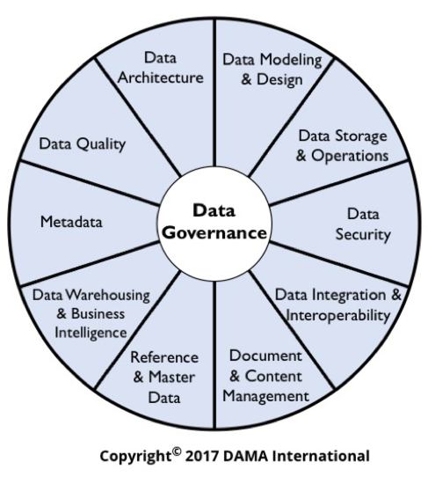
Assessment Model Selection Criteria
Data-focus | Model should address data maturity across policy, people, process, and technology dimensions.
Maturity Model Tools | Model should be aligned with DAMA principles and best practices. Model should allow for benchmarking if VA so desires
Access to Recommendations | Model should provide a clear path for the required steps to achieve the next level of maturity.
Costs | Model is self explanatory; maturity assessment provides tool or one can be developed inhouse and a self-assessment can be conducted
DAMA Wheel | Model should include all dimensions of the DAMA wheel: data governance; data architecture; data modeling and design; data storage and operations; data security; data integration and interoperability; document and content management; reference and master data; data warehousing and business intelligence; metadata; and data quality
Aligned with Legal, Statutory and Federal Data Strategy Requirements | The Evidence Act and other legislative requirements and OMB Circulars requires alignment with data governance, data architecture, records management, data security and privacy, metadata management; data quality and
Industry Focus | Preferred a model that is used by industry .
8

Slide 9
Model Assessment Results

Slide 10
CMMI Data Mamangement Maturity (DMM) Model
IBM Big Data Model
Stanford Maturity Model
DataFlux: Data Governance Maturity Model
Federal Government Data Maturity Model
Data Quality Maturity Model
Many Models were considered however, the ones listed herein were the ones selected for comparison against the criteria.
The list shows the ranking from higher to lowest recommendation.
The next slides summarizes the Workgroup assessment in each key area.

Slide 11
Model Requirements  | Data Quality Maturity Model | Federal Government Data Maturity Model | DataFlux: Data Governance Maturity Model | IBM Big Data Model | Stanford Maturity Model | CMMI DMM Model
Data-focus | Data Quality specific and its alignment to OMB guidance | Analytics, Data Culture, Data Management, Personnel, Systems/Technology, Data Governance | People, Policies, and technology | Business Strategy, Information, Analytics, Culture and Operational Execution, Architecture, Governance | Foundational and Project aspects of Data Governance | Data Management, Governance, Quality, Operations, and Platform and Architecture
Maturity Model Tools | Yes; tool needs to be created | Yes; tool needs to be created | Yes; tool needs to be created | IBM Score table | Data Governance dimension score Card | Yes- tool need to be created
Access to Recommendations | ]No | NO | No | No | No | Yes
Costs | No cost | No Cost | No cost | No cost | No cost | $250 (enterprise license)
DAMA Wheel | N/A | N/A | Partially addressed | Partially addressed | Partially addressed | Fully addressed
Aligned with Legal, Statutory… | Partially | No | Partially | Yes | Partially | Yes
Industry Focus | Federal | Federal | Commercial | Industry | Industry | Industry/Commercial
Top Pros | Assess the level of maturity of their approach to data quality and how the maturity levels correspond to Office of Management and Budget (OMB) guidance. | This model includes six lanes: analytics capability, data culture, data management, data personnel, data systems and technology, and data governance. | Model assesses the organization in people, policies, technology, risks, and reward. | Measure progress in data risk management and compliance; value creation; organizational structures and awareness; policy; stewardship; data quality management; information lifecycle management; information security and privacy; data architecture; classification and metadata; audit information, logging and reporting. | Measures data governance competencies and development of critical program resources: awareness; formalization; metadata; stewardship; and data quality. | Measures enterprise data management program in five key process areas: data management strategy; data governance; data quality; data operations; and data architecture
Top Cons | Only aligns to the DAMA data quality dimension | Don’t align to DAMA | Don’t address all of DAMA dimensions | No “people” dimension to measure maturity | Don’t address all of DAMA dimensions | Time required to answer tool due to its comprehensiveness
Notes:
FDS, Federal Government, and Data Flux maturity models are preferred, as NSF has vetted these and identified them as preferred.

Slide 12
Deep Dive into the CMMI Model

Slide 13
CMMI Framework – Addresses all Data Management Core Categories and Process Areas
13

Slide 14
CMMI Overview
Capability Maturity Model Integration (CMMI) is designed to allow the practitioner to focus on the specific processes that are considered important for the organization's immediate business objectives or high risk areas. It integrates “siloed” organizational functions by developing process improvement goals, priorities, guidance, and measurements that are used for assessments.
Maturity Levels are based on a rating scale of 1 – 5.
Numeric value of levels represents the maturity assessed of a “practice area” from 1 rated least to 5 being the highest level on the scale.

Slide 15
Data Governance Success
Source: DAMA Phoenix, 2018

Slide 16
CMMI Tool Development Process
A tool was created in Excel using the CMMI questions for each level
The questions were updated to reflect VA’s semantics.
The tool was peer reviewed for accuracy
Any issues identified during the peer review process, were adjudicated by the DGC data Maturity Workgroup
Final tool was made available for review of Workgroup members

Slide 17
Next steps
Provide training to DGC members in the CMMI Model and assessment tool
Deploy the Assessment Tool and gather results
Publish results

