Slide 1
Electronic Subcontracting Reporting System (eSRS): Individual Subcontract Report (ISR) Guide
Presented by: Lydia McKay, Chief PMRS, VA FSS
October 05, 2023

Slide 2
Housekeeping
This session is being recorded and will be made available on our Subcontracting and Training web pages.
Mute mics during the presentation​.
Hold questions until the end of the presentation​.
If you have question(s) that are not submitted/addressed during this session, please send to SubcontractingVAFSS@va.gov.

Slide 3
Agenda
Individual Subcontract Report (ISR)
Review Process
Technical Tips & Common Issues
Resources & eSRS Help Contacts

Slide 4
SSR
Individual Subcontract Report (ISR)

Slide 5
Submission Timeframe
WHEN?
The report shall be submitted semi-annually during contract performance for the periods ending March 31 and September 30.
A report is also required for each contract within 30 days of contract completion.
FAR 52.219-9(l)(1)(i)
Report Type | Spend Period for Reporting | Due Date
SSR | October 1 – September 30 | October 30th
ISR | Plan Start – March 31 & Plan Start – September 30 | April 30th & October 30th
Notes:
*ISR should NEVER by completed by commercial planholders.

Slide 6
eSRS.gov Login
https://www.esrs.gov/
All eSRS users must have a login.gov account
Create an account at login.gov with the following:
Single email address
Secure password with no common words or phrases
Additional authentication method
Site navigation guides are found on the eSRS home page
Notes:
If you have a Login.gov account, use your existing eSRS email address to connect to your profile
Effective 4/4/22, UEI numbers are the official government-wide identifier used for federal awards (formerly the DUNS number was used).

Slide 7
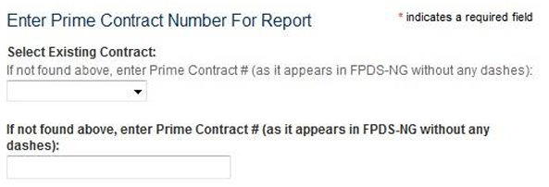
Prime Contract Number
Select the VA contract number for which you will be filling the report.
If your contract number does not appear in the drop-down box, contact your government subcontracting plan approver to look into the issue.
Notes:
xxxxxxxxxxxxxxxxx

Slide 8
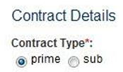
Contract Details
Always select prime as your company was awarded the contract by the Federal Government (i.e., you are not a subcontractor on the contract).
Notes:
xxxxxxxxxxxxxxxxx

Slide 9
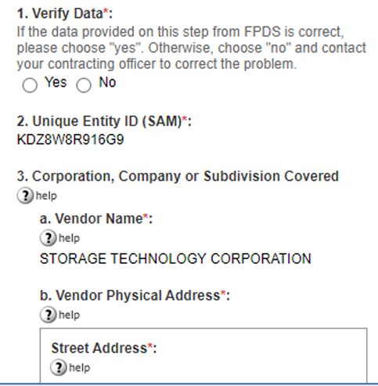
Contract Details – Cont’d
Verify that the UEI in #2 and associated name and address in #3 are correct. These pre-fill after your contract number is chosen in the prior menu.
If there is an issue with the data, do not choose “no” and submit. Please contact your assigned Contract Specialist.
Notes:
xxxxxxxxxxxxxxxxx

Slide 10
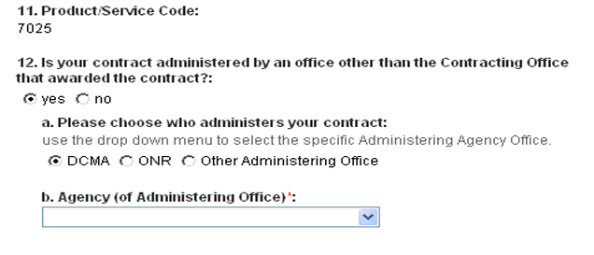
Contract Administration Office
For VA FSS contracts, your contract is always administered by the Contract Office which awarded your contract; therefore, your response to the question below will always be “no”.
Notes:
xxxxxxxxxxxxxxxxx

Slide 11
Indirect Spend
Prior to completing the goals and cumulative achievements table, you will be asked whether or not the dollars and percentages include indirect spend.
Consult # 6 on your approved Small Business Subcontracting Plan

Slide 12
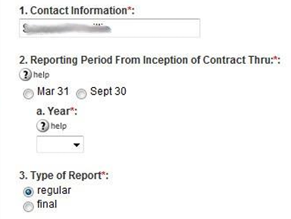
Reporting Period & Type
List the name and contact info for the individual we should contact if we have questions about the report
Choose the appropriate semi-annual report and year
This will always be “regular” unless it is your final report at contract expiration

Slide 13
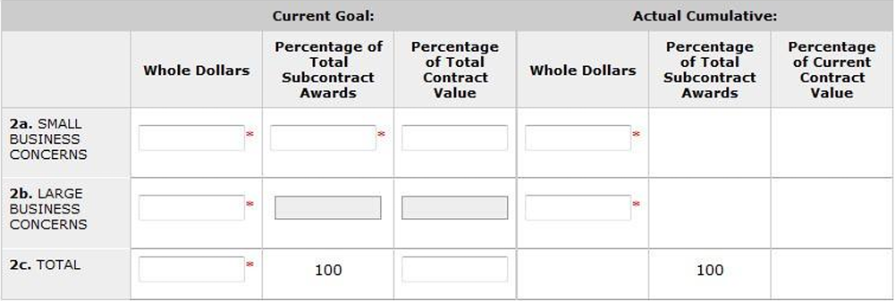
Goals & Achievements
The table below will ask for your current goals as well as your actual cumulative achievements from the time the contract was awarded.

Slide 14
Current Goals
Make sure that the goals you input match those approved under your current individual plan. The next slide will explain how to handle goals including option years.
Notes:
We will be comparing your response here to your actual plan.

Slide 15
Current Goals / Option Goals
5-Year Base Period: During the first 5 years of your contract (i.e. the base period), you will enter the 5-year base goals from your plan.
During Option Period(s): Once you are in an option period, you will combine the total spend and the dollar goals from the base and option period(s). This will require you to manually calculate the percentages of subcontract awards (dividing each category by total spend in 2c) as the percentages listed on your plan are specific to a 5-year period.

Slide 16
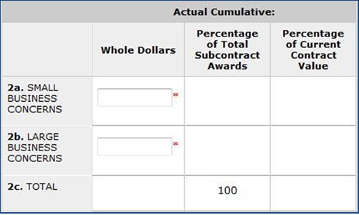
Actual Cumulative Achievements
The actual achievements you enter for all categories are cumulative, a running total of your achievements since the inception of your individual plan (start of your contract). In other words, your achievements for each 6-month period will be added to the previous ISR total.
Note that if you take the difference between the running total reported each October, that difference would be one year of spend that should match the annual spend reported under your SSR.

Slide 17
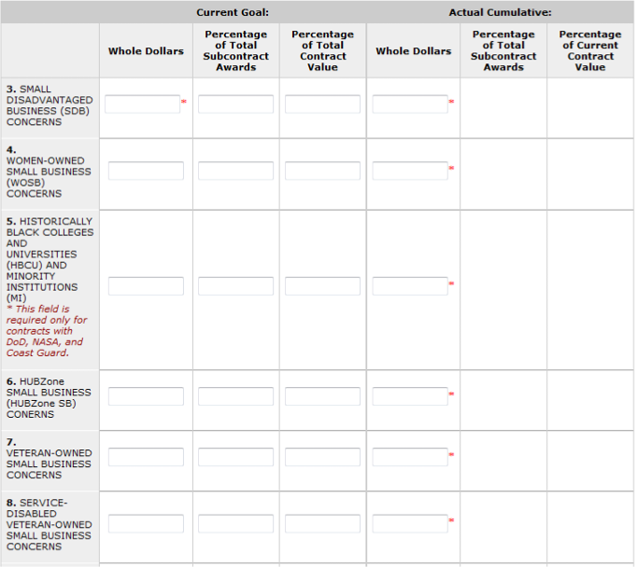
Subcategory Goals & Achievements
The instructions for the subcategories are the same as for your LB/SB goals and achievements.
Be reminded that all SB spend counts once in the SB category and as many times as it fits under each subcategory

Slide 18
Basis for Spend Data
Whatever method you choose below as the basis for spend data should be the same method you use to report your quarterly sales under your FSS contract.

Slide 19
Report Certification
The report must be certified.
If “Yes” is not selected, the report will be rejected.

Slide 20
Remarks
Remarks/explanations are required for each category …
If any actual percentage achievement falls short of your percentage goals
If you report a zero-dollar achievement

Slide 21
Subcontracting Program Administrator
This should match the Subcontracting Program Administrator, as listed on your approved plan as the Plan Administrator listed on, unless you have updated this point of contact POC since that time.
You would have already listed your eSRS point of contact earlier in this report, and it may differ from the Plan Administrator contact.
Notes:
We recognize that some companies may have different individuals handling the subcontracting plan and the eSRS reports.
This entry is for your Subcontracting Program Administrator, which should be the Plan Administrator listed on you approved subK plan, unless you have updated this POC since that time.

Slide 22
Notification
Enter the e-mail address of all Government personnel who will be reviewing the report so that they will receive an e-mail notification of your submission
This should always include the below, centralized subcontracting program e-mail address for VA FSS (or VA NCS, as applicable for your specific contract)
VA FSS Subcontracting Plans: SubcontractingVAFSS@va.gov
VA NCS Subcontracting Plans: NACSUBK@va.gov
Notes:
Other eSRS Reviewer(s): Assigned Contracting Officer/Specialist; Subcontracting Plan approver

Slide 23
Review Process Flow
Review Process

Slide 24
Review Process
Create & Submit a Report in eSRS
Automated e-mail is sent to all listed reviewers
The approving agency rejects/accepts your report
Automated e-mail is sent notifying report submitter of status
Rejected: Edit and resubmit your report
Approved: Print a copy for CEO signature & keep on file

Slide 25
Technical Tips
Technical Tips & Common Issues

Slide 26
Account Setup
Trouble establishing Login.gov account
The most common issue with account set up is that the user is not authenticated
Users are authenticated when they receive an email indicating successful account set up
If e-mail is not received, or you encounter other account setup/login issues, contact the eSRS Helpdesk: www.fsd.gov, 866-606-8220 x3

Slide 27
Setting up New Account User
How does a new user file new reports and view existing/previous reports in eSRS?
Have the new user register in eSRS/Login.gov.
Send an eSRS Technical Helpdesk ticket that includes the name and e-mail address of the new & former user, and request to have the historical data migrated to the new user’s account
Example: Angela Johnson angela@abc.com is the new eSRS representative for ABC corporation. Pam Jones pjones@abc.com will no longer have the responsibility of filing reports in eSRS for ABC Corporation. Therefore, please migrate the historical data for ABC Corporation from Pam Jones’ eSRS account to Angela Terry’s account.

Slide 28
Duplicate Report Error
What if I get an error stating that a report has already been filed for a particular reporting period under my UEI number?
First, check your account under the report type, and select the tab that says “ALL”, which will allow you to view all reports of that type in draft, pending, accepted, and rejected status. You may find that you have already submitted a report for that period or that it is in draft status.
It is possible that someone else in your company, or your predecessor filed a report for that period. If prior user account reports have not been migrated to your account, you will not see the prior reports.

Slide 29
Report Accessibility Issue
What if my reviewing Contracting Officer/Specialist can’t view my report in eSRS?
Check your account to make sure that the report is not in draft (DRT) status. You must submit the report for it to be viewed.

Slide 30
Report Rejection
Top Reasons why an ISR report is Rejected
Remarks Missing: Needed justification/explanation missing for
$0 Reported, Justification/Explanation Missing
Percentage Goals not Met
Annual Spend (two ISR cycles): Spend reported in the annual SSR does not match the annual spend added during the last two ISR cycles.
CEO did not Self-Certify Report: The report must indicate “Yes” for CEO approval, otherwise the report will be rejected.

Slide 31
Resources
Resources

Slide 32
Resources
VA FSS Subcontracting Program e-Mail: SubcontractingVAFSS@va.gov
NCS Subcontracting Program e-Mail: NACSUBK@va.gov
VA FSS Subcontracting Web Page: https://www.va.gov/opal/nac/fss/sbsp.asp
Suggested minimum percentage goals
Training/guides (eSRS & Plan Preparation)
Subcontracting Plan template
VA FSS Training Web Page: https://www.va.gov/opal/nac/fss/training.asp
Upcoming webinars
Current and archived presentations
eSRS Home Page: https://www.esrs.gov
Log-in
User Guides & Training Materials (including “Quick Reference Guides”)
Sample Reports
eSRS Helpdesk: Federal Service Desk (FSD), https://www.fsd.gov, 866-606-8220 x3

Slide 33
Questions
Questions?

