Slide 1
.Option to Extend Submission Best Practices
FSS Webinar – April 21, 2022
Presented by Lydia McKay

Slide 2
Purpose – IIb
Purpose
This training will take you step-by-step through the Option to Extend Package to assist you with preparing an accurate, complete submission package, thereby reducing clarification time during the review process and resulting in timely exercising of the option.
Please note that this presentation represents the typical VA FSS Option to Extend process and does not capture the unique circumstances that may arise with a specific contractor.

Slide 3
Agenda
  Regulations
  Option Process Stages & Responsibilities
  Fill-in Document (Word)
  Spreadsheet (.xlsx)
  Submission Protocol
  Resources

Slide 4
Regulations - 1
552.217-1 : Notice Regarding Option(s)
The Contracting Officer (CO) will “consider the quality of the Contractor’s past performance” when deciding whether to exercise the option
A-FSS-11 Consideration of Offers under Standing Solicitations
Initial (base) contract award period will be for 5 years
Contract can be extended by the Option to Extend the Term of the Contract clause
Contract can be canceled pursuant to the Cancellation clause 552.238-79 or terminated pursuant to the termination provisions of the contract

Slide 5
Regulations - 2
52.217-9 : Option to Extend the Term of the Contract
All Schedules except 66 III & 65 I B
1 or more option periods, not to exceed 5 additional years, for total potential contract period of 10 years
CO can unilaterally exercise if written notice is provided to the contractor 60 days before contract expiration
I-FSS-163: Option to Extend the Term of the Contract (Evergreen)
Schedule 66 III only
3, 5-year options; total potential contract period of 20 years
CO can unilaterally exercise if written notice is provided to the contractor 30 days contract expiration
Note: Although Schedule 65 I B contains clause 52.217-9, FSS will request a follow-on offer rather than exercise a 5-year option.

Slide 6
Option Process
FSS Sends Notice of Intent to Contractor
Contractor Submits Option Package
FSS Evaluates & Negotiates (if applicable)
Option is Exercised by Modification
FSS Reviews & Conducts Clarifications

Slide 7
Post Option Responsibilities
Contractor Responsibilities
GSA Advantage – updates text file and SIP file (as applicable)
FSS Price List – updates and submits to assigned Contract Specialist (CS) for review (contents per I-FSS-600)
NAC-CM (if applicable) – submits updates spreadsheet to assigned CS; contents feed to the Contractor Catalog Search Tool (CCST)

Slide 8
Fill-In Document
Instructions Page
Contractor Information
Contract Compliance/Deliverables
Contract Terms/Conditions
Post-Award Small Business Program Rerepresentation
Business Size Determination & NAICS Code Designation
Commercial Sales Practices (CSP) Verification
Commercial Sales Practices & Figure 515.4-2
Letters of Commitment (I-FSS-644 Dealers and Suppliers)
Option to Extend Proposal Package Verification

Slide 9
Spreadsheet - Overview
Tabs Include:
Awarded Pricing
Figure 515.4-2 (CSP-1)
Figure 515.4-2 Instructions
Nonmanufacturers
Country Codes

Slide 10
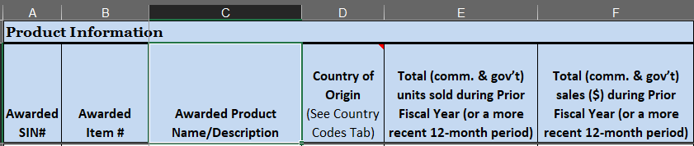
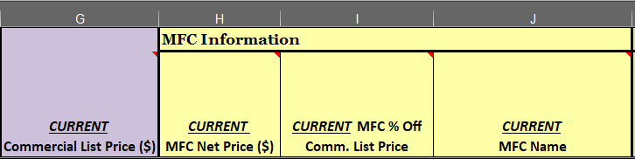
Awarded Pricing - 1

Slide 11
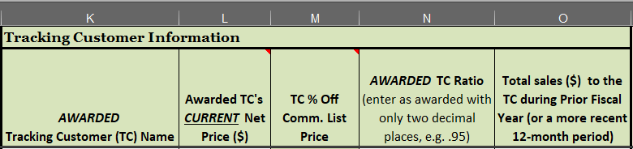
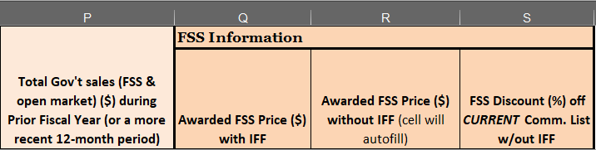
Awarded Pricing - 2

Slide 12
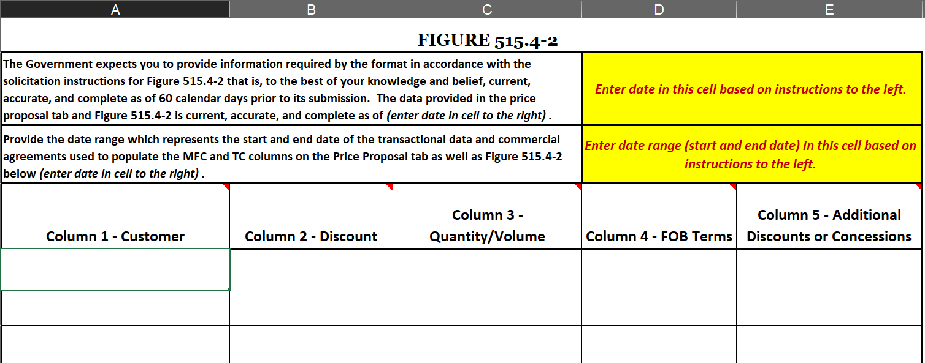
Figure 515.4-2

Slide 13
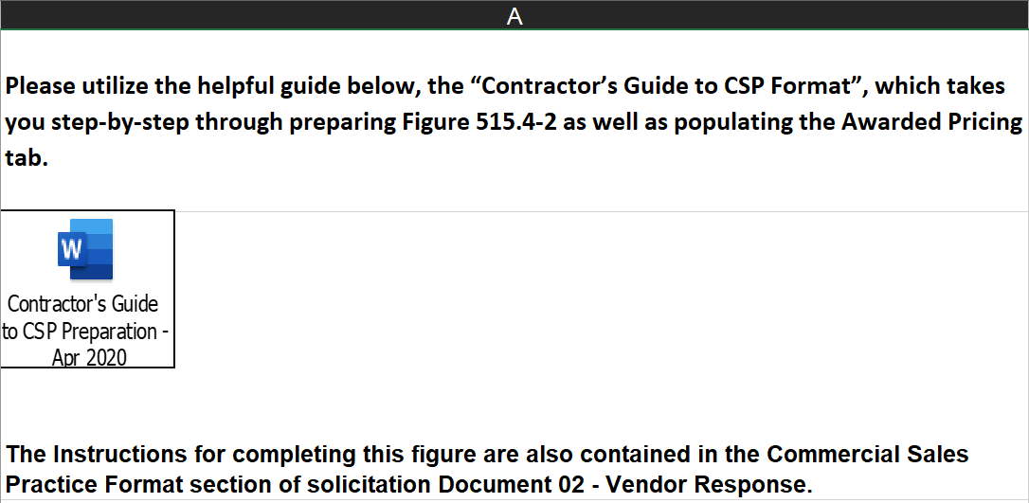
Figure 515.4-2 Instructions
  The Contractors Guide to CSP Preparation (Apr 2020) is embedded in this tab, and it is also located on our FSS Training Page in the Schedule Contract Overview Library under the VA Schedule Contractors section.

Slide 14
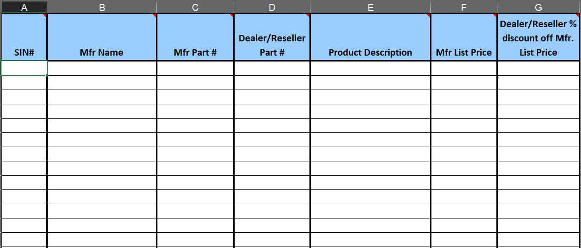
Non-Manufacturers
Notes:
Per the instructions to Figure 515.4-2, this additional information is required for non-manufacturers who must provide this information along with a listing of contact information for each manufacturer.

Slide 15
Submission Protocol - 1
Recommended Submission Timeframes
Circumstance | Submission Timeframe
Option to Extend Proposal Requiring OIG Review: If the annual value of your contract meets or exceeds $3 mil | 15 months prior to contract expiration
All Other Option to Extend Proposals: If your contract does not require OIG review and you do not need to submit a new proposal. | 6 months prior to contract expiration

Slide 16
Submission Protocol - 2
Where:
eMail to FSSOffersandExtensions@va.gov
Subject Line:
Extension – Contract Number – Schedule Number
(Example: Extension - V797D-1234d - 65IIA)
File Limit:
10MB; for larger files, send in multiple e-mails, identifying the number of files in the subject line
(Example: Extension - V797D-1234d - 65IIA, 1 of 3)
Note: We can’t accept hard copies, CDs, thumb drives, zip files, pdf portfolios, or Adobe paperclip files.
Notes:
Keep in mind that we don’t accept hard copies, CDs, thumb drives – The docs must be submitted by e-mail. We also cannot accept zip files, pdf portfolios, or Adobe paperclip files via e-mail.

Slide 17
Submission Protocol - 3
Additional Guidance
Product additions/deletions and price increases/decreases must be separately requested/processed prior to exercising the option.
Price increases must be requested before the last 60 days of the contract period, per contract clause 552.216-70 Economic Price Adjustment.

Slide 18
Resources
FSS Home Page: http://www.fss.va.gov/
VA Schedule Programs: https://www.va.gov/opal/nac/fss/schedules.asp
Option to Extend Packages: Sent to you by CS with Notice of Intent e-mail
(not published)
Option to Extend Web Page: https://www.va.gov/opal/nac/fss/extension.asp
FSS Training Page: https://www.va.gov/opal/nac/fss/training.asp
  VA Schedule Contractors – Schedule Contract Overview Library, see the file named “Contractors Guide- CSP-Apr2020”
  Procurement Technical Assistance Centers (PTAC):
http://www.aptac-us.org/contracting-assistance/
FSS Helpdesk: fss.help@va.gov

Slide 19
Questions? - IIb
QUESTIONS?

