Slide 1
Million Veteran Program
Dr. Sumitra Muralidhar
MVP Director
Jennifer Deen
MVP Associate Director,
Cohort and Public Relations
Presentation for CWV National Monthly Partners Meeting
November 3, 2021

Slide 2
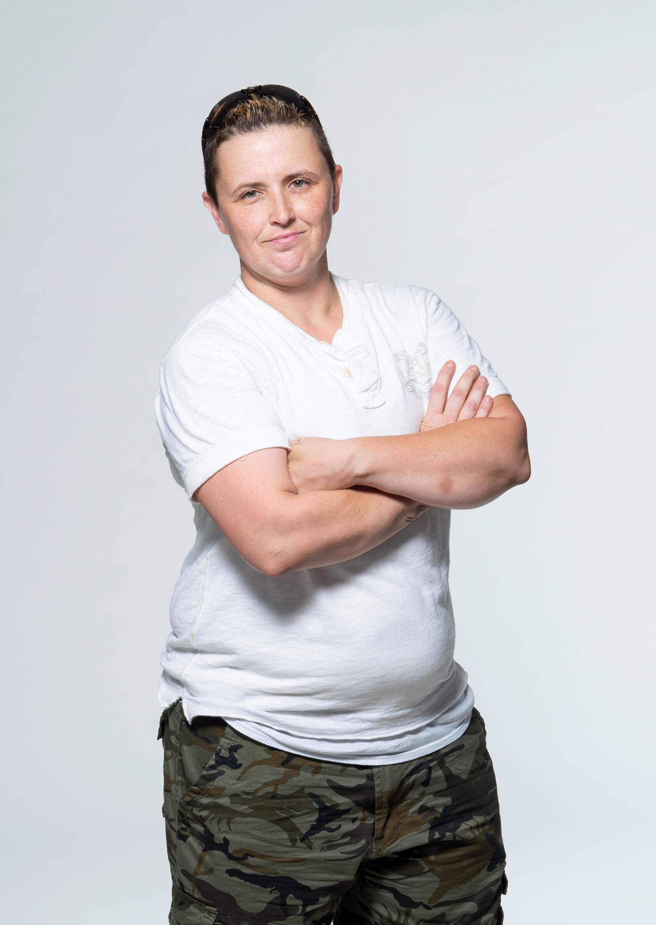
The Million Veteran Program
One of the world’s largest genetic research programs, with the goal to enroll one million Veterans by November 2022 (currently 850,000+ enrolled)
Collects genetic, military experience and exposure, lifestyle and health information from Veterans
Data is used to support research discoveries in the prevention, diagnosis and treatment of disease in Veterans

Slide 3
We Make it Easy to Join
Complete Consent Process
Provide Blood Specimen
Complete Surveys
and allow access to health records.
This can be done online at mvp.va.gov or by calling 866-441-6075
at the time of your visit
at a participating VA Healthcare Center
about health, lifestyle, and military experience.
These are either mailed to you or completed online at mvp.va.gov

Slide 4
MVP Cohort – Gender and Race/Ethnicity
Hispanic or Latino
Entire cohort: 8.2% Women only: 9.2%

Slide 5
MVP Cohort – Age
All Genders
Women only
37% under 60 years old
70% under 60 years old
Notes:
Overall age distribution comparable to the VA population.

Slide 6
Current Research
Cancer
Cardiovascular disease*
COVID-19
Diabetes
Gene variation
Gulf War Illness
Informatics
Kidney disease
Macular degeneration
Mental Health*
Osteoarthritis*
Parkinson’s disease
Post-traumatic stress disorder*
Substance use disorders
Suicide prevention
Tinnitus
Traumatic brain injury
Notes:
Areas of research with (*) are common diseases reported among women Veterans. Sources:
https://www.ncbi.nlm.nih.gov/pmc/articles/PMC7061933/#:~:text=They%20found%20women%20Veterans%20had,headaches%2C%20and%20osteoporosis%20than%20men.
https://www.ahajournals.org/doi/10.1161/CIRCULATIONAHA.118.037748
The top 5 diseases reported among women Veteran enrollees in MVP are:
Depression: 34.6%
Skin Condition: 30.5%
Hypertension: 30.3%
Acid reflux/GERD: 27.4%
Anxiety/panic disorder: 26.9%

Slide 7
Recent Findings
MVP studies identify genetic risk factors and biological processes for a range of conditions:
Using genetics, researchers identify potential drugs for early treatment of COVID-19 (March 2021)
"The problem we tried to overcome, is how to identify if existing drugs, either approved or in clinical development for other conditions, can be repurposed for the early management of COVID-19."
MVP study reveals new markers of genetic risk for PTSD (January 2021)
"These findings give us new insights into the biological basis of PTSD, and point to some possible next steps for testing new treatments."
Million Veteran Program study sheds light on genetic basis of anxiety (January 2020)
“MVP has enormous potential for increasing our knowledge about the genetics underlying a huge range of traits, including psychiatric traits.”

Slide 8
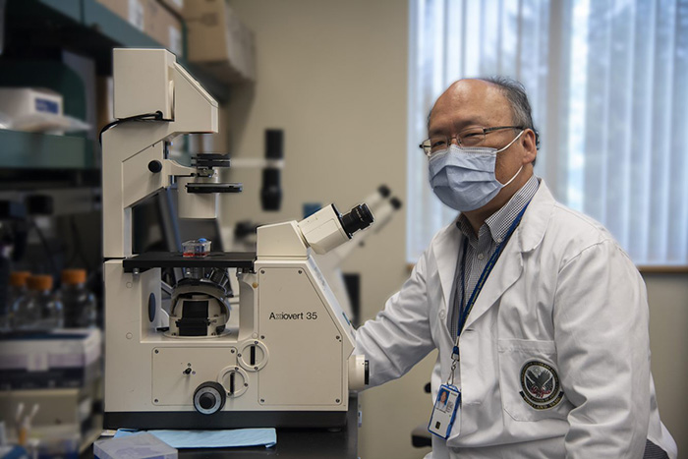
Research in Women’s Health
Breast cancer research: MVP study shows effectiveness of genetic screening tool for breast cancer risk
However, more work is needed to improve genetic risk estimation in women of non-European descent
"The goal is to find the right amount of screening that's not too expensive and not too emotionally burdensome, but also effective at detecting breast cancer early in woman with that specific risk.”
Dr. Shiuh-Wen Luoh, study lead
Notes:
More research on women’s health planned as more women join the program
Study recently published here: Polygenic Breast Cancer Risk for Women Veterans in the Million Veteran Program - Docwire News and written up in Vantage Point here: MVP study shows effectiveness of genetic screening tool for breast cancer risk - VAntage Point

Slide 9
Why women?
Historically, women have been underrepresented in biomedical research. We want to change that.
Of ~2 million living women Veterans, only ~80,000 are enrolled in MVP
Of the 850,000+ Veterans in MVP, women represent 9% of the cohort
Notes:
If more women join, researchers can better understand how genes, lifestyle behaviors and military exposures impact health and disease of women Veterans compared to male Veterans and provide women the specialized care they deserve.

Slide 10
MVP’s Women’s Campaign
MVP launched its 1st digital campaign targeting women Veterans
WHAT
March 1 through September 30, 2021 (and beyond!)
WHEN
Enroll women Veterans mainly through mvp.va.gov
Increase enrollment among younger women (under 40) and women from diverse racial/ethnic groups
Increase awareness of MVP among women Veterans, advocates, and other stakeholders
GOALS

Slide 11
Results: March 1, 2021 – September 2021
Between November 2019 and February 2021:
1,057 women enrolled online
Between March 2021and September 2021:
2,493 women enrolled online and 1,840 in person = 4,333
Prior to campaign, women comprised ~15% of all online enrollees.
During the campaign, women comprised over 50% of all online enrollees.
Notes:
This shows that our targeted outreach, encouraging women to enroll online, was effective! In seven months, we enrolled over double the number of women Veterans recruited during the previous 16 months.

Slide 12
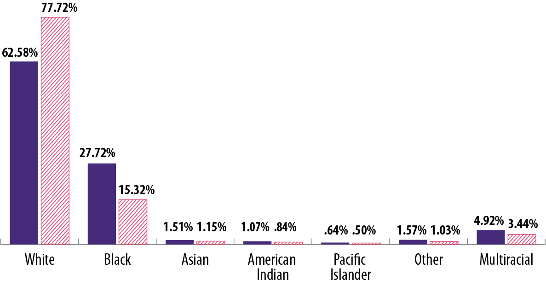
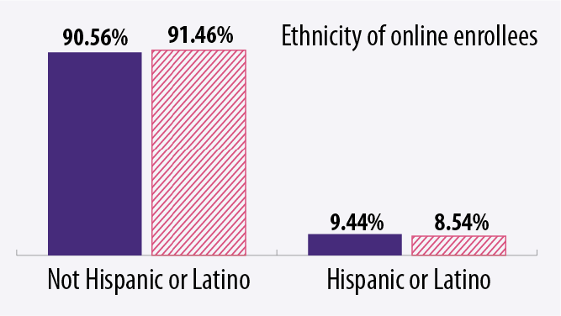
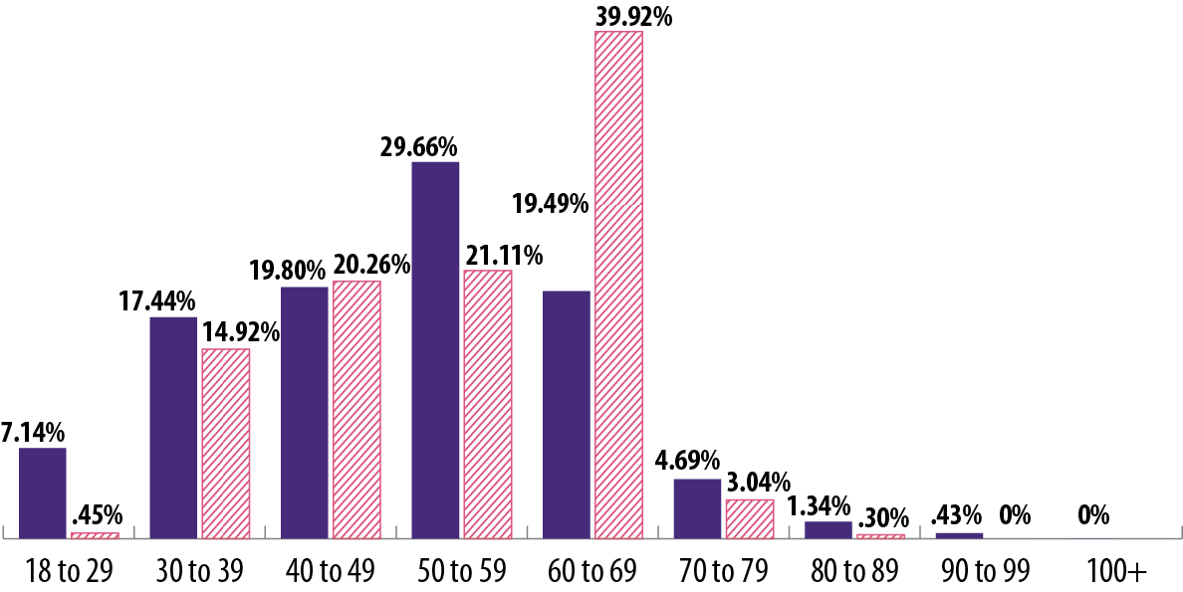
Demographic distribution before and after March 1, 2021
Race of online enrollees
Age of online enrollees
*Data reflects campaign through August only
Notes:
As you can see, our targeted communications to non-white Veterans and Veterans under 50YO were less effective. We are trying to evaluate these findings to improve our targeted communications to these communities of women Veterans in future outreach and messaging—we welcome your ideas and feedback!

Slide 13
What’s next? The March to 1M and beyond
Continued focus on increasing diversity including women, younger Veterans, and other underrepresented populations
Goal to reach the 1M by Veterans Day 2022
Expand access to MVP data to more researchers

Slide 14
How you can help
Use our toolkit materials (flyers, posters, one-pagers, FAQs, social media toolkits, digital ads for electronic screens, videos, articles)
Invite us to present or join for outreach events
Share your story for our team to promote
Feature MVP in your outreach communications (newsletters, emails, blogs, etc.)
Post about MVP on social media (see our social media content in the toolkit)
Notes:
All materials can be downloaded at: https://github.com/department-of-veterans-affairs/va.gov-team/tree/master/products/health-care/mvp-collateral
If you’d like to invite us to present, please contact Jenn Deen at Jennifer.Deen@va.gov.
If you’d like to share your story with MVP for our team to feature (i.e., in an article, video, documentary, blog, etc.) please contact Ms. Deen or Claudia Gutierrez at Claudia.Gutierrez@va.gov

Slide 15
We want to hear from you!
Please reach out if you have ideas for improving our content, outreach strategies or any other MVP communications
Notes:
Kayla video v3: https://youtu.be/DcNfH_No1SU

Slide 16
For More Information Visit: mvp.va.gov Contact: Jennifer.Deen@va.gov

