Slide 1
Center for Women Veterans - Virtual Partners Meeting FEB 3, 2021, 9:30
CW5 (Retired) Phyllis J. Wilson
President, Women In Military Service For America
Memorial Foundation

Slide 2
Memorial History

Slide 3
Memorial Fundraising

Slide 4
Groundbreaking

Slide 5
Dedication 40,000 military women, families and friends

Slide 6
Education Center

Slide 7
Military Women’s Memorial A Place of Tribute and Honor

Slide 8
Honoring Ruth Bader Ginsburg September 29, 2020

Slide 9
Military Women’s Memorial Inaugural Statue October 17, 2021

Slide 10
Military Women’s Memorial 23rd Anniversary Open House - October 18, 2020

Slide 11
An Historic Partnership Center for Women Veterans – Military Women’s Memorial MOU Signing, January 13, 2021

Slide 12
Her Story Registration Campaign

Slide 13
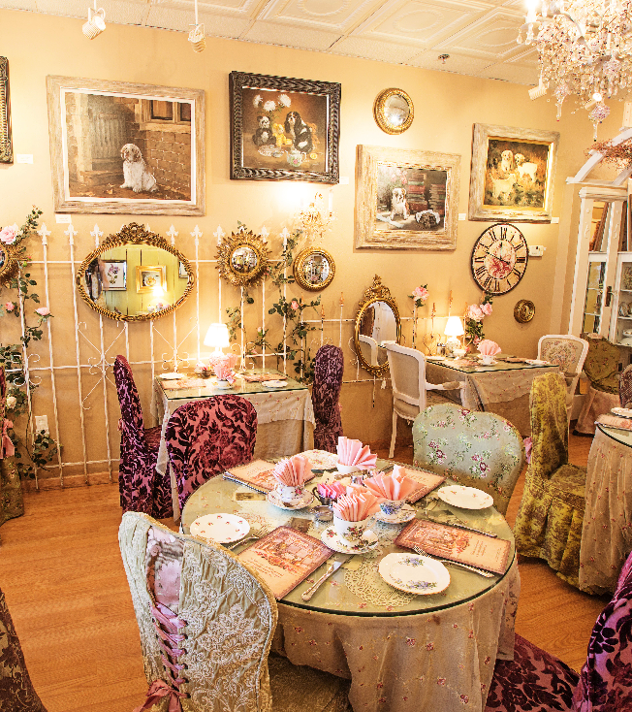
Upcoming Events

Slide 14
A New Exhibit March 4, 2021

Slide 15
Tomb of the Unknown Soldier 100th Anniversary November 11, 2021

Slide 16
https://womensmemorial.org/

