Slide 1

Women Veterans Journey Map
Women Veterans Journey Map
Final Project Deliverables
Briefer: Stephen Ellis, Sr. Customer Experience Strategist
Informational Briefing
Date July 7, 2021

Slide 2
Overview
BLUF: Providing informational briefing to VBA’s District / Regional Office Directors and CO Lines of Business on the Women Veterans Journey Map project deliverables.
The project resulted in:
One journey map
Five (5) women Veteran personas
One insights report with five (5) insights and eight (8) key findings
These products can be used by VA to identify and prioritize resources to address pain points for women Veterans.
Key Takeaways:
Human Centered Design (HCD) research confirmed that Women Veterans have a different experience than their male counterparts. VA can take specific action to ensure Women Veterans learn about, apply for, and use VA benefits and services at times that are meaningful to them. Immediate next steps:
  Share insights and personas with Women Veteran program coordinators and VBA staff to build empathy and understanding
  Share healthcare related insights with VHA and transition-related insights with DoD
  Identify 1-2 priority areas to focus future design efforts in VBA
    Enhance outreach products and programs specifically for Women Veterans
    Explore strategic partnership to develop a peer-to-peer Women Veterans network
Notes:
Insights form the basis of design decisions. While all women Veterans may not experience every insight, each insight represents a major pattern heard in the women Veteran interviews, verified with project stakeholders, and in some cases supported by findings from previous projects.
Insights are written in direct language as "universal truths.” There are likely to be some exceptions to each insight because the women Veteran population is diverse. Quotes from women Veteran interviews are provided to support and illustrate empathy for each insight.
Key Findings are additional important patterns that emerged during synthesis, but either did not express a novel sentiment or did not have enough supporting data to fully form an insight. While one key finding is outlined in the following section, additional key findings can be found in the appendix.

Slide 3
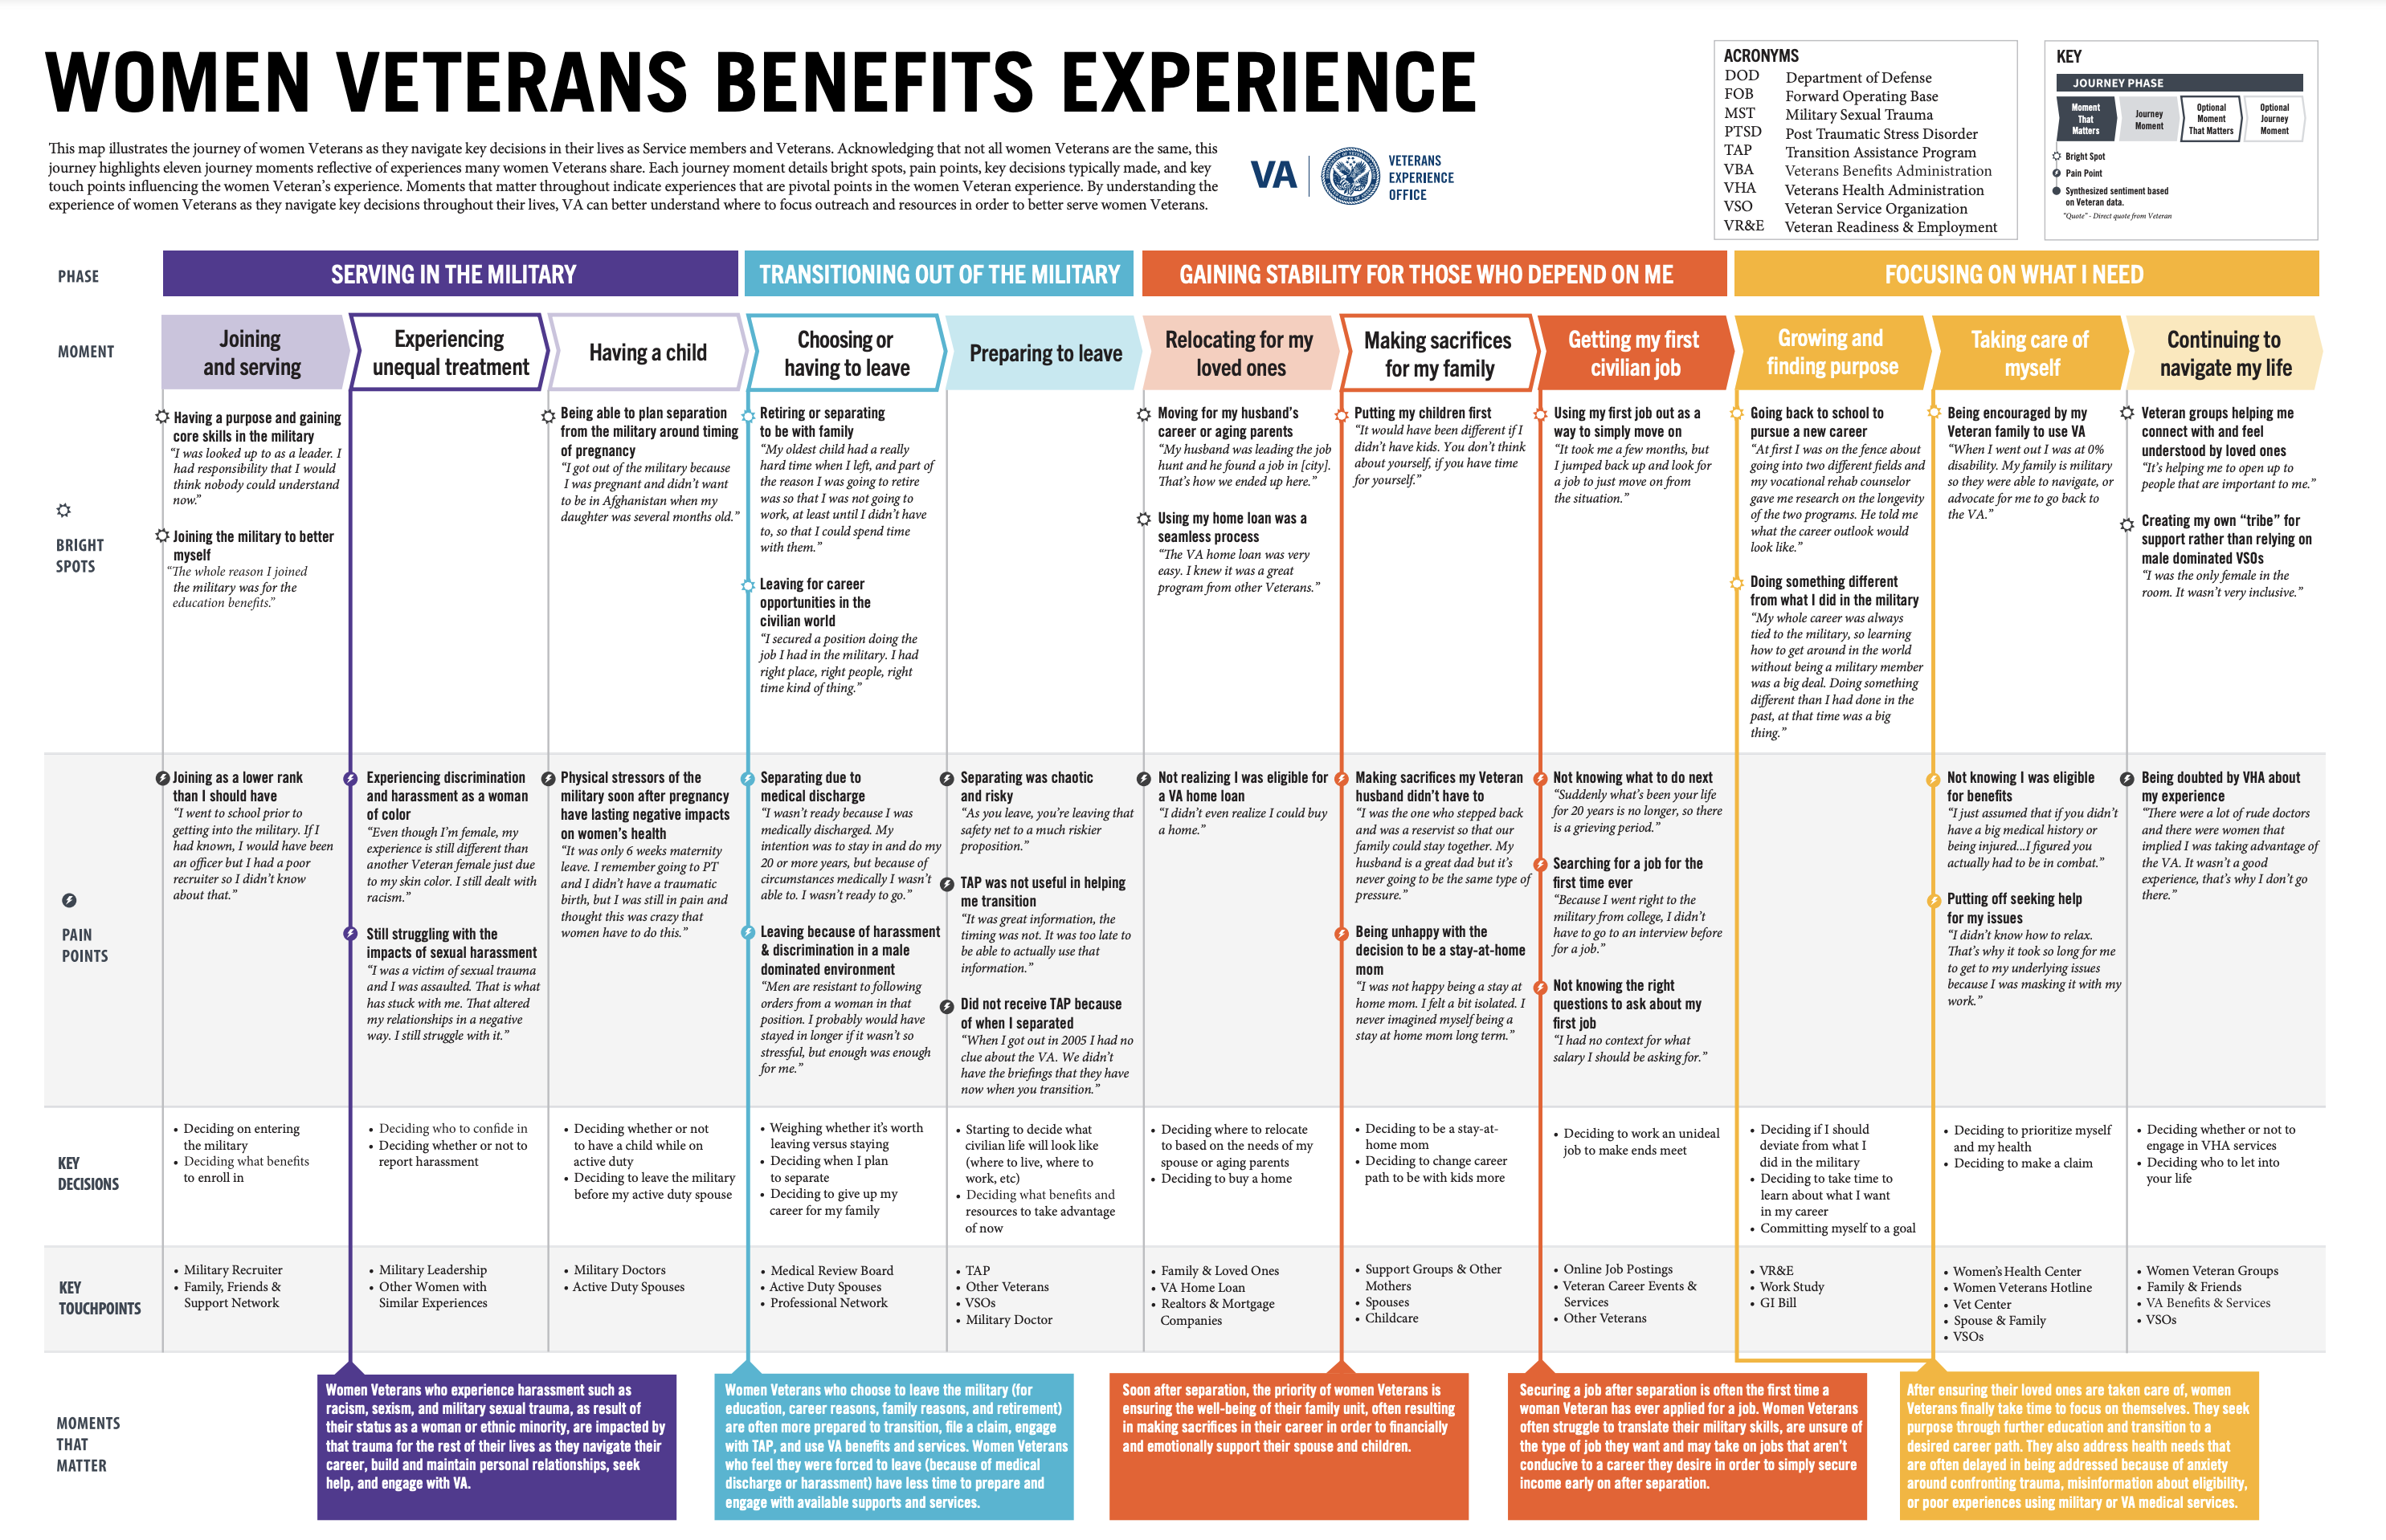
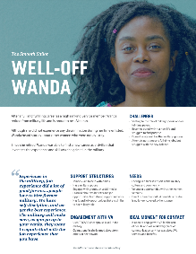
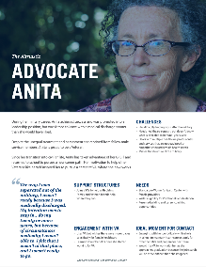
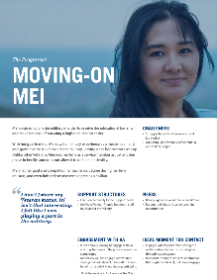

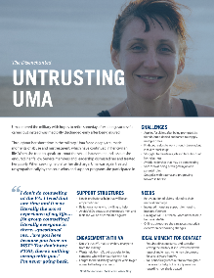
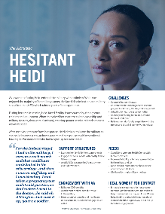
Women Veterans Journey Map 1
Opportunity: As the number of women Veterans grows, more women apply for VA benefits and services. VBA strives to better understand women Veterans’ journeys and identify the moments that matter as they navigate the VA system.
Approach: VBA used human-centered design (HCD) methodology to speak with male and female Veterans to map their benefits journey. By interviewing Veterans and listening for bright spots and pain points, the journey mapping process allows VBA to:
Discover opportunities and take action to improve processes and services for women Veterans, and
Empower VBA employees to deliver benefits in a manner that honors their service
Timeline:
Deliverables:
Journey Map
5 Personas
Insights Report
HCD Research Planning
HCD Interviews & Data Analysis
Create Journey Map(s)
June – July 2020
Aug. – Oct. 2020
Nov. – Dec. 2020
Notes:
Goal: To improve the understanding of women Veterans’ experiences with VA benefits and services
Outcomes:
Gaining actionable insights on bright spots and pain points for women Veterans
Identifying unique benefits needs of women Veterans
VA expects to develop evidence that describes how the experiences of women Veterans differs from that of men. The data collected throughout the research will be used to inform process improvement activities for current VBA benefits and services. Additionally, VA and women Service members/Veterans stand to gain the benefit of knowledge-sharing with Department of Defense (DoD).
Turn roundtable into recruitment opportunity for virtual HCD interviews – see call to action. Interested parties should email VAVBAWAS/CO/VBA_CX <VBA_CX.VBACO@va.gov>

Slide 4
Journey Map
Notes:
A Journey Map outlines steps formed from the combined experiences of a diverse group of stakeholders when moving through a specific process, program, or moment.
Oftentimes, the map outlines pain points and bright spots that the stakeholders experience during each step. The map may also use direct quotes and data points from user interviews in order to build empathy.
Journey Maps are used as a visual tool to create understanding of how a process, program, or moment is actually working for users in the real world. It can also be used later in the HCD process to inform design concepts and prototypes.
*please develop talking points that address the WVJM. How many phases of the journey were identified and what are they? How many bright spots- what is working well? How many pain points? How many pain points related directly to benefits, which VBA could do something about?

Slide 5
Personas Overview
Women Veteran personas are a combination of characteristics and experiences heard during research. They outline key perspectives shared about their unique experience as a Veteran and accessing VA benefits.
Comparing personas reveals the diversity of women Veterans’ attitudes and behaviors towards the military, VA, and VA benefits.
Women Veteran personas can be used as a tool for prototype development and design, giving insight into how certain Veterans may interact with different interventions.

Slide 6
Persona Development
Embraces Veteran identity after the military
Archetypes
Archetypes serve as a foundation for the development of personas. They outline contrasting attributes for the most clearly identified motivators, mindsets, needs, and pain-points found in the user data.
For women Veterans, the most prominent contrasting attributes were whether or not they:
faced equal treatment before and after leaving the military
embraced their Veteran identity
The Smooth Sailor
The Altruistic
Persona:
Well-Off Wanda
Persona:
Advocate Anita
Persona:
Hesitant Heidi
Faces equal treatment before and after leaving the military
Faces unequal treatment before and after leaving the military
Persona:
Moving-On Mei
Persona:
Untrusting Uma
The Progressor
The Disenchanted
Disengages from all things military or Veteran related

Slide 7

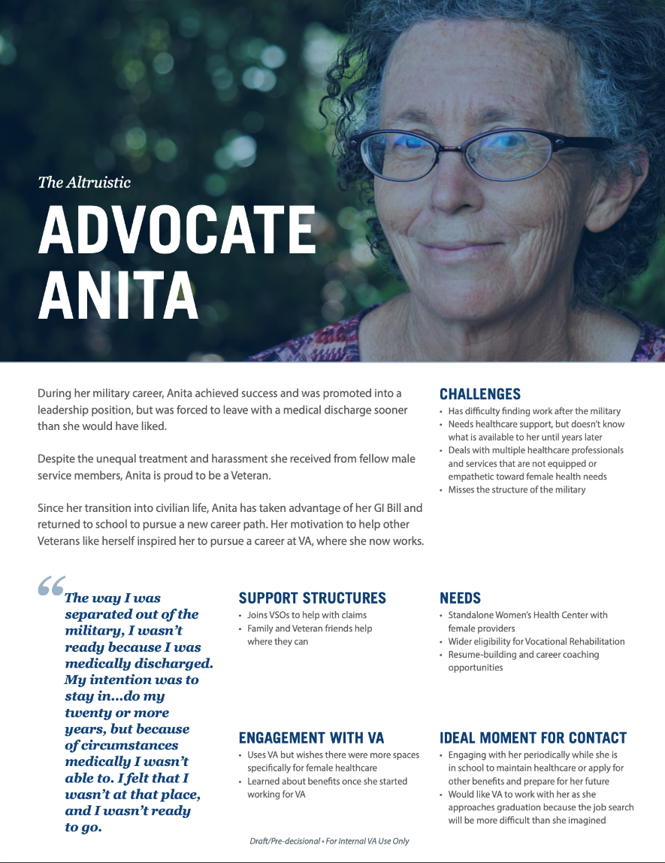

Women Veteran Personas

Slide 8
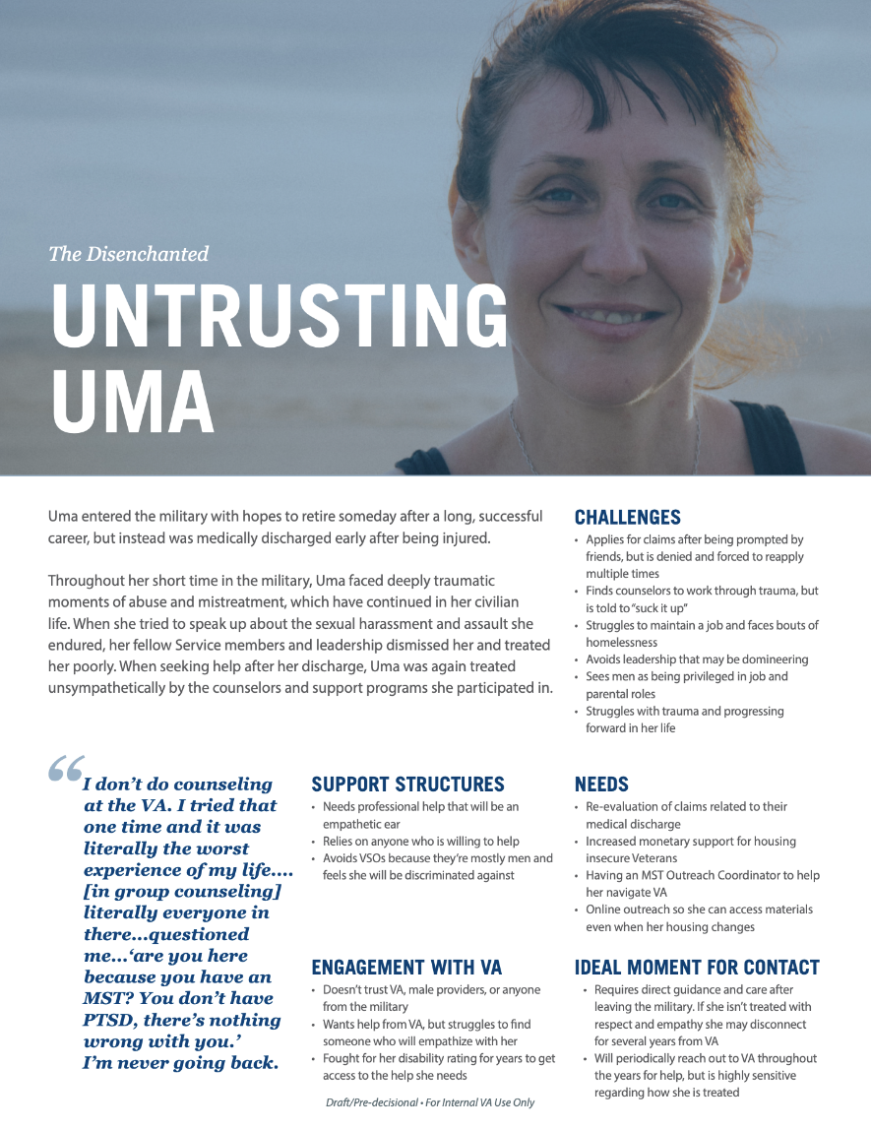
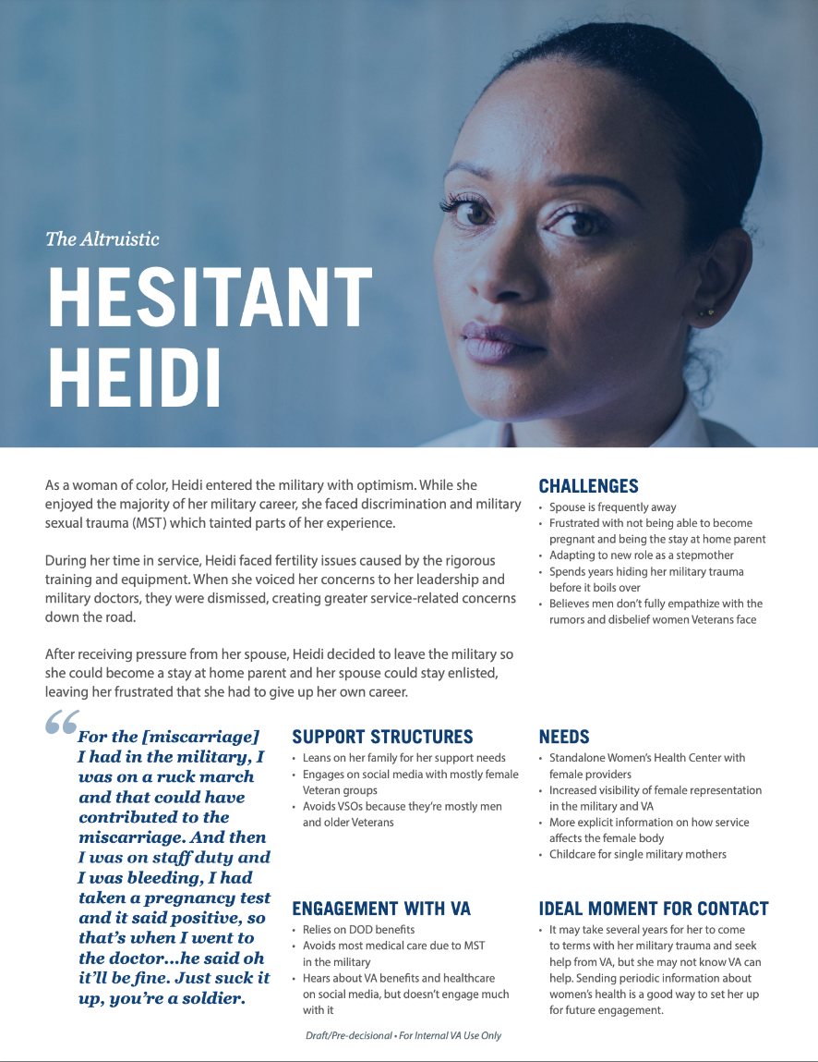
Women Veteran Personas 1

Slide 9
Insights & Key Findings Overview
Insights form the basis of design decisions. While all women Veterans may not experience every insight, each insight represents a major pattern heard in the women Veteran interviews, verified with project stakeholders, and in some cases supported by findings from previous projects.
Insights are written in direct language as "universal truths.” There are likely to be some exceptions to each insight because the women Veteran population is diverse. Quotes from women Veteran interviews are provided to support and illustrate empathy for each insight.
Key Findings are additional important patterns that emerged during synthesis, but either did not express a novel sentiment or did not have enough supporting data to fully form an insight.

Slide 10
Insights
Being Overlooked as a Veteran or Personally Not Identifying as Such
Feeling Too Overwhelmed to Find What They Need
Connecting to Others With Similar Backgrounds
Hiding Trauma to Remain Strong
Experiencing that the Military and VA are Not Designed for Women

Slide 11
Key Findings
Seeing That Veteran Men Are Treated Better Than Women Veterans
Being a VA Employee Means Being Part of a Veteran Community
Facing Discrimination Beyond Gender
Leaning On Family and Veterans Like Themselves
Needing More Personalized Outreach
Feeling the Life-Long Effects of MST
Wanting Non-Traditional Healthcare Services from VA
Acknowledging That Not All Women Veterans Have a Negative Experience

Slide 12
Questions
          Questions

Slide 13
Backup slides
          Backup Slides

Slide 14
Research by the Numbers
36 1-Hour Interviews with women Veterans
14 1-Hour Interviews with women Veteran VA Employees
14 15-Minute Interviews with women Veteran VA Employees
76 Total Veterans Interviewed
60 Total 1-Hour Interviews
16 Total 15-Minute Interviews
5 1-Hour Interviews with male Veterans
5 1-Hour Interviews with male Veterans VA Employees
2 15-Minute Interviews with male Veterans VA Employees
Veteran Demographics
*Not all Veterans who were interviewed opted to answer the demographic questionnaire.
Branch | Gender​ | Age​ | Race and Ethnicity​ | Employment Status | “Benefit” Utilization | Final Exit from Service
Army: 32 Navy: 12 Air Force: 28 Coast Guard: 1 Army, National Guard: 1 Army, Navy Reserve: 1 | Female: 64​ Male​: 12 ​ | 20-39 years old: 22 40-49 years old: 25 50-59 years old: 18 60+ years old: 9 | Caucasian: 47 Black or African American: 16 Biracial: 3 Native American: 1 Pacific Islaer: 1 Asian: 2 Veterans identified as Hispanic/Latinx: 7 | Employed: 54 Unemployed/Retired: 15 Active Duty: 2 Part-Time/Semi-Retired: 3 ​ | Yes: 64 No: 2 Tried: 1 | 1980s: 2 1990s: 15 2000s: 18 2010s: 33 2020s: 2 Still in Reserves: 2 ​

Slide 15
Research by Location
Veteran Locations
States from which Veterans were interviewed
Locations where Veterans who were interviewed reside are highlighted in navy blue.
States from which no Veterans were interviewed
Alabama
Arizona
Arkansas
California
Colorado
Florida
Georgia
Hawaii
Idaho
Illinois
Indiana
Kentucky
Maryland
Michigan
Minnesota
Missouri
Nebraska
Nevada
North Carolina
Oklahoma
Oregon
Tennessee
Texas
Utah
Virginia
Washington
Wisconsin

